Slide 1
Week 5 – Lectures 1 and 2
CMSC 508 Database Theory
CMSC 508 – Relational Algebra
Chapters 2,6 from Database System Concepts, 6th Ed. by Silberschatz, Korth, Sudarshan, 2011 Chapters 3,4 from Database Management Systems, 3rd Ed. by Ramakrishnan, Gehrke, 2003
Notes:
The ER model is a way of modeling the needs of the database that is close to the user/enterprise. It’s a first step at understanding the user requirements and is easy for the end users to understand so it facilitates communication.
Importance of getting the data model right – can change physical design later, but to change the logical design would disrupt the way data is used.
The two major things to avoid are duplication and missing information.

Slide 2
Housekeeping
Homework due Friday, 9/23, 11pm
Quiz on Monday, 9/26, in class (same as before)

Slide 3


CMSC 508 – Databases
The Relational model
Database design and implementation
Problem
definition
Data modeling
Relational model
Relational algebra
Normalization
Implementation
Usage
Information requisites and functional analysis
ER diagram
Tables
Tables
Normalized tables
SQL
Interfaces
Resolve

Slide 4
Relational algebra
CMSC 508 – Database Theory

Slide 5
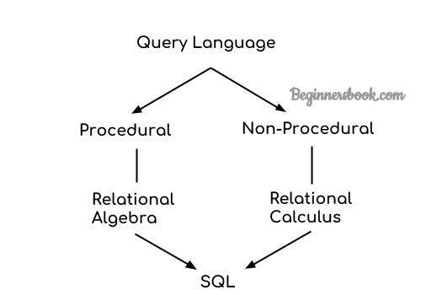
Query languages
CMSC 508 – Databases
Relational algebra
Relational Algebra
Procedural – can be applied in steps one after the other to create a mini program
Order of steps matters
Relational Calculus
Non-procedural
Can be converted into Relational Algebra
SQL is a modified, practical implementation of Relational Algebra – NOT EXACT, but close

Slide 6
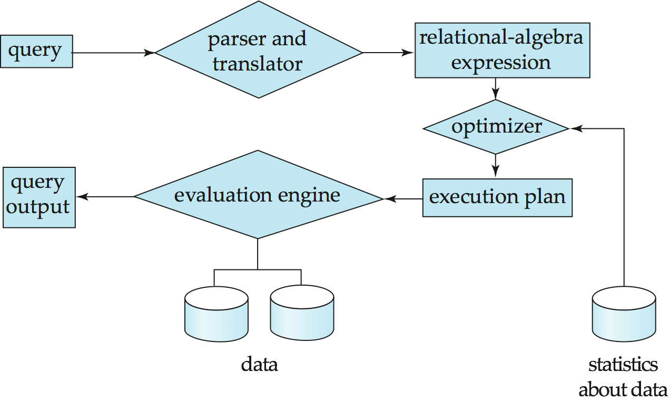
CMSC 508 – Databases
Relational algebra
Query processing
Parsing and translation
Optimization
Evaluation
Relational operators
Set operators: union, intersection, difference
Selection
Projection
Rename
Cartesian product
Joins: natural join, θ-join, inner join, outer join
Division
RelaX – relational algebra calculator http://dbis-uibk.github.io/relax/

Slide 7
Set operators
CMSC 508 – Database Theory

Slide 8
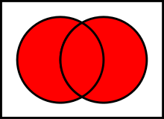

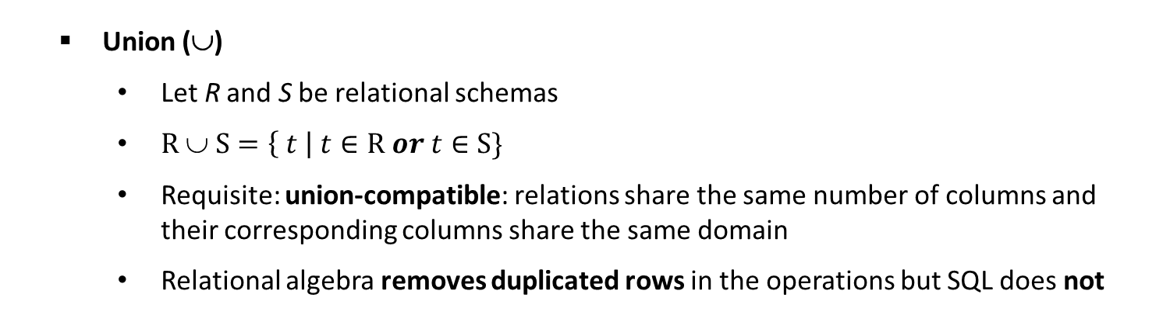



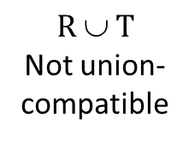
CMSC 508 – Databases
Relational algebra
Union ($\text{}$)
Let R and S be relational schemas
$R \text{∪ }S=\left\{ t \right| t∈R or t∈S\}$
Requisite: union-compatible: relations share the same number of columns and their corresponding columns share the same domain
Relational algebra removes duplicated rows in the operations but SQL does not
$$R$$
$$S$$
$$T$$
$$R \text{∪ }S$$
$$R \text{∪ }T$$
Not union-compatible
A | B
1 | 1
2 | 2
A | B
1 | 1
2 | 2
3 | 2
A | C
1 | X
4 | Y
A | B
1 | 1
2 | 2
3 | 2

Slide 9


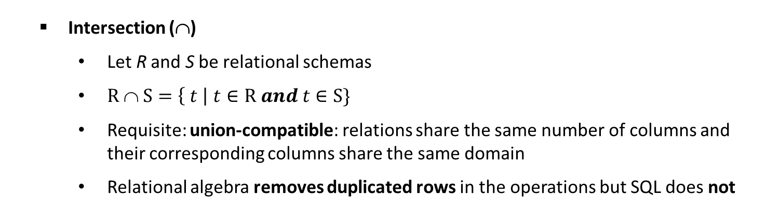
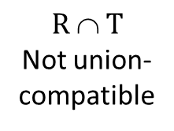


CMSC 508 – Databases
Relational algebra
Intersection ($\text{}$)
Let R and S be relational schemas
$R \text{∩} S=\left\{ t \right| t∈R and t∈S\}$
Requisite: union-compatible: relations share the same number of columns and their corresponding columns share the same domain
Relational algebra removes duplicated rows in the operations but SQL does not
$$R \text{∩} S$$
$$R \text{∩} T$$
Not union-compatible
$$R$$
$$S$$
$$T$$
$$W$$
A | B
1 | 1
2 | 2
A | B
1 | 1
2 | 2
A | B
1 | 1
2 | 2
3 | 2
A | C
1 | X
4 | Y
A | B
1 | 2
2 | 1
$$R \text{∩} W$$
A | B

Slide 10

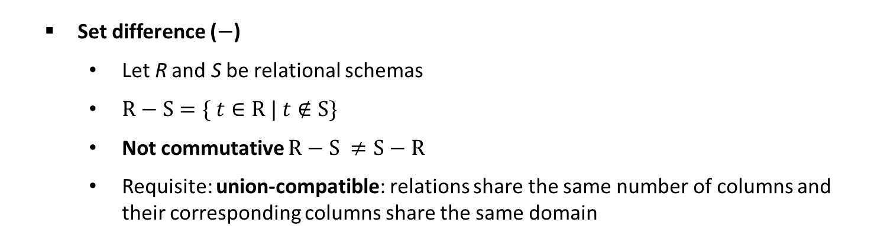

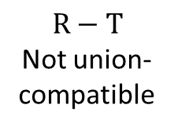

CMSC 508 – Databases
Relational algebra
Set difference ($−$)
Let R and S be relational schemas
$R\text{ −} S=\{ t∈R | t∉S\}$
Not commutative $R\text{ −} S ≠S\text{ −} R$
Requisite: union-compatible: relations share the same number of columns and their corresponding columns share the same domain
$$R$$
$$S$$
$$T$$
$$R−S$$
$$S−R$$
$$R−T$$
Not union-compatible
A | B
1 | 1
2 | 2
A | B
1 | 1
2 | 2
3 | 2
A | C
1 | X
4 | Y
A | B
A | B
3 | 2

Slide 11
Algebraic operators
CMSC 508 – Database Theory

Slide 12

CMSC 508 – Databases
Relational algebra
Selection (σ – sigma)
Notation σ_{P}(R) where P is the predicate and R is a relation
Definition:
where P is a formula in propositional calculus consisting of terms connected by: ∧ (and), ∨ (or), ¬ (not) functions
Each term is one of: <attribute> operator <attribute> or <literal>
where operator is one of: =, ≠, >, ≥, <, ≤
σ_{P}(R) = {t | t ∈ R and P(t) == true}
$$S$$
σ _{A=1} (S)
σ _{A=1 ∨ A=2} (S)
σ _{A ≠ B} (S)
σ _{¬(A > B)} (S)
A | B
1 | 1
2 | 2
3 | 2
A | B
1 | 1
A | B
1 | 1
2 | 2
A | B
3 | 2
A | B
1 | 1
2 | 2

Slide 13
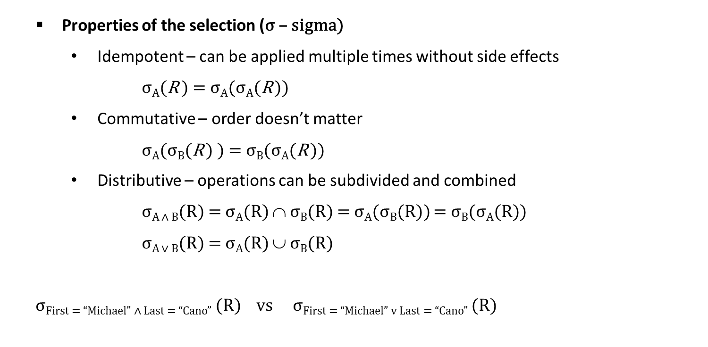

CMSC 508 – Databases
Relational algebra
Properties of the selection (σ – sigma)
Idempotent – can be applied multiple times without side effects
σ_{A}(R ) = σ_{A}(σ_{A}(R ))
Commutative – order doesn’t matter
σ_{A}(σ_{B}(R ) ) = σ_{B}(σ_{A}(R ))
Distributive – operations can be subdivided and combined
σ_{A ∧ B}(R) = σ_{A}(R) $\text{}$ σ_{B}(R) = σ_{A}(σ_{B}(R)) = σ_{B}(σ_{A}(R))
σ_{A ∨ B}(R) = σ_{A}(R) ∪ σ_{B}(R)
σFirst = “Michael” ∧ Last = “Cano” (R) vs σFirst = “Michael” v Last = “Cano” (R)
$$R$$
First | Last
Alberto | Cano
Michael | Scott
Michael | Cano
Notes:
IDEMPOTENT – the operation can be applied more than once without getting a different answer or other side effects.
Once you select – you’re done. A select applied to the same select results in the same result.
Distributive over union – see picture
NOT distributed over intersection or set difference. ORDER OF APPLICATION MATTERS!

Slide 14
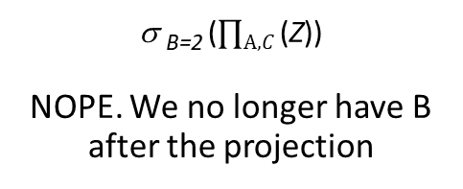




CMSC 508 – Databases
Relational algebra
Projection (∏ - pi)
Filters a set of columns and removes duplicated tuples from the output
$$R$$
$$\text{∏}\text{A}(R)$$
$$Z$$
$\text{∏}\text{A}\text{,}C$(σ _{B=2} (Z))
A | B
1 | 1
2 | 2
A
1
2
A | B | C
1 | 2 | 3
2 | 1 | 2
3 | 2 | 2
A | C
1 | 3
3 | 2
σ _{B=2} ($\text{∏}\text{A}\text{,}C$(Z))
NOPE. We no longer have B after the projection

Slide 15












CMSC 508 – Databases
Relational algebra
Properties of the Projection (∏ - pi)
Idempotent
∏_{A1,…,AN}(∏_{B1,…,BM}(R )) = ∏_{A1,…,AN}(R ) where {A₁,…,A_{N}} ⊆ {B₁,…,B_{M}}
Distributive over union
∏_{A1,…,AN}(R ∪ S ) = ∏_{A1,…,AN}(R ) ∪ ∏_{A1,…,AN}(S )
Projection does NOT distribute over intersection and set difference
$$\text{∏}\text{A}(R \text{∪} S)$$
$$\text{∏}\text{A}(R)$$
$$\text{∏}\text{A}(S)$$
$$\text{}$$
A | B
1 | 1
1 | 2
A
1
A
1
A
1
$$R$$
$$S$$
->
=
$$R \text{∪} S$$
A | B
1 | 1
A | B
1 | 2
$$\text{∏}\text{A}(R \text{∩} S)$$
$$\text{∏}\text{A}(R)$$
$$\text{∏}\text{A}(S)$$
$$\text{}$$
A | B
A
A
1
A
1
->
≠
$$R \text{∩} S$$
Notes:
IDEMPOTENT – the operation can be applied more than once without getting a different answer or other side effects.
Once you select – you’re done. A select applied to the same select results in the same result.
Distributive over union – see picture
NOT distributed over intersection or set difference. ORDER OF APPLICATION MATTERS!

Slide 16
CMSC 508 – Databases
Relational algebra
Rename (ρ - rho)
Rename a relation or a column(s)
Allows to reference a given relation/column multiple times with different names (aliases) to reflect different roles involved in the expression
∏ newname.A, newname.B ( ρ newname ( R ) )
ρ newA ← A, newB ← B (R)

Slide 17
Cartesian products and joins
CMSC 508 – Database Theory

Slide 18
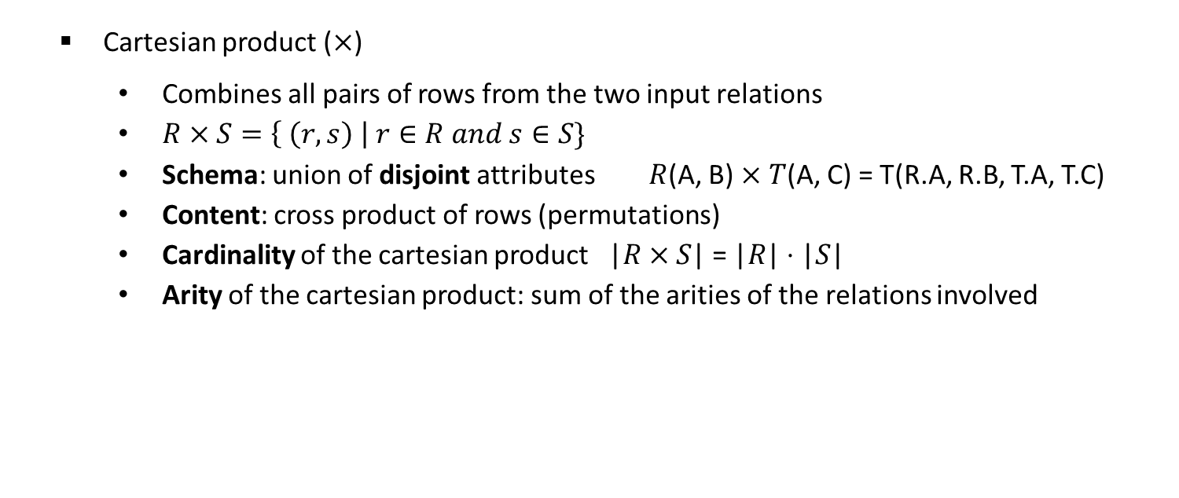



CMSC 508 – Databases
Relational algebra
Cartesian product ($×$)
Combines all pairs of rows from the two input relations
$R×S=\left\{ \left(r,s\right) \right| r∈R and s∈S\}$
Schema: union of disjoint attributes $R$(A, B) $×$ $T$(A, C) = T(R.A, R.B, T.A, T.C)
Content: cross product of rows (permutations)
Cardinality of the cartesian product $\text{|}R×S\text{|}$ = |$R\text{|}⋅\text{|}S\text{|}$
Arity of the cartesian product: sum of the arities of the relations involved
$R×$ T
$$R$$
$$T$$
R.A | R.B | T.A | T.C
1 | 1 | 1 | X
1 | 1 | 4 | Y
2 | 2 | 1 | X
2 | 2 | 4 | Y
A | B
1 | 1
2 | 2
A | C
1 | X
4 | Y

Slide 19
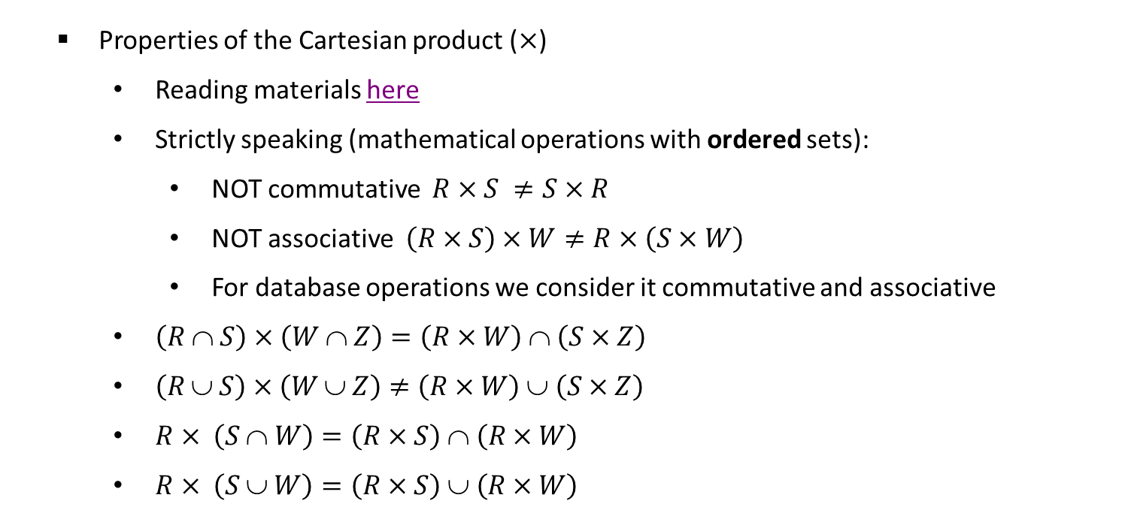
CMSC 508 – Databases
Relational algebra
Properties of the Cartesian product ($×$)
Reading materials here
Strictly speaking (mathematical operations with ordered sets):
NOT commutative $R×S ≠S×R$
NOT associative $\left(R×S\right)×W≠R×\left(S×W\right)$
For database operations we consider it commutative and associative
$\left(R \text{∩} S\right)×\left(W \text{∩} Z\right)=\left(R×W\right) \text{∩} \left(S×Z\right)$
$\left(R \text{∪} S\right)×\left(W \text{∪} Z\right)≠\left(R×W\right) \text{∪} \left(S×Z\right)$
$R× \left(S \text{∩ }W\right)=\left(R×S\right) \text{∩ }\left(R×W\right)$
$R× \left(S \text{∪} W\right)=\left(R×S\right) \text{∪ }\left(R×W\right)$

Slide 20
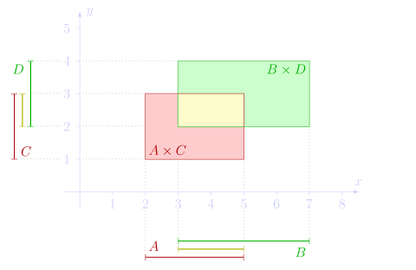
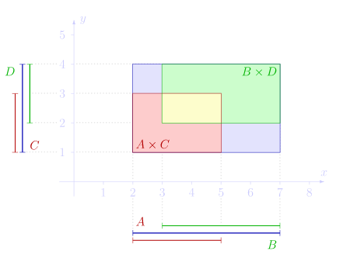
CMSC 508 – Databases
Relational algebra
Properties of the Cartesian product ($×$)
A={x:2≤x≤5}, B={x:3≤x≤7}, C={y:1≤y≤3}, D={y:2≤y≤4},
(A∩B)×(C∩D) = (A×C)∩(B×D)
(A∪B)×(C∪D) ≠ (A×C)∪(B×D)

Slide 21





CMSC 508 – Databases
Relational algebra
Natural join (⨝)
Natural join of R and S is a relation with a schema R ∪ S and content R ∩ S as:
Consider each pair of tuples t_{r} from R and t_{s} from S
If t_{r} and t_{s} have the same value on all the common attributes between R and S then add a tuple t to the result, where
t has the same value as t_{r} on r
t has the same value as t_{s} on s
$$R$$
$$S$$
$$T$$
$R \text{⨝}$ S
$R \text{⨝}$ T
A | B
1 | 2
3 | 4
A | B | C
1 | 2 | 6
3 | 1 | 8
3 | 4 | 1
1 | 2 | 8
D | E
1 | 1
2 | 2
A | B | C
1 | 2 | 6
3 | 4 | 1
1 | 2 | 8
A | B | D | E
1 | 2 | 1 | 1
1 | 2 | 2 | 2
3 | 4 | 1 | 1
3 | 4 | 2 | 2

Slide 22





CMSC 508 – Databases
Relational algebra
Natural join (⨝)
Instructor ⨝ Teaches
$$Instructor$$
$$Teaches (V1)$$
$$Teaches (V2)$$
ID | name | department
1 | Cano | CS
2 | Scott | Management
instructor | course
1 | CMSC-508
2 | INF-302
ID | course
1 | CMSC-508
2 | INF-302
$$\text{Instructor} \text{⨝ }\text{Teaches}\text{ (}\text{V}\text{1)}$$
$$\text{Instructor} \text{⨝ }\text{Teaches}\text{ (}\text{V}\text{2)}$$
ID | name | department | instructor | course
1 | Cano | CS | 1 | CMSC-508
2 | Scott | Management | 2 | INF-302
1 | Cano | CS | 2 | INF-302
2 | Scott | Management | 1 | CMSC-508
ID | name | department | course
1 | Cano | CS | CMSC-508
2 | Scott | Management | INF-302

Slide 23
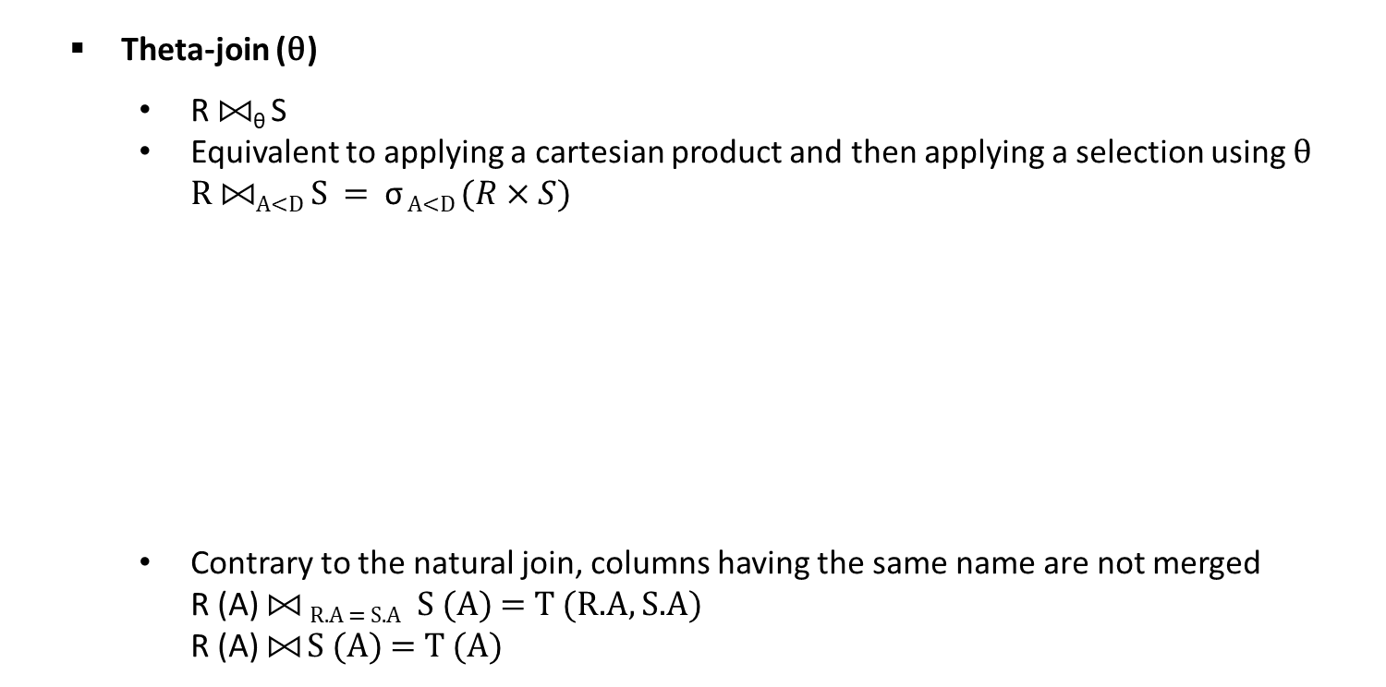



CMSC 508 – Databases
Relational algebra
Theta-join (θ)
R ⨝_{θ} S
Equivalent to applying a cartesian product and then applying a selection using θ R ⨝_{A<D} S = σ _{A<D} $(R×S)$
Contrary to the natural join, columns having the same name are not merged R (A) ⨝ _{R.A = S.A} S (A) = T (R.A, S.A) R (A) ⨝ S (A) = T (A)
$$R$$
$$S$$
$R \text{⨝}\text{A}\text{<}\text{D}$ S
A | B
3 | 2
2 | 5
C | D
2 | 1
4 | 3
4 | 7
A | B | C | D
3 | 2 | 4 | 7
2 | 5 | 4 | 3
2 | 5 | 4 | 7

Slide 24


CMSC 508 – Databases
Relational algebra
Inner and Outer joins
Extension of join operations
Computes the join and then adds tuples from one relation that does not match tuples in the other relation
Uses NULL values
All comparisons involving NULL are false by definition
The result of any arithmetic expression involving NULL is NULL
$$Instructor$$
$$Teaches$$
ID | name | department
1 | Cano | CS
2 | Scott | Management
3 | Wagner | Music
ID | course
1 | CMSC-508
2 | INF-302
99 | BIO-101

Slide 25
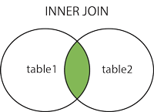

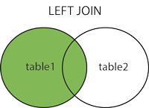
CMSC 508 – Databases
Relational algebra
Inner join (default behavior of the natural join)
Instructor ⨝ Teaches
Left join (left outer join)
Instructor Teaches
ID | name | department | course
1 | Cano | CS | CMSC-508
2 | Scott | Management | INF-302
ID | name | department | course
1 | Cano | CS | CMSC-508
2 | Scott | Management | INF-302
3 | Wagner | Music | NULL

Slide 26
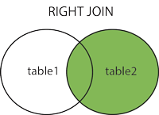

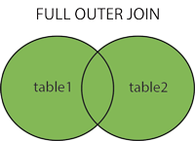
CMSC 508 – Databases
Relational algebra
Right join (right outer join)
Instructor Teaches
Full join (full outer join)*
Instructor Teaches
ID | name | department | course
1 | Cano | CS | CMSC-508
2 | Scott | Management | INF-302
99 | NULL | NULL | BIO-101
ID | name | department | course
1 | Cano | CS | CMSC-508
2 | Scott | Management | INF-302
3 | Wagner | Music | NULL
99 | NULL | NULL | BIO-101
*RelaX doesn’t merge columns with same name (even though it’s a natural full join)

Slide 27
CMSC 508 – Databases
Relational algebra
Division (/)
Let schemas R and S and S ⊆ R
R / S is a relation with a schema R – S
A tuple t is in R / S if satisfies both:
t is in ∏_{R-S}(r)
For every tuple t_{s} in s, there is a tuple t_{r} in r satisfying both:
t_{r}[S] = t_{s}[S]
t_{r}[R-S] = t

Slide 28







CMSC 508 – Databases
Relational algebra
Division (/)
$$R$$
$$S$$
$$T$$
$$W$$
$R$ / S
$R$ / T
$R$ / W
A | B
1 | 1
1 | 2
1 | 3
1 | 4
2 | 1
2 | 2
3 | 2
4 | 2
4 | 4
B
2
B
2
4
B
1
2
4
A
1
2
3
4
A
1
4
A
1

Slide 29
Practice exercises
CMSC 508 – Database Theory

Slide 30
CMSC 508 – Databases
Relational algebra
Exercises to practice
Online: Stanford, Vancouver, learn by doing!
Homework on Canvas. Assignment due Friday. Use these exercises to practice, in additions to the ones in the books and in the slides
RelaX – relational algebra calculator http://dbis-uibk.github.io/relax/
Type of exercises (and quiz questions) for the relational algebra:
A) Calculate the result of a given relational algebra expression
B) Write relational algebra expressions for a given query
C) Provide the meaning for a given relational algebra expression

Slide 31



CMSC 508 – Databases
Relational algebra
Calculate the result of the following relational algebra expressions
$R∩S$
$R−S$
$R×S$
$R⨝{S}$
$R⟕{S}$
$R⟖{S}$
$R⟗{S}$
$R ⨝_{ R.ID < S.ID} S$
${\text{∏} }_{R.ID, R.A } (R)− {\text{∏} }_{R.ID, R.A }(R ⨝_{ R.ID > S.ID} S)$
$$R$$
$$S$$
ID | A | B
1 | A1 | B1
2 | A2 | B2
3 | A3 | B3
ID | C | D | E
2 | C2 | D2 | E2
3 | C3 | D3 | E3
4 | C4 | D4 | E4

Slide 32

CMSC 508 – Databases
Relational algebra
Calculate the result of the following relational algebra expressions
R ∩ S
π ID (R ∪ S)
σ R.ID = S.ID (R ⨯ S)
R ⨝ S
R ⟕ S
$$R$$
$$S$$
ID | A | B
0 | A0 | B0
1 | A1 | B1
2 | A2 | B2
ID | C | D
0 | C0 | D0
2 | C2 | D2
3 | C3 | D3
Difficulty level:

Slide 33

CMSC 508 – Databases
Relational algebra
Write the relational algebra expression for the following query
$$Employee$$
$$Pilot$$
$$Aircraft$$
$$Certified$$
ID | Name | Salary
1 | Allison | 100
2 | Bob | 110
3 | Charles | 110
4 | David | 120
5 | Edward | 90
ID | FlightHours
1 | 500
2 | 800
4 | 750
ID | Name | Manufacturer | Range
1 | A380 | Airbus | 7000
2 | A330 | Airbus | 6500
3 | A320 | Airbus | 5800
4 | B787 | Boeing | 6300
5 | B777 | Boeing | 6500
EID | AID
1 | 1
2 | 2
2 | 3
3 | 1
3 | 4
3 | 5
4 | 1
4 | 2
4 | 3
4 | 5
Find the name of the pilots
Find the name of the pilots certified for an aircraft
Find the name of the pilots certified for a Boeing aircraft
Difficulty level:
Airplane! (1980)
Notes:
σ manufacturer = 'Boeing’ (Aircraft)
Π id (σ manufacturer = 'Boeing’ (Aircraft))
Π id (σ manufacturer = 'Boeing’ (Aircraft)) ⨝ Aircraft.id = Certified.aid Certified
Π eid (π id (σ manufacturer = 'Boeing' (Aircraft)) ⨝ Aircraft.id = Certified.aid Certified)
Π eid (π id (σ manufacturer = 'Boeing' (Aircraft)) ⨝ Aircraft.id = Certified.aid Certified) ⨝ Certified.eid = Employee.id Employee
Π eid (π id (σ manufacturer = 'Boeing' (Aircraft)) ⨝ Aircraft.id = Certified.aid Certified) ⨝ Certified.eid = Employee.id Employee ⨝ Pilot
Π name (π eid (π id (σ manufacturer = 'Boeing' (Aircraft)) ⨝ Aircraft.id = Certified.aid Certified) ⨝ Certified.eid = Employee.id Employee ⨝ Pilot)
Result: David

Slide 34
CMSC 508 – Databases
Relational algebra
Write the relational algebra expression for the following query
$$Employee$$
$$Pilot$$
$$Aircraft$$
$$Certified$$
ID | Name | Salary
1 | Allison | 100
2 | Bob | 110
3 | Charles | 110
4 | David | 120
5 | Edward | 90
ID | FlightHours
1 | 500
2 | 800
4 | 750
ID | Name | Manufacturer | Range
1 | A380 | Airbus | 7000
2 | A330 | Airbus | 6500
3 | A320 | Airbus | 5800
4 | B787 | Boeing | 6300
5 | B777 | Boeing | 6500
EID | AID
1 | 1
2 | 2
2 | 3
3 | 1
3 | 4
3 | 5
4 | 1
4 | 2
4 | 3
4 | 5
$$Flight$$
Code | Origin | Destination | Departure | Arrival | Aircraft
AA740 | PHL | MAD | 02/06 6:50 PM | 02/07 8:05 AM | 2
Find the names of the pilots capable of flying the flight AA740 on 02/06

Slide 35
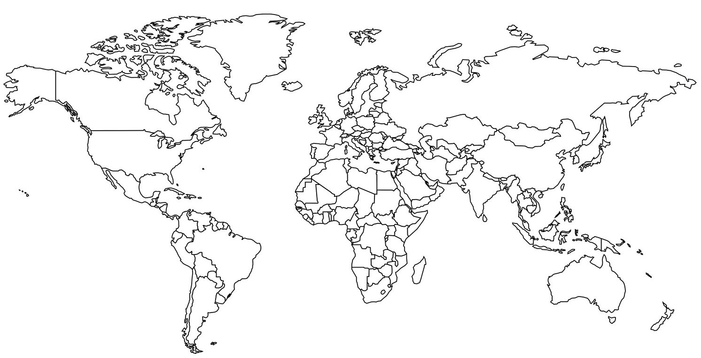


CMSC 508 – Databases
Relational algebra
Write the relational algebra expression for the following query
$$Flight$$
Code | Origin | Destination | Departure | Arrival
AA740 | PHL | MAD | 02/06 6:50 PM | 02/07 8:05 AM
AA4897 | RIC | PHL | 02/06 6:30 AM | 02/06 7:40 AM
AA3778 | RIC | NYC | 02/06 7:30 PM | 02/06 8:30 PM
AA840 | NYC | MAD | 02/06 5:30 PM | 02/07 7:45 AM
Find the code and departure time of all non-stop flights from Richmond to Philadelphia
Find the codes, departure time, and arrival time of any flight combination from Richmond to Madrid with a single stop
Difficulty level:

Slide 36

CMSC 508 – Databases
Relational algebra
Write the relational algebra expression for the following query
$$Employee$$
$$Pilot$$
$$Aircraft$$
$$Certified$$
ID | Name | Salary
1 | Allison | 100
2 | Bob | 110
3 | Charles | 110
4 | David | 120
5 | Edward | 90
ID | FlightHours
1 | 500
2 | 800
4 | 750
ID | Name | Manufacturer | Range
1 | A380 | Airbus | 7000
2 | A330 | Airbus | 6500
3 | A320 | Airbus | 5800
4 | B787 | Boeing | 6300
5 | B777 | Boeing | 6500
EID | AID
1 | 1
2 | 2
2 | 3
3 | 1
3 | 4
3 | 5
4 | 1
4 | 2
4 | 3
4 | 5
Find the name of pilots who can operate planes with a range greater than 6,500 miles but are not certified on any Boeing aircraft
1st find the set of all pilots certified for models with range > 6,500 miles and 2nd subtract the set of pilots certified for a Boeing aircraft
Difficulty level:

Slide 37
CMSC 508 – Databases
Relational algebra
What is the meaning and output of the following expressions?
$$Employee$$
$$Pilot$$
$$Aircraft$$
$$Certified$$
ID | Name | Salary
1 | Allison | 100
2 | Bob | 110
3 | Charles | 110
4 | David | 120
5 | Edward | 90
ID | FlightHours
1 | 500
2 | 800
4 | 750
ID | Name | Manufacturer | Range
1 | A380 | Airbus | 7000
2 | A330 | Airbus | 6500
3 | A320 | Airbus | 5800
4 | B787 | Boeing | 6300
5 | B777 | Boeing | 6500
EID | AID
1 | 1
2 | 2
2 | 3
3 | 1
3 | 4
3 | 5
4 | 1
4 | 2
4 | 3
4 | 5
π Employee.name, manufacturer (Employee ⟕ Employee.id = Certified.eid (Certified ⨝ Certified.aid = Aircraft.id Aircraft))
π name (Employee ⨝ Employee.id = C1.eid (σ C1.eid = C2.eid ∧ C1.aid ≠ C2.aid (ρ C1 (Certified) ⨯ ρ C2 (Certified))))

Slide 38

CMSC 508 – Databases
Relational algebra
Write the relational algebra expression for the following query
$$Employee$$
$$Aircraft$$
$$Certified$$
EID | Name | Salary
1 | Allison | 100
2 | Bob | 110
3 | Charles | 110
4 | David | 120
5 | Edward | 90
AID | Model | Manufacturer | Range
1 | A380 | Airbus | 7000
2 | A330 | Airbus | 6500
3 | A320 | Airbus | 5800
4 | B787 | Boeing | 6300
5 | B777 | Boeing | 6500
EID | AID
1 | 1
2 | 2
2 | 3
3 | 1
3 | 4
3 | 5
4 | 1
4 | 2
4 | 3
4 | 5
Find the name of employees who make the highest salary
Find the name of employees who make the second highest salary
Difficulty level:

Slide 39
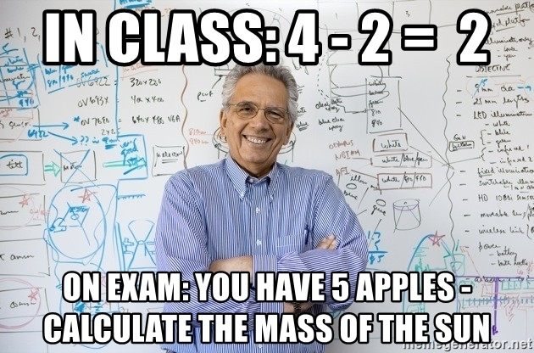
CMSC 508 – Databases
Relational algebra
Write the relational algebra expression for the following query
$$Employee$$
$$Aircraft$$
$$Certified$$
EID | Name | Salary
1 | Allison | 100
2 | Bob | 110
3 | Charles | 110
4 | David | 120
5 | Edward | 90
AID | Model | Manufacturer | Range
1 | A380 | Airbus | 7000
2 | A330 | Airbus | 6500
3 | A320 | Airbus | 5800
4 | B787 | Boeing | 6300
5 | B777 | Boeing | 6500
EID | AID
1 | 1
2 | 2
2 | 3
3 | 1
3 | 4
3 | 5
4 | 1
4 | 2
4 | 3
4 | 5
Find the name of employees who are certified for at least three aircrafts
Find the name of employees who are certified for exactly three aircrafts
Difficulty level:

Slide 40
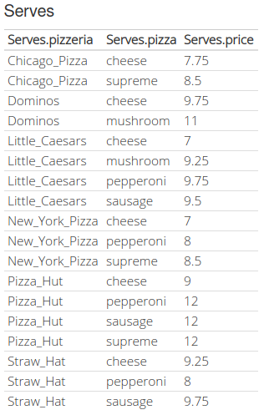
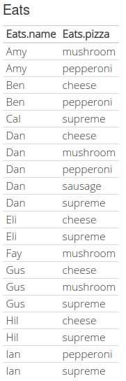
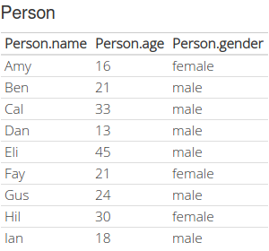

CMSC 508 – Databases
Relational algebra
Write the relational algebra expression for the following query
Find all pizzerias that serve the cheapest pepperoni pizza
Find all pizzerias that serve every pizza that females eat
Find all pizzerias that serve every pizza that every female eats
Difficulty level: LOL

Slide 41
CMSC 508 – Databases
Relational algebra
Critical thinking
Given two relations R1 and R2, where R1 contains N1 unique tuples, R2 contains N2 unique tuples, and N2 > N1 > 0, give the minimum and maximum possible sizes (in tuples) for the output produced by each of the following relational algebra expressions:
Operation | Minimum #rows | Maximum #rows
R1 ∪ R2
R1 ∩ R2
R1 − R2
R2 − R1
R1×R2

Slide 42
CMSC 508 – Databases
Relational algebra
Symbol (Name) Example of Use
(Selection) salary > = 85000 ^{(instructor)}
σ
Return rows of the input relation that satisfy the predicate.
(Projection) ^{Π} ID, salary (instructor)
Π
Output specified attributes from all rows of the input relation. Remove duplicate tuples from the output.
(Cartesian Product) instructor x department
x
Output pairs of rows from the two input relations that have the same value on all attributes that have the same name.
(Union) ^{Π} name ^{(instructor) ∪ Π} name ^{(student)}
∪
Output the union of tuples from the two input relations.
(Set Difference) Π _{name} (instructor) -- Π _{name} (student)
-
Output the set difference of tuples from the two input relations.
(Natural Join) instructor ⋈ department
⋈
Output pairs of rows from the two input relations that have the same value on all attributes that have the same name.
Notes:
Each Query input is a table (or set of tables)
Each query output is a table.
All data in the output table appears in one of the input tables
Relational Algebra is not Turning complete

