Slide 1
Week 5 - Relational Algebra Examples
Practice Queries and Discussion

Slide 2
Housekeeping
Homework Due THIS FRIDAY, 11pm
Quiz 2 – MONDAY, in class

Slide 3
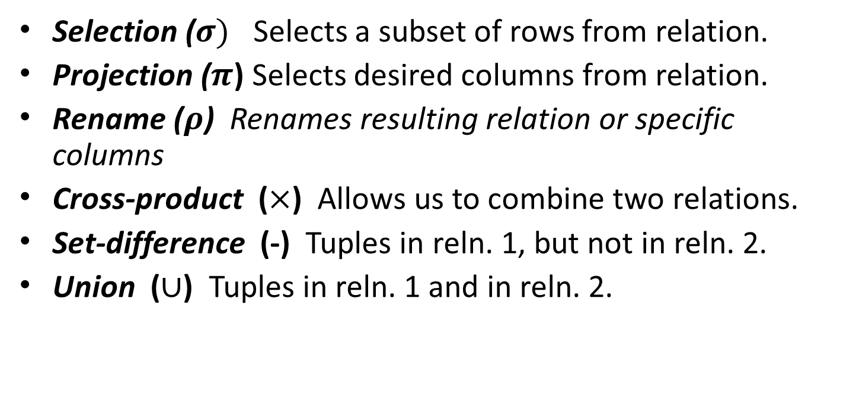
Basic operations
Selection ($σ)$ Selects a subset of rows from relation.
Projection ($π$) Selects desired columns from relation.
Rename ($ρ$) Renames resulting relation or specific columns
Cross-product ($×$) Allows us to combine two relations.
Set-difference (-) Tuples in reln. 1, but not in reln. 2.
Union ($∪$) Tuples in reln. 1 and in reln. 2.
Notes:
6
Additional operations: Intersection, join, division, renaming

Slide 4
Applying R-a expressions
CMSC 508 – Database Theory

Slide 5
Example Relational Schemas
Relations for the examples:
Sailors(sid: integer, sname: string, rating: integer, height: real)
Boats(bid: integer, bname: string, color: string)
Reservation(sid: integer, bid: integer, day: date)
Notes:
5
The example relational database schema is for a boat rental service.
Sailors register by providing their name, skill rating, and height. They are assigned a unique sid that serves as the key attribute for the relation.
Boats have an identifying number for the key field, bid and data is stored for the boat name and color.
A Reservation consists of the sailor’s id, the boat’s id, and the day the boat will be used. For this relation, the combination of all three attributes is used as the key.

Slide 6
Example Instances
R1
“Sailors” and “Reserves” relations for the examples.
S1
S2
Notes:
5

Slide 7
Projection
R1
S1
S2
Notes:
5

Slide 8
Projection
R1
S1
S2
Notes:
5

Slide 9
Selection
R1
S1
S2
Notes:
5

Slide 10
Selection
R1
S1
S2
Notes:
5

Slide 11
Union
R1
S1
S2
Notes:
5

Slide 12
Intersection
R1
S1
S2
Notes:
5

Slide 13
Difference
R1
S1
S2
Notes:
5

Slide 14
Cross-Product
R1
S1
S2
Notes:
5
Problem here is that attributes must be unique

Slide 15
Cross-Product
R1
S1
(sid) | sname | rating | age | (sid) | bid | day
22 | dustin | 7 | 45.0 | 22 | 101 | 10/10/96
22 | dustin | 7 | 45.0 | 58 | 103 | 11/12/96
31 | lubber | 8 | 55.5 | 822 | 101 | 10/10/96
31 | lubber | 8 | 55.5 | 58 | 103 | 11/12/96
58 | rusty | 10 | 35.0 | 22 | 101 | 10/10/96
58 | rusty | 10 | 35.0 | 58 | 103 | 11/12/96
S2
Notes:
5
Problem here is that attributes must be unique

Slide 16
Cross-Product
R1
S1
sid1 | sname | rating | age | sid2 | bid | day
22 | dustin | 7 | 45.0 | 22 | 101 | 10/10/96
22 | dustin | 7 | 45.0 | 58 | 103 | 11/12/96
31 | lubber | 8 | 55.5 | 822 | 101 | 10/10/96
31 | lubber | 8 | 55.5 | 58 | 103 | 11/12/96
58 | rusty | 10 | 35.0 | 22 | 101 | 10/10/96
58 | rusty | 10 | 35.0 | 58 | 103 | 11/12/96
S2
Notes:
5
Rename operator (rho)

Slide 17

Natural Join
R1
$$S_{1}⋈R_{1}$$
S1
S2
Notes:
5

Slide 18
Equi-Join
R1
S1
S2
Notes:
5
If there are more than one common attribute, you can specify which one to use.

Slide 19
Theta Join
R1
S1
S2
Notes:
5

Slide 20
Division
Find sailors who have reserved all boats.
Let A have 2 fields, x and y; B have only field y:
A/B =
i.e., A/B contains all x tuples (sailors) such that for every y tuple (boat) in B, there is an xy tuple in A.
Notes:
13

Slide 21
Examples of Division A/B
A
B1
B2
B3
A/B1
A/B2
A/B3
Notes:
14
Result is the relation in which there is a tuple in A for wich the same sno value has a pno value for all tuples in divisor.

Slide 22
Writing compound Expressions
CMSC 508 – Database Theory

Slide 23
Example 1
Sailors( sid: integer, sname: string, rating: integer, age: real)
Boats(bid: integer, bname: string, color: string)
Reserves(sid: integer, bid: integer, day: date)
Find names of sailors who’ve reserved boat #103
Notes:
5

Slide 24
Find names of sailors who’ve reserved boat #103
Answer1 =
Answer2 =
Answer3 =
Notes:
16

Slide 25
Example 2
Sailors( sid: integer, sname: string, rating: integer, age: real)
Boats(bid: integer, bname: string, color: string)
Reserves(sid: integer, bid: integer, day: date)
Find names of sailors who reserved a red boat
Notes:
5

Slide 26
Find names of sailors who’ve reserved a red boat
Information about boat color only available in Boats; so need an extra join:
Notes:
17

Slide 27
Example 3
Sailors( sid: integer, sname: string, rating: integer, age: real)
Boats(bid: integer, bname: string, color: string)
Reserves(sid: integer, bid: integer, day: date)
Find names of sailors who’ve reserved
a red or a green boat
Notes:
5

Slide 28
Find sailors who’ve reserved a red or a green boat
Can identify all red or green boats, then find sailors who’ve reserved one of these boats:
Notes:
18

Slide 29
Example 4
Sailors( sid: integer, sname: string, rating: integer, age: real)
Boats(bid: integer, bname: string, color: string)
Reserves(sid: integer, bid: integer, day: date)
Find names of sailors who’ve reserved
a red and a green boat
Notes:
5
Previous approach won’t work! Must identify sailors who’ve reserved red boats, sailors who’ve reserved green boats, then find the intersection (note that sid is a key for Sailors):

Slide 30
Find sailors who’ve reserved a red and a green boat
Notes:
19

Slide 31
Example 5
Sailors( sid: integer, sname: string, rating: integer, age: real)
Boats(bid: integer, bname: string, color: string)
Reserves(sid: integer, bid: integer, day: date)
Find names of sailors who’ve reserved
all boats
Notes:
5

Slide 32
Find the names of sailors who’ve reserved all boats
Uses division; schemas of the input relations to / must be carefully chosen:
.....
Notes:
20

Slide 33
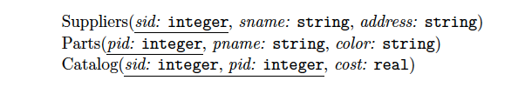
Example 6
Find the names of suppliers who supply some red part.

Slide 34

Example 6
Find the names of suppliers who supply some red part.
π _{sname} (π _{sid} ((π _{pid} σ _{color = ‘red’} Parts) Catalog) Suppliers)

Slide 35
Example 7
Find the sids of suppliers who supply some red or green part.

Slide 36
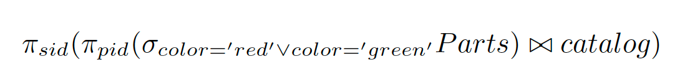
Example 7
Find the sids of suppliers who supply some red or green part.

Slide 37
Example 8
Find the sids of suppliers who supply some red part or are at 221 Packer Street.

Slide 38
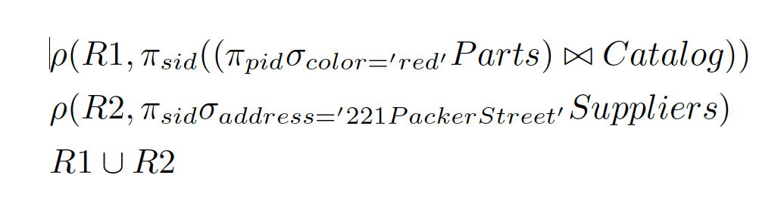
Example 8
Find the sids of suppliers who supply some red part or are at 221 Packer Street.

Slide 39
Example 9
Find the sids of suppliers who supply some red part and some green part.

Slide 40
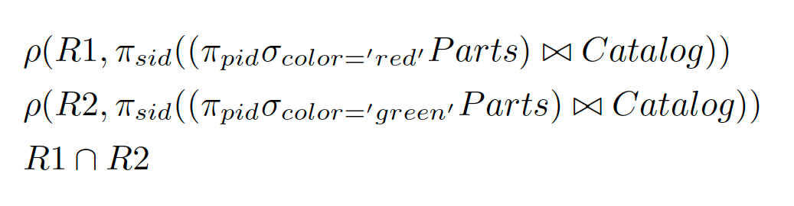
Example 9
Find the sids of suppliers who supply some red part and some green part.

Slide 41
Example 10
Find the sids of suppliers who supply every part.

Slide 42
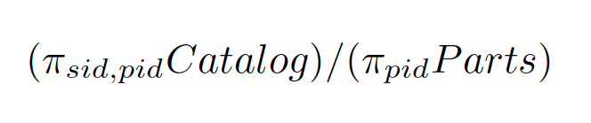
Example 10
Find the sids of suppliers who supply every part.

Slide 43
Example 11
Find the sids of suppliers who supply every red part.

Slide 44
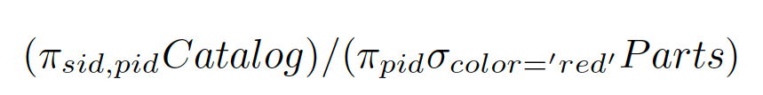
Example 11
Find the sids of suppliers who supply every red part.

Slide 45
Example 12
Find the sids of suppliers who supply every red or green part.

Slide 46
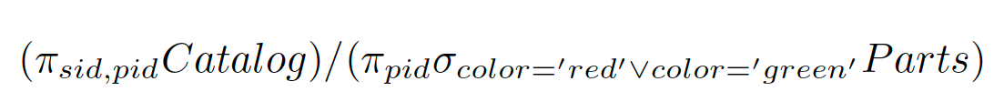
Example 12
Find the sids of suppliers who supply every red or green part.

Slide 47
Example 13
Find the sids of suppliers who supply every red part or supply every green part.

Slide 48
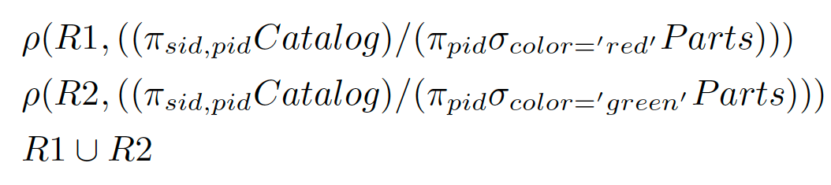
Example 13
Find the sids of suppliers who supply every red part or supply every green part.

Slide 49
Example 14
Find pairs of sids such that the supplier with the first sid charges more for some
part than the supplier with the second sid.

Slide 50
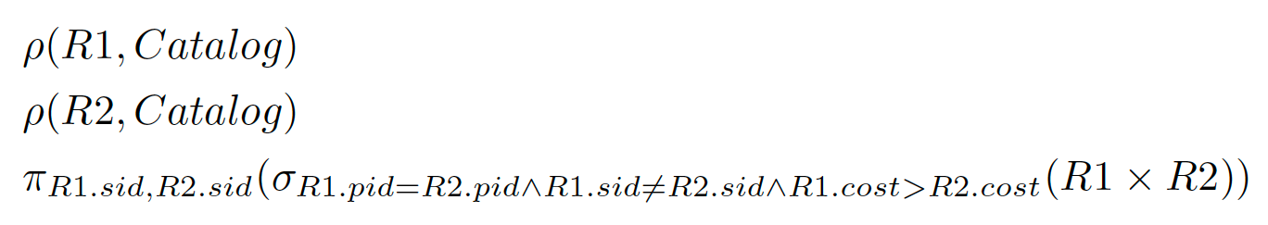
Example 14
Find pairs of sids such that the supplier with the first sid charges more for some
part than the supplier with the second sid.

Slide 51
Example 15
Find the pids of parts supplied by at least two different suppliers.

Slide 52
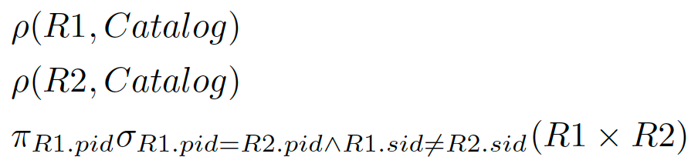
Example 15
Find the pids of parts supplied by at least two different suppliers.

Slide 53
Example 16
What is this relation?
Notes:
Find the Supplier names of the suppliers who supply a red part that costs less than 100 dollars.

Slide 54
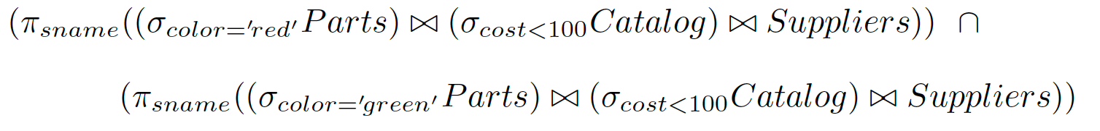
Example 17
What is this relation?
Notes:
Find the Supplier names of the suppliers who supply a red part that costs less than 100 dollars and a green part that costs less than 100 dollars.

Slide 55
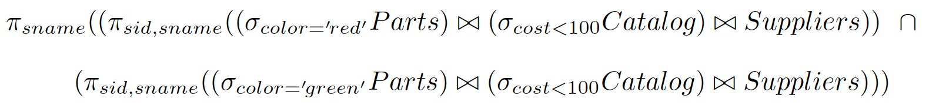
Example 18
What is this relation?
Notes:
Find the Supplier names of the suppliers who supply a red part that costs less than 100 dollars and a green part that costs less than 100 dollars.

