Slide 1
Week 7 – Class 11 - Monday Normalization
CMSC 508 Database Theory
Database System Concepts, 6th Ed. by Silberschatz, Korth, Sudarshan, 2011, Chapter 7
Database Management Systems, 3rd Ed. by Ramakrishnan, Gehrke, 2003, Chapter 19
1

Slide 2
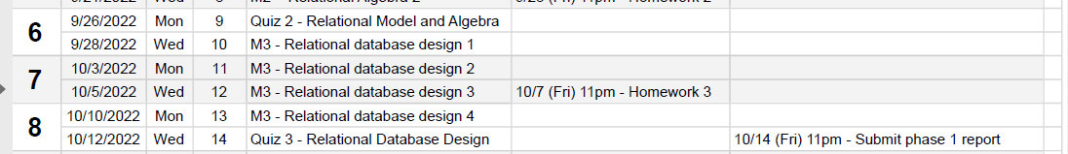
Housekeeping
Homework 3 – due THIS FRIDAY - 10/7
Quiz 3 – next Wednesday 10/12
Phase I Project – 10/14

Slide 3


CMSC 508 – Databases
Normalization
Database design and implementation
Problem
definition
Data modeling
Relational model
Relational algebra
Functional Dependencies
Implementation
Usage
Information requisites and functional analysis
ER diagram
Tables
Tables
Normalized tables
SQL
Interfaces
Resolve

Slide 4
Overview of normalization

Slide 5
CMSC 508 – Databases
Normalization
Relational database design process
Identify entities, attributes, and relationships
Draw entities and relationships in the ERD
Define the cardinality and participation of the relationships
Refine and simplify the model
Translate the model to relational schemas, identify PKs, FKs, unique, not null
Common errors in ERD / RD
Missing cardinalities, participation, roles (FOLLOW NOTATION!)
Excessive use of decomposition (attributes/values -> entities), specialization, ternary relationships, weak entities
Diagram specification, not a picture! (straight lines, legibility)
Columns with list of values
Columns missing on tables!

Slide 6
CMSC 508 – Databases
Normalization
Features of good relational design
Redundancy is at the root of problems associated with relational schemas:
Redundant storage (capacity)
Subject to errors: insert/delete/update inconsistency
Referential integrity constraints can be used to identify schemas with such problems and to suggest refinements
Refinement of big tables using decomposition into smaller tables
R1(ABCDE) -> R2(AB) and R3(BCDE), or R2(ACD) and R3(ABDE), etc
Decomposition should be used judiciously. Is there reason to decompose a relation? What problems (if any) does the decomposition cause?

Slide 7
CMSC 508 – Databases
Normalization
Functional Dependencies (FDs)
Given a relation R, a set of attributes X is said to functionally determine another set of attributes Y, (written X → Y) if, and only if, each value of X is associated with only one value of Y, where X is the antecedent and Y is the consequent of the functional dependency.
A functional dependency X → Y holds over relation R if, for every allowable instance r of R:
$t_{1}∈r,t_{2}∈r π_{X}\left(t_{1}\right)=π_{X}\left(t_{2}\right) implies π_{Y}\left(t_{1}\right)=π_{Y}\left(t_{2}\right)$
if the X values agree, then the Y values must also agree
A FD is a statement about all allowable relations
Must be identified based on semantics of application not on current values
Given some allowable instances of R, we can check if they violate some FDs, but we cannot tell if always holds over R!

Slide 8
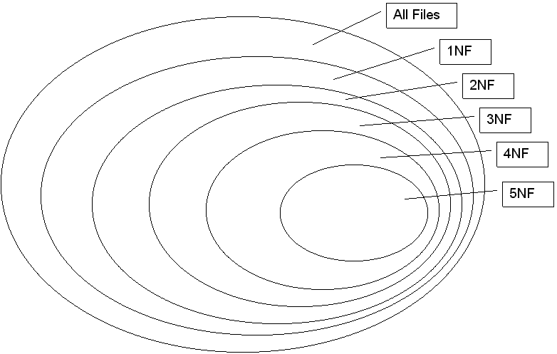
Database Normalization
CMSC 508 – Databases
Normalization
Database normalization is the process of reorganizing the relations to minimize data redundancy
Normalization involves breaking down a table into less redundant and smaller tables without losing information by using functional dependencies
The objective is to isolate data to minimize duplicates and so modifications of an attribute can be made in just one table and then propagated through the rest of the database using the defined foreign keys
BCNF

Slide 9
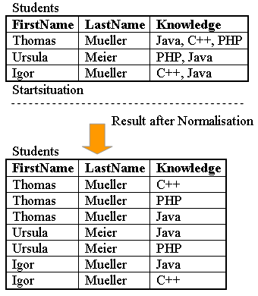
CMSC 508 – Databases
Normalization
First normal form (1NF)
A relation is in 1NF if and only if the domain of each attribute contains only atomic (indivisible) values and the value of each attribute contains only a single value from that domain
No multi-valued attributes. No arrays/lists in a cell.
Decomposition of a multi-valued attribute into atomic.
Phone numbers, email addresses, etc
Not 1NF but also recommended: Decomposition of a composite attribute into atomic.
Name → FirstName, MiddleName, LastName
Address → Street + number + city + state + zip

Slide 10
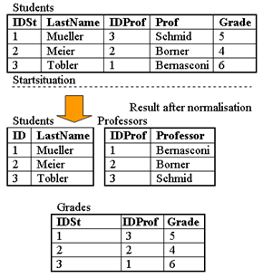
CMSC 508 – Databases
Normalization
Second normal form (2NF)
Prime Attribute – a part of a candidate key. Non-prime attribute / non-key attribute: an attribute that is not a part of any candidate key of the relation
A relation is in 2NF if it is in 1NF and every non-prime attribute of the relation is dependent on the whole of every candidate key
Having a non-prime attribute functionally dependent on a subset of any candidate key is a violation of 2NF
Example: F = {IDSt → LastName; IDProf → Prof; IDSt, IDProf → Grade }
CK = {IDSt, IDProf}
Students is NOT in 2NF because non-prime attributes (LastName, Prof) are functionally dependent on a subset of a candidate key. (IDST->LastName; IDProf->Prof)

Slide 11

CMSC 508 – Databases
Normalization
Third normal form (3NF)
A relation is in 3NF if it is in 2NF and every non-prime attribute is non-transitively dependent on every key
No non-prime attributes can depend on other non-prime attributes
All the non-prime attributes must depend only on the candidate keys
A relation R with FDs F is in 3NF if, for all X → Y in F⁺
Y $⊆$ X (trivial FD) or
X is a superkey for R or
Each attribute in {Y – X} is a prime attribute
3NF is violated when a non-key attribute depends on another non-key attribute
(Note – that we’re already in 3NF!)

Slide 12
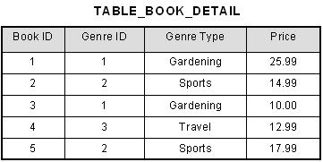
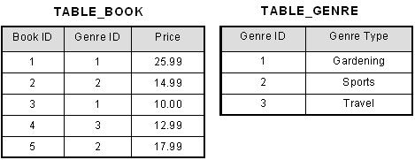
CMSC 508 – Databases
Normalization
Third normal form (3NF) – example going from 2NF to 3NF
F = { Book_ID → Genre_ID
Genre_ID → Genre_Type
Book_ID → Price}
CK is {Book_ID}
Table_Book_Detail is in 2NF but NOT in 3NF. Genre_Type (non-prime attribute) functionally depends from the Genre_ID, which is NOT a prime attribute, a 3NF violation. However, by transitivity Genre_ID can be obtained from the Book_ID, which is a CK, then 2NF is OK.
Sample Table in 2NF
Conversion to 3NF

Slide 13
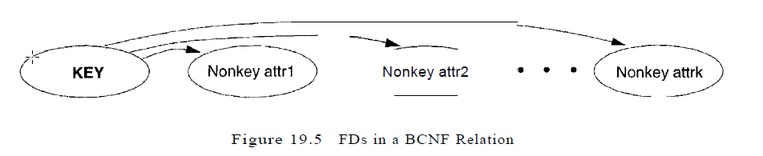
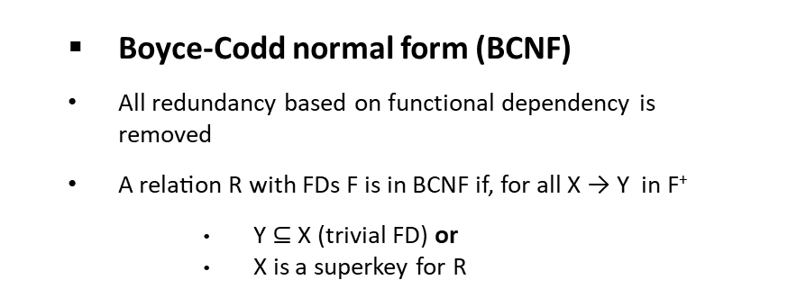
CMSC 508 – Databases
Normalization
Boyce-Codd normal form (BCNF)
All redundancy based on functional dependency is removed
A relation R with FDs F is in BCNF if, for all X → Y in F⁺
Y $⊆$ X (trivial FD) or
X is a superkey for R
(Note – that we’re already in BCNF, too!)
“The key, the whole key, and nothing but the key, so help me Codd”

Slide 14
A real world example

Slide 15
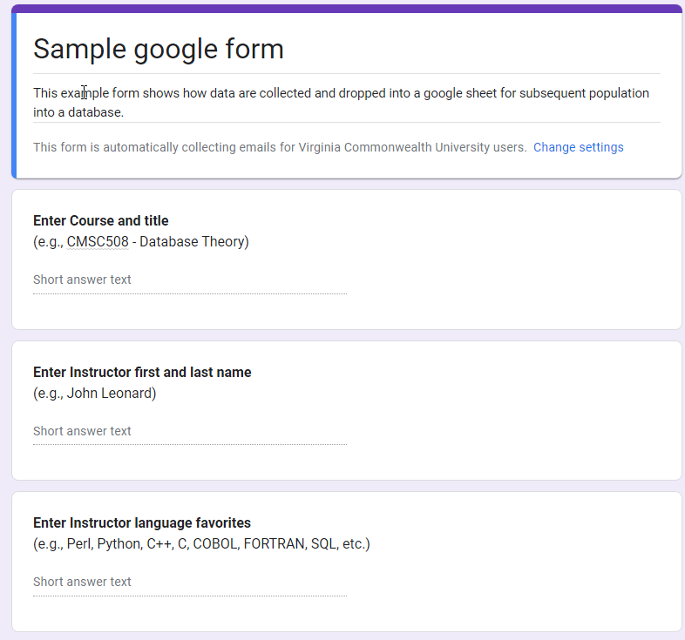
In the beginning, there was a question …

Slide 16
… and then there were data …
But the data were ill-formed and unusable
Each row represents a response
Can relational algebra be used?
Which instructors know SQL?
Who teaches CMSC508?
Is there redundant data?
FROM: google survey form
Course | Instructor | Languages
CMSC508 - Databases | John Leonard | Perl, SQL
CMSC508 - Databases | Alberto Cano | C++, SQL
CMSC255 - Intro to Coding | John Riley | Python, SQL

Slide 17
Let’s get normal – First Normal Form (1NF)
FROM: google survey form
Course | Instructor | Languages
CMSC508 - Databases | John Leonard | Perl, SQL
CMSC508 - Databases | Alberto Cano | C++, SQL
CMSC255 - Intro to Coding | John Riley | Python, SQL
A relation is in 1NF if and only if the domain of each attribute contains only atomic (indivisible) values and the value of each attribute contains only a single value from that domain.
No multi-valued attributes. No arrays/lists in a cell. NOT REQUIRED BUT YOU SHOULD: break composite values
Now what? A) Can you identify redundancies? B) What is the relational schema? B) What is primary/candidate key? Why? C) What are functional dependencies? D) How would you remove redundancies? E) How would you decompose this table into smaller tables that reduce redundancy yet maintain relationships between columns?
TO: First Normal Form - 1NF
CourseID | Course Name | First Name | Last Name | Languages
CMSC508 | Databases | John | Leonard | Python
CMSC508 | Databases | John | Leonard | Perl
CMSC508 | Databases | John | Leonard | SQL
CMSC508 | Databases | Alberto | Cano | C++
CMSC508 | Databases | Alberto | Cano | C
CMSC508 | Databases | Alberto | Cano | Python
CMSC508 | Databases | Alberto | Cano | SQL
CMSC255 | Intro to Coding | John | Riley | Python
CMSC255 | Intro to Coding | John | Riley | C++
CMSC255 | Intro to Coding | John | Riley | SQL

Slide 18
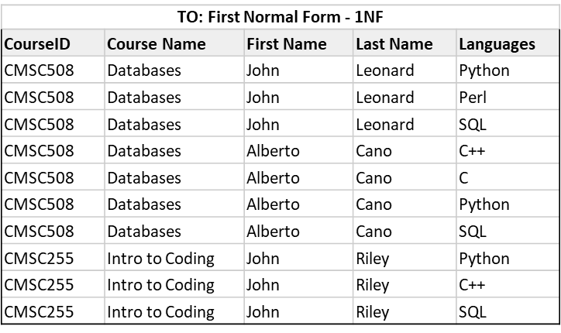
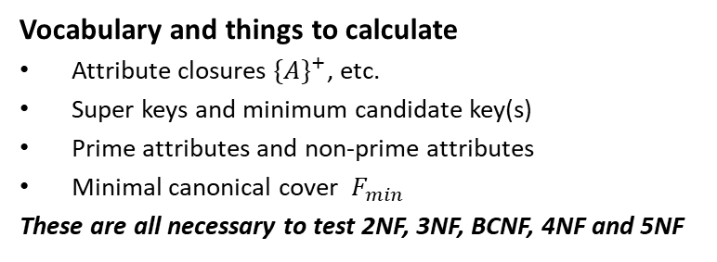
Relational schema and functional dependencies
Notation option 1: Teach(CID, Course, First, Last, Lang) CK(CID, First, Last) FD(CID->Course; First, Last->Lang)
Notation option 2:
R(A,B,C,D,E) CK(A,C,D)
FD(A->B; C,D->E)
Vocabulary and things to calculate
Attribute closures ${\{A\}}^{+}$, etc.
Super keys and minimum candidate key(s)
Prime attributes and non-prime attributes
Minimal canonical cover $F_{min}$
These are all necessary to test 2NF, 3NF, BCNF, 4NF and 5NF

Slide 19
BNCF decomposition by algorithm
BCNF decomp algorithm
BCNF on-line tool
Input: Relation R with FDs
Output: Decomposition of R into BCNF relations with lossless-join
1. Compute candidate keys for R using FDs
2. Repeat until all relations are in BCNF:
2.1 Pick any R’ with X → Y that violates BCNF
2.2 Decompose R’ into R1(X, Y) and R2(X, {R’ – Y})
2.3 Compute FDs holding for R1 and R2
2.4 Compute keys for R1 and R2
Visit http://raymondcho.net/RelationalDatabaseTools/RelationalDatabaseTools.html
Enter Relation R and FD.
Interpret the report

Slide 20
BCNF Decomposition - Step 1
R(A,B,C,D,E) CK (A,C,E) FD( A->B; C,D->E )
Step 1 – use R and A->B
Break into 2 tables, R1 and R2, maintaining functional dependencies,
Examine each table
R1 is BCNF (CK is A, A->B)
R2 is not BCNF (CK is ACDE and C,D->E. C,D is subset of ACDE. Fail!)
R1(A,B) - R(X,Y) |  |  | R2(A,C,D,E) or R(X,{R’- Y})
CourseID | Course Name |  | CourseID | First Name | Last Name | Languages
CMSC508 | Databases |  | CMSC508 | John | Leonard | Python
CMSC508 | Databases |  | CMSC508 | John | Leonard | Perl
CMSC508 | Databases |  | CMSC508 | John | Leonard | SQL
CMSC508 | Databases |  | CMSC508 | Alberto | Cano | C++
CMSC508 | Databases |  | CMSC508 | Alberto | Cano | C
CMSC508 | Databases |  | CMSC508 | Alberto | Cano | Python
CMSC508 | Databases |  | CMSC508 | Alberto | Cano | SQL
CMSC255 | Intro to Coding |  | CMSC255 | John | Riley | Python
CMSC255 | Intro to Coding |  | CMSC255 | John | Riley | C++
CMSC255 | Intro to Coding |  | CMSC255 | John | Riley | SQL

Slide 21
BCNF Decomposition - Step 2
R(A,B,C,D,E) CK (A,C,E) FD( A->B; C,D->E )
Step 2 – Use R2 and CD->E
Break into 2 tables, R3 and R4, maintaining functional dependencies,
Examine each table
R3 is BCNF! (CK is CD, and CD->E. Perfect!)
R4 is BCNF (CK is ACD, no attributes and no functional dependencies. Win!)
Using CD->E, we can break R2(A,C,D,E) into two tables: R3(C,D,E) and R4(A,C,D)
R3(C,D,E)
R2(A,C,D,E)
R4(A,C,D)
CourseID | First Name | Last Name | Languages
CMSC508 | John | Leonard | Python
CMSC508 | John | Leonard | Perl
CMSC508 | John | Leonard | SQL
CMSC508 | Alberto | Cano | C++
CMSC508 | Alberto | Cano | C
CMSC508 | Alberto | Cano | Python
CMSC508 | Alberto | Cano | SQL
CMSC255 | John | Riley | Python
CMSC255 | John | Riley | C++
CMSC255 | John | Riley | SQL
First Name | Last Name | Languages
John | Leonard | Python
John | Leonard | Perl
John | Leonard | SQL
Alberto | Cano | C++
Alberto | Cano | C
Alberto | Cano | Python
Alberto | Cano | SQL
John | Riley | Python
John | Riley | C++
John | Riley | SQL
CourseID | First Name | Last Name
CMSC508 | John | Leonard
CMSC508 | John | Leonard
CMSC508 | John | Leonard
CMSC508 | Alberto | Cano
CMSC508 | Alberto | Cano
CMSC508 | Alberto | Cano
CMSC508 | Alberto | Cano
CMSC255 | John | Riley
CMSC255 | John | Riley
CMSC255 | John | Riley

Slide 22
BCNF Decomposition – Clean up
R(A,B,C,D,E) CK (A,C,E) FD( A->B; C,D->E )
Clean up and summary
Remove duplicate values from R1, R4
Started with 1 table: R(A,B,C,D,E)
Ended with 3 tables, R1, R3, R4, each in BCNF
Design questions
Are we done?
Can we improve the design?
Algorithm notes
This works with simple FD
Sometime FD overlap or are redundant
Best is to calculate Minimum Canonical Cover and use this to decompose the original table.
R3(C,D,E)
R1(A,B)
First Name | Last Name | Languages
John | Leonard | Python
John | Leonard | Perl
John | Leonard | SQL
Alberto | Cano | C++
Alberto | Cano | C
Alberto | Cano | Python
Alberto | Cano | SQL
John | Riley | Python
John | Riley | C++
John | Riley | SQL
CourseID | Course Name
CMSC508 | Databases
CMSC255 | Intro to Coding
R4(A,C,D)
CourseID | First Name | Last Name
CMSC508 | John | Leonard
CMSC508 | Alberto | Cano
CMSC255 | John | Riley

Slide 23
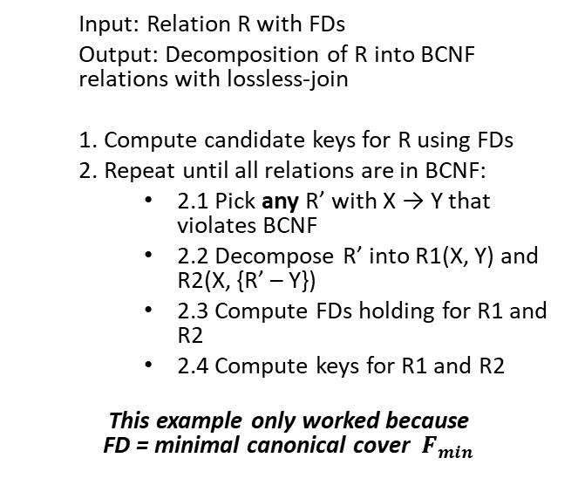
Revisit decomposition by algorithm
BCNF decomp algorithm
BCNF on-line tool
Input: Relation R with FDs
Output: Decomposition of R into BCNF relations with lossless-join
1. Compute candidate keys for R using FDs
2. Repeat until all relations are in BCNF:
2.1 Pick any R’ with X → Y that violates BCNF
2.2 Decompose R’ into R1(X, Y) and R2(X, {R’ – Y})
2.3 Compute FDs holding for R1 and R2
2.4 Compute keys for R1 and R2
This example only worked because FD = minimal canonical cover $F_{min}$
Visit http://raymondcho.net/RelationalDatabaseTools/RelationalDatabaseTools.html
Enter Relation R and FD.
Interpret the report

Slide 24
Additional Decomposition examples

Slide 25
CMSC 508 – Databases
Relational database design
BCNF decomposition - example 1
R(A,B,C,D,E) with FDs {A → B, C → D}, and CK {A,C,E}
R(A,B,C,D,E) is not in BCNF, why?
CK for R is {A,C,E} and the antecedent for both FDs are subsets of the CK, which is a violation of 2NF and therefore cannot satisfy BCNF
1. Pick FD: A → B which violates BCNF
R1(A,B) with A → B CK is {A}, all good! R2(A,C,D,E) with C → D CK is {A,C,E}, violation!
2. Pick FD: C → D which violates BCNF
R1(A,B) with A → B CK is {A}, all good!
R3(C,D) with C → D CK is {C}, all good! R4(A,C,E) with no FDs CK is {A,C,E}, all good!
Apply algorithm!
Pick any FD in the form X → Y that violates BCNF
Decompose R’ into R1(X, Y) and R2(X, {R’-Y})
Repeat until no more BCNF violations

Slide 26
CMSC 508 – Databases
Relational database design
BCNF decomposition – example 2
Student (SSN, name, address, HScode, HSname, HScity, GPA, priority)
FD1: SSN → name, address, GPA
FD2: GPA → priority
FD3: HScode → HSname, HScity
Decompose Student via FD3:
R1(HScode, HSname, HScity)
Compute keys for R1 considering only FD3 applies, CK {HScode}. No other FDs hold
FD3 does not violate BCNF in R1 because antecedent is a superkey
R2(SSN, name, address, HScode, GPA, priority)
Compute keys for R2 considering FD1 and FD2 apply, CK {SSN,HScode}
FD1 violates BCNF in R2, antecedent is not a superkey
FD2 violates BCNF in R2, antecedent is not a superkey

Slide 27
CMSC 508 – Databases
Relational database design
BCNF decomposition – example 2
Student (SSN, name, address, HScode, HSname, HScity, GPA, priority)
FD1: SSN → name, address, GPA
FD2: GPA → priority
FD3: HScode → HSname, HScity
R1(HScode, HSname, HScity) satisfies BNCF, then we may label PK for R1 and we’re done
Decompose R2 via FD2, repeat the process:
R2(SSN, name, address, HScode, GPA, priority)
R3(GPA, priority) FD2 applies, CK {GPA}, no violation of BCNF. No other FDs hold
R4(SSN, name, address, HScode, GPA), FD1 applies
CK for R4 is {SSN,HScode}, FD1 violates BCNF in R4

Slide 28
CMSC 508 – Databases
Relational database design
BCNF decomposition - example 2
Student (SSN, name, address, HScode, HSname, HScity, GPA, priority)
FD1: SSN → name, address, GPA
FD2: GPA → priority
FD3: HScode → HSname, HScity
R1(HScode, HSname, HScity)
R3(GPA, priority)
Decompose R4 via FD1:
R4(SSN, name, address, HScode, GPA)
R5(SSN, name, address, GPA)
FD1 applies, CK {SSN}, no violation BCNF. No other FDs hold
R6(SSN, HScode) no FDs apply, no violation BCNF

Slide 29
CMSC 508 – Databases
Relational database design
BCNF decomposition - example 2
Student (SSN, name, address, HScode, HSname, HScity, GPA, priority)
FD1: SSN → name, address, GPA
FD2: GPA → priority
FD3: HScode → HSname, HScity
R1(HScode, HSname, HScity)
R3(GPA, priority)
R5(SSN, name, address, GPA)
R6(SSN, HScode)
*Key in R6 is {SSN, HScode} because there are no FDs holding, this technically allows a given student to be enrolled in multiple HSs, because there’s no FD SSN → HScode defined in the functional dependencies

Slide 30
CMSC 508 – Databases
Relational database design
BCNF decomposition – example 2
Student (SSN, name, address, HScode, HSname, HScity, GPA, priority)
FD1: SSN → name, address, GPA, HScode
FD2: GPA → priority
FD3: HScode → HSname, HScity
{SSN}⁺ determines all the attributes
R1(HScode, HSname, HScity)
R2(GPA, priority)
R3(SSN, HScode, name, address, GPA)
Attribute closure calculator, Candidate key calculator, Minimum (Canonical) cover calculator, Functional dependency calculator and Normal form calculator
http://raymondcho.net/RelationalDatabaseTools/RelationalDatabaseTools.html

Slide 31
CMSC 508 – Databases
Relational database design
Review terms
Normalization
Functional dependency
Lossless decomposition
Atomic domains
First normal form
Second normal form
Third normal form
Boyce-Codd normal form
Dependency preservation
BCNF decomposition algorithm
Armstrong’s axioms
Closure of functional dependencies
Closure of attributes
Canonical cover

