Slide 1
Week 8 – Class 13 - Monday 4NF and 5NF
CMSC 508 Database Theory
Database System Concepts, 6th Ed. by Silberschatz, Korth, Sudarshan, 2011, Chapter 7
Database Management Systems, 3rd Ed. by Ramakrishnan, Gehrke, 2003, Chapter 19
1

Slide 2
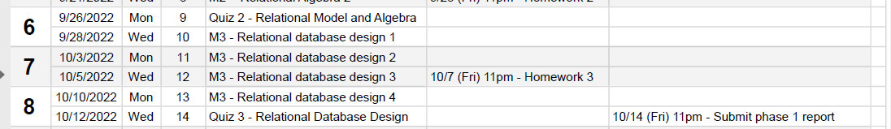
Housekeeping
Quiz 3 – Wednesday 10/12
Phase I Project – due Friday 10/14

Slide 3


CMSC 508 – Databases
Normalization
Database design and implementation
Problem
definition
Data modeling
Relational model
Relational algebra
Functional Dependencies
Implementation
Usage
Information requisites and functional analysis
ER diagram
Tables
Tables
Normalized tables
SQL
Interfaces
Resolve

Slide 4
Other dependencies
CMSC 508 – Database Theory

Slide 5
CMSC 508 – Databases
Relational database design
Our goal has been to quantify and reduce redundundancy
Functional dependencies describe attribute relationships within individual tables
In a FD X → Y each value of X is associated with only one value of Y
Functional dependencies guide 2NF, 3NF and BCNF decomposition
THERE ARE OTHER KINDS OF DEPENDENCIES
Multivalued dependency (MVD) – are guide 4NF decomposition
Join dependencies (JD) – are guide 5NF decomposition
Inclusion dependences (ID) – involve keys across tables, influence ER diagram

Slide 6
multivalued dependencieS
CMSC 508 – Database Theory

Slide 7
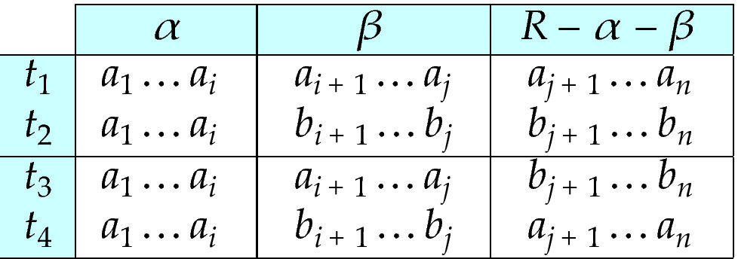
CMSC 508 – Databases
Relational database design
Multivalued Dependency (MVD)
Let R be a relational schema and α ⊆ R and β ⊆ R
The multivalued dependency α →→ β holds on R if for all pairs for tuples t₁ and t₂ in R such that t₁[α] = t₂ [α], there exist tuples t₃ and t₄ in R such that:
t₁[α] = t₂ [α] = t₃ [α] = t₄ [α] t₃[β] = t₁ [β]
t₄ [β] = t₂[β] t₃[R – β] = t₂[R – β] t₄[R – β] = t₁[R – β]

Slide 8

CMSC 508 – Databases
Relational database design
Multivalued Dependencies (MVD)
If a relation R fails to satisfy a set of multivalued dependencies, we can decompose R into relations R₁, … , R_{n} that satisfy the multivalued dependency without redundancy
From the definition of multivalued dependency, we can derive:
If α → β then α →→ β (where the cardinality is 1) i.e. a functional dependency is single-valued multivalued dependency
F⁺ is the set of all functional and multivalued dependencies logically implied by F
We can compute F⁺ from F, using the formal definitions of functional dependencies and multivalued dependencies through the Armstrong's axioms*
Multivalued dependencies are NOT used to compute the closure of an attribute. Therefore, don’t use them to calculate keys

Slide 9
CMSC 508 – Databases
Relational database design
Multivalued Dependencies (MVD)
Motivation:
SSN →→ email
SSN →→ phone
Relation R is in BCNF, key is {SSN, email, phone} and there are no regular FDs
However, this doesn’t look a good design: there is redundancy due to MVDs
SSN | email | phone
567-89-0123 | hsimpson@vcu.edu | 804-827-0001
567-89-0123 | hsimpson@vcu.edu | 512-555-4321
567-89-0123 | mrx@yahoo.com | 804-827-0001
567-89-0123 | mrx@yahoo.com | 512-555-4321

Slide 10
CMSC 508 – Databases
Relational database design
Fourth normal form (4NF)
A relation schema R is in 4NF if it is in BNCF with respect to the functional dependencies and if for all multivalued dependencies in F⁺ in the form α →→ β at least one of the following hold:
α →→ β is trivial or
α is a superkey for schema R or
α and β together form the whole set of attributes of the relation
A relation is in 4NF if it is in BCNF, if for each of it’s non-trivial multivalued dependencies, the left-hand side is a superkey
[CRITICAL] The right side of a MVD cannot be split nor combined, e.g.
Location →→ Street, City, State, ZIP

Slide 11
CMSC 508 – Databases
Relational database design
Fourth normal form (4NF) decomposition algorithm
result = {R}; compute F⁺; Let F_{i} denote the restriction of F⁺ to R_{i}
while (there is a schema R_{i} in result that is not in 4NF) then begin
let α →→ β be a nontrivial multivalued dependency that holds on R_{i}
such that α → R_{i} is not in F_{i} and α ∩ β = φ; result = (result - R_{i}) ∪ (R_{i} - β) ∪ (α, β); end
The restriction of F to R_{i} is the set F_{i} consisting of
All functional dependencies in F⁺ that include only attributes of R_{i}
All multivalued dependencies in the form
α →→ (β ∩ R_{i}) where α ⊆ R_{i} and α →→ β is in F⁺

Slide 12
CMSC 508 – Databases
Relational database design
Fourth normal form (4NF) decomposition algorithm example
book (isbn, title, author, publisher)
isbn → title, publisher
isbn →→ author
book (isbn, title, publisher) isbn → title, publisher
book_author (isbn, author)
isbn →→ author
isbn | title | author | publisher
111 | T1 | A1 | Springer
111 | T1 | A2 | Springer
222 | T2 | A3 | Elsevier
isbn | title | publisher
111 | T1 | Springer
222 | T2 | Elsevier
isbn | author
111 | A1
111 | A2
222 | A3

Slide 13
CMSC 508 – Databases
Relational database design
Fourth normal form (4NF) decomposition algorithm example
R = (A, B, C, G, H, I)
F = { A →→ B
B →→ HI
CG →→ H }
Candidate key for R?
Is R in 4N?

Slide 14
CMSC 508 – Databases
Relational database design
Fourth normal form (4NF) decomposition algorithm example
R = (A, B, C, G, H, I)
F = { A →→ B
B →→ HI
CG →→ H }
Candidate key for R = {A,B,C,G,H,I}
R is not in 4NF since A →→ B and A is not a superkey for R nor {A,B} is R
R is not in 4NF since B →→ HI and B is not a superkey for R nor {B,H,I} is R
R is not in 4NF since CG →→ H and CG is not a superkey for R nor {C,G,H} is R

Slide 15
CMSC 508 – Databases
Relational database design
Fourth normal form (4NF) decomposition algorithm example
R = (A, B, C, G, H, I)
F = { A →→ B
B →→ HI
CG →→ H }
Decomposition of R = (A, B, C, G, H, I) via MVD1 A →→ B
R₁ = (A, B)
F₁ = { A →→ B }
CK = {A, B}
R₁ is in 4NF because A→→ B holds and {A,B} is R₁
R₂ = (A, C, G, H, I)
F₂ = { CG →→ H, A →→ HI }
CK = {A, C, G, H, I)
R₂ is not in 4NF since CG →→ H holds and {C,G,H} is not a superkey for R₂ nor {C,G,H} is R₂
R₂ is not in 4NF since A →→ HI holds and {A,H,I} is not a superkey for R₂ nor {A,H,I} is R₂

Slide 16
CMSC 508 – Databases
Relational database design
Fourth normal form (4NF) decomposition algorithm example
R = (A, B, C, G, H, I)
F = { A →→ B
B →→ HI
CG →→ H }
Decomposition of R₂ = (A, C, G, H, I) via MVD3 CG →→ H
R₃ = (C, G, H)
F₃ = { CG →→ H }
CK = {C, G, H}
R₃ is in 4NF because CG →→ H holds and {C,G,H} is R₃
R₄ = (A, C, G, I)
F₄ = {} A →→ I does not hold (we cannot split rhs of a MVD)
CK = {A, C, G, I}
R₄ is in 4NF because there are no FDs nor MVDs
4NF solution
R₁ = (A, B) F₁ = { A →→ B }
R₃ = (C, G, H) F₃ = { CG →→ H }
R₄ = (A, C, G, I) F₄ = {}

Slide 17
CMSC 508 – Databases
Relational database design
Fourth normal form (4NF) decomposition algorithm example
R = (A, B, C, G, H, I)
F = { A →→ B
B →→ HI
CG →→ H }
Alternative decomposition of R₂ = (A, C, G, H, I) via transitivity A →→ HI
R₃ = (A, H, I)
F₃ = { A →→ HI }
CK = {A, H, I}
R₃ is in 4NF because AH →→ I holds and {A,H, I} is R₃
R₄ = (A, C, G)
F₄ = {}
CK = {A, C, G}
R₄ is in 4NF because there are no FDs nor MVDs
4NF alternative solution
R₁ = (A, B) F₁ = { A →→ B }
R₃ = (A, H, I) F₃ = { A →→ HI }
R₄ = (A, C, G) F₄ = {}

Slide 18
Join dependencieS
CMSC 508 – Database Theory

Slide 19
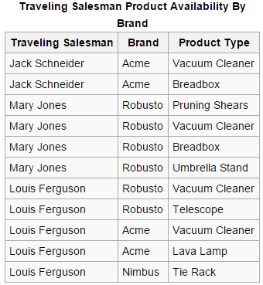
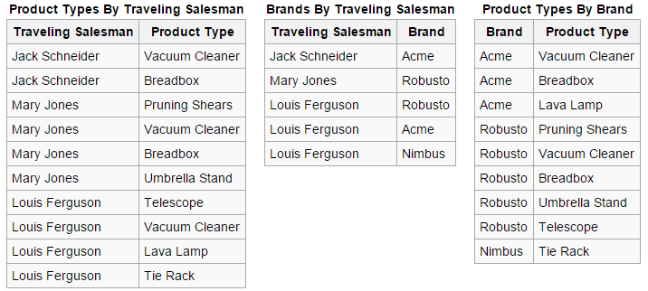
CMSC 508 – Databases
Relational database design
Fifth normal form (5NF) a.k.a. project-join normal form (PJNF)
Reduces redundancy in relational databases recording multi-valued facts by isolating semantically related multiple relationships
A table is said to be in the 5NF if and only if every non-trivial join dependency is implied by the candidate keys
A table is in 5NF if it cannot be decomposed into any smaller tables with different keys that when joined produce the original relation

Slide 20
Additional design thoughts
CMSC 508 – Database Theory

Slide 21
CMSC 508 – Databases
Relational database design
Entity-Relationship Diagram and Normalization
When an ER diagram is carefully designed, identifying all entities correctly, the tables generated from the ER diagram should not need further normalization if correctly translated
However, in a real (imperfect) design, there can be functional dependencies from non-key attributes of an entity to other attributes of the entity
Functional dependencies from non-key attributes of a relationship are possible but rare, most relationships are binary
Don’t be skimpy with tables, trying to “double up” attributes to share info
Use single-value IDs for keys, don’t get tricky using human readable attributes

Slide 22
CMSC 508 – Databases
Relational database design
Normalization vs performance
We may want to use non-normalized schema for better performance
Example: course(ID, title) and prerequisite(course_ID, prerequisite_course_ID)
Showing the title of every prerequisite course requires to a join of the tables
Alternative: use denormalized table containing attributes of course as well as prerequisite with all above attributes
faster lookup for frequently queried attributes
extra space and extra execution time for updates
extra coding work for programmer and possibility of error
better if duplicated attributes are not likely to be modified
best design decision depends on the usage of the database: balance

Slide 23
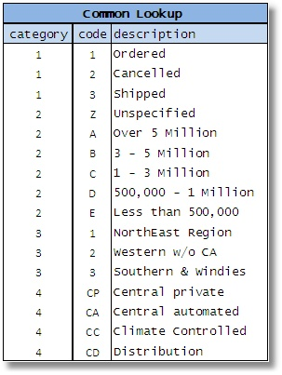
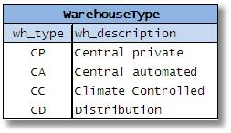
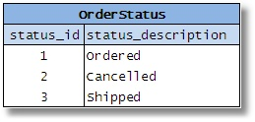
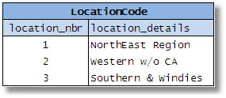
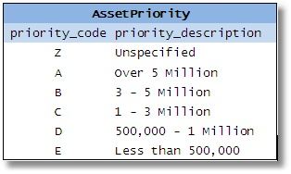
CMSC 508 – Databases
Relational database design
Database design errors to avoid
Crosstab: values for one attribute become column names or tables
earnings (company_id, year, amount)
company_year (company_id, earnings_2004, earnings_2005)
earnings_2004(company_id,amount) and earnings_2005(company_id,amount)
Common lookup tables

Slide 24
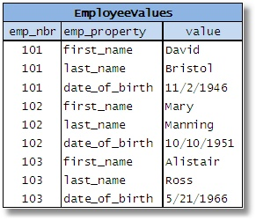
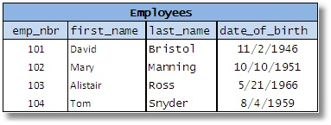
CMSC 508 – Databases
Relational database design
Database design errors to avoid
Entity-Attribute-Value Table
Enforcing integrity via applications
DB designer must enforce the consistency and integrity of the information. Don’t rely and trust other users nor developers. They’ll screw up, sooner than later

Slide 25
CMSC 508 – Databases
Relational database design
Relational design
Data (ssn, name, birthdate, childssn, childname, childbirthdate, carsn, carmodel)
F = { ssn → name, birthdate
childssn → childname, childbirthdate
carsn → carmodel
ssn, name, birthdate →→ childssn, childname, childbirthdate
ssn, name, birthdate →→ carsn, carmodel }
Identify and remove extraneous attributes. Yes, there can be redundant attributes in MVDs.

Slide 26
CMSC 508 – Databases
Relational database design
Relational design
Data (ssn, name, birthdate, childssn, childname, childbirthdate, carsn, carmodel)
F = { ssn → name, birthdate
childssn → childname, childbirthdate
carsn → carmodel
ssn, name, birthdate →→ childssn, childname, childbirthdate
ssn, name, birthdate →→ carsn, carmodel }
Fc = { ssn → name, birthdate
childssn → childname, childbirthdate
carsn → carmodel
ssn →→ childssn
ssn →→ carsn }
Do ssn/childssn need to be separate? Is a simpler design possible?

Slide 27
CMSC 508 – Databases
Relational database design
Relational design
Data (ssn, name, birthdate, childssn, childname, childbirthdate, carsn, carmodel)
F = { ssn → name, birthdate
carsn → carmodel
ssn →→ ssn
ssn →→ carsn }
Person (ssn: [PK], name, birthdate)
Car-model (carsn: [PK], carmodel)
Car-owner (ssn, carsn) PK {ssn, carsn} ssn references Person.ssn carsn references Car-model.carsn
Relative (ssnParent, ssnChild)
PK {ssnParent, ssnChild}
ssnParent references Person.ssn
ssnChild references Person.ssn

Slide 28
CMSC 508 – Databases
Relational database design
4NF decomposition
Preferences (name, address, movies, games, customercategory)
F = { name → address
name → → movies
name → → games
movies, games → customercategory }
Apply 4NF algorithm
1.1 First apply BCNF to meet BCNF and FDs requisites
1.2 Second apply 4NF to meet 4NF and MVDs requisites

