Slide 1
Week 8 – Class 14 - Wednesday Quiz 3 Study Guide
CMSC 508 Database Theory
Database System Concepts, 6th Ed. by Silberschatz, Korth, Sudarshan, 2011, Chapter 7
Database Management Systems, 3rd Ed. by Ramakrishnan, Gehrke, 2003, Chapter 19
1

Slide 2
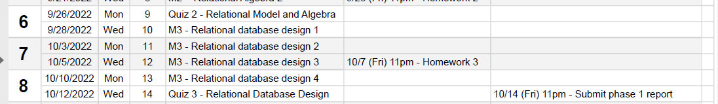
Housekeeping
Quiz 3 – TODAY!
Phase I Project – This Friday - 10/14, 11pm

Slide 3


CMSC 508 – Databases
Quiz 3 Study Guide
Database design and implementation
Problem
definition
Data modeling
Relational model
Relational algebra
Functional Dependencies
Implementation
Usage
Information requisites and functional analysis
ER diagram
Tables
Tables
Normalized tables
SQL
Interfaces
Resolve

Slide 4
Quiz 3 review

Slide 5
Quiz 3 Review
Attribute closures – given a relation R and a set of functional dependencies, FD, apply Armstrong’s Axioms to determine attribute closures and candidate keys for any functional dependency.
Terms and definitions - Identify minimal candidate keys, prime and non-prime attributes
Decomposition - given a minimal canonical cover, apply decomposition to a larger table to determine the BCNF schema.
Armstrong’s Axioms – associate names with equations
Normal forms – definitions of each, relationships between each

Slide 6
Decompositions

Slide 7
Let’s get normal – First Normal Form (1NF)
FROM: google survey form
Course | Instructor | Languages
CMSC508 - Databases | John Leonard | Perl, SQL
CMSC508 - Databases | Alberto Cano | C++, SQL
CMSC255 - Intro to Coding | John Riley | Python, SQL
A relation is in 1NF if and only if the domain of each attribute contains only atomic (indivisible) values and the value of each attribute contains only a single value from that domain.
No multi-valued attributes. No arrays/lists in a cell. NOT REQUIRED BUT YOU SHOULD: break composite values
Now what? A) Can you identify redundancies? B) What is the relational schema? B) What is primary/candidate key? Why? C) What are functional dependencies? D) How would you remove redundancies? E) How would you decompose this table into smaller tables that reduce redundancy yet maintain relationships between columns?
TO: First Normal Form - 1NF
CourseID | Course Name | First Name | Last Name | Languages
CMSC508 | Databases | John | Leonard | Python
CMSC508 | Databases | John | Leonard | Perl
CMSC508 | Databases | John | Leonard | SQL
CMSC508 | Databases | Alberto | Cano | C++
CMSC508 | Databases | Alberto | Cano | C
CMSC508 | Databases | Alberto | Cano | Python
CMSC508 | Databases | Alberto | Cano | SQL
CMSC255 | Intro to Coding | John | Riley | Python
CMSC255 | Intro to Coding | John | Riley | C++
CMSC255 | Intro to Coding | John | Riley | SQL

Slide 8
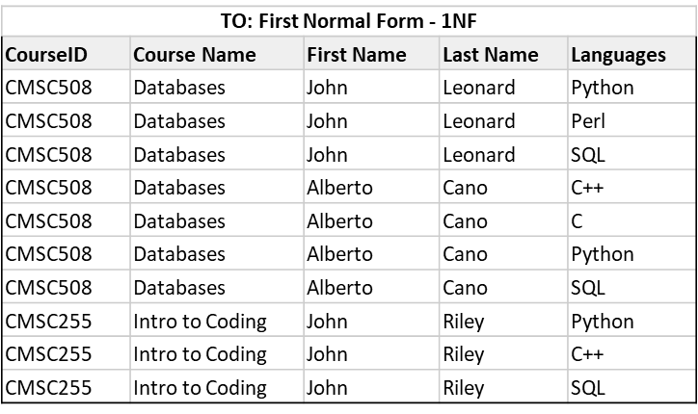
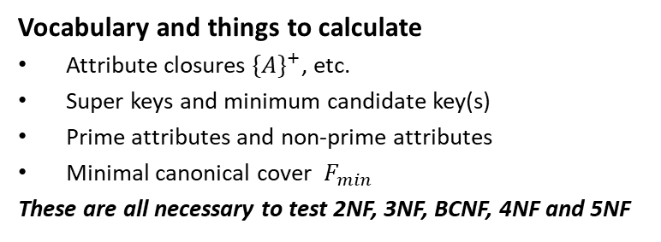
Relational schema and functional dependencies
Notation option 1: Teach(CID, Course, First, Last, Lang) CK(CID, First, Last, Lang) FD(CID->Course; First, Last, Lang-> )
Notation option 2:
R(A,B,C,D,E) CK(A,C,D,E)
FD(A->B; C,D,E->)
Vocabulary and things to calculate
Attribute closures ${\{A\}}^{+}$, etc.
Super keys and minimum candidate key(s)
Prime attributes and non-prime attributes
Minimal canonical cover $F_{min}$
These are all necessary to test 2NF, 3NF, BCNF, 4NF and 5NF

Slide 9
Recreate R with separate IDs
Notation option 1: Teach(CID, Course, InstrID,First, Last, LangID, Lang) CK(CID, InstrID, LangID) FD(CID->Course; InstrID->First, Last; LangID->Lang)
Original google form input
Course | Instructor | Languages
CMSC508 - Databases | John Leonard | Perl, SQL
CMSC508 - Databases | Alberto Cano | C++, SQL
CMSC255 - Intro to Coding | John Riley | Python, SQL
Notation option 2:
R(A,B,C,D,E,F,G) CK(A,C,F)
FD(A->B; C->D,E; F->G)
Conversion to 1NF
CourseID | Course Name | InstrID | First Name | Last Name | LangID | Lang
CMSC508 | Databases | V001 | John | Leonard | 1 | Python
CMSC508 | Databases | V001 | John | Leonard | 2 | Perl
CMSC508 | Databases | V001 | John | Leonard | 3 | SQL
CMSC508 | Databases | V099 | Alberto | Cano | 4 | C++
CMSC508 | Databases | V099 | Alberto | Cano | 5 | C
CMSC508 | Databases | V099 | Alberto | Cano | 1 | Python
CMSC508 | Databases | V099 | Alberto | Cano | 3 | SQL
CMSC255 | Intro to Coding | V031 | John | Riley | 1 | Python
CMSC255 | Intro to Coding | V031 | John | Riley | 4 | C++
CMSC255 | Intro to Coding | V031 | John | Riley | 3 | SQL
Positive features
Keeps “human readable data” out of keys
Removes multi-value keys from LHS of FD
Prime attributes and non-prime attributes

Slide 10
Decomposed into BCNF
Simple decomposition
Started with 1 table
Finished with 4 tables, each table in BCNF
No duplicate values hiding in keys.
Natural join will recreate original data table.
For fun – write a query that finds all instructors who like Perl!
R1(A,B)
CourseID | Course Name
CMSC508 | Databases
CMSC255 | Intro to Coding
R4(A,C,F)
CourseID | InstrID | LangID
CMSC508 | V001 | 1
CMSC508 | V001 | 2
CMSC508 | V001 | 3
CMSC508 | V099 | 4
CMSC508 | V099 | 5
CMSC508 | V099 | 1
CMSC508 | V099 | 3
CMSC255 | V031 | 1
CMSC255 | V031 | 4
CMSC255 | V031 | 3
R2(C,D,E)
InstrID | First Name | Last Name
V001 | John | Leonard
V099 | Alberto | Cano
V031 | John | Riley
R3(F,G)
LangID | Lang
1 | Python
2 | Perl
3 | SQL
4 | C++
5 | C

Slide 11
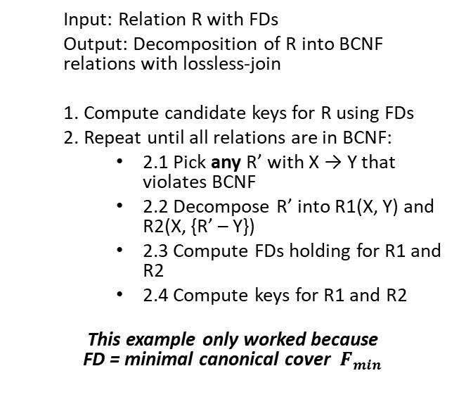
Revisit decomposition by algorithm
BCNF decomp algorithm
BCNF on-line tool
Input: Relation R with FDs
Output: Decomposition of R into BCNF relations with lossless-join
1. Compute candidate keys for R using FDs
2. Repeat until all relations are in BCNF:
2.1 Pick any R’ with X → Y that violates BCNF
2.2 Decompose R’ into R1(X, Y) and R2(X, {R’ – Y})
2.3 Compute FDs holding for R1 and R2
2.4 Compute keys for R1 and R2
This example only worked because FD = minimal canonical cover $F_{min}$
Visit http://raymondcho.net/RelationalDatabaseTools/RelationalDatabaseTools.html
Enter Relation R and FD.
Interpret the report

Slide 12
Additional Decomposition examples

Slide 13
CMSC 508 – Databases
Quiz 3 Study Guide
BCNF decomposition - example 1
R(A,B,C,D,E) with FDs {A → B, C → D}, and CK {A,C,E}
R(A,B,C,D,E) is not in BCNF, why?
CK for R is {A,C,E} and the antecedent for both FDs are subsets of the CK, which is a violation of 2NF and therefore cannot satisfy BCNF
1. Pick FD: A → B which violates BCNF
R1(A,B) with A → B CK is {A}, all good! R2(A,C,D,E) with C → D CK is {A,C,E}, violation!
2. Pick FD: C → D which violates BCNF
R1(A,B) with A → B CK is {A}, all good!
R3(C,D) with C → D CK is {C}, all good! R4(A,C,E) with no FDs CK is {A,C,E}, all good!
Apply algorithm!
Pick any FD in the form X → Y that violates BCNF
Decompose R’ into R1(X, Y) and R2(X, {R’-Y})
Repeat until no more BCNF violations

Slide 14
CMSC 508 – Databases
Quiz 3 Study Guide
BCNF decomposition – example 2
Student (SSN, name, address, HScode, HSname, HScity, GPA, priority)
FD1: SSN → name, address, GPA
FD2: GPA → priority
FD3: HScode → HSname, HScity
Decompose Student via FD3:
R1(HScode, HSname, HScity)
Compute keys for R1 considering only FD3 applies, CK {HScode}. No other FDs hold
FD3 does not violate BCNF in R1 because antecedent is a superkey
R2(SSN, name, address, HScode, GPA, priority)
Compute keys for R2 considering FD1 and FD2 apply, CK {SSN,HScode}
FD1 violates BCNF in R2, antecedent is not a superkey
FD2 violates BCNF in R2, antecedent is not a superkey

Slide 15
CMSC 508 – Databases
Quiz 3 Study Guide
BCNF decomposition – example 2
Student (SSN, name, address, HScode, HSname, HScity, GPA, priority)
FD1: SSN → name, address, GPA
FD2: GPA → priority
FD3: HScode → HSname, HScity
R1(HScode, HSname, HScity) satisfies BNCF, then we may label PK for R1 and we’re done
Decompose R2 via FD2, repeat the process:
R2(SSN, name, address, HScode, GPA, priority)
R3(GPA, priority) FD2 applies, CK {GPA}, no violation of BCNF. No other FDs hold
R4(SSN, name, address, HScode, GPA), FD1 applies
CK for R4 is {SSN,HScode}, FD1 violates BCNF in R4

Slide 16
CMSC 508 – Databases
Quiz 3 Study Guide
BCNF decomposition - example 2
Student (SSN, name, address, HScode, HSname, HScity, GPA, priority)
FD1: SSN → name, address, GPA
FD2: GPA → priority
FD3: HScode → HSname, HScity
R1(HScode, HSname, HScity)
R3(GPA, priority)
Decompose R4 via FD1:
R4(SSN, name, address, HScode, GPA)
R5(SSN, name, address, GPA)
FD1 applies, CK {SSN}, no violation BCNF. No other FDs hold
R6(SSN, HScode) no FDs apply, no violation BCNF

Slide 17
CMSC 508 – Databases
Quiz 3 Study Guide
BCNF decomposition - example 2
Student (SSN, name, address, HScode, HSname, HScity, GPA, priority)
FD1: SSN → name, address, GPA
FD2: GPA → priority
FD3: HScode → HSname, HScity
R1(HScode, HSname, HScity)
R3(GPA, priority)
R5(SSN, name, address, GPA)
R6(SSN, HScode)
*Key in R6 is {SSN, HScode} because there are no FDs holding, this technically allows a given student to be enrolled in multiple HSs, because there’s no FD SSN → HScode defined in the functional dependencies

Slide 18
CMSC 508 – Databases
Quiz 3 Study Guide
BCNF decomposition – example 2
Student (SSN, name, address, HScode, HSname, HScity, GPA, priority)
FD1: SSN → name, address, GPA, HScode
FD2: GPA → priority
FD3: HScode → HSname, HScity
{SSN}⁺ determines all the attributes
R1(HScode, HSname, HScity)
R2(GPA, priority)
R3(SSN, HScode, name, address, GPA)
Attribute closure calculator, Candidate key calculator, Minimum (Canonical) cover calculator, Functional dependency calculator and Normal form calculator
http://raymondcho.net/RelationalDatabaseTools/RelationalDatabaseTools.html

Slide 19
Attribute Closures

Slide 20
Definition of Closure
Given a set F of functional dependencies, there are certain other functional dependencies that are logically implied by F.
For example: If A → B and B → C, then we can infer that A → C
The set of all functional dependencies logically implied by F is the closure of F.
We denote the closure of F by F⁺.
F⁺ is a superset of F.
Notes:
*Slide
Determining the closure of F is helpful in the decomposition process. The procedure for computing all functional dependencies used the rules of Armstrong's Axioms shown in the next slide.

Slide 21
Armstrong’s Axioms
Reflexivity if B ⸧ A then A → B
Augmentation if A → B then AC → BC
Splitting rule (Decomposition) if A → B and A → C then A → BC
Combining rule (Union) if A → B and A → C then A → BC
Transitivity if A → B and B → C, then A → C

Slide 22
Getting to Closure
CMSC 508 – Database Theory
Quiz 3 Study Guide
R (A, B, C, D, E, F)
F = { A → B,
A → C,
CD → E,
CD → F,
B → E }
F⁺ (some members of the closure set of FDs can be determined)
A → BC by combining A → B with A → C
A → E by transitivity from A → B and B → E
AD → F by augmenting A → C with D, to get AD → CD and then transitivity with CD → F
CD → EF by combining CD → F with CD → E
F⁺ = { A → B, A → C, A → BC, CD → E, CD → F, B → E,
A → E, AD → F, CD → EF, (plus others)}
Notes:
(Here we have a relation R with attributes A, B, C, D, E, F. Suppose that from the real-world domain the set of functional dependencies, F, is determined to be those shown here.
We can use Armstrong Axioms to determine the set of attributes that are functionally determined by some FD in this set, F.
Our goal is the minimal set of completely nontrivial FDs such that all FDs that hold on the relation follow from the dependencies in the set. We can then use this set, F+, to testing if an attribute set is a superkey of R.
However, because F+ can get very large we can look at another way to use Armstrong’s Axioms to find superkeys using the closure of attribute sets.

Slide 23
Getting to Closure
CMSC 508 – Database Theory
Quiz 3 Study Guide
Attribute closure: the set of attributes, A, such that X ➝ A can be inferred using Armstrong Axioms
R (A, B, C, D, E)
A ➝ B
CD ➝ E
E ➝ A
B ➝ E
What are the minimum set of keys that will generate all the attributes of R?
The first step is to find the attribute closure for each functional dependency
Find the minimum set of left-hand attributes that will generate all the attributes of R
Notes:
The idea here is that we have the FDs for a relation and now we want to determine what are the superkeys based on the FDs for the relation.
The closure for an attribute is the set of attributes that can be determined by a given attribute set based on the FDs.
The first step is to find the attribute closure for each FD.
FD CLOSURE CANDIDATE KEY
A ➝ B : ABE ACD // Add CD to the left side of the FD
CD ➝ E : CDEAB Already a candidate key as CD
E ➝ A : EAB CDE
B ➝ E : BEA BCD
Find the minimum set of left-hand attributes that will generate all the attributes of R.
CD

Slide 24
Getting to Closure – A roadmap!
CMSC 508 – Database Theory
Quiz 3 Study Guide
The closure of {A₁, A₂, … A_{n}} under the FD’s in S is the set of attributes B such that every relation that satisfies all the FD’s in set S also satisfies A₁, A₂, … A_{n} ➝ B
This is denoted by {A₁, A₂, … A_{n}}⁺
Algorithm:
Split the FD’s of S, so that each FD in S has a single attribute on the right.
Let X be the set of attributes that will become the closure. Initialize X to {A₁, A₂, … A_{n}}
Repeatedly search for some FD, such that the right side is not in X and add the right side to X, until no more attributes can be added.
X now represents the closure of attributes, {A₁, A₂, … A_{n}} ⁺
Notes:
The closure of attributes is the set of attributes of the relation that can be functionally determined based on Armstrong’s Axioms.
These rules are used to determine the closure.
Trivial FD – the right side is a subset of the left side.

Slide 25
Additional Closure Examples

Slide 26
Example 1
R (A, B, C, D, E, F)
F = { AB → C,
BC → AD,
D → E,
CF → B }
What is the closure of {AB}?
Notes:
Step-by-step instructions on the following slides

Slide 27
Example 1
R (A, B, C, D, E, F)
F = { AB → C, BC → AD, D → E, CF → B }
What is the closure of {AB}?
Split BC → AD to BC → A and BC → D

Slide 28
Example 1
R (A, B, C, D, E, F)
F = { AB → C, BC → AD, D → E, CF → B }
What is the closure of {AB}?
Split BC → AD to BC → A and BC → D
The set of attributes, X, is initially {A, B}
AB → C, so C gets added to X

Slide 29
Example 1
R (A, B, C, D, E, F)
F = { AB → C, BC → AD, D → E, CF → B }
What is the closure of {AB}?
Split BC → AD to BC → A and BC → D
X is now {A, B, C}
BC → D, so D gets added to X

Slide 30
Example 1
R (A, B, C, D, E, F)
F = { AB → C, BC → AD, D → E, CF → B }
What is the closure of {AB}?
Split BC → AD to BC → A and BC → D
X is now {A, B, C, D}
D → E, so E gets added to X

Slide 31
Example 1
R (A, B, C, D, E, F)
F = { AB → C, BC → AD, D → E, CF → B }
What is the closure of {AB}?
Split BC → AD to BC → A and BC → D
X is now {A, B, C, D, E}
Nothing else can be added, so
{AB}⁺ is {A, B, C, D, E}
Notes:
Can AB be used as a key to the relation r? No because it doesn’t include all the attributes of R.

Slide 32
Example 2
Student (SSN, name, address, HScode, HSname, HScity, GPA, priority)
SSN → name, address, GPA
GPA → priority
HScode → HSname, HScity
SSN⁺ = ?
HScode⁺ = ?
Why do we care?
If {SSN, HScode}⁺ determine all the attributes, then they can be keys
Notes:
Functional dependencies help to decompose schemas and minimize redundancy

Slide 33
Example 2
Student (SSN, name, address, HScode, HSname, HScity, GPA, priority)
SSN → name, address, GPA
GPA → priority
HScode → HSname, HScity
SSN⁺ = {SSN, name, address, GPA, priority}
HScode⁺ = {HScode, HSname, HScity}
Notes:
Can either one be a key on its own? No
But SSN and Hscode can be a key.

Slide 34
Canonical cover

Slide 35
Canonical cover – Extraneous Attributes
Sets of functional dependencies may have redundant dependencies that can be inferred from the others
For example: A → C is redundant in: {A → B, B → C, A → C}
Parts of a functional dependency may be redundant
{A → B, B → C, A → CD} can be simplified to {A → B, B → C, A → D}
{A → B, B → C, AC → D} can be simplified to {A → B, B → C, A → D}
Intuitively, a canonical cover of F is a “minimal” set of functional dependencies equivalent to F, having no redundant dependencies or redundant parts of dependencies
Notes:
The canonical cover is a simplified set of functional dependencies that are derived from the given set. Having a simplified set allows for easier verification that changes to the database don't violate any of the FD integrity constraints.
Extraneous attributes are those attributes that can be removed from an FD without changing the closure of the set of FDs.

Slide 36
Canonical cover – Extraneous Attributes
Consider a set F of functional dependencies and 𝛂 ➝ 𝛽 in F
To test if attribute A ∈ 𝛂 is extraneous in 𝛂
compute ({𝛂} – A)⁺ using the dependencies in F
check that ({𝛂} – A)⁺ contains 𝛽; if it does, A is extraneous in 𝛂
To test if attribute B ∈ 𝛽 is extraneous in 𝛽
compute 𝛂⁺ using only the dependencies in
F' = (F – {𝛂 ➝ 𝛽 }) ∪{𝛂 ➝ (𝛽 – B)},
check that 𝛂⁺ contains B; if it does, B is extraneous in 𝛽
10
Notes:
Redundant attributes in the functional dependencies

Slide 37
Canonical cover – a roadmap!
CMSC 508 – Database Theory
Quiz 3 Study Guide
A canonical cover for F is a set of dependencies F_{c} such that
F logically implies all dependencies in F_{c}
F_{c} logically implies all dependencies in F
No FD in F_{c} contains an extraneous attribute
Each left side of functional dependency in F_{c} is unique
repeat
Use the union rule to replace any dependencies in F
𝛂₁ ➝ 𝛽₁ and 𝛂₁ ➝ 𝛽₂ with 𝛂₁ ➝ 𝛽₁ 𝛽₂
Find a FD 𝛂 ➝ 𝛽 with an extraneous attribute either in 𝛂 or in 𝛽
If an extraneous attribute is found, delete it from 𝛂₁ ➝ 𝛽₁
until F does not change
/* Note: test for extraneous attributes done using F_{c,} not F*/
Notes:
The union rule states that if X-> Y and X -> Z, then X -> YZ

Slide 38
CMSC 508 – Database Theory
Quiz 3 Study Guide
Canonical Cover – an example
R = (A, B, C), F = {A ➝ BC, B ➝ C, A ➝ B, AB ➝ C}
Combine A ➝ BC and A ➝ B into A ➝ BC
F’ = {A ➝ BC, B ➝ C, AB ➝ C}
Is A extraneous in AB ➝ C ?
Check if the result of deleting A from AB ➝ C is implied by the other dependencies. Yes: in fact, B ➝ C is already present, so remove it
F’ = {A ➝ BC, B ➝ C}
Is C extraneous in A ➝ BC ?
Check if A ➝ C is logically implied by A ➝ B and the other dependencies. Yes: using transitivity on A ➝ B and B ➝ C
The canonical cover F_{c} is: {A ➝ B, B ➝ C}

Slide 39
Normal forms

Slide 40
CMSC 508 – Databases
Quiz 3 Study Guide
Relational database design process
Identify entities, attributes, and relationships
Draw entities and relationships in the ERD
Define the cardinality and participation of the relationships
Refine and simplify the model
Translate the model to relational schemas, identify PKs, FKs, unique, not null
Common errors in ERD / RD
Missing cardinalities, participation, roles (FOLLOW NOTATION!)
Excessive use of decomposition (attributes/values -> entities), specialization, ternary relationships, weak entities
Diagram specification, not a picture! (straight lines, legibility)
Columns with list of values
Columns missing on tables!

Slide 41
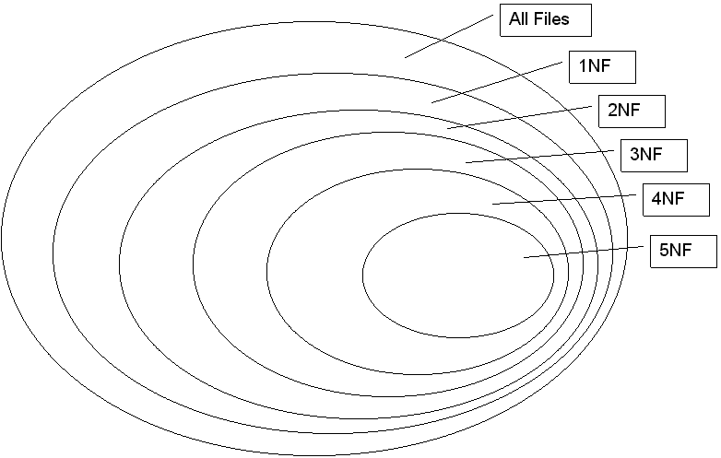
Database Normalization
CMSC 508 – Databases
Quiz 3 Study Guide
Database normalization is the process of reorganizing the relations to minimize data redundancy
Normalization involves breaking down a table into less redundant and smaller tables without losing information by using functional dependencies
The objective is to isolate data to minimize duplicates and so modifications of an attribute can be made in just one table and then propagated through the rest of the database using the defined foreign keys
BCNF

Slide 42
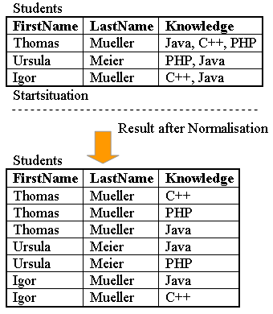
CMSC 508 – Databases
Quiz 3 Study Guide
First normal form (1NF)
A relation is in 1NF if and only if the domain of each attribute contains only atomic (indivisible) values and the value of each attribute contains only a single value from that domain
No multi-valued attributes. No arrays/lists in a cell.
Decomposition of a multi-valued attribute into atomic.
Phone numbers, email addresses, etc
Not 1NF but also recommended: Decomposition of a composite attribute into atomic.
Name → FirstName, MiddleName, LastName
Address → Street + number + city + state + zip

Slide 43
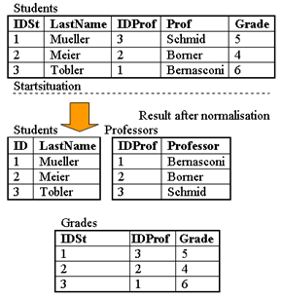
CMSC 508 – Databases
Quiz 3 Study Guide
Second normal form (2NF)
Prime Attribute – a part of a candidate key. Non-prime attribute / non-key attribute: an attribute that is not a part of any candidate key of the relation
A relation is in 2NF if it is in 1NF and every non-prime attribute of the relation is dependent on the whole of every candidate key
Having a non-prime attribute functionally dependent on a subset of any candidate key is a violation of 2NF
Example: F = {IDSt → LastName; IDProf → Prof; IDSt, IDProf → Grade }
CK = {IDSt, IDProf}
Students is NOT in 2NF because non-prime attributes (LastName, Prof) are functionally dependent on a subset of a candidate key. (IDST->LastName; IDProf->Prof)

Slide 44

CMSC 508 – Databases
Quiz 3 Study Guide
Third normal form (3NF)
A relation is in 3NF if it is in 2NF and every non-prime attribute is non-transitively dependent on every key
No non-prime attributes can depend on other non-prime attributes
All the non-prime attributes must depend only on the candidate keys
A relation R with FDs F is in 3NF if, for all X → Y in F⁺
Y $⊆$ X (trivial FD) or
X is a superkey for R or
Each attribute in {Y – X} is a prime attribute
3NF is violated when a non-key attribute depends on another non-key attribute
(Note – that we’re already in 3NF!)

Slide 45
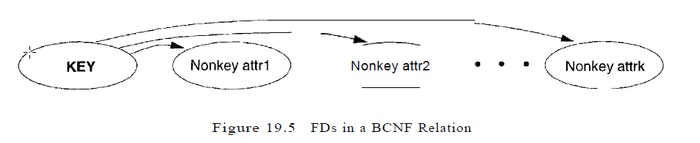
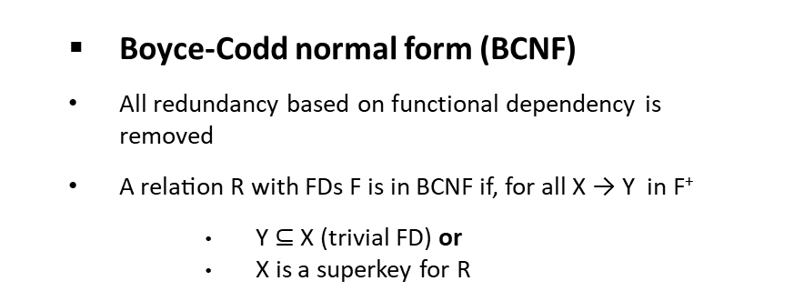
CMSC 508 – Databases
Quiz 3 Study Guide
Boyce-Codd normal form (BCNF)
All redundancy based on functional dependency is removed
A relation R with FDs F is in BCNF if, for all X → Y in F⁺
Y $⊆$ X (trivial FD) or
X is a superkey for R
(Note – that we’re already in BCNF, too!)
“The key, the whole key, and nothing but the key, so help me Codd”

Slide 46
CMSC 508 – Databases
Quiz 3 Study Guide
Fourth normal form (4NF)
A relation schema R is in 4NF if it is in BNCF with respect to the functional dependencies and if for all multivalued dependencies in F⁺ in the form α →→ β at least one of the following hold:
α →→ β is trivial or
α is a superkey for schema R or
α and β together form the whole set of attributes of the relation
A relation is in 4NF if it is in BCNF, if for each of it’s non-trivial multivalued dependencies, the left-hand side is a superkey
[CRITICAL] The right side of a MVD cannot be split nor combined, e.g.
Location →→ Street, City, State, ZIP

Slide 47
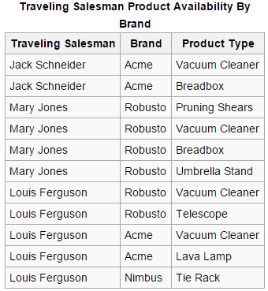
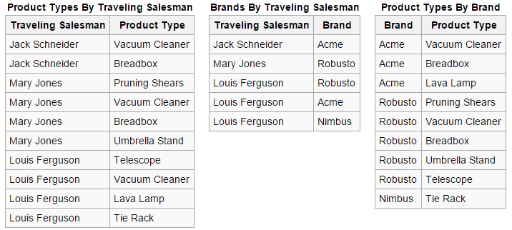
CMSC 508 – Databases
Quiz 3 Study Guide
Fifth normal form (5NF) a.k.a. project-join normal form (PJNF)
Reduces redundancy in relational databases recording multi-valued facts by isolating semantically related multiple relationships
A table is said to be in the 5NF if and only if every non-trivial join dependency is implied by the candidate keys
A table is in 5NF if it cannot be decomposed into any smaller tables with different keys that when joined produce the original relation

