Slide 1
Week 10 – Monday
CMSC 508 Database Theory
CMSC 508 – SQL Funhouse
Chapters 2,6 from Database System Concepts, 6th Ed. by Silberschatz, Korth, Sudarshan, 2011 Chapters 3,4 from Database Management Systems, 3rd Ed. by Ramakrishnan, Gehrke, 2003
Notes:
The ER model is a way of modeling the needs of the database that is close to the user/enterprise. It’s a first step at understanding the user requirements and is easy for the end users to understand so it facilitates communication.
Importance of getting the data model right – can change physical design later, but to change the logical design would disrupt the way data is used.
The two major things to avoid are duplication and missing information.

Slide 2
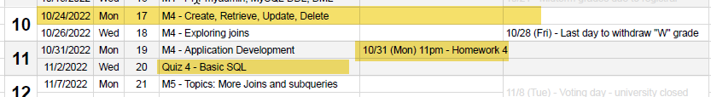
Housekeeping
Homework due NEXT WEEK Monday, 10/31
Homework is posted – we’ll discuss today
Quiz 4 TENTATIVELY scheduled for next Wed. 11/2
Passwords in MySQL – use “SET PASSWORD” command!

Slide 3
Homework Assignment 4

Slide 4
Homework 4 activities
Visit GITHUB classroom and create your REPO
Visit your personal databases at cmsc508.com using PHPMyAdmin
Get VS Code working on your machine
Install necessary extensions
DO THIS WALK THROUGH – GET IT WORKING!

Slide 5

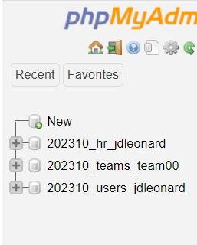
PHPMyAdmin
https://www.cmsc508.com/phpMyAdmin/
Username: your VCUeID (e.g. jl66)
Password: Shout4_jl66_GOME
Use SET PASSWORD command!!!
We’ll be using this one for HW4
202310_users_jl66

Slide 6
Creating tables

Slide 7

CMSC 508 – Databases
Introduction to SQL
CREATE TABLE
A SQL relation is defined using the CREATE TABLE command:
CREATE TABLE relation (C₁ D₁, C₂ D₂, ..., C_{n} D_{n}, (integrity-constraint₁), ..., (integrity-constraint_{k}))
relation is the name of the table
C_{i} is the i-th column name
D_{i} is the data type of values in the domain of column C_{i}
Constraints
AUTO_INCREMENT
NOT NULL
UNIQUE
CHECK (predicate)
PRIMARY KEY (Cn, ..., Cm )
FOREIGN KEY (Cj, ..., Ck ) REFERENCES relation([Cq, ..., Cw ])
*Referenced foreign keys must be on an indexed attribute
Main data types
CHAR(size)
VARCHAR(size)
INT
FLOAT
DECIMAL(P,S)
DATE
DATETIME
TIMESTAMP

Slide 8
CMSC 508 – Databases
Introduction to SQL
CREATE TABLE (MySQL Reference Manual)
CREATE TABLE instructor (
ID int AUTO_INCREMENT,
name varchar(20) NOT NULL,
dept_name varchar(30),
salary decimal(10,2) CHECK (salary > 0),
office char(5) NOT NULL UNIQUE,
PRIMARY KEY (ID),
FOREIGN KEY (dept_name) REFERENCES departments (department_name)
);

Slide 9
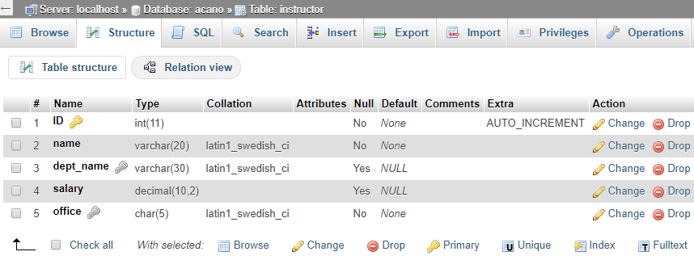
CMSC 508 – Databases
Introduction to SQL
ALTER TABLE (MySQL Reference Manual)
ALTER TABLE instructor ADD foocolumn VARCHAR(25);
ALTER TABLE instructor DROP COLUMN foocolumn;
phpMyAdmin GUI: Structure tab

Slide 10
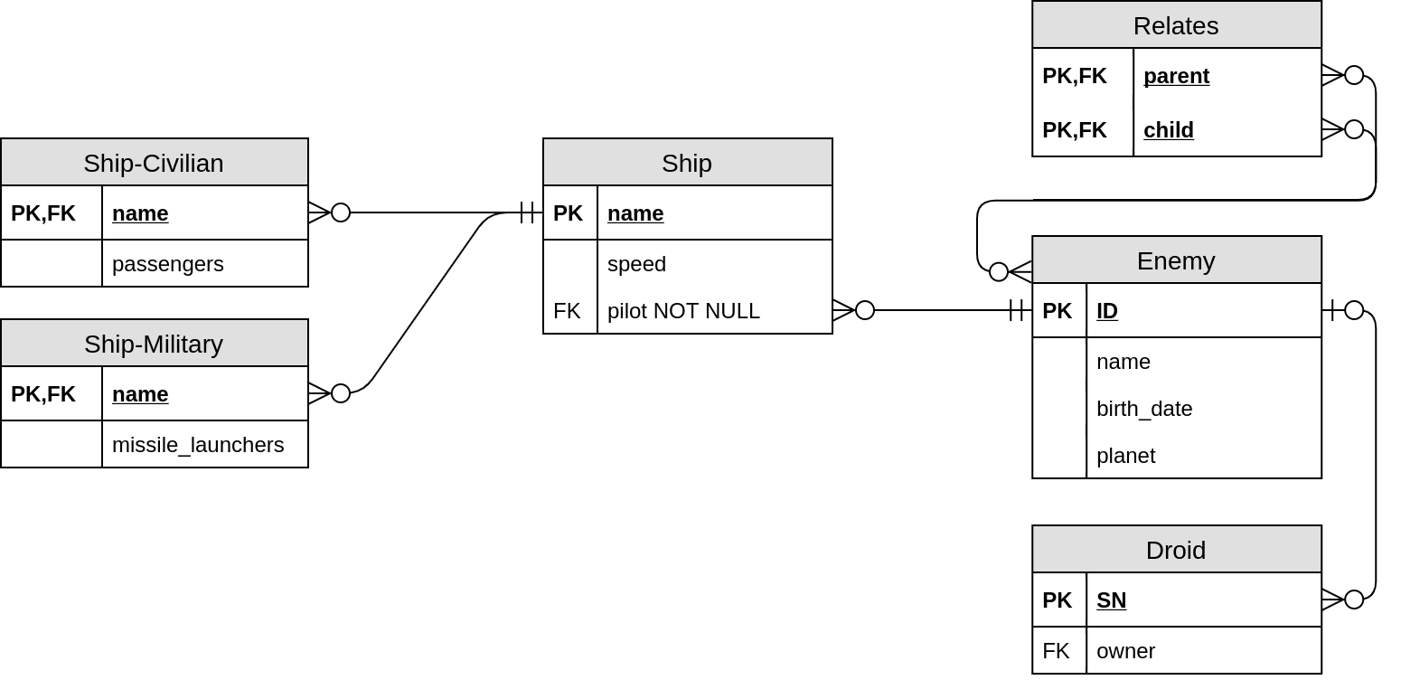
CMSC 508 – Databases
Introduction to SQL
Remember the Star Wars relational diagram?

Slide 11
CMSC 508 – Databases
Introduction to SQL
Star Wars SQL syntax
CREATE TABLE enemy ( ID char(5), name varchar(255), birth_date date, planet varchar(255), PRIMARY KEY (ID));
CREATE TABLE relates ( parent char(5), child char(5), PRIMARY KEY (parent, child),
FOREIGN KEY (parent) REFERENCES enemy (ID),
FOREIGN KEY (child) REFERENCES enemy (ID));

Slide 12
CMSC 508 – Databases
Introduction to SQL
Star Wars SQL syntax
CREATE TABLE droid ( SN char(32), owner char(5), PRIMARY KEY (SN),
FOREIGN KEY (owner) REFERENCES enemy (ID));
CREATE TABLE ship ( name varchar(255), speed float,
pilot char(5) NOT NULL, PRIMARY KEY (name),
FOREIGN KEY (pilot)
REFERENCES enemy (ID));
CREATE TABLE ship-civilian ( name varchar(255), passengers int, PRIMARY KEY (name),
FOREIGN KEY (name) REFERENCES ship (name));
* Similar to ship-military

Slide 13
Insert, update and delete

Slide 14
CMSC 508 – Databases
Introduction to SQL
INSERT (MySQL Reference Manual)
INSERT INTO relation VALUES (V₁, …, V_{N});
Inserts a new row with all the values matching the order of the columns. DO NOT USE.
INSERT INTO instructor VALUES (123, 'ALBERTO CANO', NULL, 1234.56, 'E4251');
INSERT INTO relation (C_{i}, …, C_{j}) VALUES (V_{i}, …, V_{j});
Inserts a new row with the values matching any order of the columns specified, any other column not listed is assumed to be NULL.
INSERT INTO instructor (ID, name, salary, office)
VALUES (123, 'ALBERTO CANO', 1234.56, 'E4251');
INSERT INTO instructor (name, salary, office)
VALUES ('ALBERTO CANO', 9876.5, 'W0465'); -- ID AUTO GENERATED

Slide 15
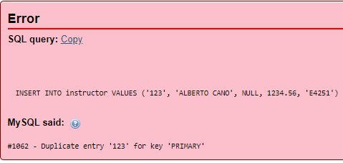
CMSC 508 – Databases
Introduction to SQL
Understanding MySQL errors
If we execute both instructions, the first will be valid inserting the new instructor with ID 123. However, the second will fail because we attempt to insert another row with the same value for the PRIMARY KEY (ID).
INSERT INTO instructor VALUES (123, 'ALBERTO CANO', NULL, 1234.56, 'E4251');
INSERT INTO instructor (ID, name, salary, office)
VALUES (123, 'ALBERTO CANO', 1234.56, 'E4251');

Slide 16
CMSC 508 – Databases
Introduction to SQL
UPDATE (MySQL Reference Manual)
UPDATE relation SET C_{i} = V_{i} , C_{j} = V_{j} , … [WHERE predicate];
Updates the content of a table, modifying the columns specified with the provided values for the rows satisfying the predicate.
UPDATE instructor SET salary = 4321.00 WHERE ID = 123;
CORRECT. Will update the salary based on the PRIMARY KEY.
UPDATE instructor SET salary = 4321.00 WHERE name = 'ALBERTO CANO';
INCORRECT. Will update the salary for ALL instructors with the given name.
UPDATE instructor SET salary = 4321.00;
INCORRECT. Will update everyone’s salary!
UPDATE instructor SET salary = salary * 1.05;
Will update everyone’s salary +5% respectively.

Slide 17
CMSC 508 – Databases
Introduction to SQL
UPDATE (MySQL Reference Manual)
UPDATE instructor
SET salary = CASE
WHEN salary <= 100000 THEN salary * 1.05
ELSE salary * 1.03
END;
Updates every salary based on SWITCH CASE
UPDATE instructor SET dept_name = 'CS' WHERE ID = 123;
#1452 - Cannot add or update a child row: a foreign key constraint fails (`acano`.`instructor`, CONSTRAINT `instructor_ibfk_1` FOREIGN KEY (`dept_name`) REFERENCES `departments` (`department_name`))
Foreign key violation! there's no 'CS' department in the departments table.
Update command canceled.

Slide 18
CMSC 508 – Databases
Introduction to SQL
DELETE (MySQL Reference Manual)
DELETE FROM relation [WHERE predicate];
Removes from a table the rows satisfying the condition of the predicate.
DELETE FROM instructor;
Removes every row from the instructor table. Are you sure about that?
DELETE FROM instructor WHERE ID = 123;
CORRECT. Removes the row where the PRIMARY KEY (ID) is 123.
DELETE FROM instructor WHERE name = 'ALBERTO CANO';
INCORRECT. Removes all rows for instructors with a given name.
DELETE FROM instructor; [PANIC]
If you know some Spanish, there’s even a musical video to honor those who forget the WHERE clause in a DELETE statement on production systems.

Slide 19

CMSC 508 – Databases
Introduction to SQL
DELETE (MySQL Reference Manual)
What happens if you try to delete a row for which there’s an existing foreign key?
DELETE FROM employees WHERE employee_id = 100;
#1451 - Cannot delete or update a parent row: a foreign key constraint fails (`acano`.`departments`, CONSTRAINT `dept_mgr_fk` FOREIGN KEY (`manager_id`) REFERENCES `employees` (`employee_id`))
You cannot delete a “parent” record if there’s a child dependency -> Foreign key constraints -> Referential integrity

Slide 20
CMSC 508 – Databases
Introduction to SQL
TRUNCATE (MySQL Reference Manual)
DROP TABLE (MySQL Reference Manual)
TRUNCATE TABLE relation;
Removes all rows in a table and resets metadata (counters, indexes, etc)
DROP TABLE relation;
Removes the table from the database.
DROP TABLE instructor;
DELETE = Removes rows satisfying conditions
TRUNCATE = Removes all rows in a table and resets metadata (e.g. auto increment)
DROP TABLE = Deletes the whole table from the database

