Slide 1
Week 10 – Wednesday
CMSC 508 Database Theory
CMSC 508 – More SQL Fun
Chapters 2,6 from Database System Concepts, 6th Ed. by Silberschatz, Korth, Sudarshan, 2011 Chapters 3,4 from Database Management Systems, 3rd Ed. by Ramakrishnan, Gehrke, 2003
Notes:
The ER model is a way of modeling the needs of the database that is close to the user/enterprise. It’s a first step at understanding the user requirements and is easy for the end users to understand so it facilitates communication.
Importance of getting the data model right – can change physical design later, but to change the logical design would disrupt the way data is used.
The two major things to avoid are duplication and missing information.

Slide 2
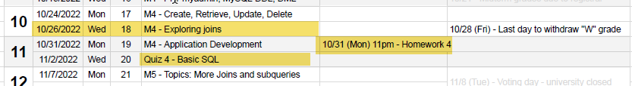
Housekeeping
Homework due NEXT WEEK Monday, 10/31
Quiz 4 TENTATIVELY scheduled for next Wed. 11/2
Passwords in MySQL – use “SET PASSWORD” command!
Doesn’t always work!

Slide 3
Homework Assignment 4

Slide 4
Homework 4 activities
Visit GITHUB classroom and create your REPO
Visit your personal databases at cmsc508.com using PHPMyAdmin
Get VS Code working on your machine
Install necessary extensions
DO THIS WALK THROUGH – GET IT WORKING!

Slide 5

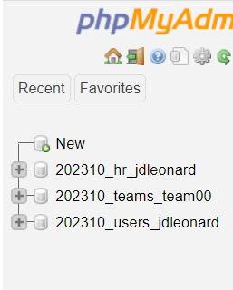
PHPMyAdmin
https://www.cmsc508.com/phpMyAdmin/
Username: your VCUeID (e.g. jl66)
Password: Shout4_jl66_GOME
Use SET PASSWORD command!!!
We’ll be using this one for HW4
202310_users_jl66

Slide 6
Homework 4
More DDL
Unique keys
Foreign keys
Select statements and joins
Committing and pushing to GITHUB
Autograding

Slide 7
Select statement Details

Slide 8
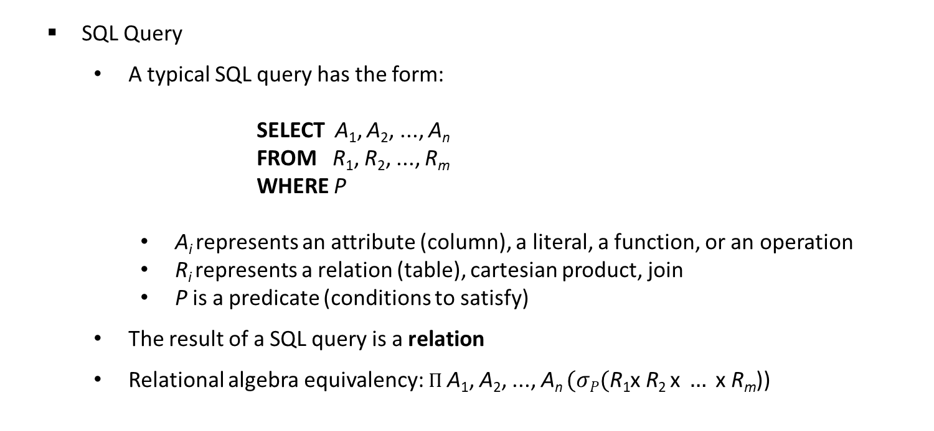
SQL Query
A typical SQL query has the form: SELECT A₁, A₂, ..., A_{n} FROM R₁, R₂, ..., R_{m} WHERE P
A_{i} represents an attribute (column), a literal, a function, or an operation
R_{i} represents a relation (table), cartesian product, join
P is a predicate (conditions to satisfy)
The result of a SQL query is a relation
Relational algebra equivalency: $Π$A₁, A₂, ..., A_{n} $(σP(\text{R}\text{1}\text{x} \text{R}\text{2 }\text{x} … \text{x} \text{Rm}$))

Slide 9
SELECT clause
The select clause lists the attributes desired in the result of a query, corresponds to the projection operation of the relational algebra
SQL names are case insensitive
SQL allows duplicates in relations as well as in query results
To force the elimination of duplicates, use the keyword distinct
An asterisk in the select clause denotes “all attributes”
May rename columns using alias
SELECT [DISTINCT] {*, column [[as] alias],...}
FROM table;

Slide 10
SELECT clause
SELECT first_name FROM employees;
SELECT DISTINCT first_name FROM employees;
SELECT DISTINCT first_name, last_name FROM employees;
SELECT department_id AS ID, department_name AS Department FROM departments;
SELECT * FROM employees;

Slide 11
SELECT clause
An attribute can be a literal or function:
SELECT 27 FROM dual; SELECT now() FROM dual;
An attribute can be a literal with from clause:
SELECT 'ASD' AS "fOo" FROM departments;
The select clause can contain arithmetic and string expressions on constants or attributes of tuples
SELECT CONCAT(first_name, ' ', last_name), salary*12 AS "ANNUAL SALARY"
FROM employees;
double quotes to enforce upper/lowercase formatting of column name

Slide 12
WHERE clause
The where clause specifies conditions that the results must satisfy, corresponds to the selection predicate of the relational algebra
Comparisons can be combined with logical connectives AND, OR, NOT
Special operators: BETWEEN, IN, IS NULL
SELECT [DISTINCT] {*, column [[as] alias], ...}
FROM table
WHERE operand (< | <= | = | <> | >= | >) operand [and | or | not ...];

Slide 13
WHERE clause
SELECT last_name, department_id FROM employees WHERE department_id = 110;
SELECT last_name, manager_id FROM employees WHERE manager_id IN (100, 145, 146);
SELECT last_name, manager_id FROM employees WHERE manager_id = 100 OR manager_id = 145 OR manager_id = 146;
SELECT last_name, job_id, manager_id FROM employees WHERE manager_id IS NULL;
SELECT last_name, salary FROM employees WHERE salary < 10000;
SELECT last_name, salary FROM employees WHERE salary BETWEEN 10000 AND 12000;

Slide 14
Exercise
Compute the annual salary of all employees as 12 x the monthly salary (attribute salary) plus a commission percentage of the monthly salary (attribute commission_pct ranged [0-1) ). Show results in the form:
Name Salary Annual
Russell, John 14000 173600
…
Format of the column header
Format of the data output

Slide 15
Exercise (uses HR database, 202310_hr_<your EID>)
Compute the annual salary of all employees as 12 x the monthly salary (attribute salary) plus a commission percentage of the monthly salary (attribute commission_pct ranged [0-1) ).
SELECT CONCAT(last_name, ', ', first_name) AS "Name", salary AS "Salary", salary*12+commission_pct*salary AS "Annual" FROM employees;

Slide 16
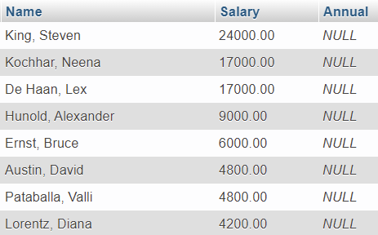

Exercise
Compute the annual salary of all employees as 12 x the monthly salary (attribute salary) plus a commission percentage of the monthly salary (attribute commission_pct ranged [0-1) ).
SELECT CONCAT(last_name, ', ', first_name) AS "Name", salary AS "Salary", salary*12+commission_pct*salary AS "Annual" FROM employees;

Slide 17
IFNULL for NULL values
IFNULL(expr1,expr2) replaces NULL with a value in the results of a query.
If expr1 is NOT NULL, then IFNULL returns expr1
If expr1 is NULL, then IFNULL returns expr2
SELECT CONCAT(last_name, ', ', first_name) AS "Name", salary AS "Salary", salary*12+ IFNULL(commission_pct,0)*salary AS "Annual"
FROM employees;
SELECT last_name, IFNULL(commission_pct, 'Not Applicable')
AS "COMMISSION" FROM employees;
NULL signifies an unknown value or that a value does not exist

Slide 18
STRING operations
The operator LIKE uses patterns (case insensitive) (use LIKE BINARY for case sensitive) for string-matching operations using two special characters:
percentage ( % ) matches any substring (none or many characters)
underscore ( _ ) matches any single character
Examples:
'Intro%' matches any string beginning with “Intro”
'%Comp%' matches any string containing “Comp” as a substring
'_ _ _' matches any string of exactly three characters
'_ _ _ %' matches any string of at least three characters
'%_ a _ ' same as before but the second to the last letter is 'a'

Slide 19
STRING operations
SELECT last_name FROM employees
WHERE last_name LIKE 'Mc%';
SELECT last_name FROM employees
WHERE last_name LIKE BINARY 'MC%';
SELECT first_name FROM employees
WHERE first_name LIKE 'D__i%';
SELECT phone_number FROM employees
WHERE phone_number LIKE '%123%';
SELECT phone_number FROM employees
WHERE phone_number LIKE '%.123.%';

Slide 20
Logical operators
AND, OR, NOT as in Boolean algebra
Operator precedence:
INTERVAL
BINARY, COLLATE
!
- (unary minus), ~ (unary bit inversion)
^
*, /, DIV, %, MOD
-, +
<<, >>
&
|
= (comparison), <=>, >=, >, <=, <, <>, !=, IS, LIKE, REGEXP, IN
BETWEEN, CASE, WHEN, THEN, ELSE
NOT
AND, &&
XOR
OR, ||
= (assignment), :=

Slide 21
Logical operators
SELECT last_name, job_id, salary FROM employees
WHERE job_id = 'SA_MAN' OR job_id = 'AD_PRES' AND salary >= 14000;
SELECT last_name, job_id, salary FROM employees
WHERE (job_id = 'SA_MAN' OR job_id = 'AD_PRES') AND salary >= 14000;
NOT IN and NOT NULL
SELECT last_name, job_id FROM employees
WHERE job_id NOT IN ('SA_MAN' , 'AD_PRES') AND department_id = 50;
SELECT last_name, commission_pct FROM employees
WHERE commission_pct IS NOT NULL;
** NOT IN (NULL, A, B, C, …) is ALWAYS FALSE --> careful with this operation

Slide 22
Sort the output
SELECT DISTINCT last_name FROM employees
ORDER BY last_name;
SELECT last_name, first_name FROM employees
ORDER BY last_name, first_name;
SELECT employee_id, manager_id FROM employees
ORDER BY manager_id ASC, employee_id DESC;

Slide 23
Manipulation functions (there're maaaaany, here's some of them)
Function | Results
LOWER ('BD sql') | bd sql
UPPER ('BD sql') | BD SQL
INITCAP ('BD sql') | BD Sql
CONCAT ('BD', 'SQL') | BDSQL
SUBSTR ('MYSQL',1,3) | MYS
INSTR ('MYSQL','Y') | 2
LPAD (salary, 10, '*') | ******5000
ROUND (7.968, 2) | 7.97
TRUNC (7.968, 2) | 7.96
MOD (1600, 300) | 100

Slide 24
Quiz 4 Study Guide
SQL commands to know
CREATE
INSERT
UPDATE
DROP
DELETE
SELECT + WHERE
LIKE
IN
ORDER BY
Activities
Show CREATE command
Show INSERT command
Convert SQL to natural
Given SQL select values from a table
Given a SQL query with joins draw a relational diagram

Slide 25
Exercises – using 202310_hr_<your EID> on CMSC508.
Find the department names containing IT
Find the employees names working for the Purchasing department
Find the employees names whose manager is the president: Steven King
Find the employees not working for any department
Find the locations of the offices sorted by country, state, and city (use ORDER BY)
Find the employees working for any of the IT departments and earning more than $5k. Show their salary with the $ symbol first.
Find the employees hired before Jan 1st, 2005 and whose first name ends with 'n'
Build the email of the employees by combining the first letter of their first name plus the last name plus “@dundermifflinpaper.com” (Yes, https://dundermifflinpaper.com/ exists)

