Slide 1
Week 11 – Monday
CMSC 508 Database Theory
CMSC 508 – More SQL Fun
Chapters 2,6 from Database System Concepts, 6th Ed. by Silberschatz, Korth, Sudarshan, 2011 Chapters 3,4 from Database Management Systems, 3rd Ed. by Ramakrishnan, Gehrke, 2003
Notes:
The ER model is a way of modeling the needs of the database that is close to the user/enterprise. It’s a first step at understanding the user requirements and is easy for the end users to understand so it facilitates communication.
Importance of getting the data model right – can change physical design later, but to change the logical design would disrupt the way data is used.
The two major things to avoid are duplication and missing information.

Slide 2
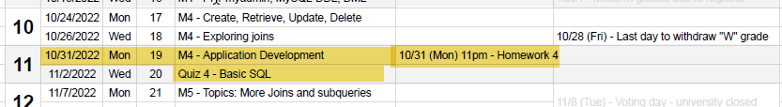

Housekeeping
Homework due TODAY, Monday, 10/31
Quiz 4 scheduled for Wednesday, 11/2
Today –
FOREIGN KEYS, UNIQUE and referential integrity
Application development cycle using PHP

Slide 3




Quiz 4 Study Guide
SQL commands to know
CREATE
INSERT
UPDATE
DROP
DELETE
SELECT + WHERE
LIKE
IN
ORDER BY
Activities
Show CREATE command
Show INSERT command
Convert SQL to natural
Given SQL select values from a table
Given a SQL query with joins draw a relational diagram

Slide 4
Homework Assignment 4

Slide 5
Homework 4 activities
Visit GITHUB classroom and create your REPO
Visit your personal databases at cmsc508.com using PHPMyAdmin
Get VS Code working on your machine
Install necessary extensions
DO THIS WALK THROUGH – GET IT WORKING!

Slide 6

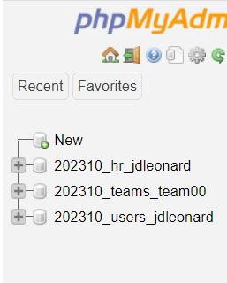

PHPMyAdmin
https://www.cmsc508.com/phpMyAdmin/
Username: your VCUeID (e.g. jl66)
Password: Shout4_jl66_GOME
Use SET PASSWORD command, both in PHPMyAdmin AND from VSCODE (they are different passwords!)
We’ll be using this one for HW4
202310_users_jl66

Slide 7



General observations
34 students have used autograder (leaving 70!)
Issues on discord revolve around logging in with the correct username/password
Must COMMIT to repo PRIOR to submitting (otherwise you get a zero)
JOINS are tricky

Slide 8

Safety TIP – Starting a new query
I start all fresh queries with a template (at right)
THEN, I modify and test one piece at a time
Start with FROM and grow joins as necessary
Then work on select or where
Then work on remaining section
select * from peopleroles where 1=1

Slide 9
Tonight’s code enhancements
More DDL
Unique keys
Foreign keys
DELETING records
CASCADING
DROPPING tables and table order
SET foreign_key_checks = 1;
https://www.javatpoint.com/mysql-foreign-key

Slide 10

Exercises – using 202310_hr_<your EID> on CMSC508.
Find the department names containing IT
Find the employees names working for the Purchasing department
Find the employees names whose manager is the president: Steven King
Find the employees not working for any department
Find the locations of the offices sorted by country, state, and city (use ORDER BY)
Find the employees working for any of the IT departments and earning more than $5k. Show their salary with the $ symbol first.
Find the employees hired before Jan 1st, 2005 and whose first name ends with 'n'
Build the email of the employees by combining the first letter of their first name plus the last name plus “@dundermifflinpaper.com” (Yes, https://dundermifflinpaper.com/ exists)

Slide 11
Application development

Slide 12
Getting started on Semester Project
At this point
You can create design and create the initial data base using DDL.
How do you start to test and grow your web application?
What tools do you need to install?
What is your workflow?
How to you test and iterate?

Slide 13








Tools required
Chocolatey (PC) Homebrew(Mac)
Package managers for EASILY installing other tools
XAMPP
Apache-MySQL-PHP-Perl stack for windows/linux
FileZilla
File transfer program for moving from local machine to CMSC508
GIT and VSCODE – your bread and butter! or wine and cheese, or pretzels and beer or whatever!

Slide 14








Steps and Tasks: Install software
Install Chocolatey (must use powershell script)
Chocolatey.org
Install XAMPP and FileZilla
Download your TEAM repo from github
https://github.com/cmsc-vcu/202310-cmsc508-semester-project-team#.git where # is your team number.
Create public_html inside your repo
Add changes, commit, then push/sync.

Slide 15


Steps and tasks #2: Set up file transfer
Open FileZilla and connect to CMSC508
LOGIN using: server:cmsc508.com, username: <eid>, password: your “V” number.
LOCAL folder:
The “public_html” folder in your project repo
REMOTE folder:
/home/202310/team0/public_html
Files can be copied from: LOCAL->REMOTE and REMOTE->LOCAL

Slide 16
Steps and tasks #3: Do your first transfer
Copy files from REMOTE to LOCAL
Edit .htaccess to freshen DB connection info
Edit index.php to modify message to verify new changes
Transfer files back to REMOTE
Visit web site to test:
http://cmsc508.com/202310/team0/index.php

Slide 17
Steps and tasks #4: Get local server running
Find “XAMMP control panel” in menu
Edit HTTPD.CONF
<Directory "C:/Users/User/Projects/202310-cmsc508-semester-project-cmsc508-202310-team-0/public_html">
## Options Indexes FollowSymLinks Includes ExecCGI
## AllowOverride All
## Require all granted
AllowOverride FileInfo AuthConfig Limit Indexes
Options MultiViews Indexes SymLinksIfOwnerMatch IncludesNoExec ExecCGI
Require method GET POST OPTIONS
</Directory>

Slide 18
Steps and tasks #4: Get local server running
Add “junction” to C:\XAMPP\htdocs folder
new-item -itemtype Junction -Path "C:\xampp\htdocs\team00“ -Target "C:\Users\User\Projects\202310-cmsc508-semester-project-cmsc508-202310-team-0\public_html\“
Start Apache in XAMPP control panel
Visit:
http://localhost/team00/index.php
Your local PHP file should show.

Slide 19
Steps and tasks #5: review .htaccess
.htaccess will need to be fixed to correctly point to your team database on cmsc508. As with VSCODE, the password will be tricky.

