Slide 1
Week 13 – Monday
CMSC 508 Database Theory
CMSC 508 – More subqueries
Chapter 3 from Database System Concepts, 6th Ed. by Silberschatz, Korth, Sudarshan, 2011
Chapter 5 from Database Management Systems, 3rd Ed. by Ramakrishnan, Gehrke, 2003
Notes:
The ER model is a way of modeling the needs of the database that is close to the user/enterprise. It’s a first step at understanding the user requirements and is easy for the end users to understand so it facilitates communication.
Importance of getting the data model right – can change physical design later, but to change the logical design would disrupt the way data is used.
The two major things to avoid are duplication and missing information.

Slide 2
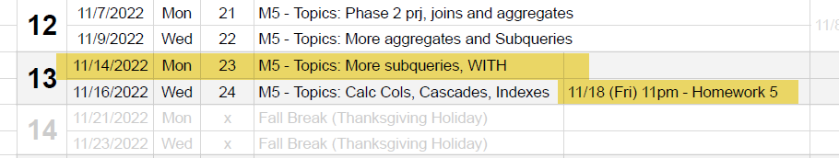
Housekeeping
Homework 5 – due this Friday, 11/18
Semester project – Due 12/12 (last Monday of class)
Watch the videos posted on Canvas – good stuff!

Slide 3
Project phase 1 evaluation

Slide 4
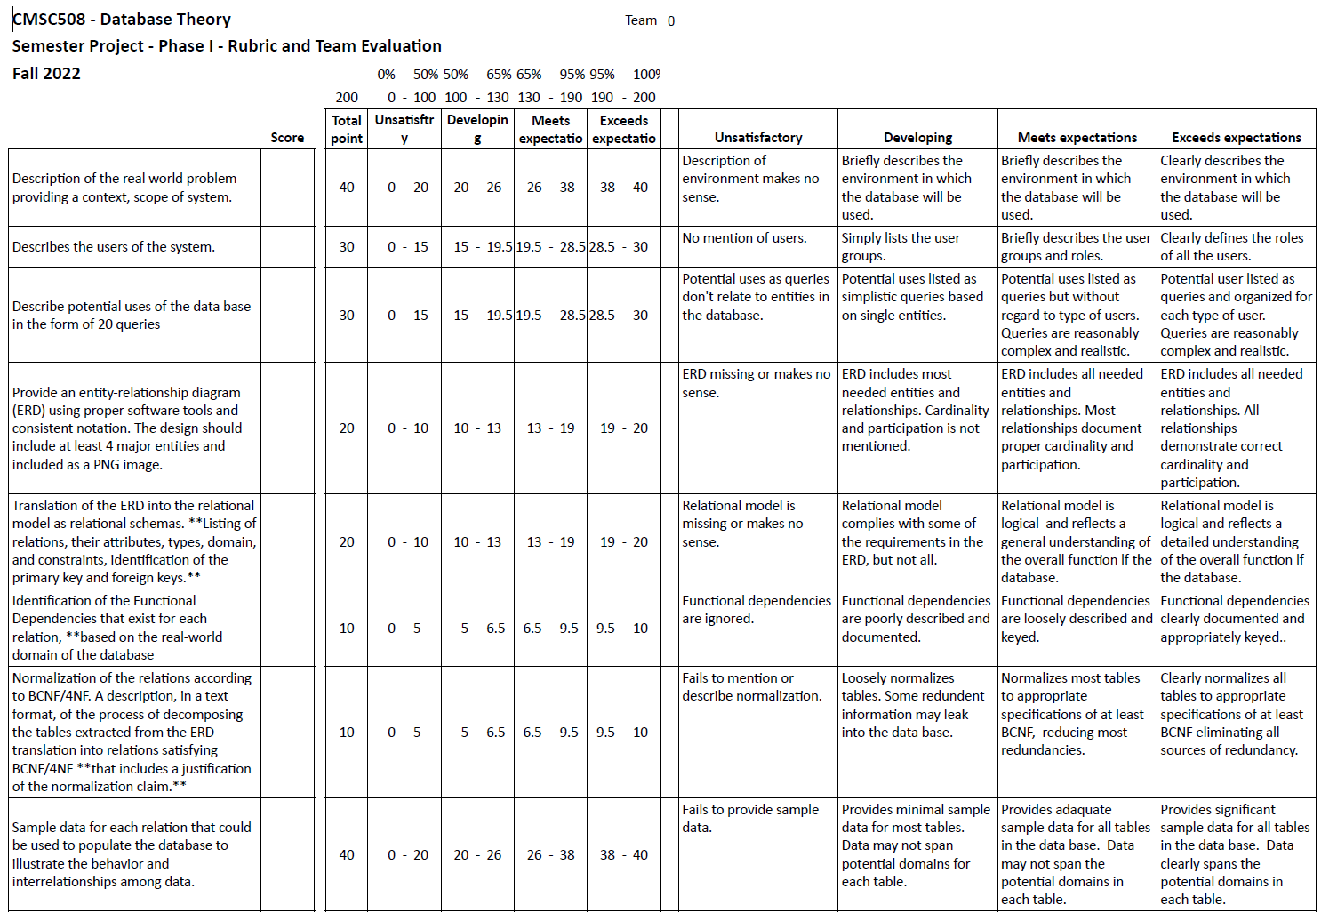

Slide 5
WITH - a real life saver!

Slide 6
WITH statement
Create multiple Common Table Expressions – CTE
A tool for crafting temporary tables for use and reuse within the same SQL statement:
WITH <new table name> AS
(
<create a new table using SELECT>
)
SELECT * FROM <use new table name here>
VERY useful for homework 5!

Slide 7
WITH statement
This:
Becomes:
SELECT cust_id
FROM Orders
WHERE order_num IN (SELECT order_num
FROM OrderItems
WHERE prod_id = 'RGAN01');
WITH filtered_orders as (
SELECT order_num
FROM OrderItems
WHERE prod_id = 'RGAN01’
)
SELECT cust_id
FROM Orders
WHERE order_num IN (select order_num from filtered_orders)

Slide 8
Homework 5 – Moving forward

Slide 9
Homework 5
Build a few more queries in class

Slide 10
Phase 2 – semester project

Slide 11
Phase 2 Project
GREAT TUTORIALS:
Installing XAMPP (“zamp”)
https://www.youtube.com/watch?v=P6DV1nTH8kU
Building a web site using PhP
https://www.simplilearn.com/tutorials/php-tutorial
Get XAMPP installed!

Slide 12
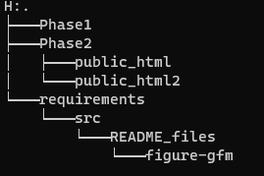
Phase 2 Project – tips and tricks
Create a PUBLIC_HTML folder INSIDE the Phase2 folder of your GITHUB team site
Use a “symbolic link” to connect the public_html folder to your XAMPP web server document root:
On Mac, use the “ln –s” command
On PC/powershell use the “new-item” command
new-item –ItemType SymbolicLink
new-item –ItemType SymbolicLink \
-Target “C:\Users\jdleonard\projects\team00-project\Phase2\public_html” \
–Path “C:\xampp\htdocs\team00”

Slide 13
Phase 2 Project
Overall workflow
Do development on a PC/Mac
Small edits to PHP files / Save / Refresh browser / Fix
Iterate / adding more code and complexity
At larger intervals,
Save code to GITHUB
Transfer files to CMSC508.COM to set in the wild
Move entire public_html folder using FileZilla

Slide 14
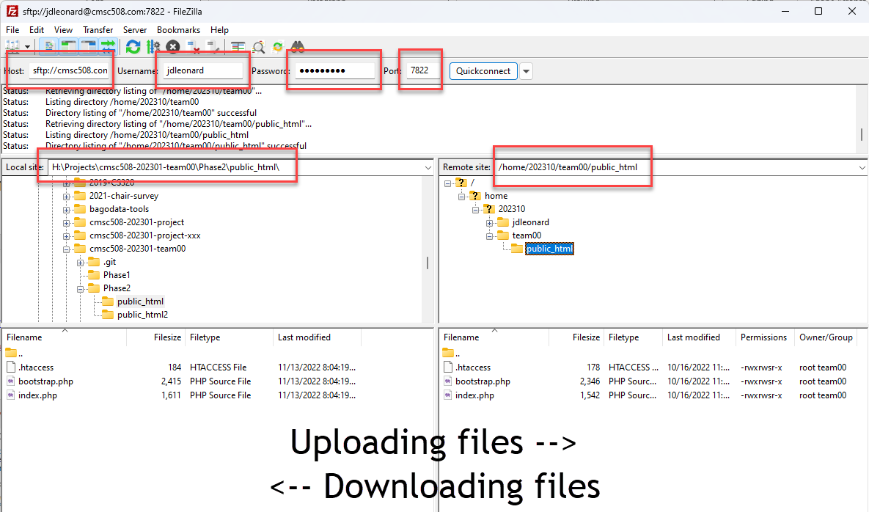
Phase 2 Project - FileZilla

