Slide 1
Week 15 – Monday
CMSC 508 Database Theory
CMSC 508 – Procedures and Triggers
Chapter 3 from Database System Concepts, 6th Ed. by Silberschatz, Korth, Sudarshan, 2011
Chapter 5 from Database Management Systems, 3rd Ed. by Ramakrishnan, Gehrke, 2003
Notes:
The ER model is a way of modeling the needs of the database that is close to the user/enterprise. It’s a first step at understanding the user requirements and is easy for the end users to understand so it facilitates communication.
Importance of getting the data model right – can change physical design later, but to change the logical design would disrupt the way data is used.
The two major things to avoid are duplication and missing information.

Slide 2
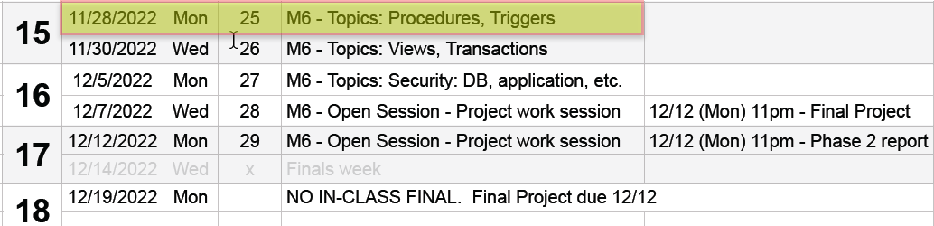


Housekeeping
No in-class final – Homework 6 is now Final Project
Final project due Monday, 12/12
Phase 2 semester project – Due Monday, 12/12
Phase 2 project rubric posted
Course evaluations – opening tomorrow! Please do (for credit!)

Slide 3
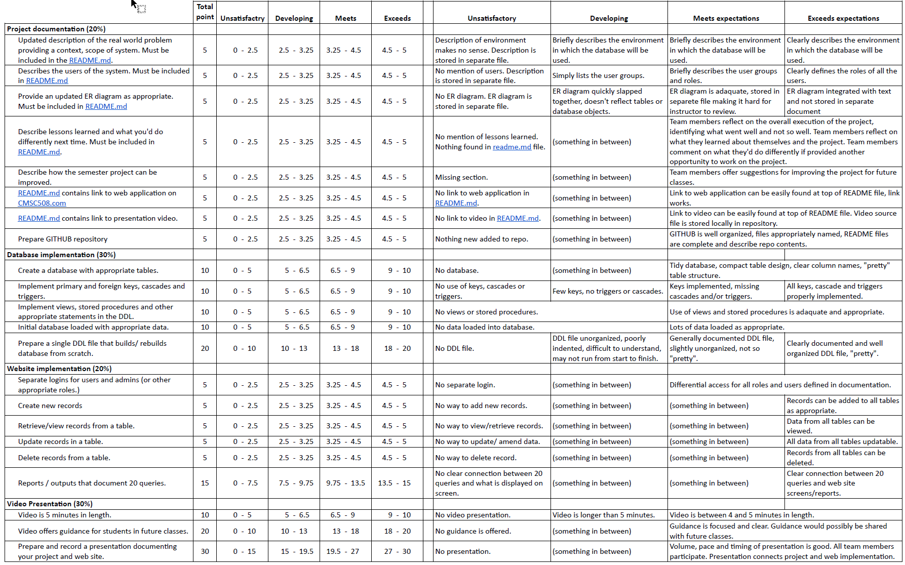


Slide 4
Database IntegritY

Slide 5
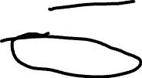




Database integrity
Record level constraints
NOT NULL, CHECK
Table level constraints
Primary keys – prevents duplicate records
UNIQUE: ensures unique values, can’t be used as a key
Foreign keys – connects tables, referential integrity
Cascades: on update and on delete
TRIGGERS

Slide 6
“CHECK” constraints

Slide 7



CHECK Constraints
Used to ensure that data in a column meets a set of specified criteria
Check minimum or maximum value
Specify ranges
Allowing only specific values
They place further restrictions within the specified datatype of an attribute.
10
Notes:
Datatypes restrict the type of value that can be stored for an attribute; check constraints add an additional restriction on the data
Prevent an order of 0 items by setting a minimum value to 1
Making sure that a ship date is greater than or equal to today’s date and not greater than 1 year from now
Restricting a workers shift to AM or PM.

Slide 8


CHECK Constraints
CMSC 508 Database Theory
Defined in CREATE TABLE
CREATE TABLE instructor (
ID char(5) PRIMARY KEY,
name varchar(20),
dept_name varchar(20) REFERENCES Departments(dept_name),
salary number(8,2) CHECK (salary > 0)
);

Slide 9
CHECK Constraints
CMSC 508 Database Theory
create table students (
first_name varchar2(20) not null,
last_name varchar2(20) not null,
email varchar2(20) not null unique,
semester varchar2(20),
primary key (first_name, last_name),
check (semester in ('Fall', 'Winter', 'Spring', 'Summer'))
);
Notes:
However, we cannot include a subquery in a check predicate:
check (email not in (select email from spam_addresses)) Therefore, use triggers to control such “dynamic” behavior!

Slide 10
Procedures – a quick intro

Slide 11
PROCEDURES
Offers way to bundle multiple SQL statements into a single group
Similar to subprograms in other languages:
PROCEDURE, FUNCTION, TRIGGER
Real advantages
Reduce network traffic
Centralize business logic
Permits SQL reuse
Improves DB security – specific procedures can be “locked”

Slide 12
PROCEDURES
We’ll focus on procedures and functions in a later lecture – today we’re focusing on triggers,
BUT – we need to know about DELIMITER

Slide 13








PROCEDURES
CMSC 508 – Databases
Advanced SQL
DELIMITER - A really important statement!!!!
Distinguishes bundles of SQL commands from a single, regular SQL command:
DELIMITER // -- change delimiter to //
CREATE FUNCTION function_name
( [parameter datatype [, parameter datatype …]] )
RETURNS return_datatype
BEGIN
-- Declarations section (local variables and cursors);
-- Executable section (logic of the function);
RETURN result;
END; //
DELIMITER ; -- change delimiter back to ;

Slide 14
Triggers

Slide 15
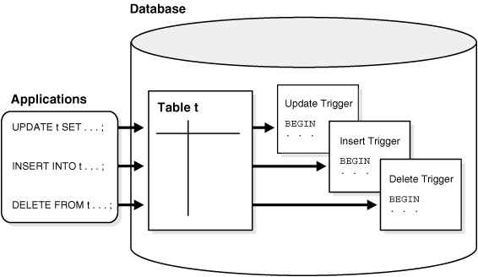
TRIGGERS
A trigger is a statement that is executed automatically by the DBMS as a result of a modification to the database
To design a trigger we must:
Specify the conditions under which the trigger is to be executed
Specify the actions to be taken when the trigger executes
Triggers vs procedures: a procedure is explicitly run by an user or trigger. Triggers are implicitly fired by the DBMS when a triggering condition occurs.

Slide 16




TRIGGERS
Triggering event can be an INSERT, DELETE or UPDATE
Triggers may execute BEFORE or AFTER a manipulation of a table
BEFORE|AFTER INSERT ON tablename
BEFORE|AFTER UPDATE ON tablename
BEFORE|AFTER DELETE ON tablename
Triggers cannot change a table that is already undergoing change. Otherwise, you’ll get a mutating table error.
CREATE TRIGGER BEFORE|AFTER INSERT|UPDATE|DELETE ON tableName
FOR EACH ROW
BEGIN
-- DO STUFF
END//
MySQL will run the trigger code for every row which was affected by the SQL statement and NOT for each row in the table itself

Slide 17








TRIGGERS
Values of attributes before and after an operation can be referenced
Statement old.attribute new.attribute
INSERT NULL Post-insert value
UPDATE Pre-update value Post-update value
DELETE Pre-delete value NULL
CREATE TRIGGER salary_log_trigger
AFTER UPDATE ON employees
FOR EACH ROW
BEGIN
IF(new.salary <> old.salary) THEN
INSERT INTO salary_log (employee_id, new_salary, old_salary)
VALUES (new.employee_id, new.salary, old.salary);
END IF;
END//

Slide 18

TRIGGERS
CMSC 508 – Databases
Trigger (AFTER)
Commonly employed for log information after a modification
DB example: maintaining the job history of the employees
CREATE TRIGGER update_job_history
AFTER UPDATE ON employees
FOR EACH ROW
BEGIN
IF (new.job_id <> old.job_id OR new.department_id <> old.department_id) THEN
CALL add_job_history(old.employee_id, old.hire_date, sysdate(),
old.job_id, old.department_id);
END IF;
END//
where add_job_history is an existing procedure inserting data into job_history

Slide 19






TRIGGERS
Trigger (BEFORE)
Commonly employed for checking conditions prior modification (EXCEPTIONS)
Generic SQLSTATE value '45000' means “unhandled user-defined exception”
Example: check salary conditions within a valid range prior inserting
CREATE TRIGGER salary_check_trigger
BEFORE INSERT ON employees
FOR EACH ROW
BEGIN
DECLARE job_id_avg_sal DECIMAL (9,2);
SELECT AVG(salary) INTO job_id_avg_sal FROM employees WHERE job_id = new.job_id;
IF(new.salary > 2*job_id_avg_sal OR new.salary < 0.5*job_id_avg_sal) THEN
SIGNAL SQLSTATE '45000'
SET MESSAGE_TEXT = 'Salary deviates from average of the job';
END IF;
END//

Slide 20

Trigger (INSTEAD OF) (IMPLEMENTED ON ORACLE BUT NOT MYSQL, JUST FYI)
CREATE TRIGGER insert_emp_dept INSTEAD OF INSERT ON emp_dept_join
DECLARE v_department_id departments.department_id%TYPE;
BEGIN
BEGIN
SELECT department_id INTO v_department_id
FROM departments
WHERE department_name = :new.department_name;
EXCEPTION
WHEN NO_DATA_FOUND THEN
INSERT INTO departments (department_id, department_name)
VALUES (departments_seq.nextval, :new.department_name)
RETURNING department_id INTO v_department_id; -- MySQL use LAST_INSERT_ID();
END;
INSERT INTO employees (employee_id, first_name, last_name, department_id)
VALUES(employees_seq.nextval, :new.first_name, :new.last_name, v_department_id);
END//

Slide 21
TRIGGERS
Trigger example
Create a trigger to maintain a new column in the departments table that stores the total salary of all members in a department
Prerequisites:
ALTER TABLE departments ADD total_salary DECIMAL(12,2);
Trigger logic:
When the trigger should be executed by the DBMS?
What should the trigger do in each firing event case?

Slide 22
TRIGGERS
Trigger example
Create a trigger to maintain a new column in the departments table that stores the total salary of all members in a department
The trigger should be executed when:
New employee is inserted
Employee is removed
Employee’s salary is updated
Employee’s department is updated
Please ALWAYS take time to THINK what are ALL the triggering conditions and ALL the possible actions/outcomes for each case

Slide 23
Trigger example
CREATE TRIGGER total_salary_trigger_insert
AFTER INSERT ON employees
FOR EACH ROW
BEGIN
UPDATE departments
SET total_salary = total_salary + new.salary
WHERE department_id = new.department_id;
END//
CREATE TRIGGER total_salary_trigger_delete
AFTER DELETE ON employees
FOR EACH ROW
BEGIN
UPDATE departments
SET total_salary = total_salary - old.salary
WHERE department_id = old.department_id;
END//

Slide 24

Trigger example
CREATE TRIGGER total_salary_trigger_update
AFTER UPDATE ON employees
FOR EACH ROW
BEGIN
IF(old.department_id <> new.department_id) THEN
UPDATE departments SET total_salary = total_salary - old.salary
WHERE department_id = old.department_id;
UPDATE departments SET total_salary = total_salary + new.salary
WHERE department_id = new.department_id;
END IF;
IF(old.department_id = new.department_id AND old.salary <> new.salary) THEN
UPDATE departments SET total_salary = total_salary - old.salary + new.salary
WHERE department_id = new.department_id;
END IF;
END//

Slide 25
Trigger example (ORACLE SQL)
CREATE TRIGGER total_salary_trigger
AFTER DELETE OR INSERT OR UPDATE OF department_id, salary ON employees
FOR EACH ROW
BEGIN
IF DELETING OR (UPDATING AND :old.department_id != :new.department_id)
THEN UPDATE departments
SET total_salary = total_salary - :old.salary
WHERE department_id = :old.department_id;
END IF;
IF INSERTING OR (UPDATING AND :old.department_id != :new.department_id)
THEN UPDATE departments
SET total_salary = total_salary + :new.salary
WHERE department_id = :new.department_id;
END IF;
IF (UPDATING AND :old.department_id = :new.department_id AND :old.salary != :new.salary)
THEN UPDATE departments
SET total_salary = total_salary - :old.salary + :new.salary
WHERE department_id = :new.department_id;
END IF;
END//
MySQL, Oracle and Postgres

Slide 26
Trigger examples
Create a trigger to maintain a new column in the departments table that stores the total salary of all members in a department
Issues:
How to compute the current total salary?
1) UPDATE employees SET salary = salary; ?
2) UPDATE departments SET total_salary = 0; then 1) ?
total_salary is null … total_salary + :new.salary will be null
salary = salary … will execute the trigger, but no condition is satisfied
TROLOLOLOL

Slide 27
Trigger examples
Create a trigger to maintain a new column in the departments table that stores the total salary of all members in a department
Issues:
How to compute the current total salary?
UPDATE departments d
SET d.total_salary =
(SELECT sum(e.salary) FROM employees e
WHERE d.department_id = e.department_id);
What if inserting/updating wrong department ID? Referential integrity
What if adding an employee/department for the first time?
Column total_salary is NULL! Triggers in the example are incomplete

Slide 28
Trigger exercise
Create a trigger to increase the salary (+5% of current salary) of the employees belonging to a department every time an employee joins that department
Identify conditions to execute the trigger
Identify actions using new and old references
Merge conditions with common actions

Slide 29
Trigger exercise
Create a trigger to increase the salary (+5% of current salary) of the employees belonging to a department every time an employee joins that department
CREATE TRIGGER update_salary_insert
AFTER INSERT ON employees
FOR EACH ROW
BEGIN
UPDATE employees
SET salary = salary*1.05
WHERE department_id = new.department_id;
END//
CREATE TRIGGER update_salary_update
AFTER UPDATE ON employees
FOR EACH ROW
BEGIN
IF(new.department_id <> old.department_id) THEN
UPDATE employees SET salary = salary*1.05
WHERE department_id = new.department_id;
END IF;
END//
Triggers compile and everything looks good. Let’s run something to execute them

Slide 30

Mutating table
A mutating table is a table that is currently being modified by an update, delete, or insert statement. When a trigger tries to reference a table that is in state of flux (being changed), it is considered "mutating", and raises an error.
CREATE TRIGGER update_salary_insert
AFTER INSERT ON employees
FOR EACH ROW
BEGIN
UPDATE employees
SET salary = salary*1.05
WHERE department_id = new.department_id;
END//
CREATE TRIGGER update_salary_update
AFTER UPDATE ON employees
FOR EACH ROW
BEGIN
IF(new.department_id <> old.department_id) THEN
UPDATE employees SET salary = salary*1.05
WHERE department_id = new.department_id;
END IF;
END//
#1442 - Can't update table 'employees' in stored function/trigger because it is already used by statement which invoked this stored function/trigger.

Slide 31
Exercises
Create a trigger to prevent having employees whose salary is bigger than their manager (or the president’s salary if they have no manager). Consider all scenarios.
Create a table for projects (title, manager, duration (days), cost), and check that the cost must be < 1000 per day nor bigger than the sum of the salaries of the department employees the manager works for. Consider all scenarios.
Create a new table to keep the count of the number of subordinates of an employee. Create a trigger to keep this table up to date. Remove from this table the data of the employee if fired. Consider all scenarios.
Create a new log table and a trigger to keep track of any changes to the employees table. The table schema should be (log_event_id, date, description) and the contents should look as e.g. (1234, 04/05/17, “Employee 123 updated salary from 5000 to 10000”). Track salaries, managers, departments, and jobs.

