Slide 1
Accessing the DBMS

Slide 2
Accessing the DBMS
Using PHPMyAdmin – through a web browser
To manage, monitor and tune the overall system
Using the command line – SSH into server
To script creation and population of the databases
Using Vscode – through a connection
To script creation and population of the databases

Slide 3
Accessing the DBMS
Using python/flask as an API
To run the application and use the database
Using a PHP full stack
To run the application and use the database
LAMP – Linux : Apache : MySQL : PHP/Perl/Python
Using NodeJS full stack
To run the application and use the data base
MEAN – Mongo/MySQL : Express : Angular : Node
MERN – Mondo/MySQL : Express : React : Node

Slide 4

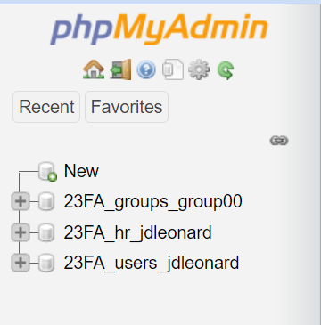
PHPMyAdmin
https://www.cmsc508.com/phpMyAdmin/
Username: 23FA_<EID> (e.g. 23FA_jdleonard)
Password: Shout4_jdleonard_GOME
There are three databases for each user:
23FA_hr_jdleonard -> for learning and play
23FA_users_jdleonard -> for play
23FA_teams_group00 -> for semester project (this is shared with other team members!)

Slide 5
SSH directly into server
>> ssh 23FA_jdleonard@cmsc508.com
Password: your VID
For example: V00758588
(need to use alternate port number)
>> mysql –p Enter password: Shout4_jdleonard_GOME

Slide 6
Using the PHP full stack
Point your browser at your ~ account
http://cmsc508.com/~23FA_jdleonard/
http://cmsc508.com/~23FA_jdleonard/bootstrap.php
Source files are located in your home:
/home/23FA/23FA_jdleonard/public_html
Edit using VSCODE and GITHUB, then RSYNC them to the desired location
Semester project:
/home/23FA/23FA_group00/public_html
PHP 8 + MySQL + JavaScript + jQuery + Bootstrap + other libraries

