Slide 1
BIOF509 Final Project
Lowrey Peyton
December 15, 2021

Slide 2
Overview
About the dataset
Preprocessing
ANN training and testing
Results
Future directions

Slide 3

About the dataset
Surge of COVID cases in Israel in mid-2021
Caused by decreased protection against Delta variant and waning immunity
Notes:
Also looked at dz severity
People vaccinated earlier were more likely to get infected (especially in older adults, 60+)

Slide 4
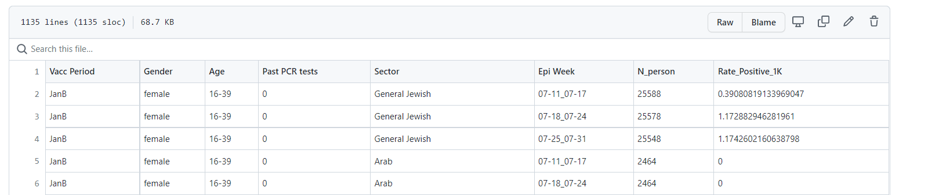
About the dataset
COVID-19 infection data in Israel from July 2021
Fully-vaccinated, Pfizer
Goldberg et al. Waning immunity after the BNT162b2 Vaccine in Israel, NEJM, 2021.

Slide 5
Preprocessing
Ordinal
Vaccination date, age, past PCR tests, epi week
Then normalized each feature
One hot encoding
Sector, gender
Binning the output layer

Slide 6
Preprocessing
Ordinal
Vaccination date, age, past PCR tests, epi week
Then normalized each feature
One hot encoding
Sector, gender
Binning the output layer
Bin range | Frequency
0 | 428
(0, 1] | 416
(1, 2] | 204
(2, 5] | 79
(5, infinity) | 7

Slide 7
ANN testing and training
Artificial neural network
Input: 9 features
2 hidden layers, 6 neurons
Output: 5 classes
Trained: 80%, tested: 20%, 4 epochs

Slide 8
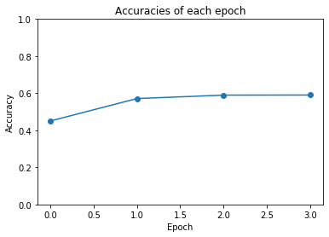
Results

Slide 9
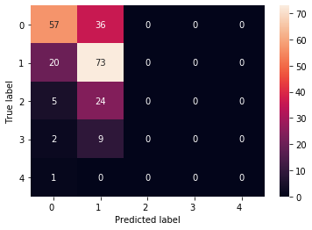
Test set results
Accuracy = 57.3%

Slide 10
To run my code
Simply run the final_project.py script
Outputs: print statements, plots of results

Slide 11
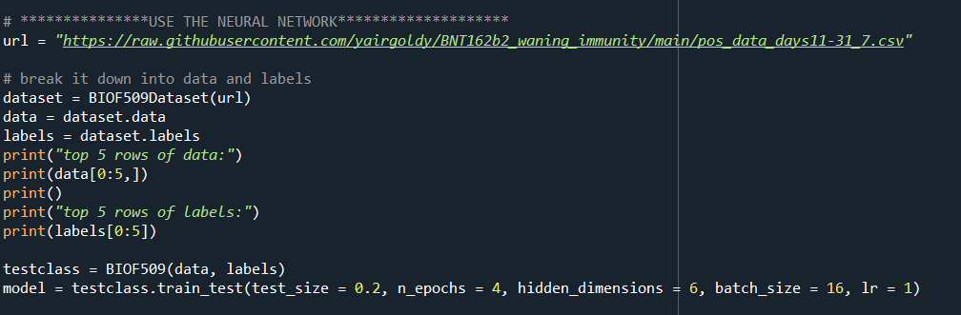
To run my code
Simply run the final_project.py script
Outputs: print statements, plots of results

Slide 12
Future directions
Incorporate disease severity
Incorporate more samples from Israel’s Ministry of Health data
Instead of classifier ANN, use multilayer perceptron (MLP)
One class in output layer

