Slide 1
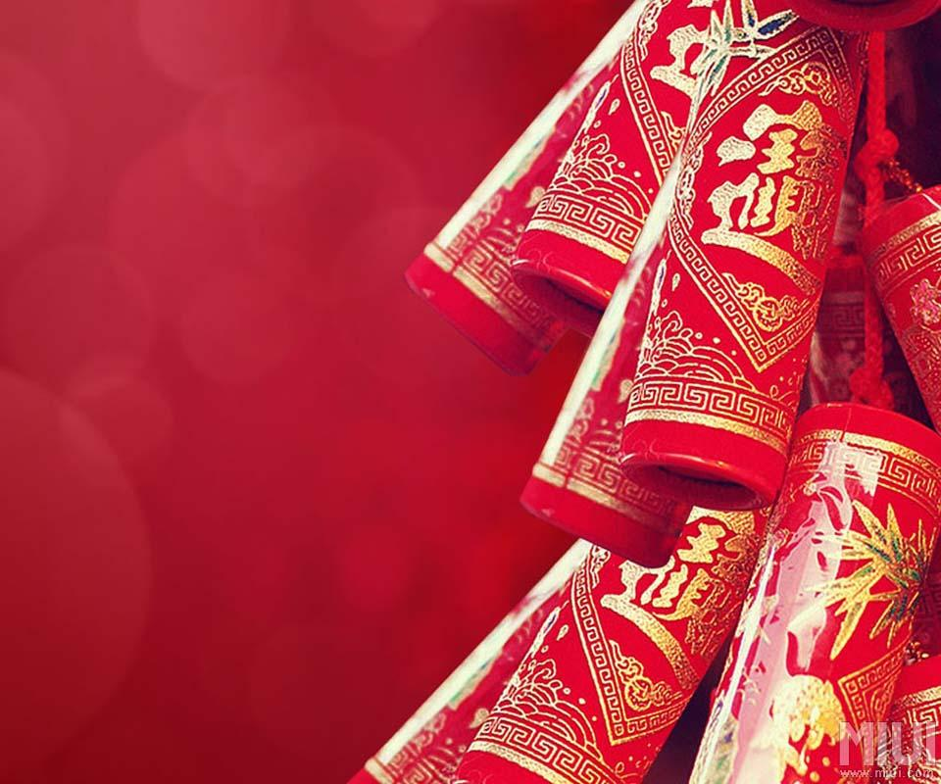
Traditional
Costumes and Dyeing
China and Morocco • Chinese Elective • 6-minute report • 40 points
Notes:
0:00–0:15. Hello. My report compares traditional costume and dyeing in China and Morocco. I will focus on silhouette, materials, color, and what clothing can communicate.

Slide 2
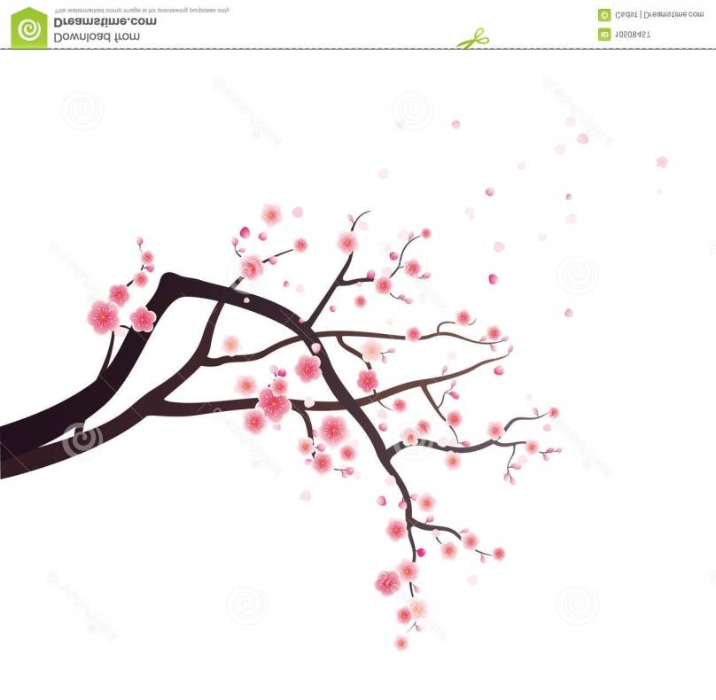
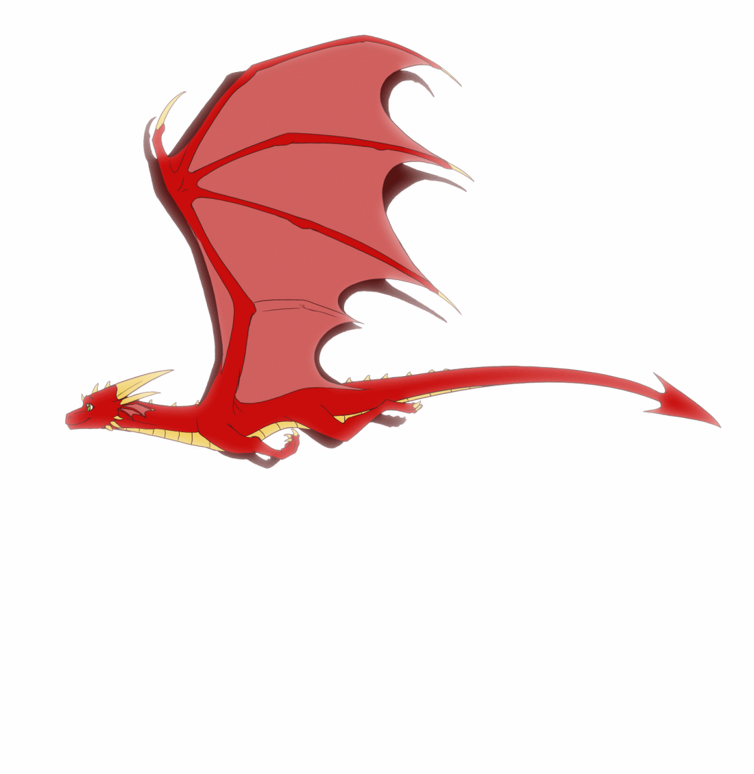
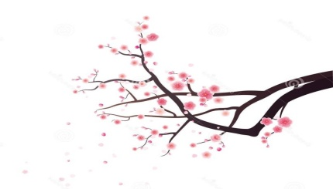
Traditional clothing is a record of history, materials, and skilled work. Chinese dress changed across dynasties; Moroccan dress varies by region and occasion. In both traditions, the cut, fabric, color, and decoration can express identity and social meaning. This report compares examples from China and Morocco.
Notes:
0:15–0:45. Traditional clothing records history and skilled work. Chinese styles changed over many dynasties, while Moroccan styles also vary by region and occasion. Looking at fabric, cut, color, and decoration gives us a fair way to compare the two traditions. Neither country has one single costume that represents everyone.

Slide 3
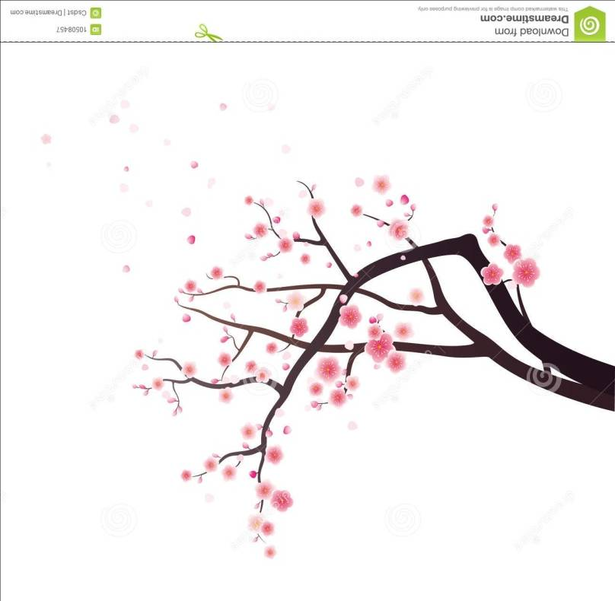
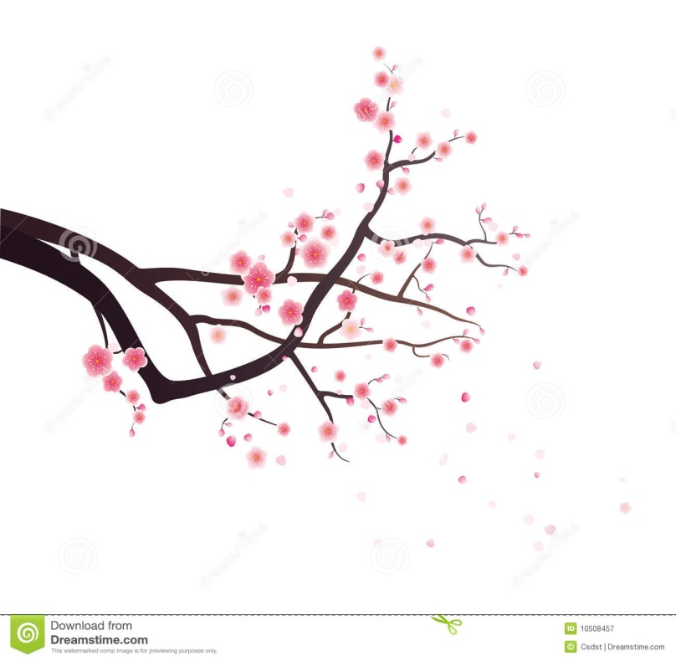
Common forms
• Upper garment with a skirt; or a long robe.
Shape and construction
• Overlapping collars and waist ties are common in many styles.
• Straight, flowing lines; sleeve and hem length vary by period and purpose.
• Garments were often layered and cut from flat panels.
Notes:
0:45–1:20. Many Chinese garments can be grouped as an upper garment with a skirt or a long robe. Overlapping collars and waist ties appear in many historical forms. The lines are often long and flowing, but sleeves, length, and layers changed with period, activity, and status. These are recurring features, not rules for every garment.

Slide 4
Materials
Silk was prized; hemp, cotton, and other fibers were also used, depending on period and access.
Dye and color
In China, indigo gave blues; safflower reds and pinks; gardenia yellows are examples of plant dyes.
In Morocco, regional textile dyes include indigo, madder, saffron, and henna; fibers and palettes vary by place.
Patterns
Auspicious motifs could express good wishes; dragons on imperial clothing could signal authority.
Notes:
1:20–2:05. Silk became an important and prestigious material in China, alongside hemp and cotton in different eras. Indigo is associated with blue; safflower can produce reds and pinks; yellow shades came from several plants. Patterned cloth could carry auspicious wishes or signal rank. Moroccan dress uses varied fibers too, and its palettes and techniques differ across regions. A garment's color reflects both available materials and the work of dyers.

Slide 5
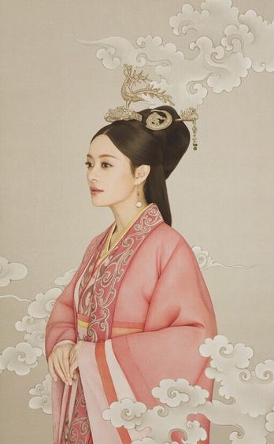
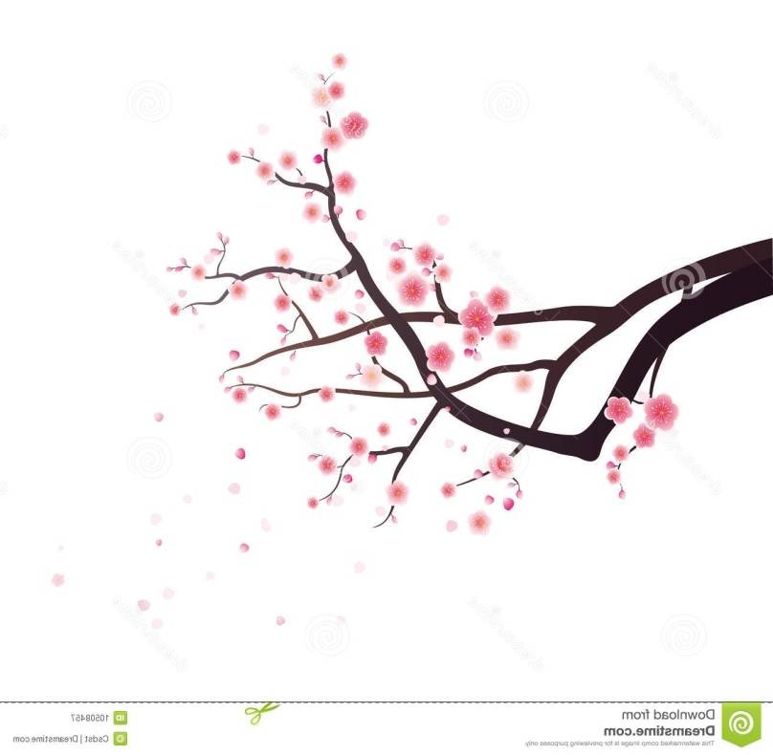
Hanfu refers broadly to traditional Han Chinese dress; it includes many styles rather than one uniform outfit. Overlapping collars, waist ties or sashes, and layered garments appear in many forms. Materials and details changed over time and could reflect occasion, identity, or social position.
Hanfu, a national formal wear, takes its name from the times of the Han Dynasty, and now long out of fashion. A complete set of Hanfu, covers the clothing, clothing accessories, jewelry etc, and reflects the rituals of Chinese culture from that era.
Notes:
2:05–2:35. Hanfu is a broad term for traditional Han Chinese clothing, with many styles rather than one uniform outfit. Crossed collars, sashes, and layers can appear in several forms. Accessories and details changed over time and could communicate occasion, identity, or social position. It is best to think of Hanfu as a changing family of clothing.

Slide 6
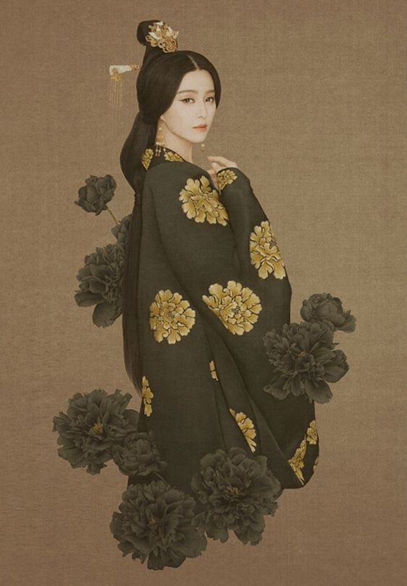
Chinese clothing changed with fashion, materials, and social life.
Tang (618–907): flowing forms and vivid colors are often associated with the period.
Song (960–1279): some elite styles favored restrained lines and quieter colors.
Ming (1368–1644): layered robes and patterned textiles featured in formal dress.
These are broad tendencies—not rules for everyone.
Notes:
2:35–3:15. A quick comparison across three eras shows changing ideals. Tang clothing is often associated with vivid color and flowing forms. Some Song elite styles favored restraint and quieter colors. Ming formal clothing could use layered robes and rich patterns. These are broad tendencies; regional practice, personal status, gender, and occasion all mattered.

Slide 7
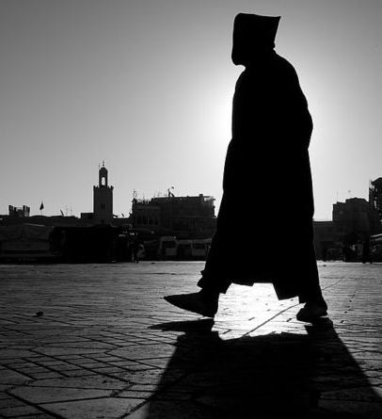
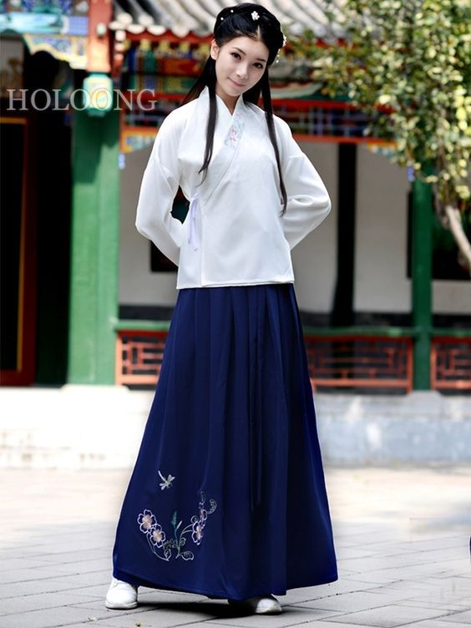
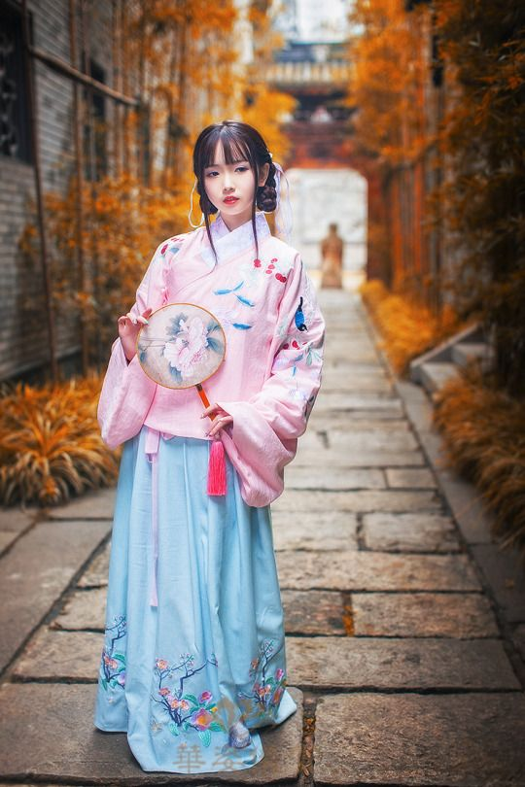
Moroccan dress
Djellaba: a long outer garment, often hooded. Caftans and takchitas are formal layered garments, often finished with embroidery, braided sfifa, or a belt. Styles, materials, and colors vary by region and occasion.
Photo: Maghreb Magazine / Wikimedia Commons.
Notes:
3:15–4:00. Moroccan examples include the djellaba, a long outer garment often made with a hood, and caftans or takchitas for formal occasions. Braided sfifa trim, belts, and embroidery can make the garment a display of craft. Styles and materials vary by region and by the occasion. The photograph is one example, not a complete picture of Moroccan dress.

Slide 8
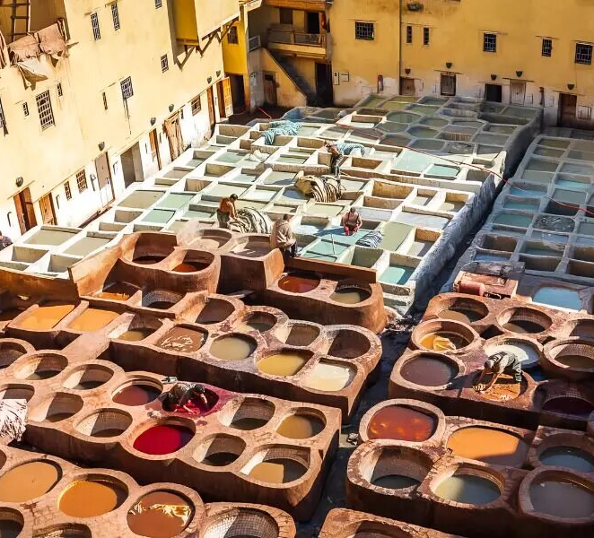
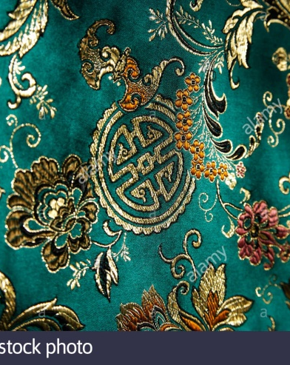
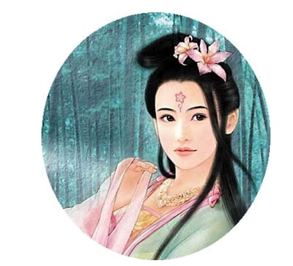
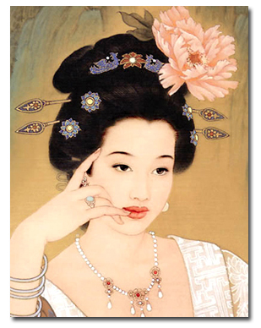
China
Indigo, safflower, and yellow-producing plants are examples of historic dye sources. Resist and repeated-dip methods create different shades and patterns.
Morocco
Dye practice varies by region and material. Fez is known for historic leather dyeing; its vats show a related craft, not garment-fabric dyeing.
In both places, color depends on preparation, the dye bath, rinsing, and careful finishing.
Chinese favoured beautiful, petite women with pale skin, bright eyes and white teeth.
The typical look was bushy, sprawling eye brows, long slanted eyes, thick pouting lips, an expansive coating of rouge on the cheeks and dainty flowers painted on the forehead.
Tang Dynasty there were seven steps to applying cosmetics. First they applied the powder base then they applied colour to their face, eyebrow darkening came next, then they applied 'forehead gold' or 'floral gold', then they painted the dimples, decorated the cheeks and, lastly, applied lip colour.
The Ancient Chinese began to stain their nails with gum, gelatin, beeswax and egg. This was an early form of nail polish.
Lower class were forbidden to colour their nails with bright colours.
Women used rice powder to make their faces white and Henna dyes to stain their hair.
Fez tannery image: Marrakeche.com. Lower textile image reused from the original presentation.
Notes:
4:00–4:45. Dyeing is a sequence: prepare the material, apply color, rinse, and finish. In China, indigo and other plant dyes created varied palettes and patterns. Moroccan dye traditions also vary by material and place. The Fez image shows leather dyeing at historic tannery vats, which is related craft but not the same as dyeing cloth. This distinction matters when comparing costume textiles.

Slide 9
China &
Morocco
FEATURE | CHINA | MOROCCO
Silhouette | Layered robes; crossed collars and waist ties recur in many styles. | Djellaba outerwear; caftan / takchita for formal occasions.
Materials | Silk, hemp, and cotton across different periods. | Wool, cotton, and silk in varied regional uses.
Color & craft | Plant dyes, woven patterns, and embroidery. | Regional palettes, embroidery, and braided sfifa trim.
Meaning | Can express era, occasion, status, and identity. | Can express region, occasion, craft, and identity.
Shared value | Clothing carries cultural memory and makers’ skill. | Clothing carries cultural memory and makers’ skill.
Different histories.
Shared respect for
craft and identity.
Notes:
4:45–5:40. The table compares silhouette, materials, color and craft, and meaning. Chinese historical clothing includes layered robes and overlapping collars; Moroccan examples include the djellaba and formal caftan or takchita. The fibers and dye methods are diverse in both places. Both traditions use clothing to communicate identity and occasion, and both depend on the knowledge and labor of makers. Similarities do not erase their distinct histories.

Slide 10
Tradition &
craftsmanship
Costumes are more than garments: they carry materials, memory, and the hands of the makers.
Notes:
5:40–6:00. To conclude, traditional costume connects materials and skilled work with history and identity. China and Morocco developed distinct forms, yet both preserve cultural memory through clothing. Thank you.

