Slide 1

ELEMENTS
COLLECTION — SS26
ASMARA INDIA · SUSTAINABLE FABRICS
13 STYLES

Slide 2
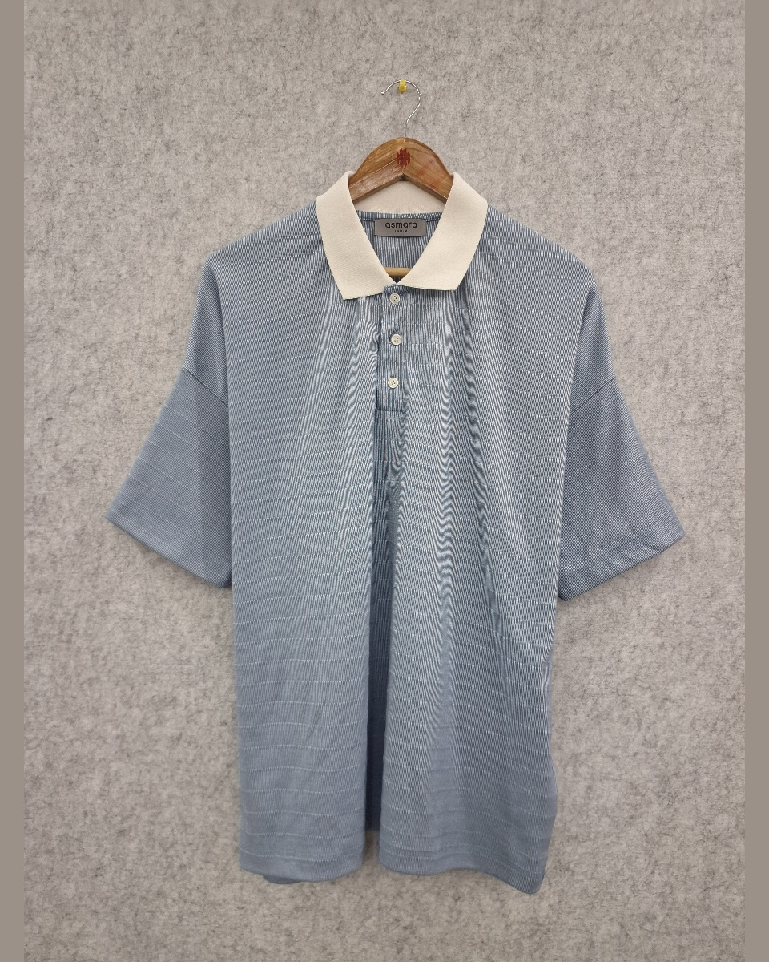
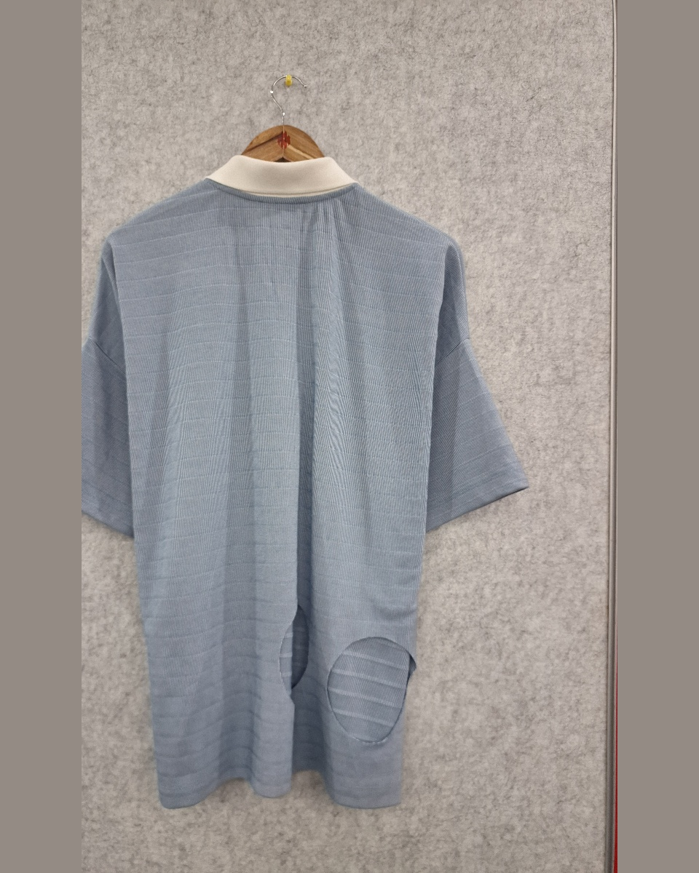
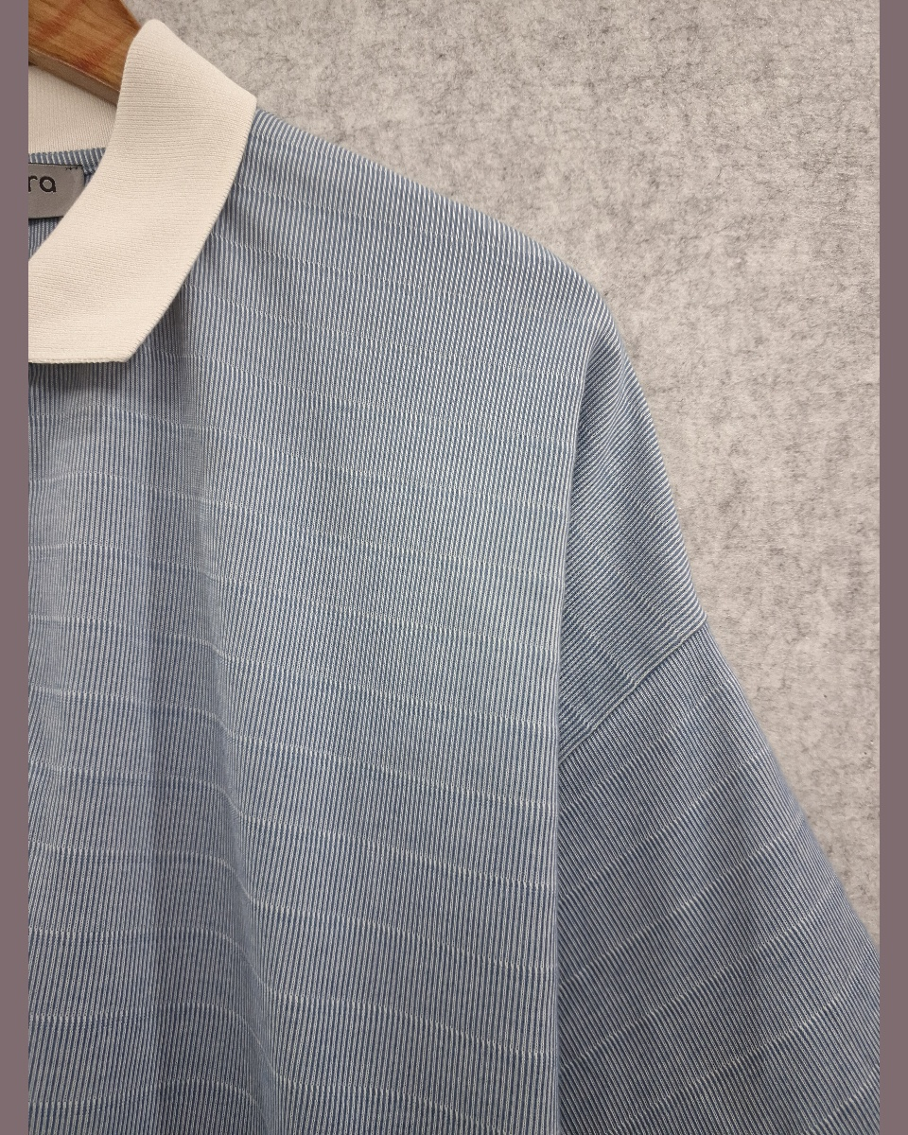
01
BLUE STRIPE POLO
ASM-NXT-003 · 55.3% Recycled Polyester, 44.7% Organic Cotton · 202 GSM
DETAIL
REF
ASM-NXT-003
CONTENT
55.3% Recycled Polyester, 44.7% Organic Cotton
GSM
202 g/m²
REMARKS
AFS-4357
DATE
30-03-2026
FRONT
BACK
1 / 13
ASMARA INDIA

Slide 3
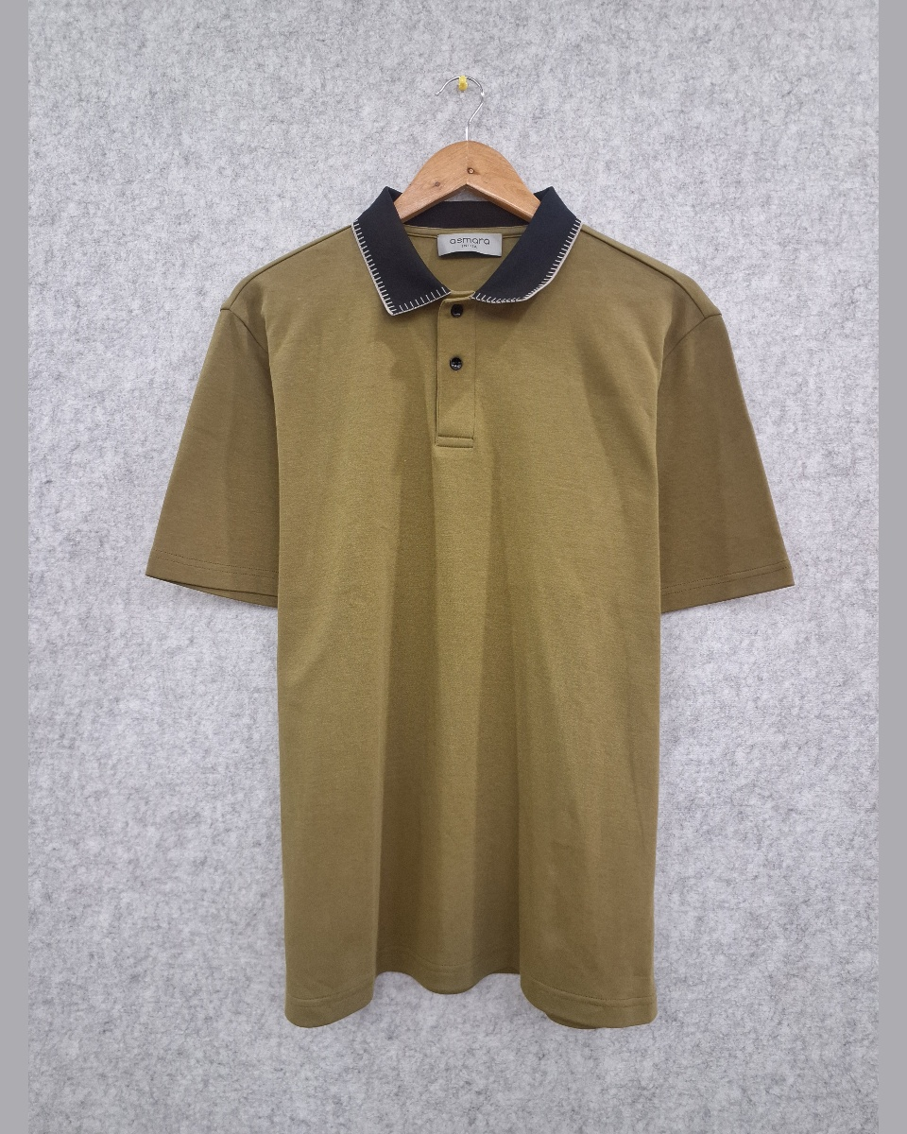
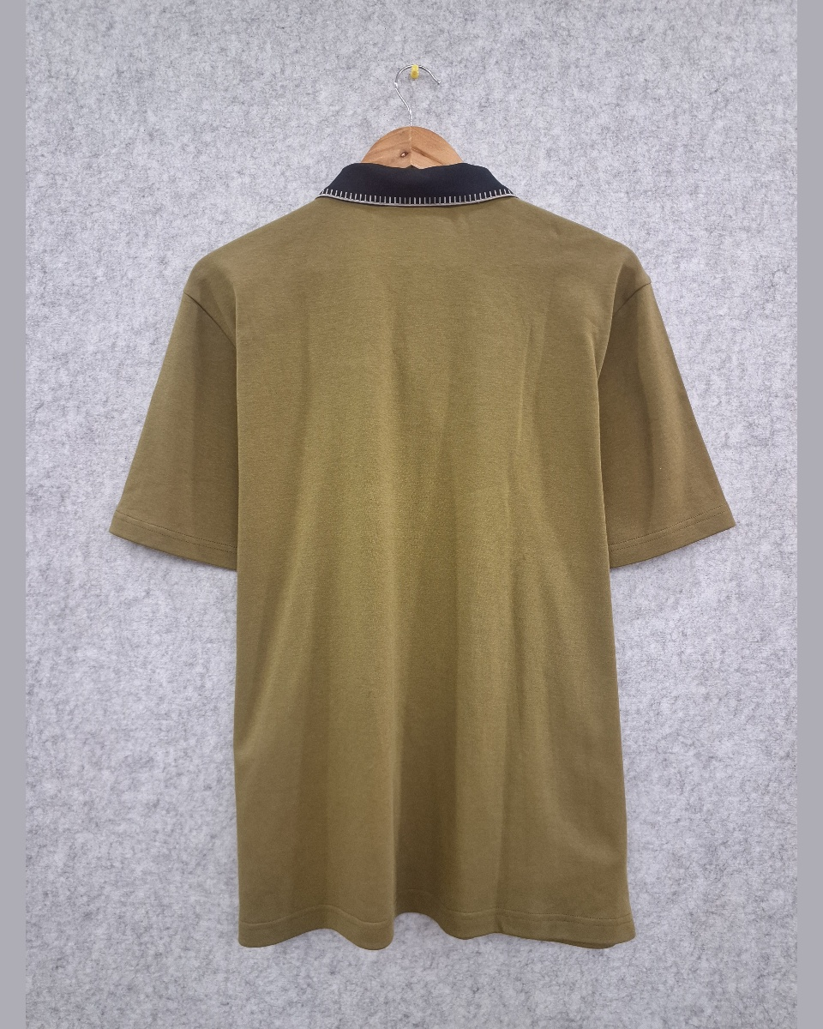
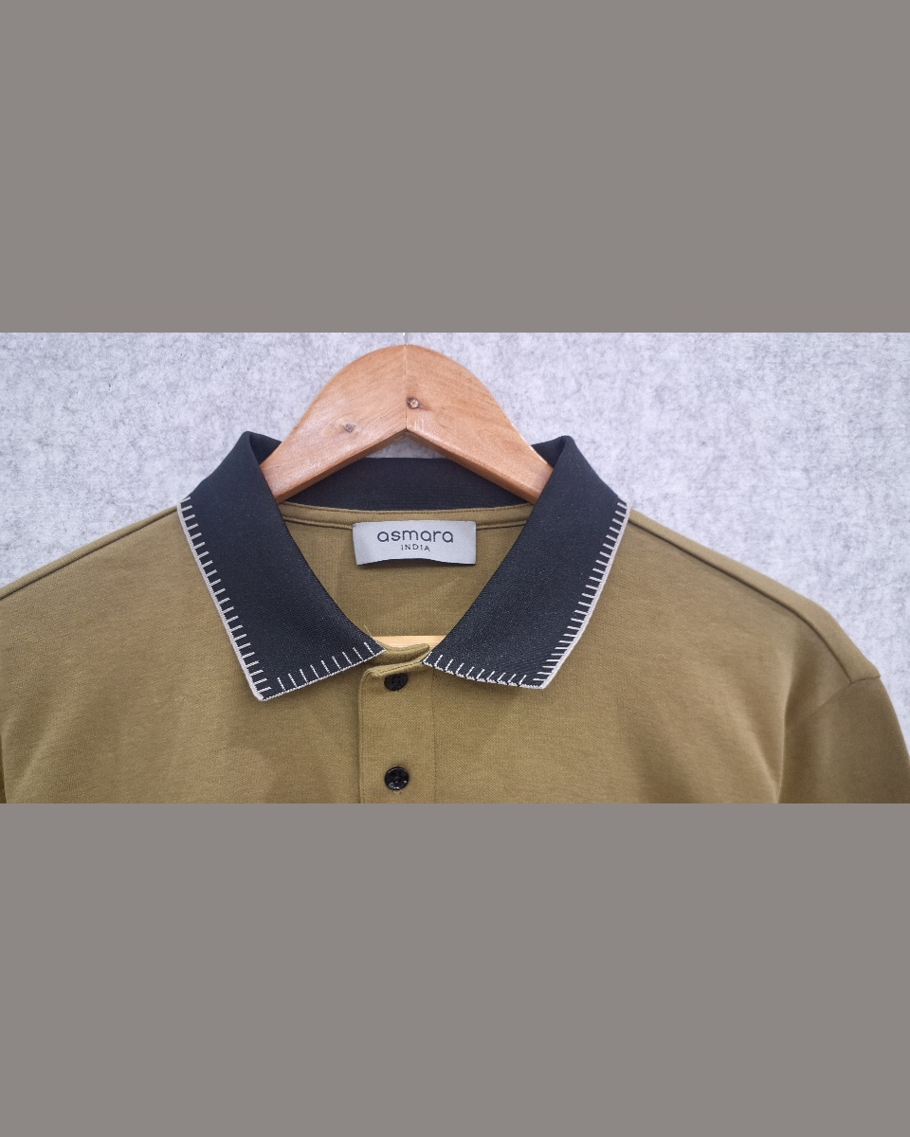
02
OLIVE POLO — NAVY BLANKET COLLAR
AFS-4371 · 100% Cotton · 222 GSM
DETAIL
REF
AFS-4371
CONTENT
100% Cotton
GSM
222 g/m²
DATE
06-04-2026
FRONT
BACK
2 / 13
ASMARA INDIA

Slide 4
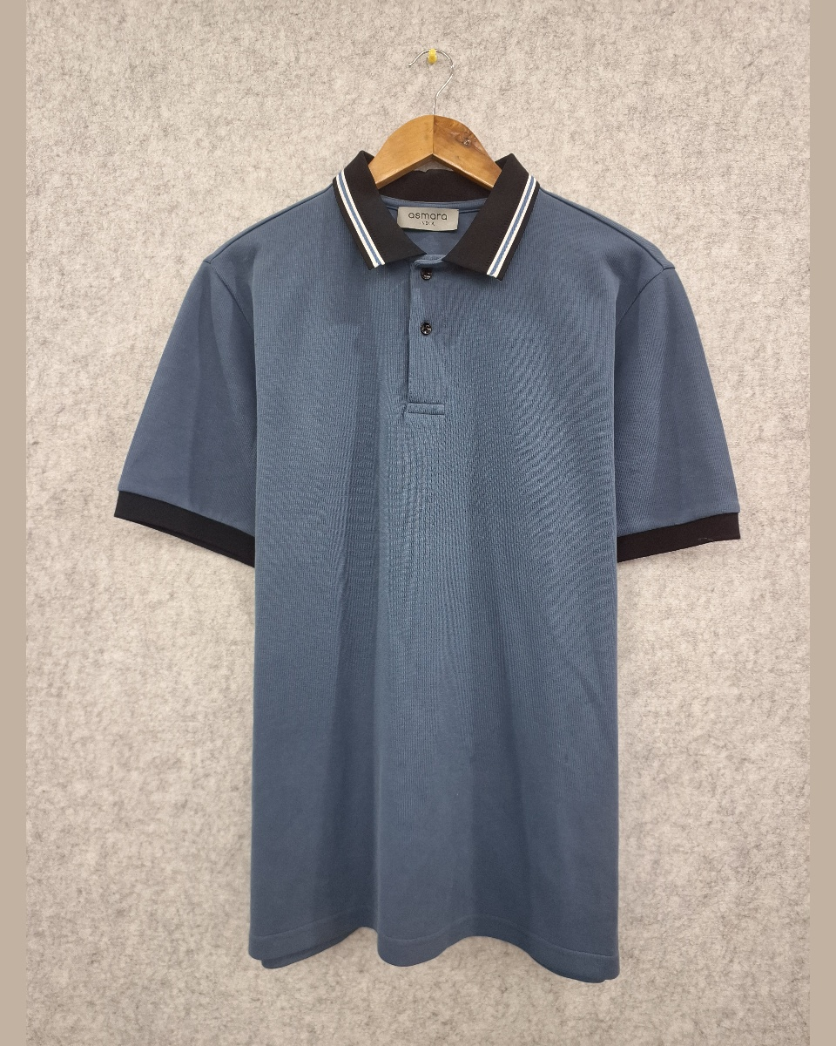
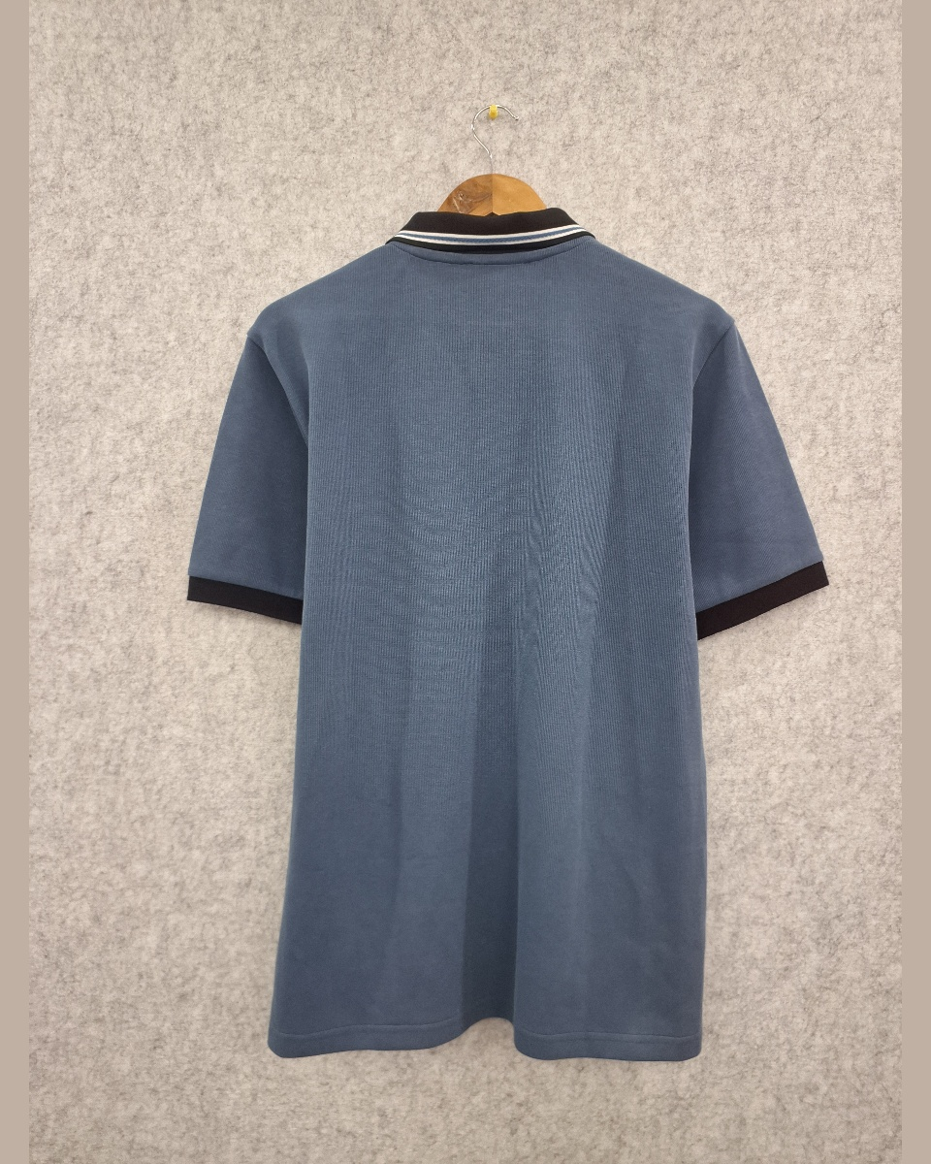
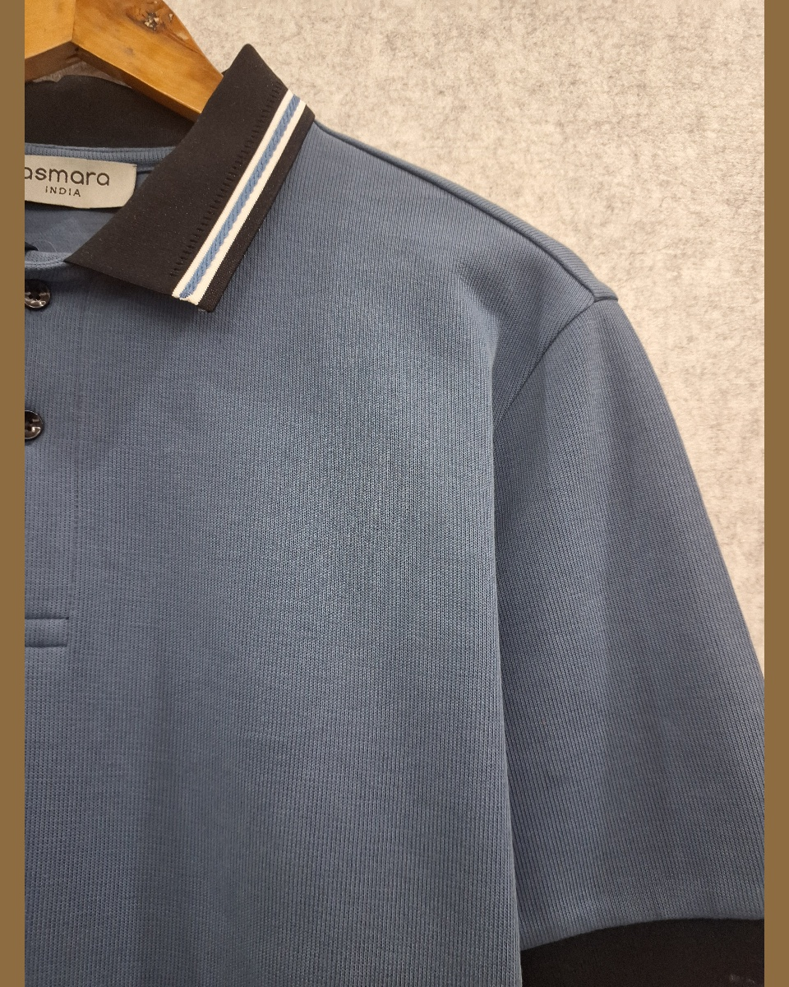
03
STEEL BLUE POLO — BLACK STRIPE COLLAR
AFS-4372 · 100% Cotton · 340 GSM
DETAIL
REF
AFS-4372
CONTENT
100% Cotton
GSM
340 g/m²
DATE
06-04-2026
FRONT
BACK
3 / 13
ASMARA INDIA

Slide 5
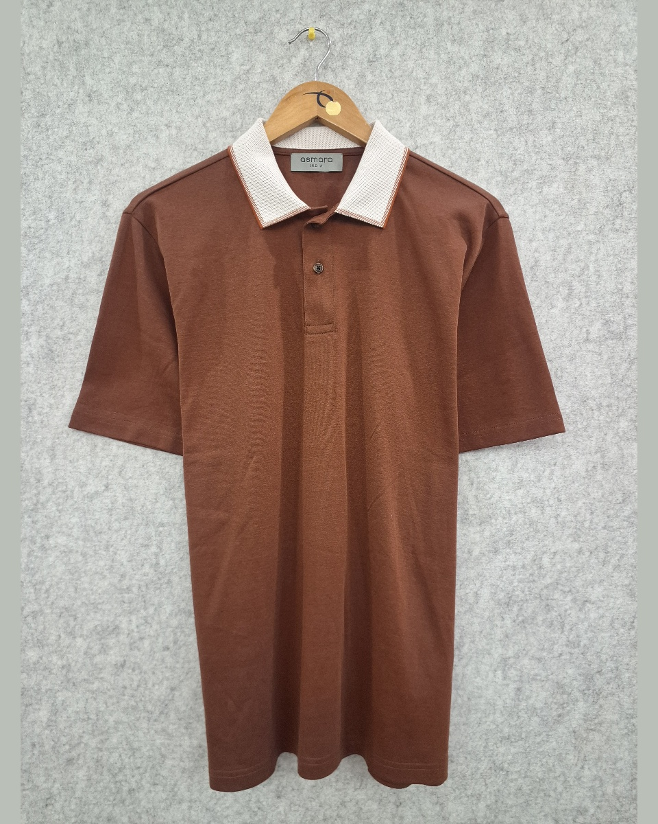
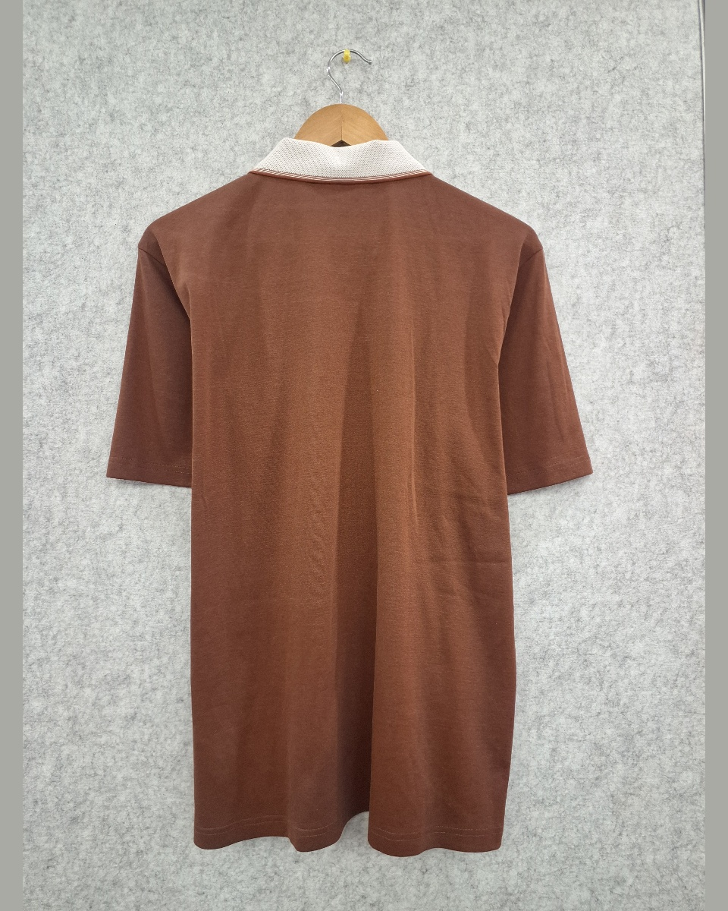
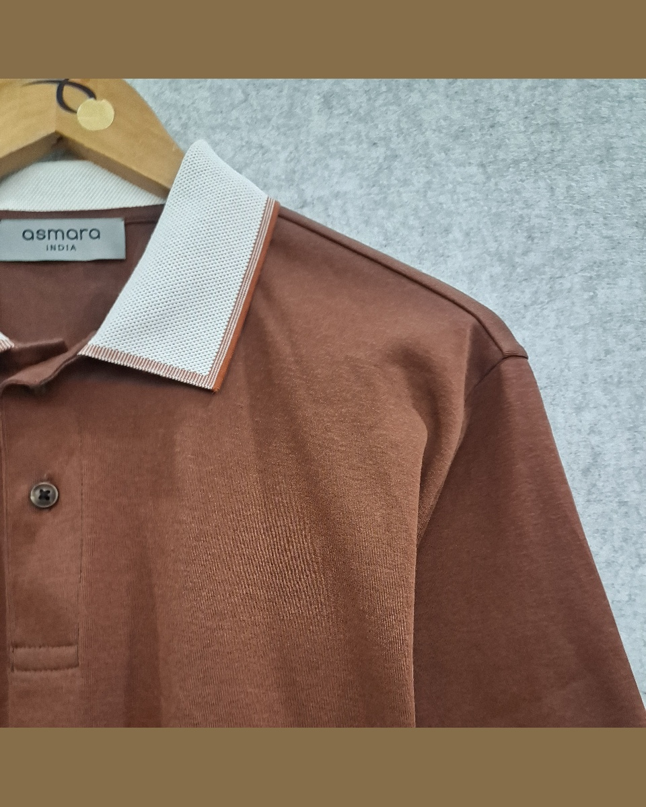
04
BROWN POLO — WHITE COLLAR
AFS-4373 · 100% Cotton · 202 GSM
DETAIL
REF
AFS-4373
CONTENT
100% Cotton
GSM
202 g/m²
DATE
06-04-2026
FRONT
BACK
4 / 13
ASMARA INDIA

Slide 6
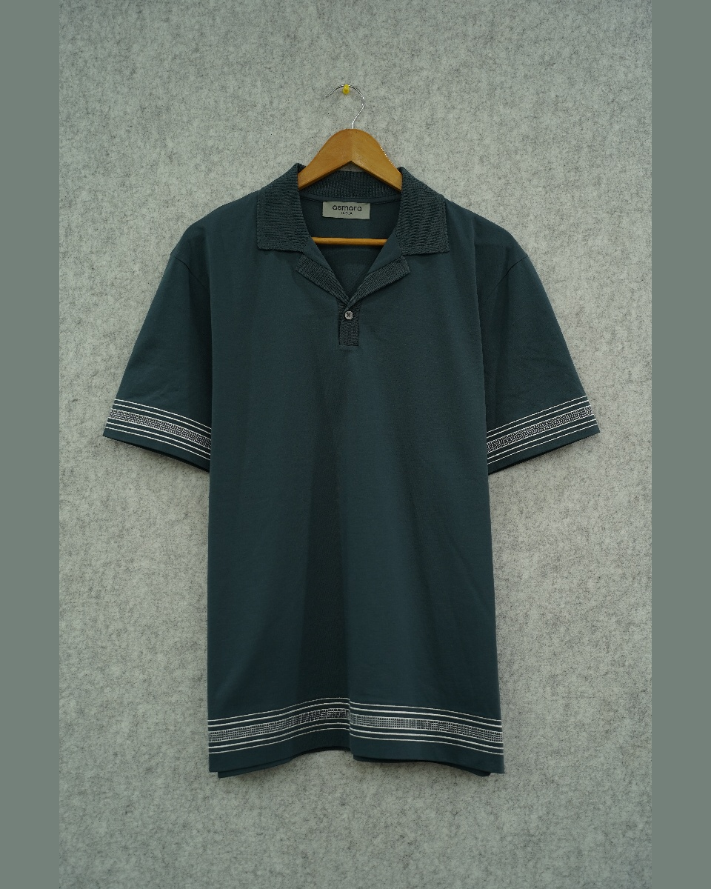
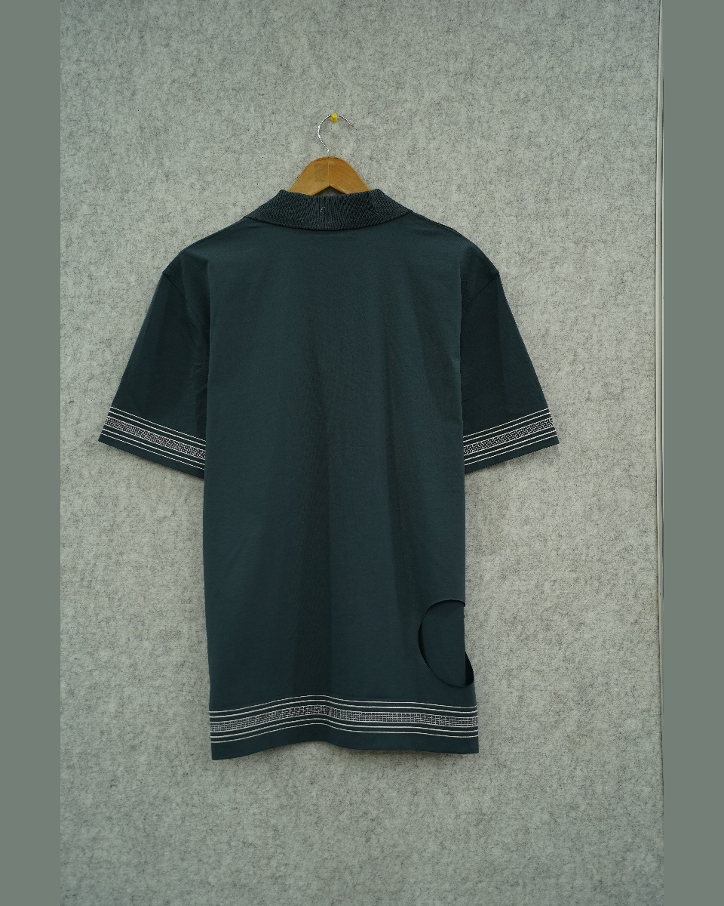
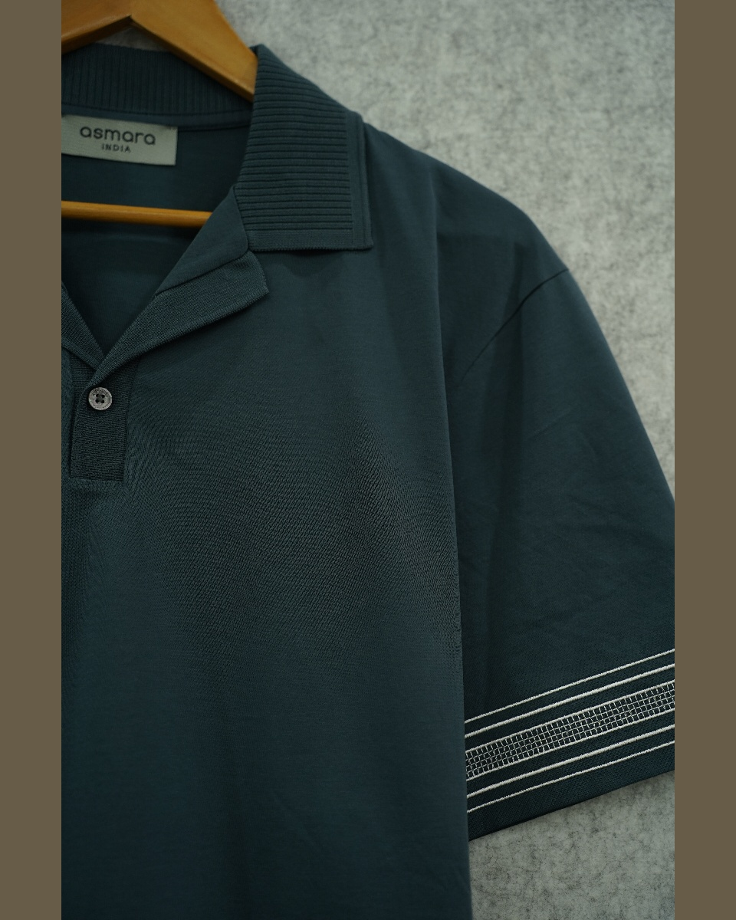
05
DARK TEAL POLO — WHITE STRIPE HEM
AU-BOG-005 · 100% Organic Cotton · 180 GSM
DETAIL
REF
AU-BOG-005
CONTENT
100% Organic Cotton
GSM
180 g/m²
REMARKS
AFS-4316
DATE
23-03-2026
FRONT
BACK
5 / 13
ASMARA INDIA

Slide 7
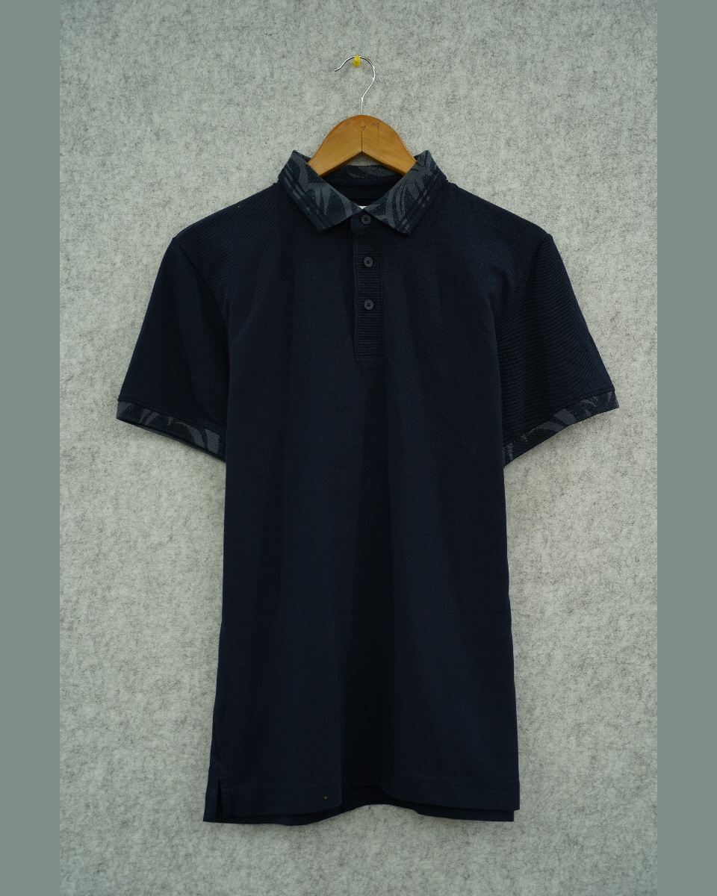
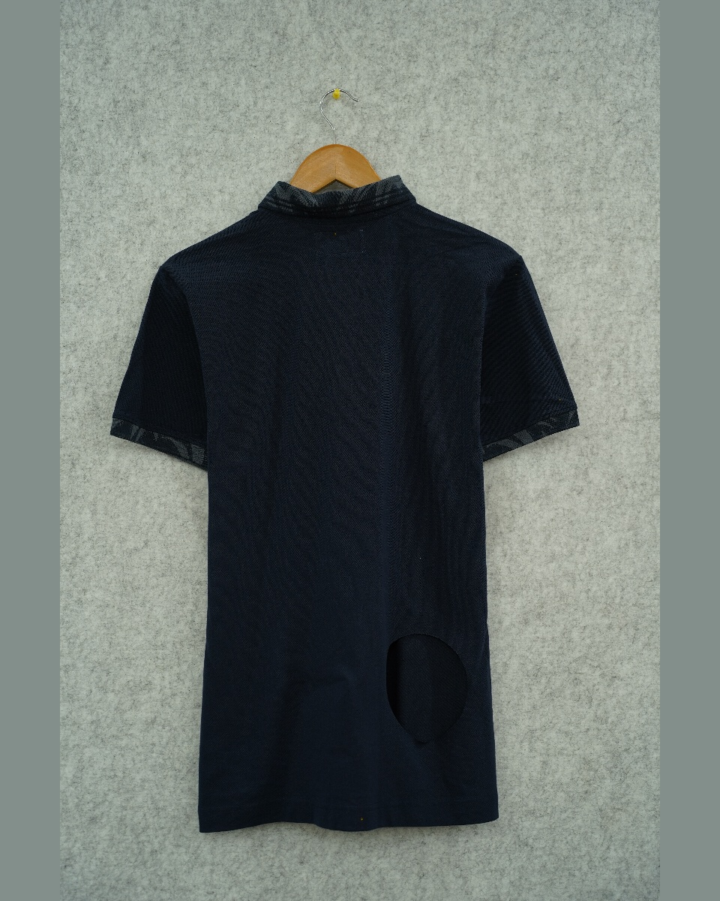
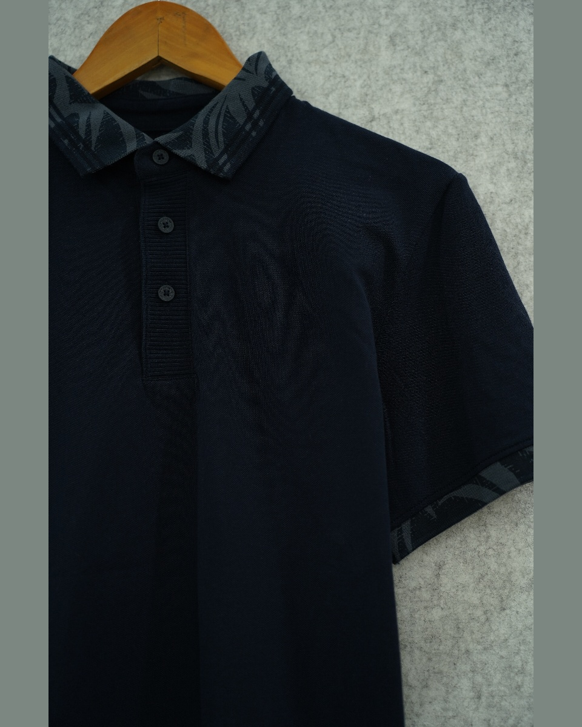
06
NAVY POLO — JACQUARD COLLAR
TT-BOG-001 · 95% Organic Cotton, 5% Elastane · 220 GSM
DETAIL
REF
TT-BOG-001
CONTENT
95% Organic Cotton, 5% Elastane
GSM
220 g/m²
REMARKS
AFS-4312
DATE
23-03-2026
FRONT
BACK
6 / 13
ASMARA INDIA

Slide 8
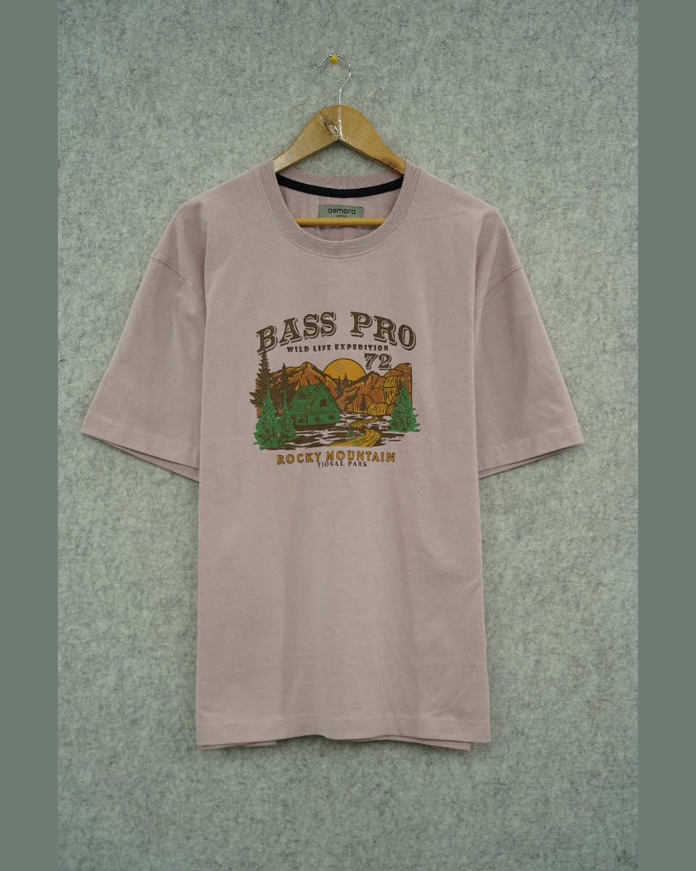
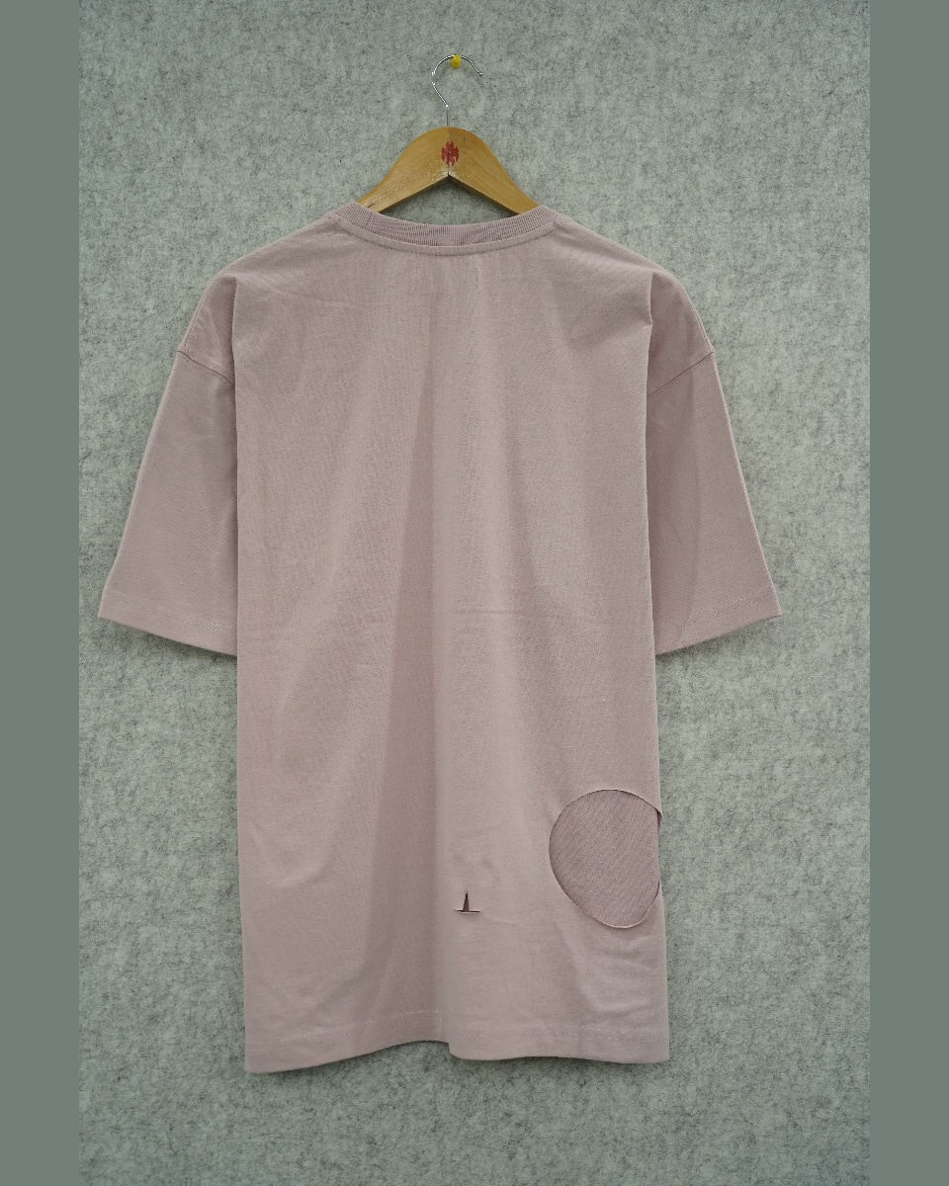

07
BLUSH TEE — BASS PRO GRAPHIC
BP DSRG 13 / AFS-4344 · 60% Organic Cotton, 40% Recycled Polyester · 190 GSM
DETAIL
REF
BP DSRG 13 / AFS-4344
CONTENT
60% Organic Cotton, 40% Recycled Polyester
GSM
190 g/m²
DATE
23-03-2026
FRONT
BACK
7 / 13
ASMARA INDIA

Slide 9
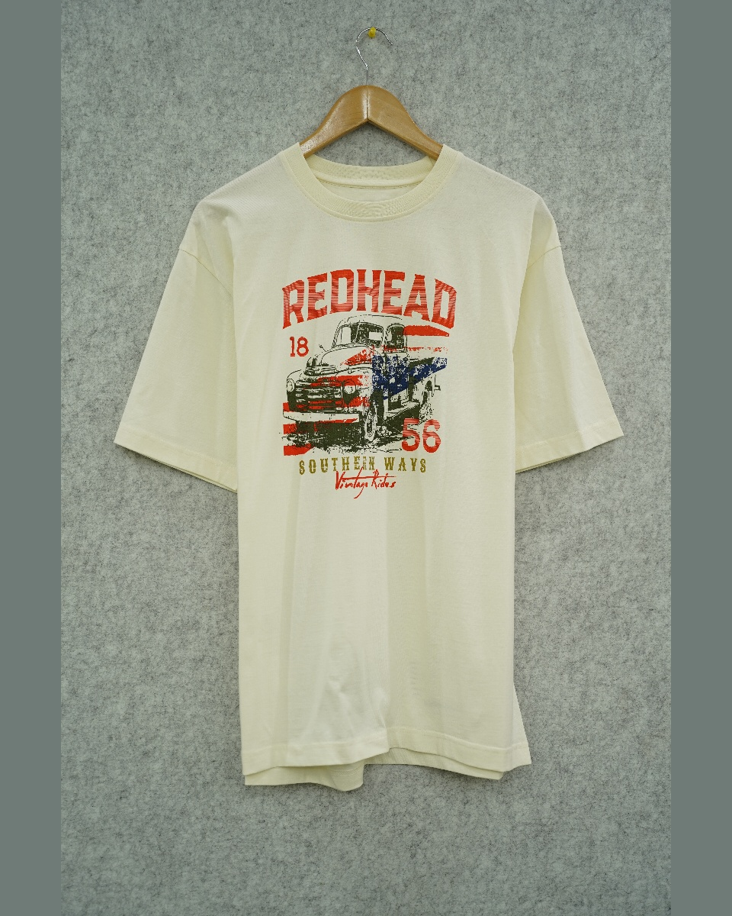
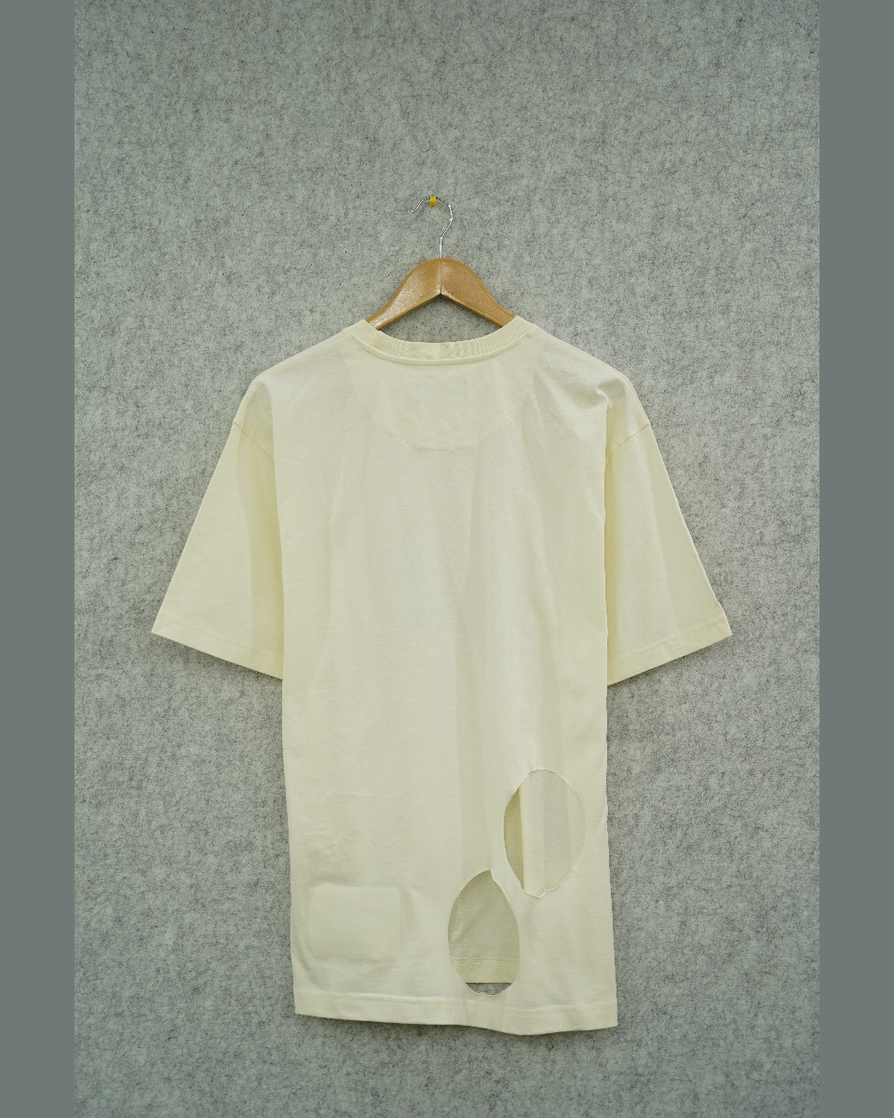

08
CREAM TEE — REDHEAD GRAPHIC
BPNL-02 / BPSC-362 · 100% Organic Cotton · 180 GSM
DETAIL
REF
BPNL-02 / BPSC-362
CONTENT
100% Organic Cotton
GSM
180 g/m²
DATE
24-03-2026
FRONT
BACK
8 / 13
ASMARA INDIA

Slide 10
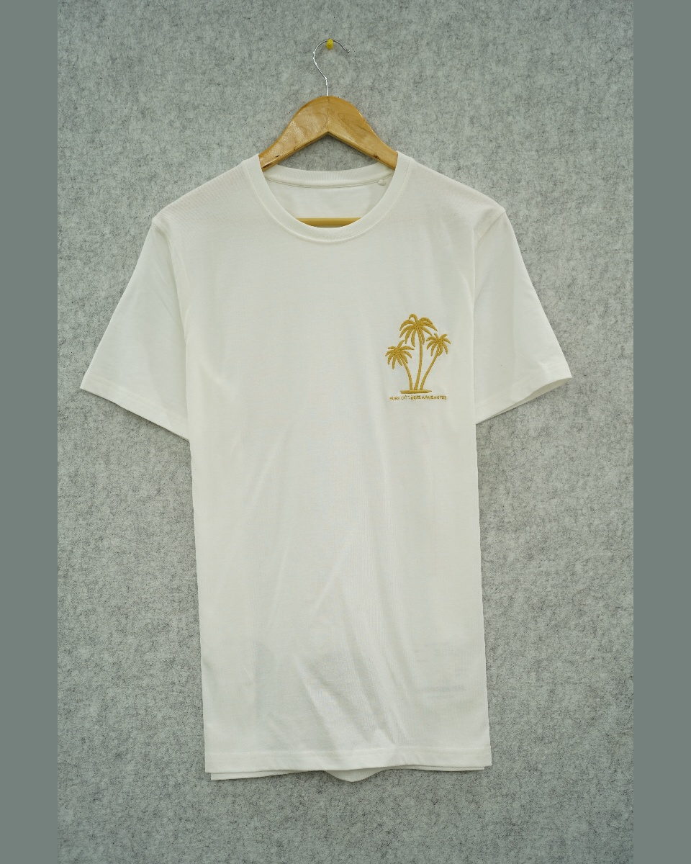
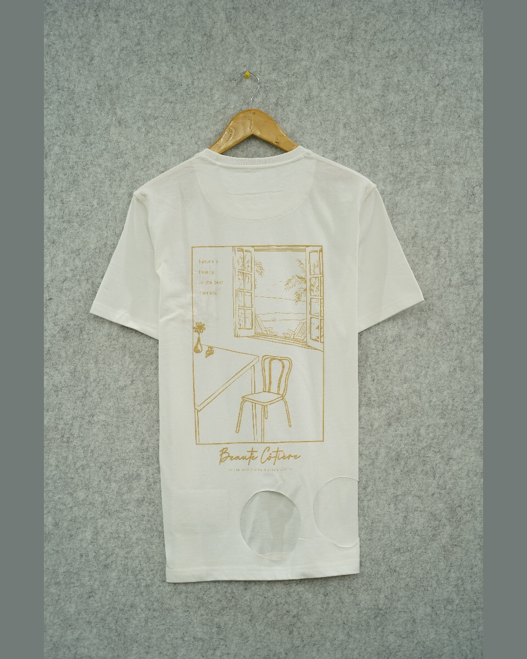
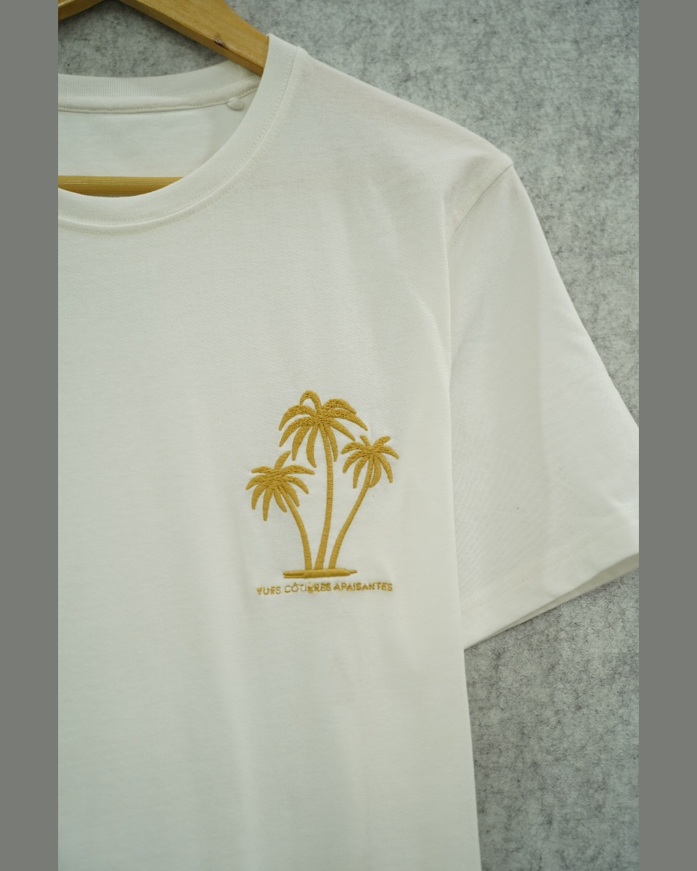
09
WHITE TEE — PALM TREE & BEAUT CITINE GRAPHIC
DEV-001 / BPSC-360 · 100% Organic Cotton · 190 GSM
DETAIL
REF
DEV-001 / BPSC-360
CONTENT
100% Organic Cotton
GSM
190 g/m²
DATE
24-03-2026
FRONT
BACK
9 / 13
ASMARA INDIA

Slide 11
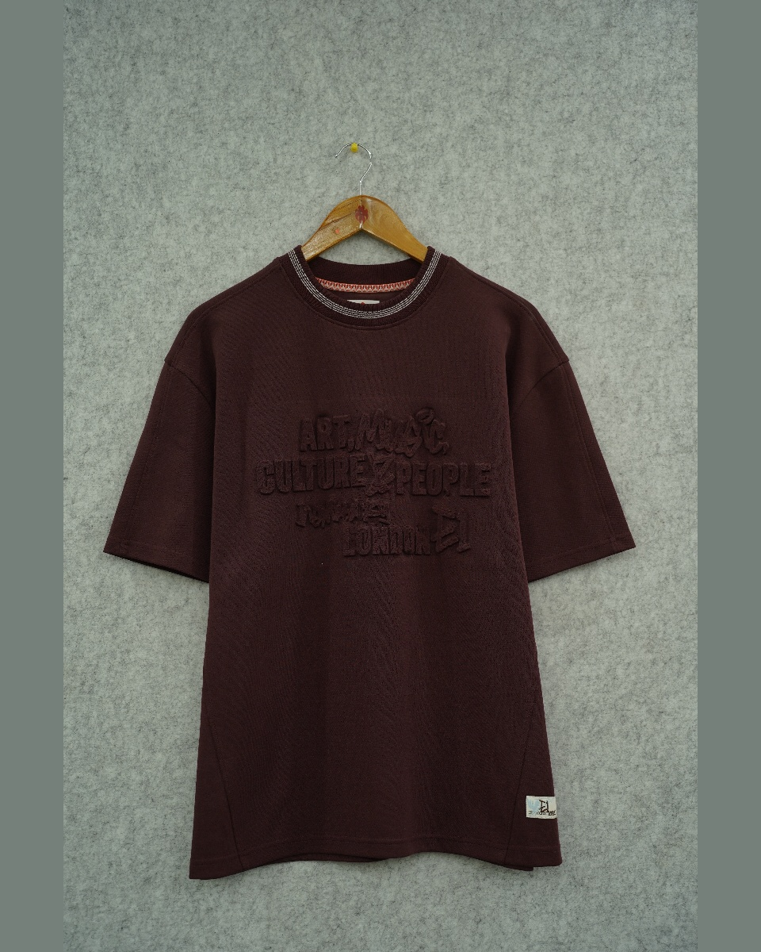
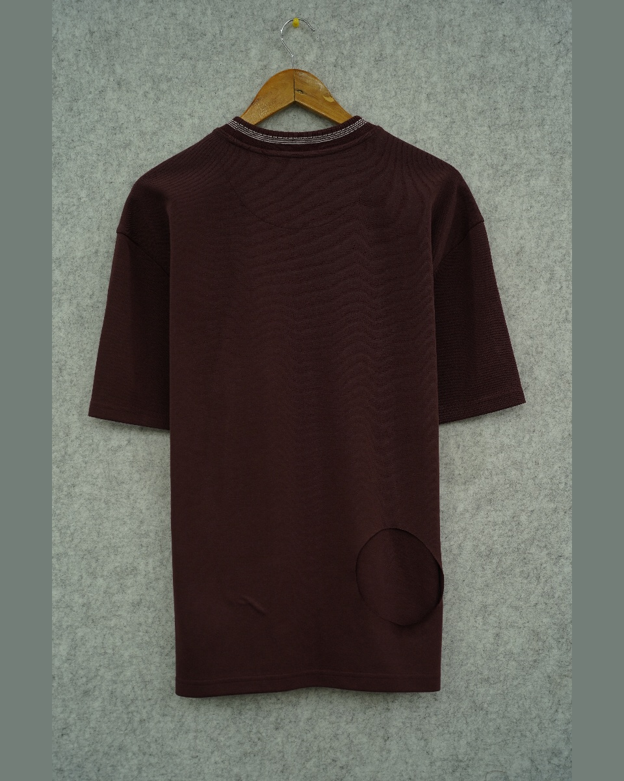

10
CHOCOLATE TEE — LONDON EMBOSS
SPL-PE EMBOSSED TEE · 70% Organic Cotton, 30% Recycled Polyester · 275 GSM
DETAIL
REF
SPL-PE EMBOSSED TEE
CONTENT
70% Organic Cotton, 30% Recycled Polyester
GSM
275 g/m²
REMARKS
AFS-4342
DATE
23-03-2026
FRONT
BACK
10 / 13
ASMARA INDIA

Slide 12
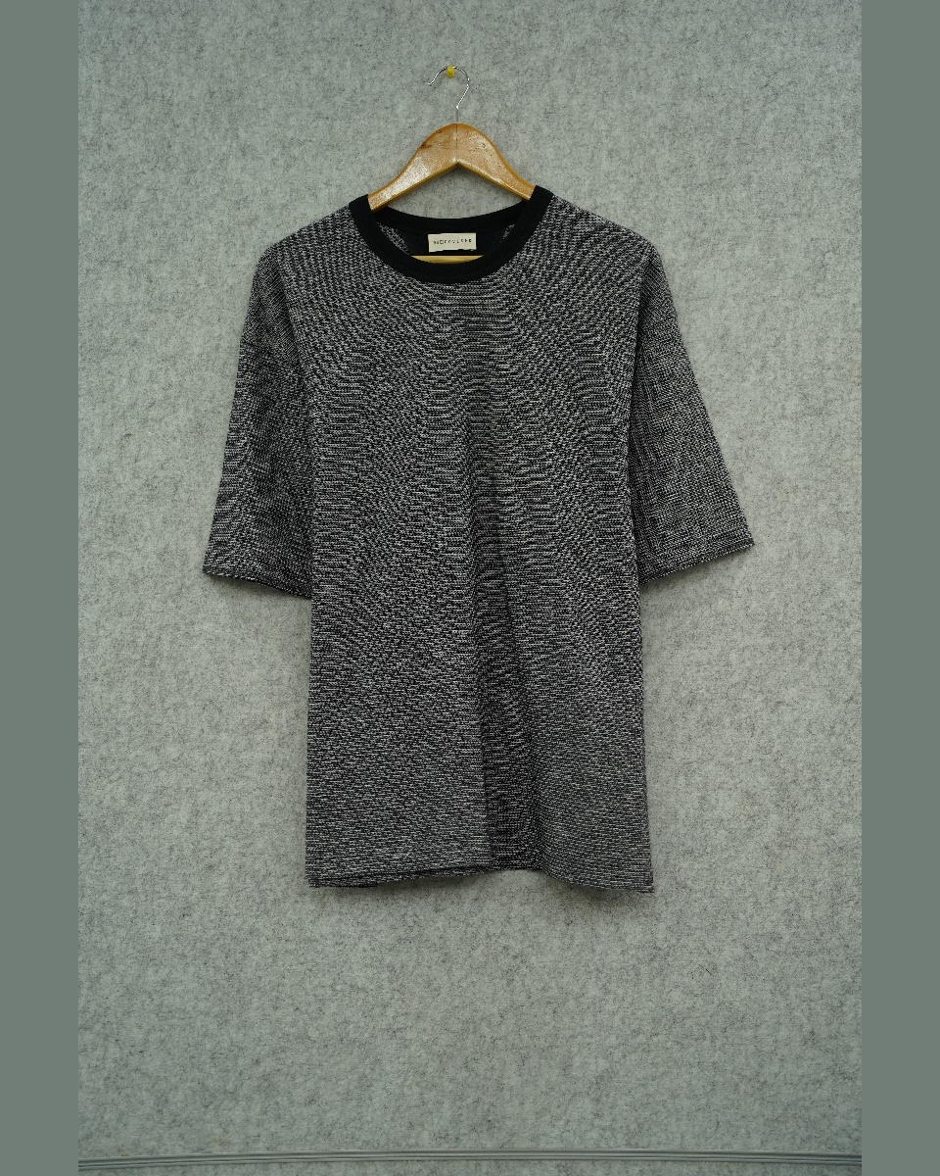
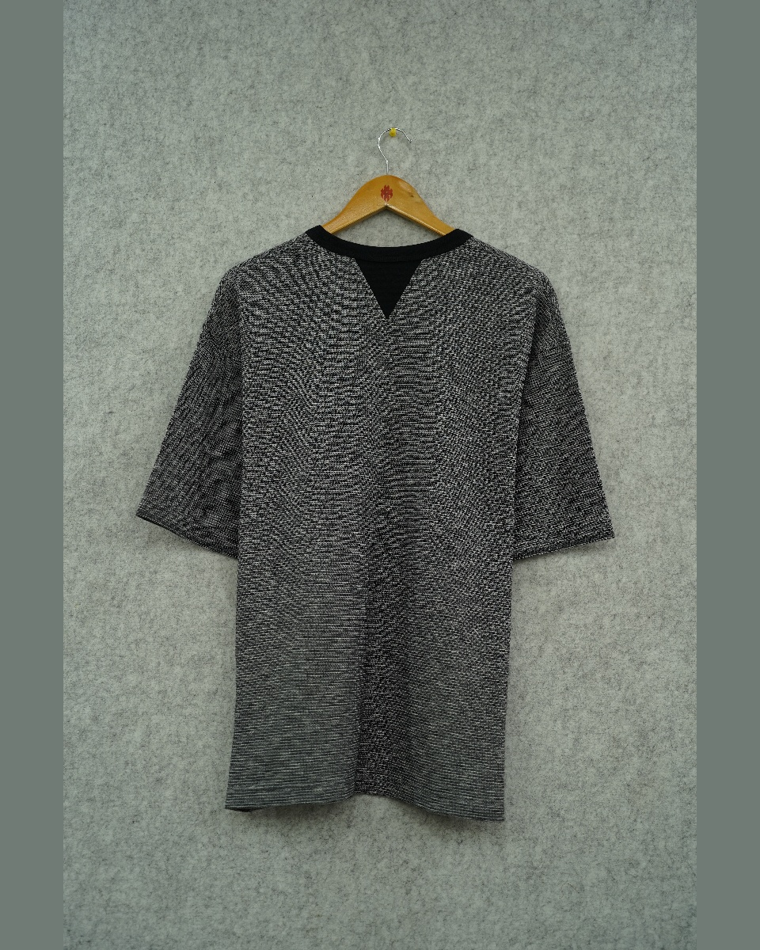
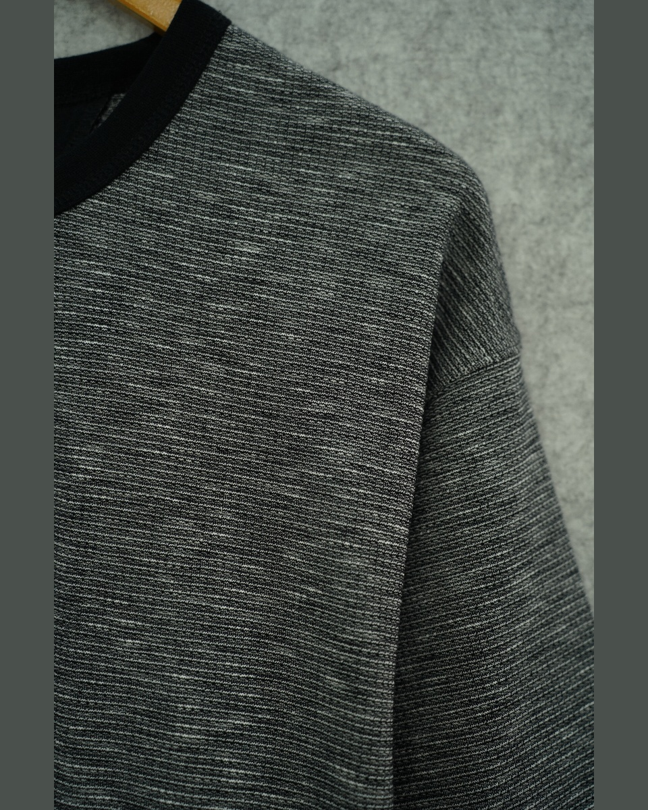
11
GRAY MELANGE POLO — BLACK COLLAR
AND-642 · 100% Organic Cotton · 265 GSM
DETAIL
REF
AND-642
CONTENT
100% Organic Cotton
GSM
265 g/m²
REMARKS
MOPA-124
DATE
20-03-2026
FRONT
BACK
11 / 13
ASMARA INDIA

Slide 13
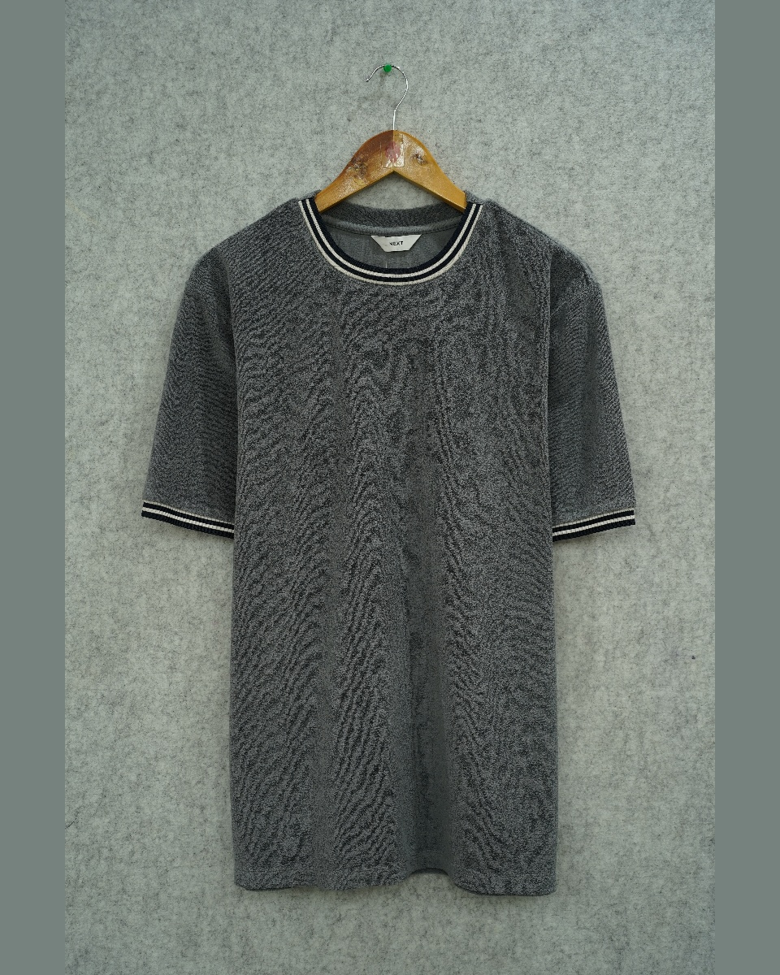
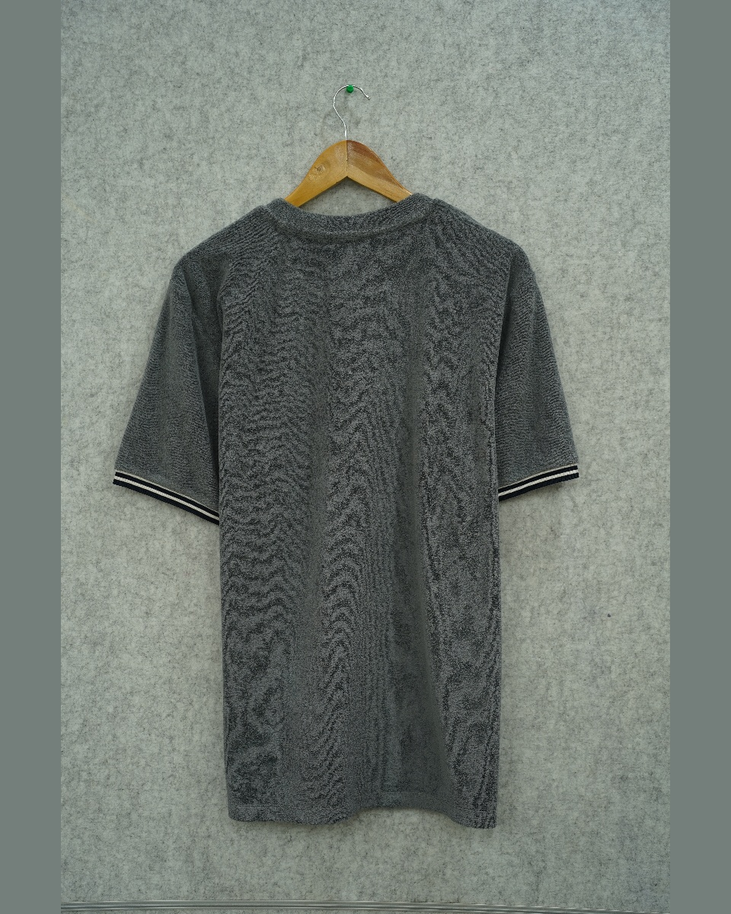
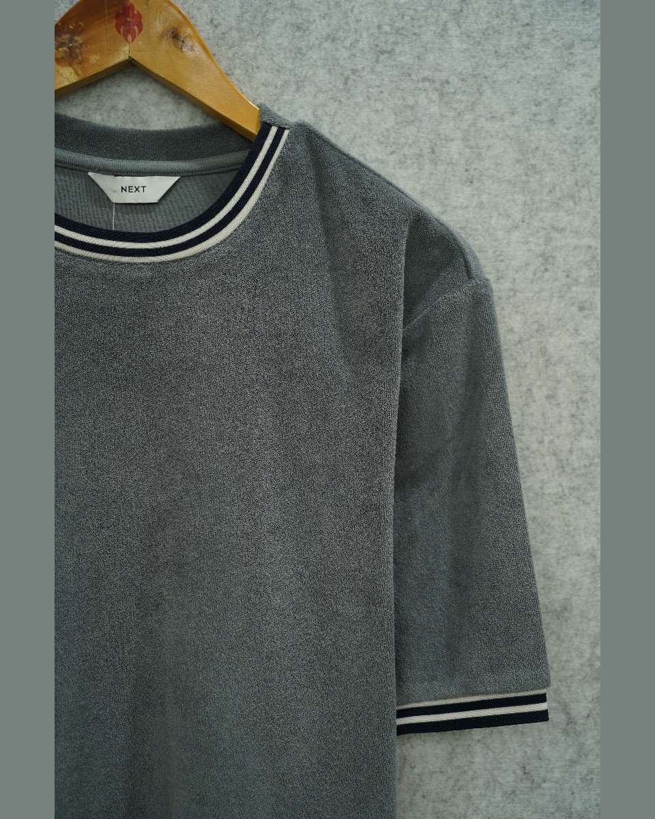
12
GRAY TERRY POLO — STRIPE TRIM
AND-5127-RJ · Organic Cotton / Recycled Polyester · 300 GSM
DETAIL
REF
AND-5127-RJ
CONTENT
Organic Cotton / Recycled Polyester
GSM
300 g/m²
REMARKS
AFS-4189
DATE
20-03-2026
FRONT
BACK
12 / 13
ASMARA INDIA

Slide 14
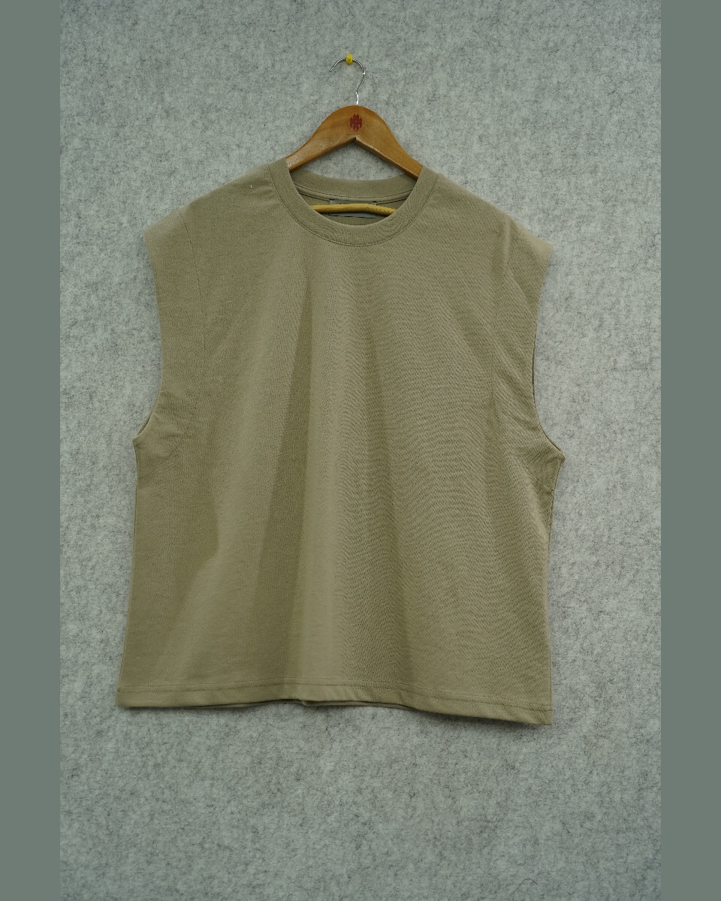
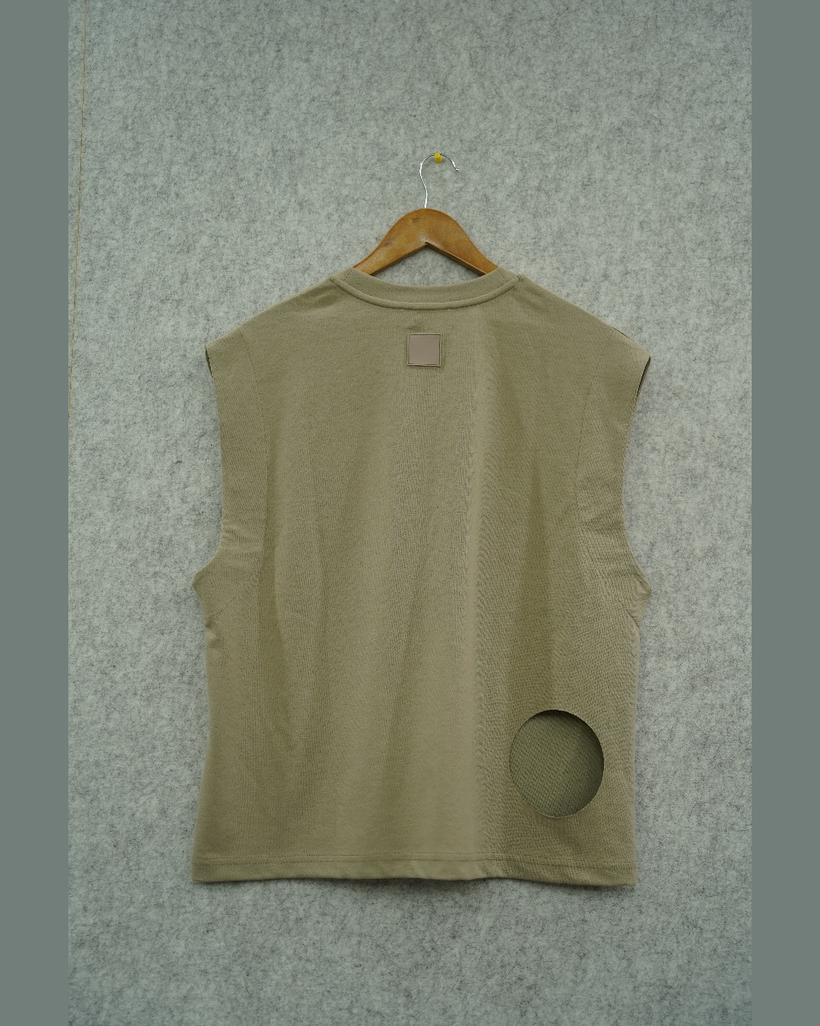
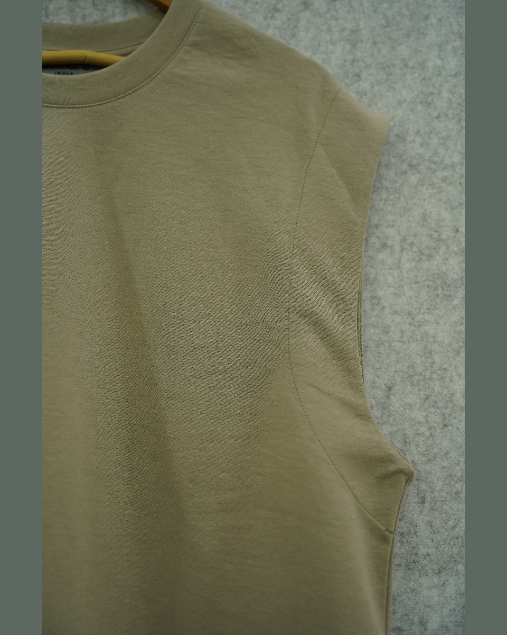
13
KHAKI TEE — PLAIN CREWNECK
ZA-BOG-013 · 51% Organic Cotton, 49% Recycled Polyester · 233 GSM
DETAIL
REF
ZA-BOG-013
CONTENT
51% Organic Cotton, 49% Recycled Polyester
GSM
233 g/m²
REMARKS
AFS-4314
DATE
23-03-2026
FRONT
BACK
13 / 13
ASMARA INDIA

