Slide 1

ELEMENTS
COLLECTION — SS26
ASMARA INDIA · SUSTAINABLE FABRICS
4 STYLES

Slide 2
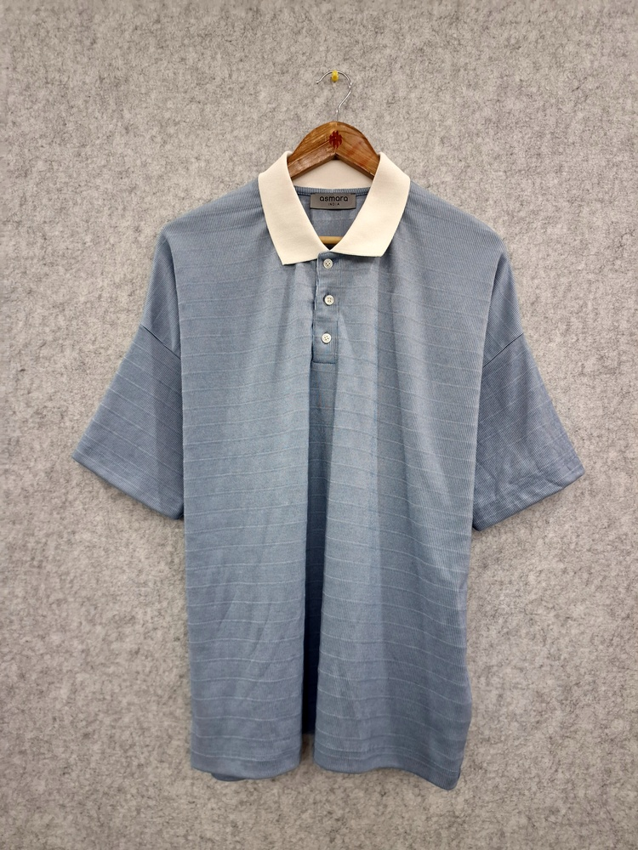
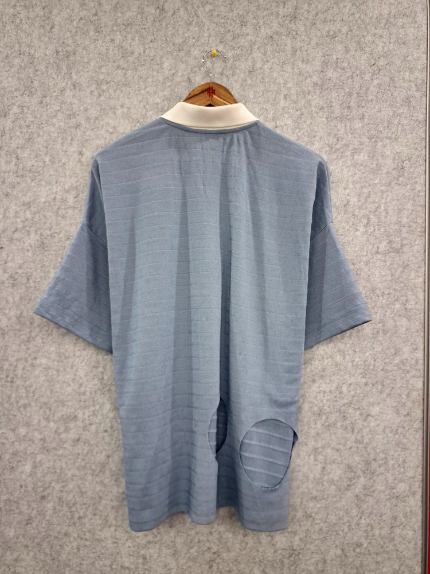
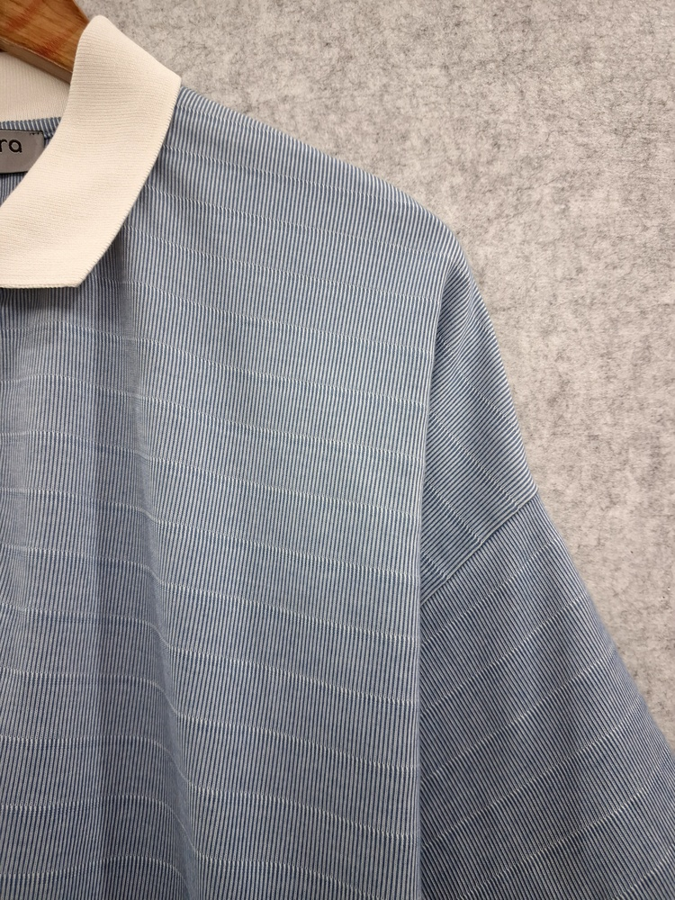
01
LIGHT BLUE RIBBED KNIT LONG-SLEEVED POLO SHIRT
AFS-4373 · 100%COTTON · 202 GSM
REF
AFS-4373
CONTENT
100%COTTON
GSM
202
REMARKS
ASMT202604002341
DATE
06-04-2026
F R O N T
B A C K
ASMARA INDIA
1 / 4

Slide 3
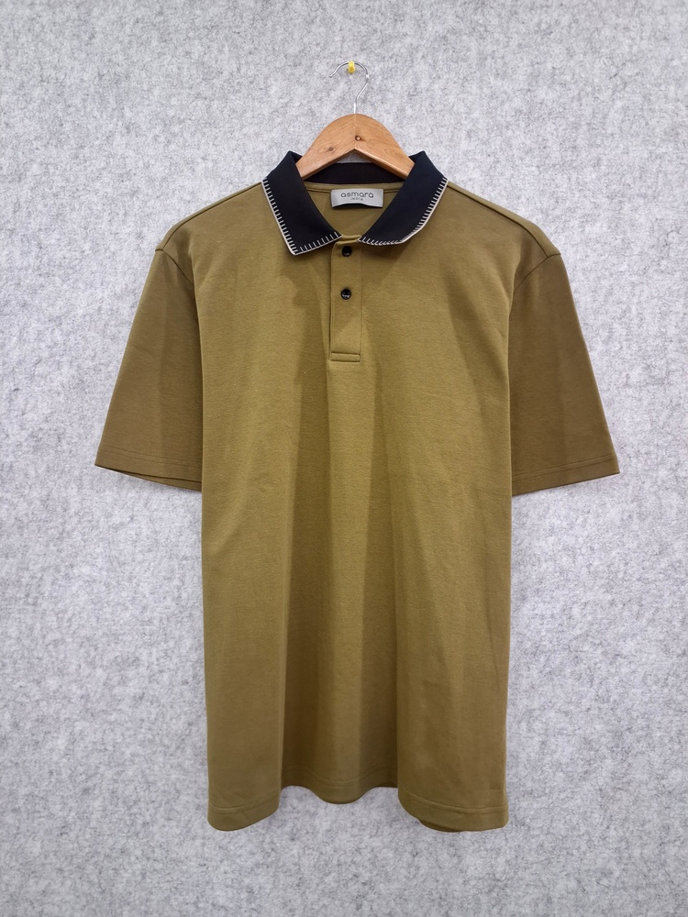
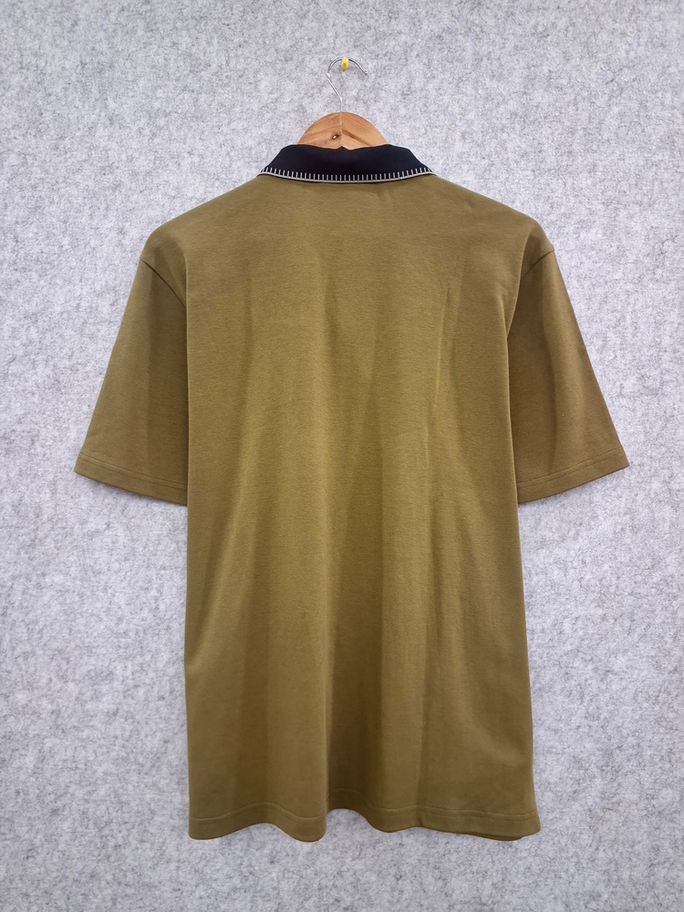
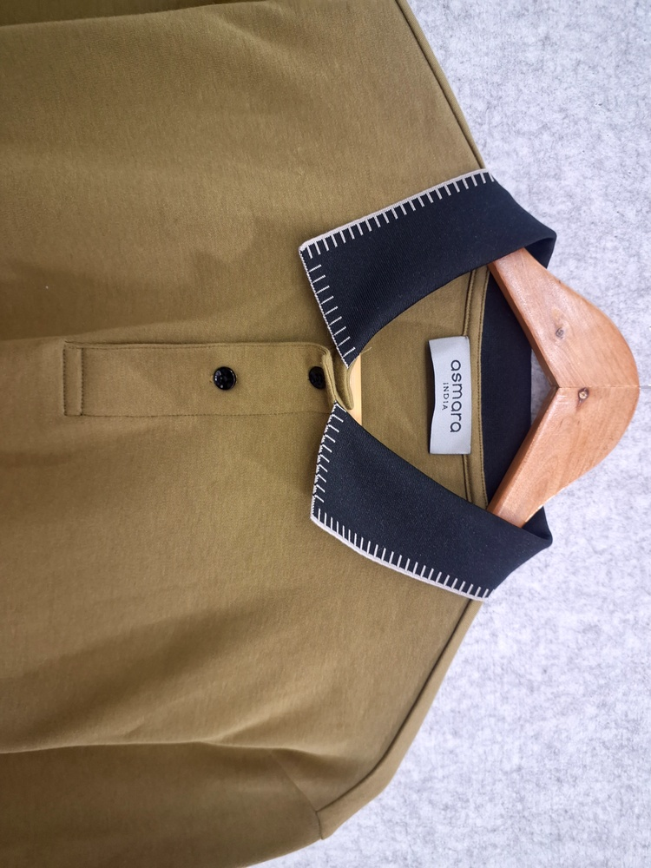
02
OLIVE GREEN SOLID POLO SHIRT
REF
CONTENT
GSM
REMARKS
DATE
F R O N T
B A C K
ASMARA INDIA
2 / 4

Slide 4
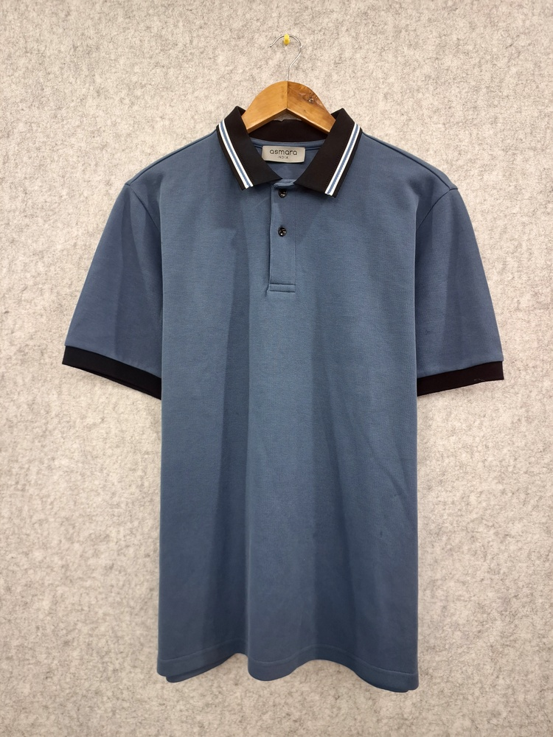
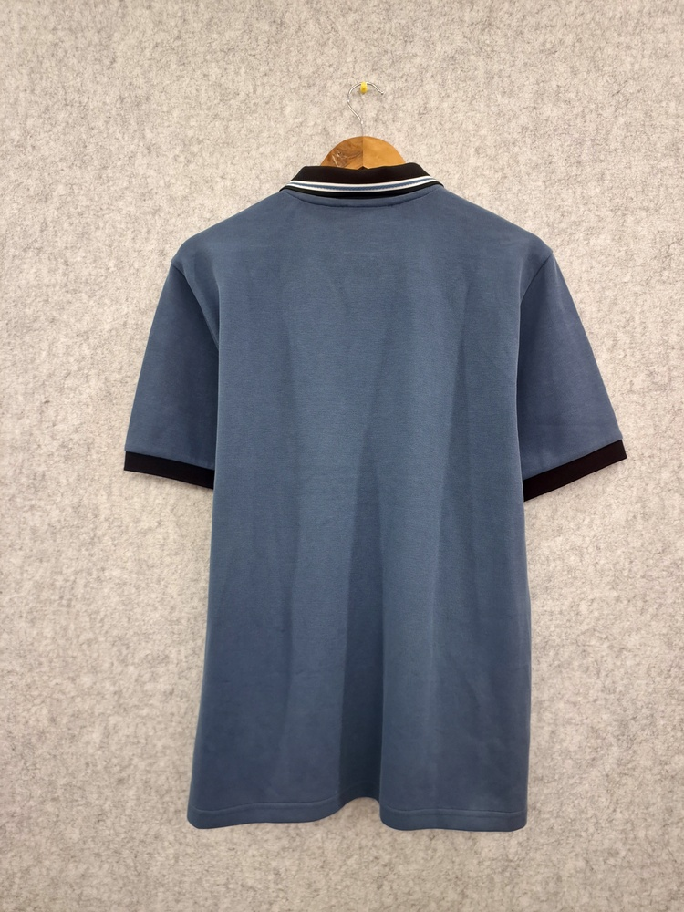
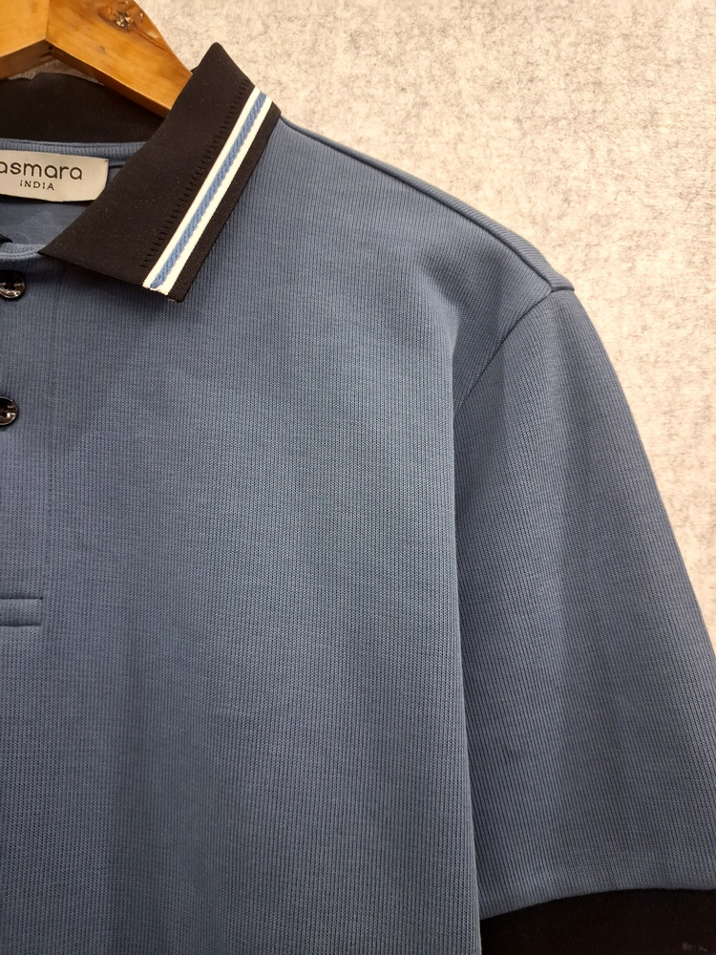
03
SLATE BLUE SOLID POLO SHIRT
ASM-NXT-003 · 55.3% RECYCLED POLYESTER, 44.7% ORGANIC COTTON · 202 GSM
REF
ASM-NXT-003
CONTENT
55.3% RECYCLED POLYESTER, 44.7% ORGANIC COTTON
GSM
202
REMARKS
AFS-4357, ASMT202603002246
DATE
30-03-2026
F R O N T
B A C K
ASMARA INDIA
3 / 4

Slide 5
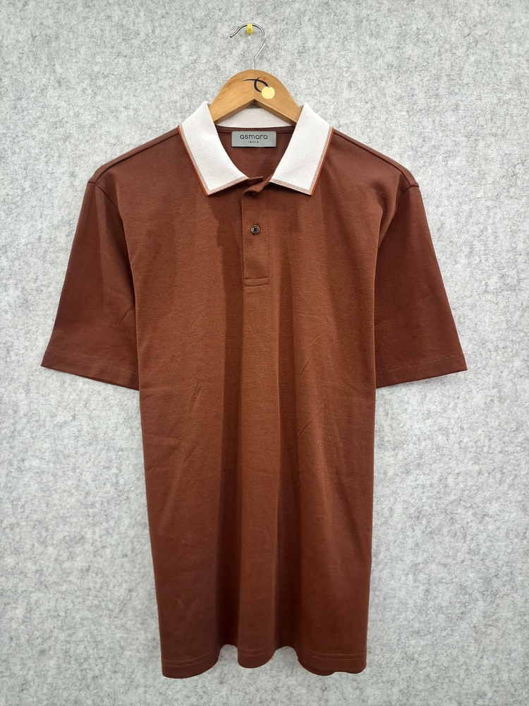
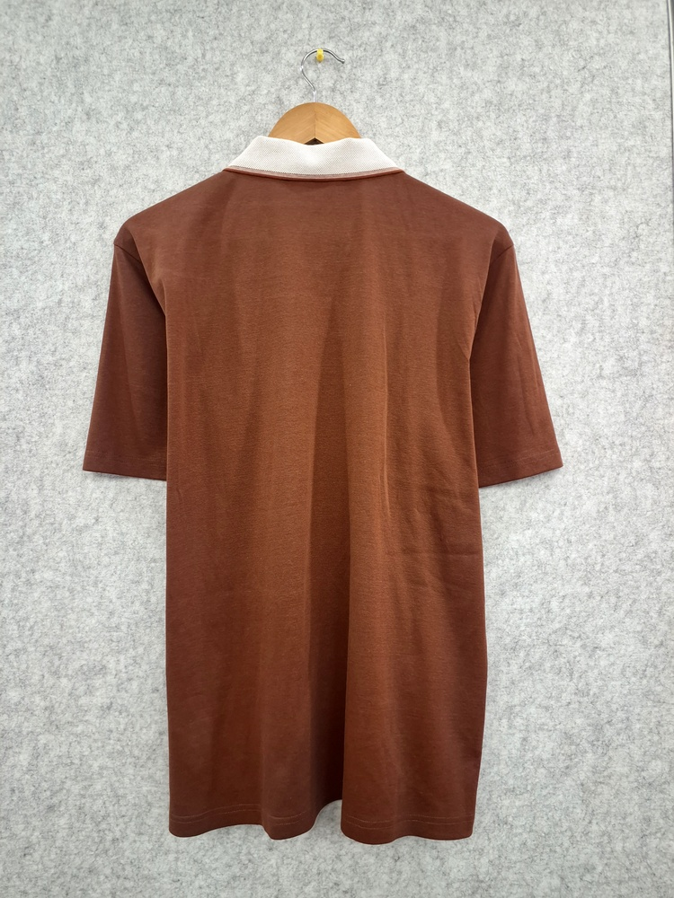
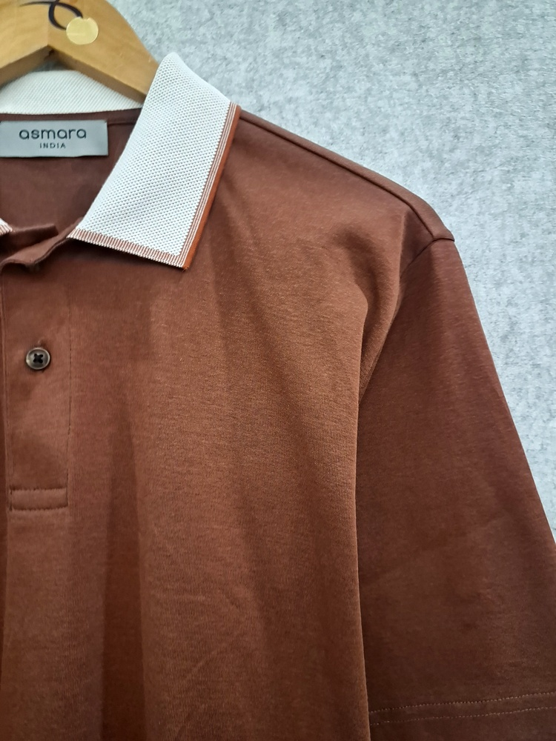
04
BROWN SOLID LONG-SLEEVE POLO SHIRT
REF
CONTENT
GSM
REMARKS
DATE
F R O N T
B A C K
ASMARA INDIA
4 / 4

