Slide 1
BTAO Services
Business –Think Apply Observe

Slide 2
BTAO services
Hosting provider
Web development
App development
Software services
Security Breach Solutions
Real Time Solutions with AI and IOT
Business Automation Solutions

Slide 3
FOR HOSTING SERVICE

Slide 4
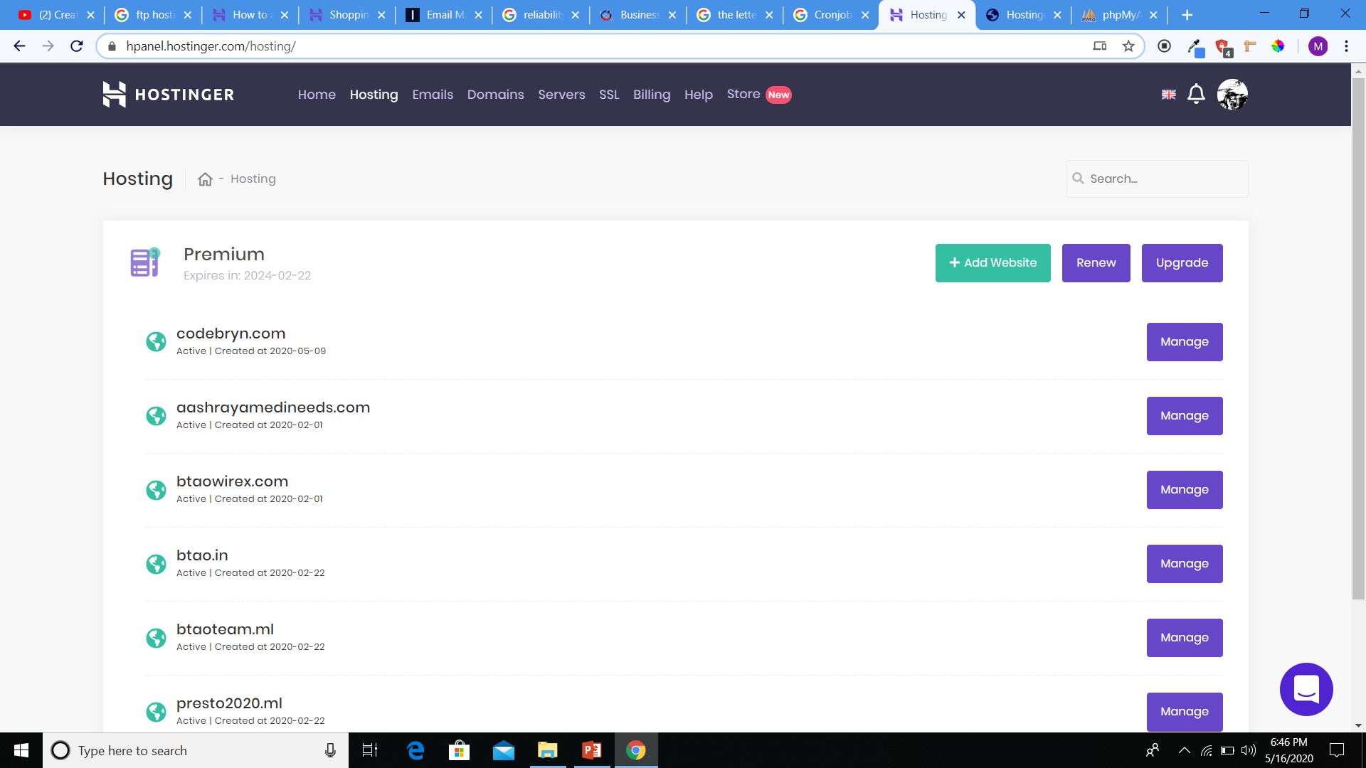
Our access panel
https://hpanel.hostinger.com/

Slide 5
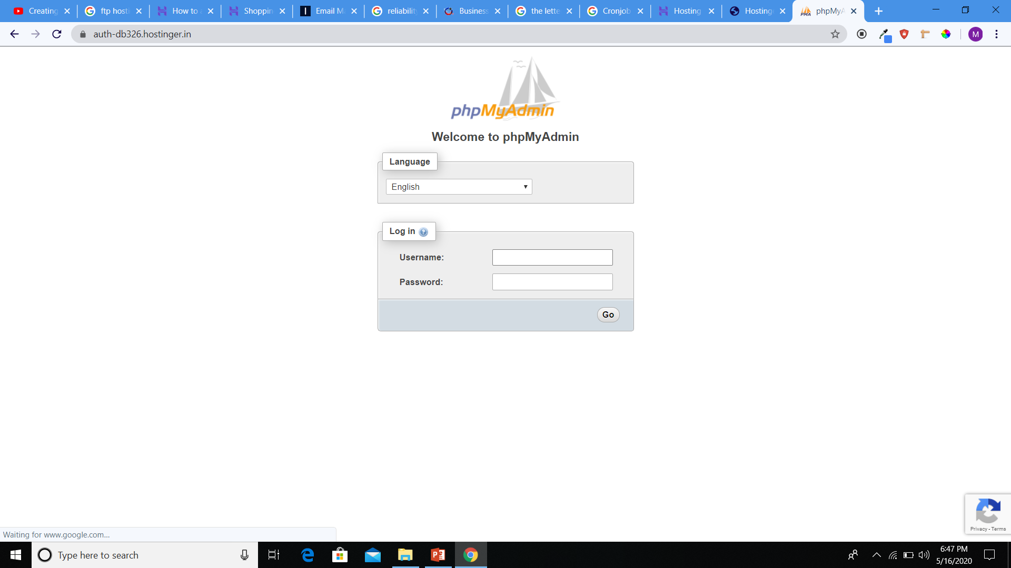
Database access panel
https://auth-db326.hostinger.in/

Slide 6
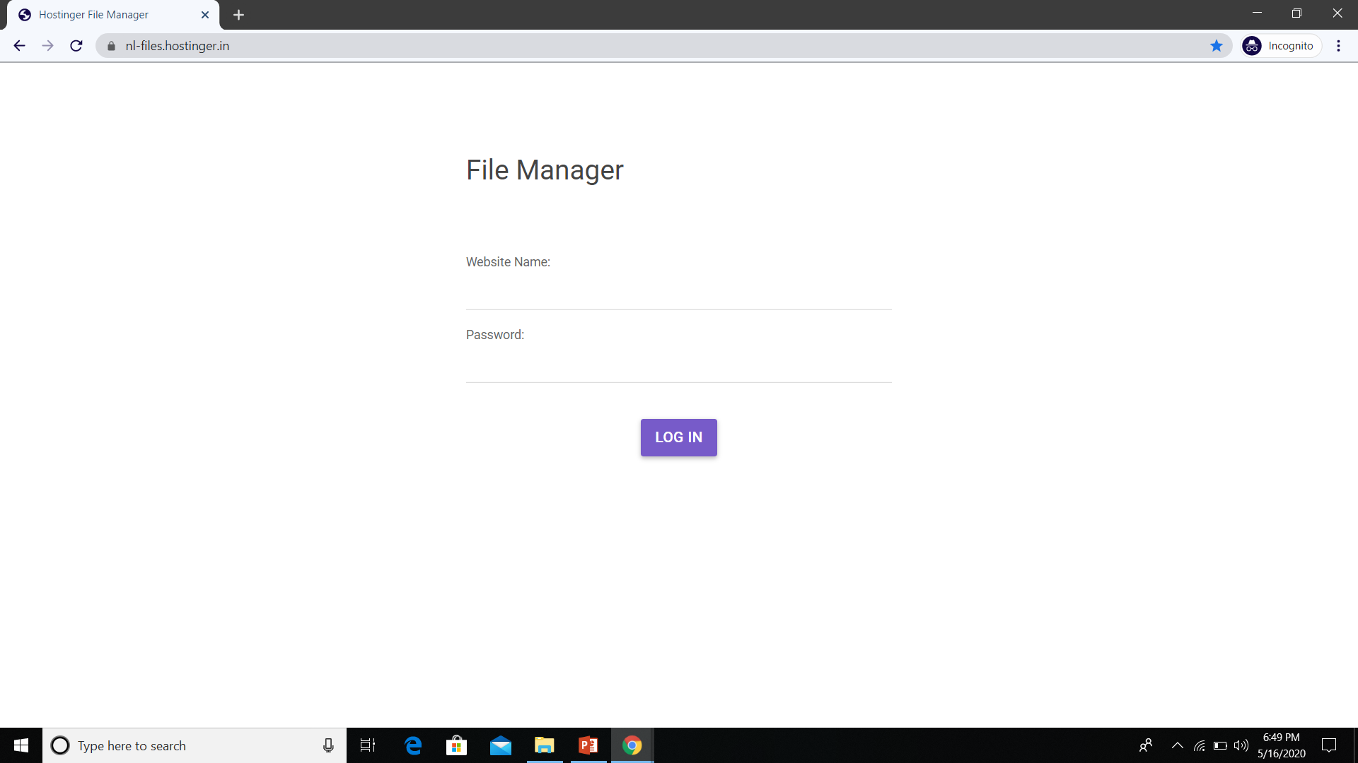
FTP Access (files access)
https://nl-files.hostinger.in/

Slide 7
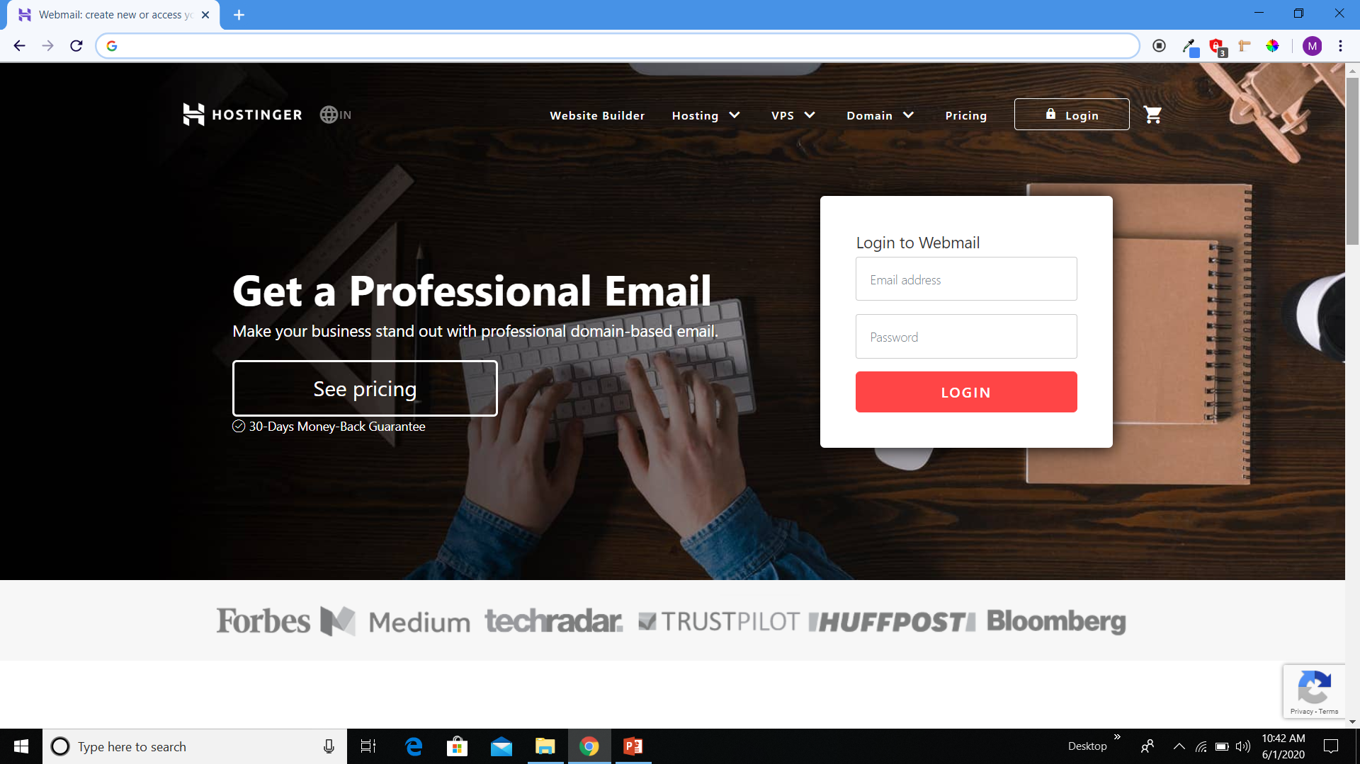
Domain Email Access
https://webmail.hostinger.in/

Slide 8
+

Slide 9
HOSTINGER FEATURES we can give up to 4 years
2X Processing Speed
Unlimited Bandwidth
FTP Account
Unlimited MySQL Database (3 GB)
Unlimited Email Accounts
Unlimited Storage (20 GB Disk Space)
99.9% Uptime Guarantee
Weekly Backup
Continuous Support
100 Sub Domains
Lite Speed Cache

Slide 10
What we cant Give(can we give)
Free SSL Certificate for life Time
Free Domain
Unlimited Sub Domains
Unmetered disk
Unlimited Traffic

Slide 11
Additional Tools
SEARCH ENGINE OPTIMIZATION(SEO)
Google Analytics
APP and Website maintenance
UX Interface
Traffic Management

Slide 12
Student plan
1X Processing Speed
Bandwidth
FTP Account
1 GB MySQL Database (3 GB)
2 Email Accounts
99.9% Uptime Guarantee
Weekly Backup
Continuous Support
1 GB Storage (20 GB Disk Space)
Sub Domains
Free Domain
Lite Speed Cache
6 months Free
150/month

Slide 13
Start-Up plan
1 month = 300/month{3600} Renew[400/month{4800}]
12 months = 200/month{2400}
Renew[300/month{3600}]
24 months = 150/month{3600}
Renew[250/month{6000}]
48 months = 100/month{4800}
Renew[200/month{9600}]
2X Processing Speed
Unlimited Bandwidth
FTP Account
Unlimited MySQL Database (3 GB)
Unlimited Email Accounts
99.9% Uptime Guarantee
Weekly Backup
Continuous Support
Unlimited Storage (20 GB Disk Space)
100 Sub Domains
Free Domain
Lite Speed Cache

