Slide 1
Go Go Coach Web Application

Slide 2
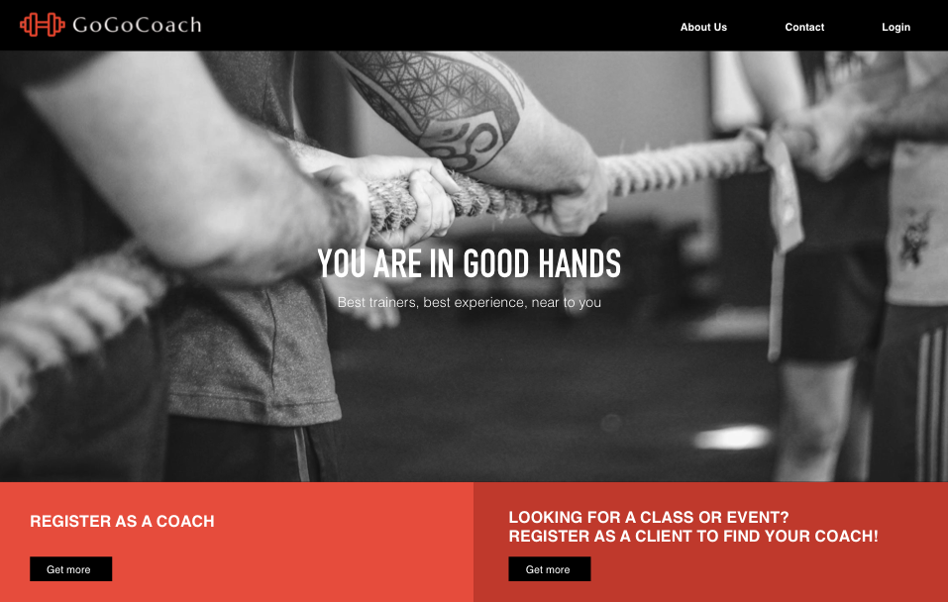

Slide 3
Objectives
GoGo Coach is web application developed to add sports coaches in touch with people interested in group workouts or private coaching lessons.
This website allow clients to find a nearby coach based on location and there will be discount rates to the clients based on the number of bookings done for certain event or course activity.

Slide 4
Requirements
App should be responsive .
Any users aged above 18 years will be allowed to Register as Coach or Client.
Registered users should be able to login.
If the logged-in user is a Coach, then he/she can create their own page.
If the logged-in user is a Client then he/she should be able to add presentation.

Slide 5
Project Plan
The schedule and resources that were used throughout the development process is shown using UML Diagrams
System context diagram
package diagram
Use Case diagram

Slide 6
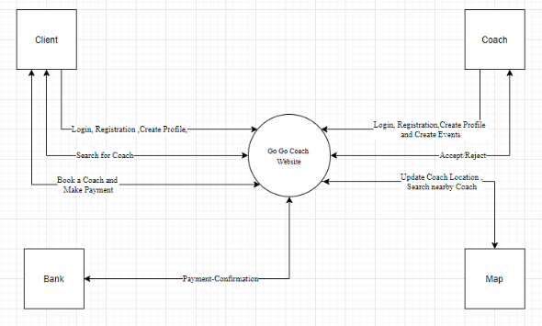
System Context Diagram

Slide 7
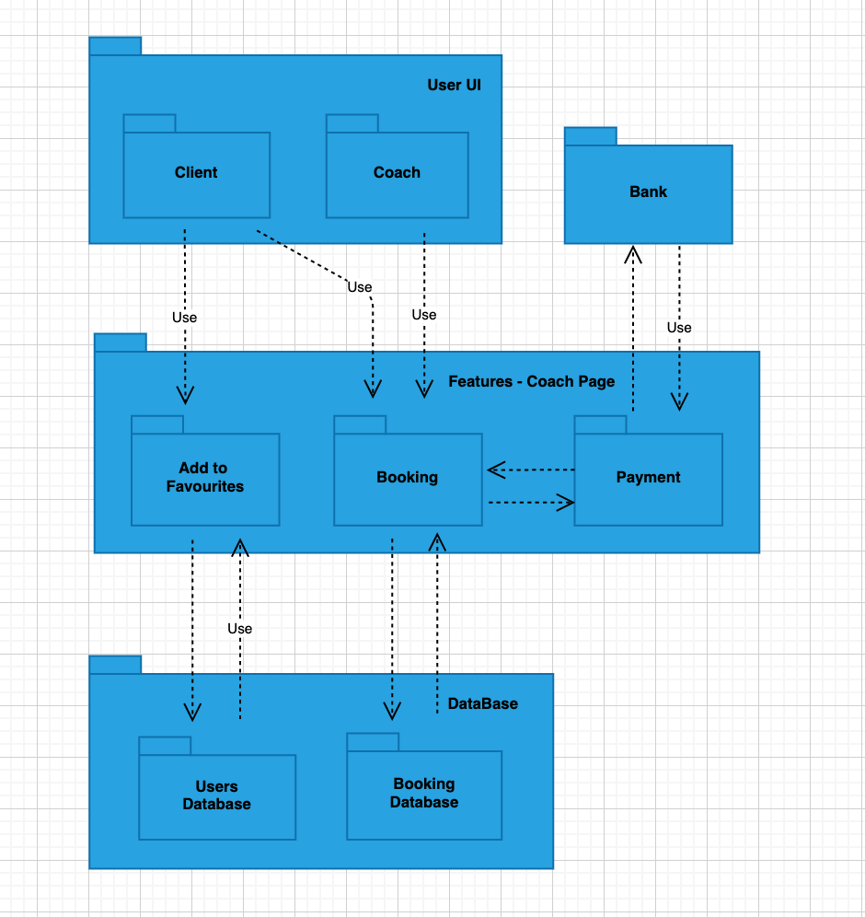
Package Diagram

Slide 8
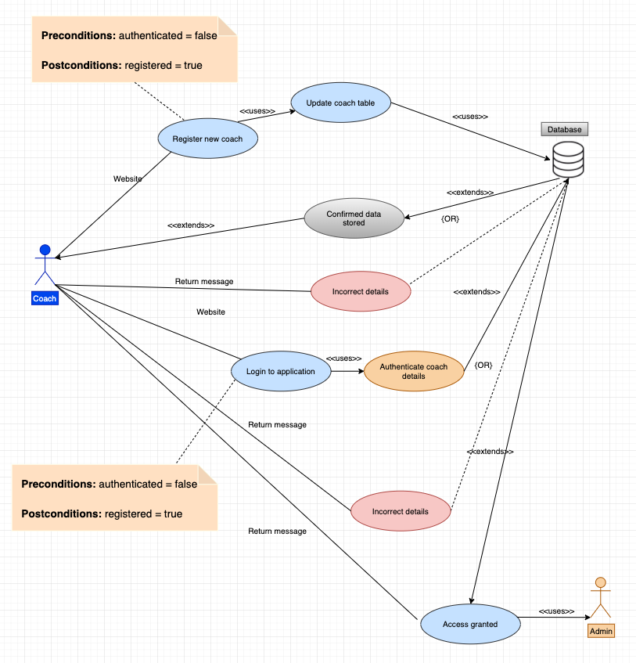
Use Case Diagram

Slide 9
Technical Details
Here we are using NodeJS, Express.js for place to host back-end service.
For implementing visual elements we use HTML5, CSS3, JavaScript, Bootstrap4 and Express Handlebars.
To implement the database we will use a MySQL relational model.
For payment process we will use PayPal API.
To connect coaches and users, we will use interactive map for geolocation through the Google Maps API.

Slide 10
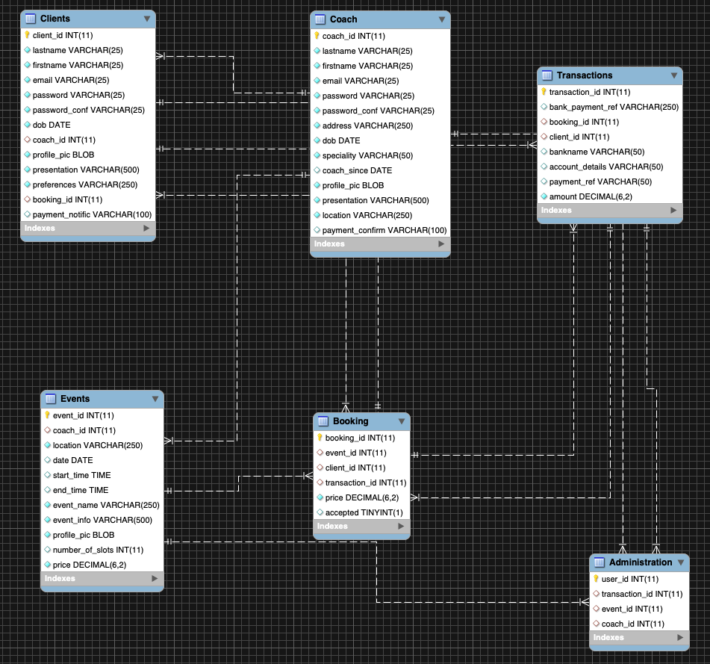
Technical Proposal

Slide 11
Evaluation
In assessing the requirements in this project, an assessment is carried out requirements by the developers. With this assessment, documents and diagrams (artifacts) are constructed for better understanding. In addition, the feasibility of implementing the requirements found must be analyzed, helping to define costs and conflicts for the implementation of each requirement.
After this analysis, there is a notion about the risk involved in meeting each requirement. These types of strategies favor and optimize maintenance and error correction, in addition to clearly requesting the implemented service, both for the user and the developers. At the end of the requirements assessment, the requirements specification activities were performed, where it was possible to model the software through diagrams and descriptions of use cases that were previously shown.

Slide 12
Thanks, Inco! Thanks, Lorcan!

