Slide 1
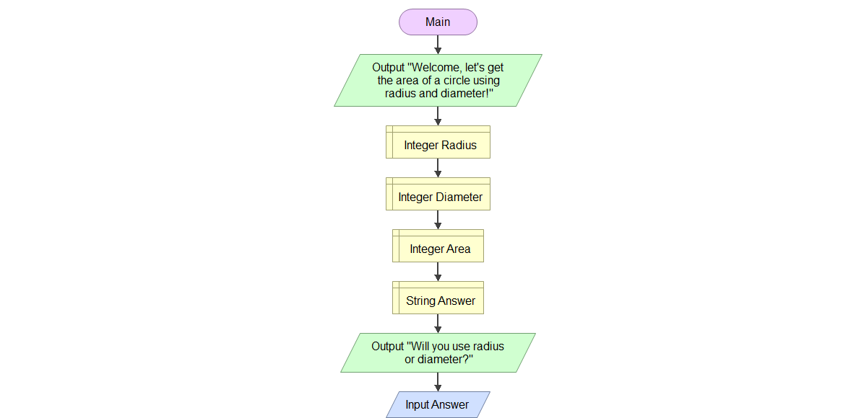

Slide 2
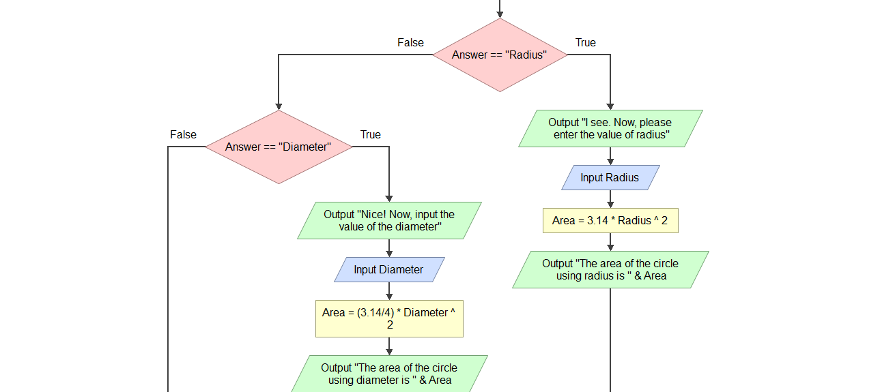

Slide 3
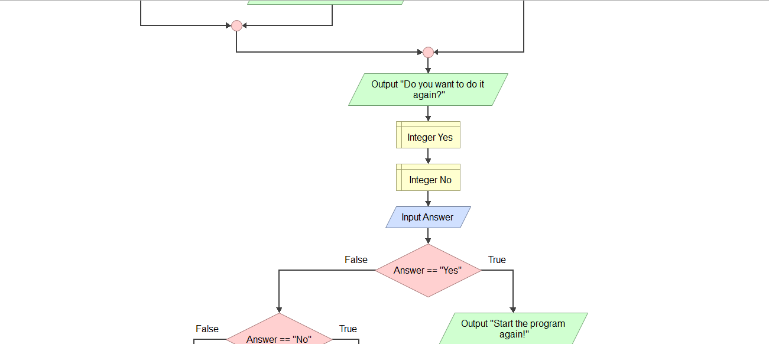

Slide 4
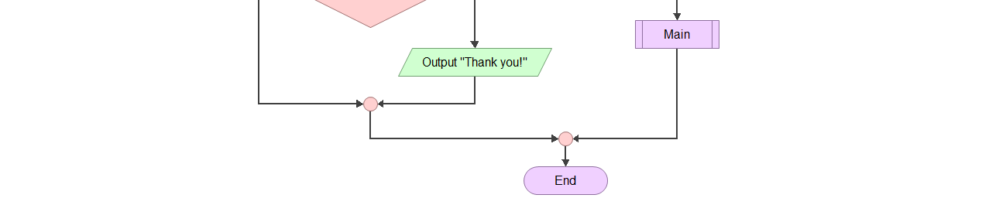

Slide 5
STEPS AND PROCEDURES:
Start the flowchart
Write output: “ Welcome! Let’s get the area of circle using radius and diameter!”
Declare Integer Radius
Declare Integer Diameter
Declare Integer Area
Declare String Answer
Write output: “Will you use radius or diameter?”
Input Answer, if the answer is Radius
Input radius
Area= 3.14 * Radius ^ 2
Write output: “The area of the circle using radius is “ & Area
If the answer is Diameter, ask for the value of Diameter
Input Diameter
Area=(3.14/4) * Diameter * 2
Write output: “The area of the circle using diameter is “ & Area
Write output: “Do want to do it again?”
Declare Integer Yes
Declare Integer No
Input Answer
If the answer is yes, write output: “Start the program again!”
Loop Start
If the answer is no
Write output: “Thank you!”
End the flowchart

