Slide 1



Conceptual Architecture
1
Channels
The proposed architecture has the following main blocks:
Channels – Different channels via which the end users will interface with the system
Integration – Covers integration mechanism with different components of the system
Application modules –High level Application level modules, these will be further split into sub modules as needed.
Shared components – Cross cutting components to be shared across all other system components
Predictive Analysis – Performs various predictive suggestions
External Service– Interaction with the external services
Web
Mobile
Reports/ Dashboard
TPP
Integration
3
NGO Application Modules
2
4
Shared Components
User Management
Notification
Service
Event Organizer
Experience API
Monitoring
Logging
Feedback Management
Group Advisor
Accounting
System/Process API
Custom Components
Configuration
Auditing
Card
Donation Hub
Risk Ratings
Security
Management
Messaging Queues
5
AI/ML Predictive Analytics
6
External Service
Chatbots
Event Recommendations
Fraudulent Prediction
Payment gateway
Google Pay

Slide 2





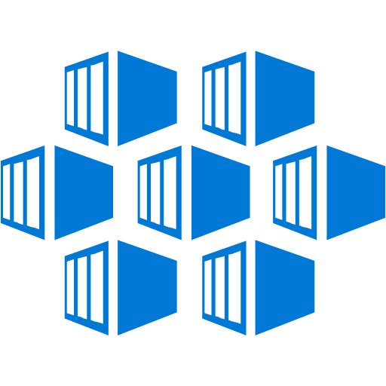





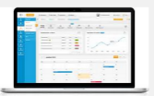
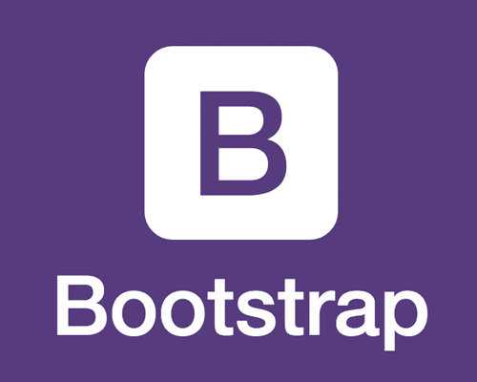


Technical View
Channels
Client Layer
Broker
Microservice Layer
Integration
Business Layer
API Gateway / Management
Shared Services
View / Presentation
Controller / Presenter
View Model
Logging
Auditing
Exception
Configuration
Caching
API Layer
Repository
System Integration
DB
Normal User
Model
Service/ Factory
ORM
Local Storage
Routing
Payment GW
Google Pay
JS Binding Framework
Bootstrap
JavaScript compiler
Front Office Call Center
Security
Authentication
SSO
OS [Windows/ Linux]
Authorization

Slide 3
Logical Architecture
Channels
The proposed architecture has the following main blocks:
Channels – Different channels via which the end users will interface with the system
External Facing Architecture–External facing APIs
Internal Facing Architecture
Cross cutting – cross-cutting component are centric focus by nature. It prevents the code redundancy and provides high maintainability
Experience Layer – Purposeful APIs for Apps and Web
Process Layer – Orchestration, Composable APIs, Microservices
System Layer – Abstraction layer to hide underlying systems of record.
Integration Layer – Seamless integration between platform systems and external systems (Cloud vs On-Premises)
Web/Mobile Browsers
Mobile App
Reports
Dashboard
JSON (HTTPS)
External Facing Architecture
API Management Layer (External Facing APIs)
OAuth
SSO
LDAP
JSON (HTTPS)
Internal Facing Architecture
Cross Cutting
Security Platform
Experience Layer
Filtration
Experience API
(Business unit 1)
Experience API
(Business unit 2 )
Experience API
(Business unit n)
Security
Security
Monetization
Analytics
Lifecycle Management
Aggregation
Management
Domain A
JSON (HTTPS)
Domain B
Reusable
Process Orchestration
Microservice
Microservice
Microservice
Monitoring
Process
Layer
Service Orchestration
Process
Layer
Microservice
Microservice
Microservice
Business Rules
Logging
JSON (HTTPS)
Auditing
System
Layer
Stateless
System APIs
System
Layer
Transformation
Configuration
JSON (HTTPS)
Integration Layer
Messaging
Google Pay
Payment GW
Chat Bot

Slide 4





Integration View
Customer Channels
Third Parties
Realtime Modules
Google Pay
API Gateway
(internal API)
UI
(Web, Reports, BPM)
IAM
Payment Gateways
Chatbot
Transition Service
(Filtering, Aggregation, Transform)
Predictor
Transaction Data Storage
Accounts
ESB
Batch Framework
OLAS
OLAS
OLAS
Batch Modules
Data Sync
RealTime Event
HTTPS / REST/ JSON
HTTPS
ODBC
Data Sync
Websocket/ XMPP
SFTS

Slide 5






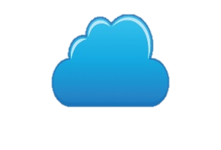




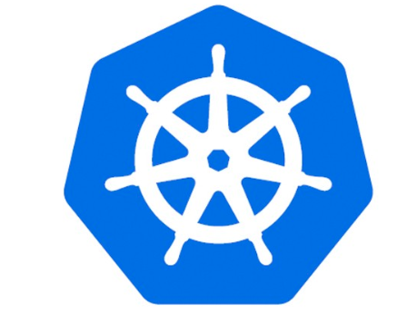











Deployment View
Azure
APIGEE
Azure cache
Mobile
NGINX Ingress
PODs
Orchestration
Hbase / SQL
Traffic
Web
Availability Zone -1
Web/Mobile Browser
Front Door
Manager
Application Gateway
Istio Service Mesh
Replication
Tablet
Kubernetes Cluster
Hbase / SQL
Private subnet
Availability Zone -2
DMZ Virtual
Functions (FAAS)
Data Analysis
Private Subnet
VPN Gateway
ExpressRoute Gateway
Private Subnet
Service Bus
Event Hub
Data Factory
Analysis Service
Virtual Network
On-premise Network
ExpressRoute
Gateway
Local edge Routers
5
Microsoft edge Routers

Slide 6


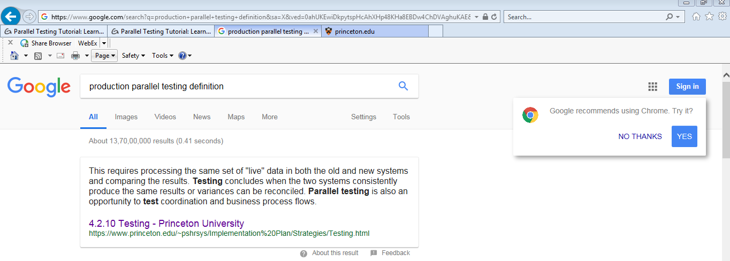

Logical Data View
OLAS
Reporting
Client
Web Server
BL
OLTP
App Server

Slide 7








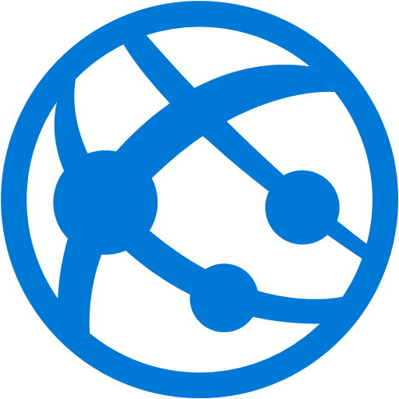








DE VOPS
Azure DevOps
Docker container
Azure Container Registry
Pull
Trigger Build
Trigger Release
Azure Repos(Git)
Azure Build Pipeline(CI)
Azure Release Pipeline(CD)
Build Job
Release Job
Azure Kubernetes Service
Code Push
Dev Stage
Dev
Get Sources
Deploy To Development
Install Tools/Packages
Visual Studio/
Visual Studio Code
Approval Gate
Build Solution
QA Stage
QA
Build/Deployment Feedback
Code Quality Check
Deploy To QA
Azure
Application Insights
Developer
Run Tests
Approval Gate
Sprint Backlog & Work Items
Prod Stage
PROD
Security Scan
(Nexus IQ/ Fortify)
Deploy To QA
Create Image
Azure Boards
Scan Image & Publish

