Slide 1
Architecture Patterns
Category | Patterns
Communication Pattern | Client / Server Broker Layer SOA Event Driven Microservices
Presenter Pattern | MVC MVP (Active / Supervision) MVVM Front Controller Page Controller Interception Filter
Security Pattern | Impersonation Trusted Subsystem Multiple Trusted Service Identities Brokered Authentication Direct Authentication Federated Authentication (SSO) Forward Foxy Reverse Proxy

Slide 2
Architecture Patterns
Category | Patterns
Data Pattern | Data Replication Master- Master Replication Master- Slave Replication Master-Master Row-Level Synchronization Master-Slave Snapshot Replication Master-Slave Cascading Replication SAGA [Distribution]
Deployment | Layered Application Three-Layered Services Application Tiered Distribution Three-Tiered Distribution Deployment Plan
Performance & Reliability | Server Clustering Load-Balanced Cluster Failover Cluster
Others | Scheduler / Agent / Supervisor Circuit Breaker CQRS Domain Façade / Application Façade Producer / Consumer [Publisher / Subscriber] Event Based Architecture Pipes and Filter

Slide 3
Architecture Styles
Category | Architecture Styles
Deployment | Client/server 3-Tier N-Tier
Structure | Component-Based Object-Oriented Layered Architecture
Domain | Domain Model Gateway
Communication | Service-Oriented Architecture (SOA) Message Bus Pipes and Filters REST

Slide 4
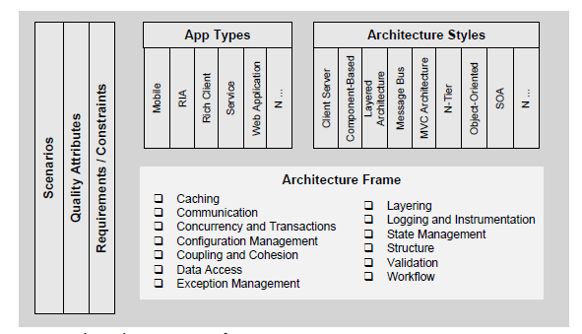
Holistic View

Slide 5
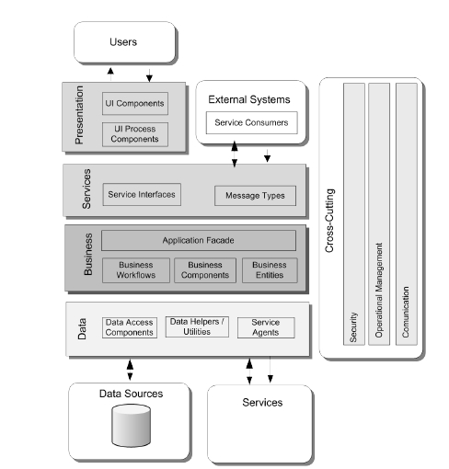
Common Application Architecture

Slide 6





Target State - Application Architecture
Auditing
Logging
Configuration
Exception
Caching
Key Features
Shared Services
UI layer will use AngularJS to customize user screen look and feel with SPA design approach
RWD design approach will be leveraged for optimal viewing experience for various channel
WEB API /WCF RESTFUL service is used in the middle layer
Splunk/ ELX for log data analysis
Security services will provide configurable authentication and role authorization
Custom Job Scheduler / Qurtz Net to manage the scheduling the job
SLA monitor and Management Information, reconciliation report .
APIGEE integration to support with homogeneous environment
Caching the data in a common location to improve the performance
Test Driven development
GS Dashboard
ASP.NET MVC
(Router, Controller, Model, View Model)
Batch Screening
Job Scheduler
Bridger Batch Service
Real time Screening
Integrity Verifier
Bridger Insight Service
GS Configuration
Screening List Processing
File Uploader/ Downloader
Bridger Web Service
WCF Restful Interface
Response Formatter
Router
APIGEE
Scheduler Maintenance
Inbound Data validator
Splunk/ ELX
Model
SOD
Correspondence/ Incident Manager
GS DataStore
View
Auto Mapper and Filters
Controller
Reconciliation
Activity Monitoring
Bridger DataStore
Angular 2, Bootstrap,
Local Storage
Security Services
Authentication
Authorization
SSO
Test Driven Development
Client Tier
Presentation & BP Tier
Middle Tier
Integration
This layer will use Angular JS with Bootstrap components for GS Configuration and Dashboards
This layer interfaces with UI tier. The services are exposed as REST services. JSON prams are converted to POCO Objects. Auto mapper will be used to convert View model to model.
This tier holds the core business logic for Collection and interfaces with Bridger Services and Local Data Stores.
This tier holds core integration components like APIGEE and External System Interface Layer with Bridger Services.
Color Index
New Components
Projected Re group
Partial Reusable
Complete Reusable

Slide 7
Deployment Architecture

Slide 8
Deployment Architecture

Slide 9
Quality Attributes / NFR
Category
Availability | Usability
Conceptual Integrity | RTO(Recovery Time objective)
Flexibility | RPO(Recovery Point Objective)
Interoperability | Resilience
Maintainability | Throughput
Manageability | Reliability
Performance | Responsiveness
Reliability | Consistency
Reusability | Redundancy
Scalability
Security
Supportability
Testability

Slide 10
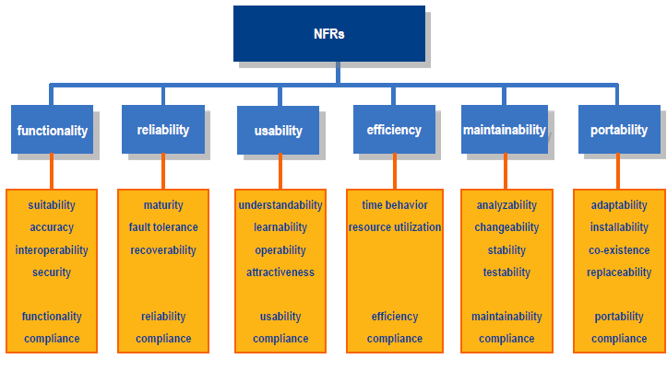

Slide 11
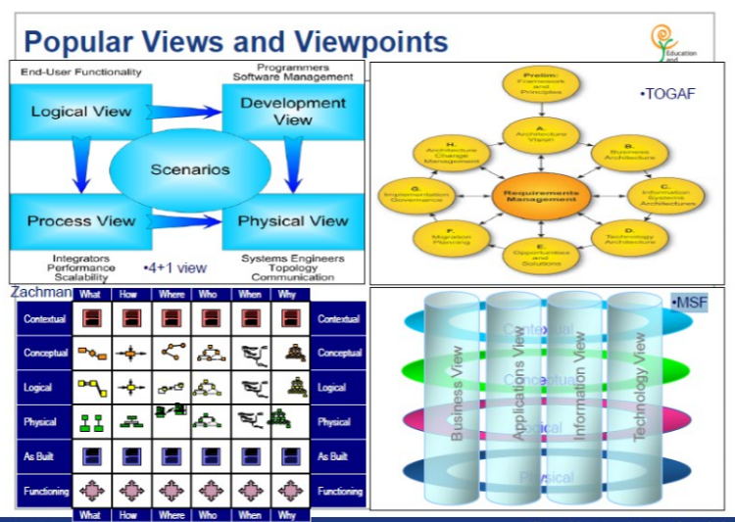
Communicating Architecture

Slide 12
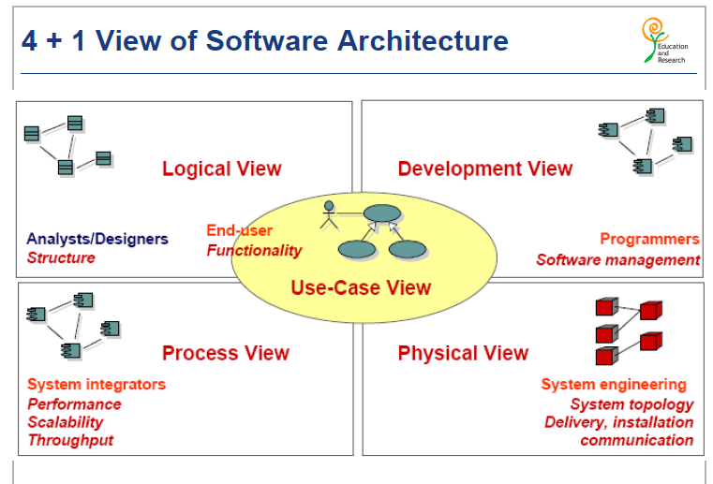
Communicating Architecture

Slide 13
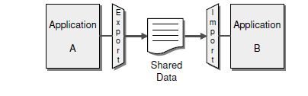
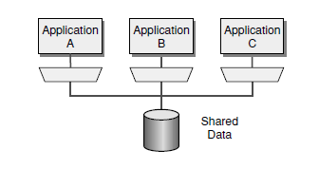
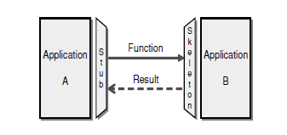
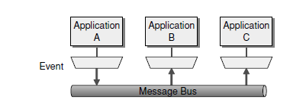
Enterprise Application Integration Styles
Styles |  | Others
File Transfer |  | At least once At most once MFT SFT
Shared Database
Remote Procedure Invocation
Messaging

Slide 14
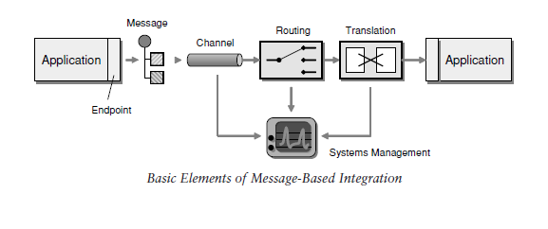
Enterprise Application Integration Patterns
Synchronous
Asynchronous
Send and Forget
Store and Forward
Scatter and Gather

Slide 15
System Design
Think the following Area before design the system and ask the relevant questions with the business user
Features
Define API
Availability
Latency Performance
Scalability
Durability
Class Diagram
Security & Privacy
Cost Effective

Slide 16
System Design
Vertical vs Horizontal scaling
CAP Theorem[Consistency, Availability, Partition tolerance ]
Partition / Shadding Data
Consistence Hashing
Optimistic vs Pessimistic Locking
Strong vs Eventually consistency
Relational DB vs NOSQL
Types of NoSQL
Key – Value
Wide column
Document based
Graph based
Caching
Data Center / racks/ host
CPU/ Memory/ Hardware/ Memory bandwidth
Random vs sequential read/write on disk
Http vs Http2 vs web socket
TCP / IP Model
IPV4 vs IPV6
TCP vs UDP
HTPPS & TLS
Public key infrastructure & certificate authority
Symmetric vs Asymmetric key
Load balancer L4 vs L5
CDN vs Edge
Bloom Filters and Count-min-sketch
Design pattern and Object Oriented design
Virtual Machine & Containers
Publisher –Subscriber
Map reduce
Multi Threading, concurrency, locks, synchronization, CAS

Slide 17
System Design
SQL / NOSQL
Cassandra
MandoDB
Mysql
Cache
MEMCACHED
Redis
Configuration
Zookeeper
Messaging System
Kafka
RabiMQ
ActiveMQ
SSBQ
Load Balancer
NGINX
HAProxy
Solr, Elastic Search
BlobStore [Amazon s3]
Docker
Kubernetes
MESOS
Hadoop / Spark
HDFS

Slide 18
EAI Tools
KAFKA [Stream Engine]
RabitMq
SSBQ
Service bus / NServiceBus
SPARK
STORM
SPLUNK
ELK
VARNISH
LogStash
KIBANA
Control-M
NServiceBus
Quarts
APIGEE

Slide 19
Monitoring System
BPMN - Business Process Model Notation
SCOM
SIEM - Logythms
BAM - AppDynamics

Slide 20
Threading
Racing condition
Memory league
Blocking / Unblocking call
Deadlock
Mutex / Semaphore

Slide 21
Security
Authentication
Authorization
Integrity
Confidential
Auditing / Logging
Digital Signature
HSM (gemalto)
Canonicalization
OAuth
Simple web authentication
SAML
DMZ(Demilitory Zone)

Slide 22
Service Virtualization / Tools
WireMock
MounteBank
stubby
Docker
Kubernetis
OpenShift
WireShark
Hypervisor [WMWare]

Slide 23
Database Patterns
Performance Tuning
Dead Lock
Concurrency
Isolation Level
Read Committed
Read Uncommitted
Repeatable Read
Sync
ACID
Synchronization
Merge
Snapshot
transaction
Active Record
Optimistic Offline Lock
Pessimistic Offline Lock
Repository
Row Data Gateway
Table Data Gateway
Query Object

Slide 24
UML
Association
Aggregation
Composition
State Diagram
Component Diagram
Sequence Diagram
Activity Diagram
Collaboration Diagram

Slide 25
Design Principle and patterns
SOLID
Creational Pattern
Factory
Abstract Factory
Singleton
Builder Pattern
Prototype
Structural Pattern
Adaptor
Decorator
Bridge Pattern
Façade
Proxy
Behavioral Pattern
Visitor
Strategy
Template
Composite
State
Mediator

Slide 26
Layering
Coupling – understanding, how other components works
Cohesion – change together and live together should live apart

Slide 27
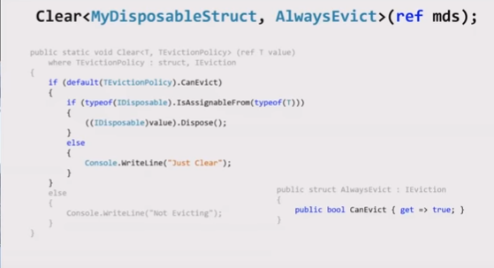

Slide 28
MIGRATION
6 R -
Re_host(SMS)
Re_platform
Repurchase
Re_architecting / refactor
Retire
retain
Unstructured Data Migration(File, Block)
File gateway
Volume Gateway (32 Volumes)
Cache - 32 TB ( 1 PB volume)
Shared - 16 TB (512 TB per volume
Tape Gateway
Large Data
Snowball ( 50 Tb - 80 TB)
Snallball Edge (100 TB)
Snowmobile ()
Database
DMS
Schema Conversion Tool
Virtual Machine
AWS Server Migration Service (SMS)
Service Discovery
Agent less
With Agent
Disaster Recovery
Communication
VPN (Site to Site)
Customer Gateway(CGW)
Private VPN Gateway(VGW)
VPN Cloud Hub
VPN client
Direct Connect
VIF
Direct Connect Link Aggregate Group
Direct Connect Gateway

Slide 29
Virtual Private Computing
VPC
Subnet
Private
Public
Elastic Network Interface
Security
Routing Table
Security Group
NACL
Communication
NAT Instance / NAT Gateway
Internet Gateway( IGW)
Bastion Host(jump Box)
VPC Peering (Not transitive)
Transitive Gateway
Gateway Endpoint
Endpoint Interface
Endpoint Services / Private Link

