Slide 1
Agenda
High Level Solution View – DEMO Environment
PostMan Test case walkthrough
Simple test case
Using environment variable
NewMan execution – report
Jenkin integration
Web Hook
Email
Attachment

Slide 2



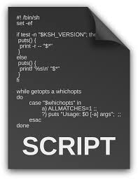






DEMO Deployment Solution
The APIGEE CI/CD pipeline consists of following stage namely Code Preparation, Quality (Unit Test), Deploy, Integration Test(Post)
Code preparation stage, the code will be pulled from the Bitbucket repository and fetch the configuration details(.xml) and dynamically build the name and versioning
Quality Gate verifies code quality before package and deploy
Package and Deployment will deploy the code in the defined environment specified int the config(.xml)
Validate the code using Integration testing
Bitbucket Repository
Master branch
Commit
Create feature branch
Bit Bucket Client
Continuous Integration
Continuous Deployment
LIVE Deployment
Orchestration Server(JENKIN)
Code preparation
Quality and deployment Pipeline
Trigger Build
Unit Test
Quality Check
Package and Deploy
Integration Testing
APIGEE Code
Publish
Execute
DEV
QA
Load Testing
UAT
Pre-PROD
PROD

Slide 3
DEMO Deployment Solution
Jenkin Server (http://3.224.116.234:8080/job/Newman_TestExecute/) Web hooks in the https://gitlab.com/soninsunil/newman_test repo
Rep has the integration test, verifying the APIGEE server (loyolastalin-eval-test.apigee.net)
Git Repository (https://gitlab.com/soninsunil/newman_test)
Master branch
Commit
Create feature branch
Bit Bucket Client
Continuous Integration
Continuous Deployment
LIVE Deployment
JENKIN Server(http://3.224.116.234:8080)
Code preparation
Quality and deployment Pipeline
Trigger Build
Unit Test
Quality Check
Package and Deploy
Integration Testing
APIGEE Code
Publish
Execute
loyolastalin-eval-test.apigee.net

Slide 4
POST MAN DEMO
Simple test case
Using environment variable
NewMan execution – report

Slide 5
JENKIN DEMO
Web Hook
Email – Notification without Attachment
Attachment

Slide 6
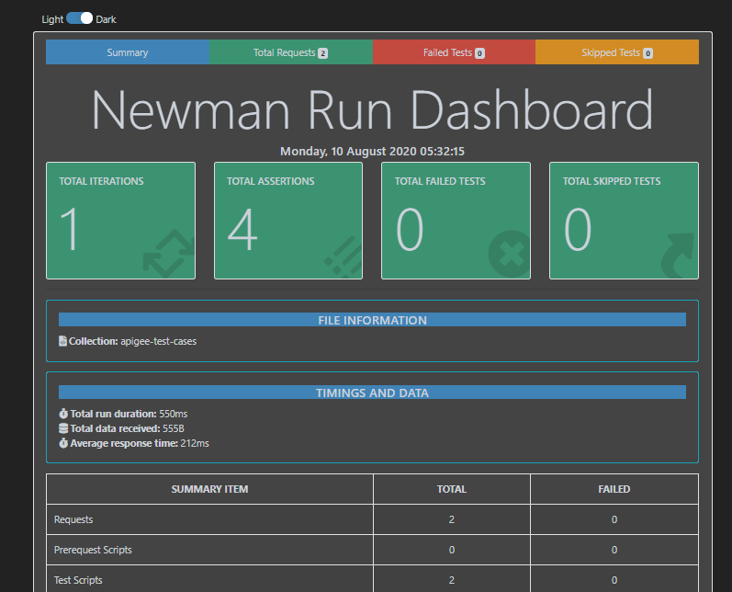
Report

Slide 7
Reference
https://github.com/loyolastalin/postman-test-cases

