Slide 1
Final Exam
2023/12/18

Slide 2
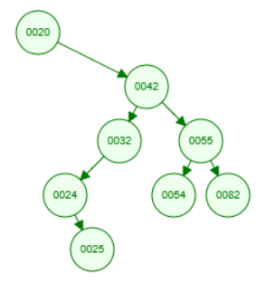
3. (10%, 5% each) For a given binary search tree, the in-order sequence is {20, 24, 25, 32, 42, 54, 55, 82} and the pre-order sequence is {20, 42, 32, 24, 25, 55, 54, 82} a. Please draw down the tree b. Please write down the level-order traversal sequence
a.
b. {20, 42, 32, 55, 24, 54, 82, 25}

Slide 3
6. (10%; 5% each) Please perform quick sort on the provided arrays until the data is sorted. For each partition during the sorting process, write down the final form of the sorted partition before continuing with the recursive process.
a. Pivot is always the first element: [3, -4, 0, -1, 2, 1]
  [3, -4, 0, -1, 2, 1] → [1, -4, 0, -1, 2, 3]
    [1, -4, 0, -1, 2] → [-1, -4, 0, 1, 2]
      [-1, -4, 0] → [-4, -1, 0]
b. Pivot is always the last element: [10, 5, 15, 0, 20, -10, -5]
  [10, 5, 15, 0, 20, -10, -5] → [-10, -5, 15, 0, 20, 5, 10]
    [15, 0, 20, 5, 10] → [5, 0, 10, 20, 15]
      [5, 0] → [0, 5]
      [20, 15] → [15, 20]

Slide 4
7. (5%) Select all the correct statements for minimum spanning trees.
Answer: a, b, e, f
Every spanning tree of an unweighted graph is a minimum spanning tree.
If Kruskal’s algorithm is performed on a graph that is not connected, then it finds a minimum spanning forest.
If Prim’s algorithm is performed on a graph that is not connected, then it finds a minimum spanning forest.
To perform Kruskal’s algorithm, the graph must be a connected graph.
To perform Prim’s algorithm, the graph must be a connected graph
Prim’s algorithm is a greedy algorithm.

