Slide 1
Midterm
2023/11/15

Slide 2
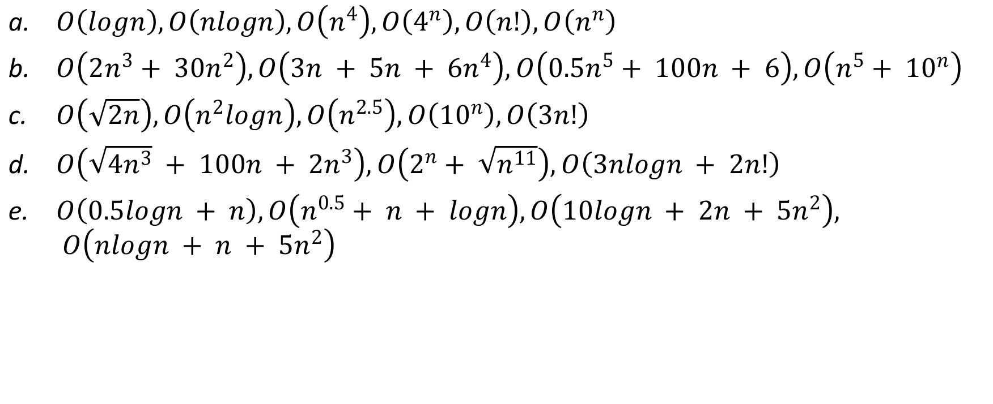
1. (15%; 3% each) Write in increasing order of time complexity:
$O\left(logn\right), O\left(nlogn\right), O\left(n^{4}\right), O\left(4^{n}\right), O\left(n!\right), O\left(n^{n}\right)$
$O\left(2n^{3}+ 30n^{2}\right), O\left(3n + 5n + 6n^{4}\right), O\left(0.5n^{5}+ 100n + 6\right), O\left(n^{5}+ {10}^{n}\right)$
$O\left(\sqrt{2n}\right), O\left(n^{2}logn\right), O\left(n^{2.5}\right), O\left({10}^{n}\right), O\left(3n!\right)$
$O\left(\sqrt{4n^{3}} + 100n + 2n^{3}\right), O\left(2^{n}+ \sqrt{n^{11}}\right), O\left(3nlogn + 2n!\right)$
$O\left(0.5logn + n\right), O\left(n^{0.5}+ n + logn\right), O\left(10logn + 2n + 5n^{2}\right), O\left(nlogn + n + 5n^{2}\right)$

Slide 3
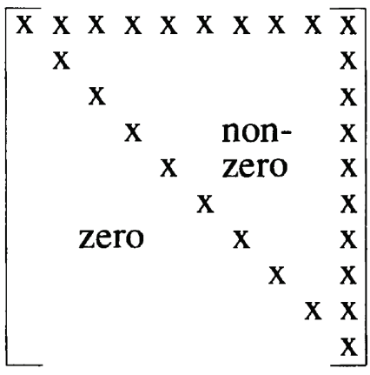
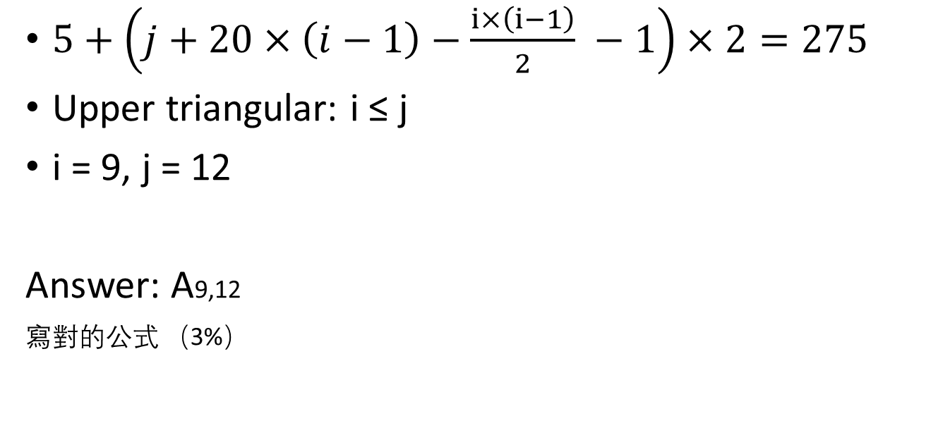
2. (5%) Given a row-major upper triangular matrix 𝐴 with both rows and columns of size 20. If the starting memory location is 5 and the size of each element is 2, what is the row and column index of 𝐴 that has the memory location 275? Hint: The starting element is 𝐴1,1
$5+\left(j+20×\left(i−1\right)−\frac{ⅈ×\left(ⅈ−1\right)}{2} −1\right)×2=275$
Upper triangular: i ≤ j
i = 9, j = 12
Answer: A9,12
寫對的公式 （3%）

Slide 4
3. (5%) Given the expression 𝐴 + ((𝐵 − 𝐶 ÷ 𝐷) − 𝐸) × (𝐹 + 𝐺), please show the content in the stack after the operand 𝐸 is read in postfix transformation.
Infix Scanned | Stack | Postfix Expression
 | (
A | ( | A
+ | (+ | A
( | (+( | A
( | (+(( | A
B | (+(( | AB
- | (+((- | AB
C | (+((- | ABC
/ | (+((-/ | ABC
D | (+((-/ | ABCD
) | (+( | ABCD/-
- | (+(- | ABCD/-
E | (+(- | ABCD/-E
Answer: (+(-

Slide 5
4. (5%) Choose all the correct statements about linked list.
Circular linked list is a type of linked list where the first node contains a pointer to the last node of the list.
The last node contains a pointer to the first node of the list.
Double ended linked list is a type of linked list where each node contains a pointer to the next as well as the previous node in the sequence.
Doubly linked list
A linked list stores its nodes in consecutive memory locations.
A linked list does not store its nodes in consecutive memory locations
A linked list allows random access of data.
A linked list does not allow random access of data
Nodes in a linked list can be accessed only in a sequential manner.
Answer: e

Slide 6
5. (5%) If a list in prefix transformation is WQERTSDAZGH, and in postfix transformation is ESTADRQGHZW. Choose all the correct statements can be the list in infix transformation?
EQSTRDAWGZH
W
Q
Z
E
R
G
H
T
D
S
A

Slide 7
5. (5%) If a list in prefix transformation is WQERTSDAZGH, and in postfix transformation is ESTADRQGHZW. Choose all the correct statements can be the list in infix transformation?
b. EQTSRADWGZH
W
Q
Z
E
R
G
H
T
D
S
A

Slide 8
5. (5%) If a list in prefix transformation is WQERTSDAZGH, and in postfix transformation is ESTADRQGHZW. Choose all the correct statements can be the list in infix transformation?
c. EQTSRADWGHZ
Postfix: ESTADRQHGZW
W
Q
Z
E
R
G
T
D
H
S
A

Slide 9
5. (5%) If a list in prefix transformation is WQERTSDAZGH, and in postfix transformation is ESTADRQGHZW. Choose all the correct statements can be the list in infix transformation?
d. EQSTRDAWGHZ
Postfix: ESTADRQHGZW
W
Q
Z
E
R
G
T
D
H
S
A

Slide 10
5. (5%) If a list in prefix transformation is WQERTSDAZGH, and in postfix transformation is ESTADRQGHZW. Choose all the correct statements can be the list in infix transformation?
e. EQTSRDAWGZH
W
Q
Z
E
R
G
H
T
D
S
A
Answer: abe

Slide 11
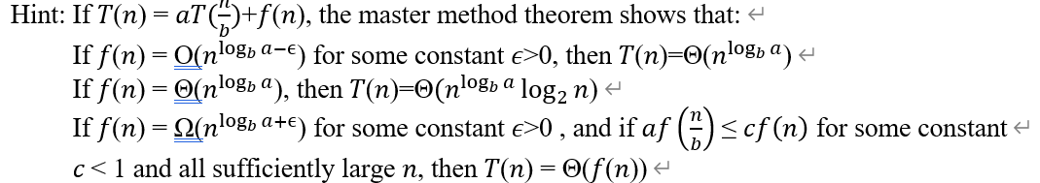
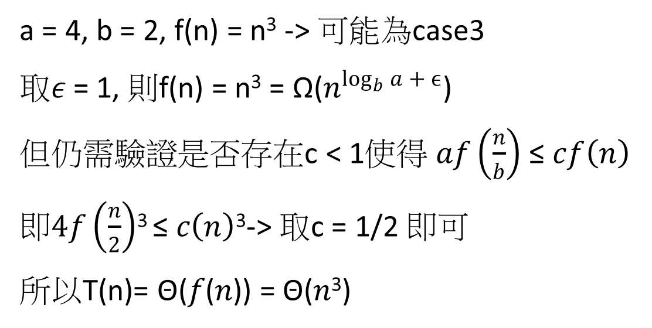
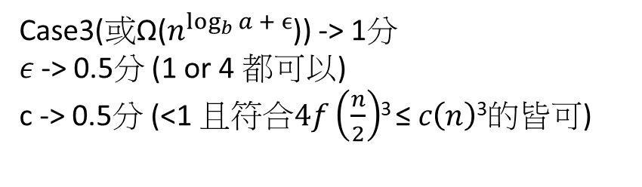
6. (5%) Use master method to solve the recurrence: T(n)=4T(n/2)+n³.
a = 4, b = 2, f(n) = n³ -> 可能為case3
取𝜖 = 1, 則f(n) = n³ = Ω($n^{\log_{b}{a + ϵ}}$)
但仍需驗證是否存在c < 1使得 𝑎$f\left(\frac{n}{b}\right)$ ≤ 𝑐$f\left(n\right)$
即$4f\left(\frac{n}{2}\right)$³ ≤ 𝑐$\left(n\right)$³-> 取c = 1/2 即可
所以T(n)= Θ(𝑓(𝑛)) = Θ(𝑛³)
Case3(或Ω($n^{\log_{b}{a + ϵ}}$)) -> 1分
𝜖 -> 0.5分 (1 or 4 都可以)
c -> 0.5分 (<1 且符合$4f\left(\frac{n}{2}\right)$³ ≤ 𝑐$\left(n\right)$³的皆可)

Slide 12

7. (5%) In the worst case, a red black tree will take how much time to insert an element?
a. $O(n^{2})$
b. $O(n)$
c. $O(n\log_{2}n)$
d. $O(\log_{2}n)$
Answer:
abcd (5%)
d (3%)

Slide 13
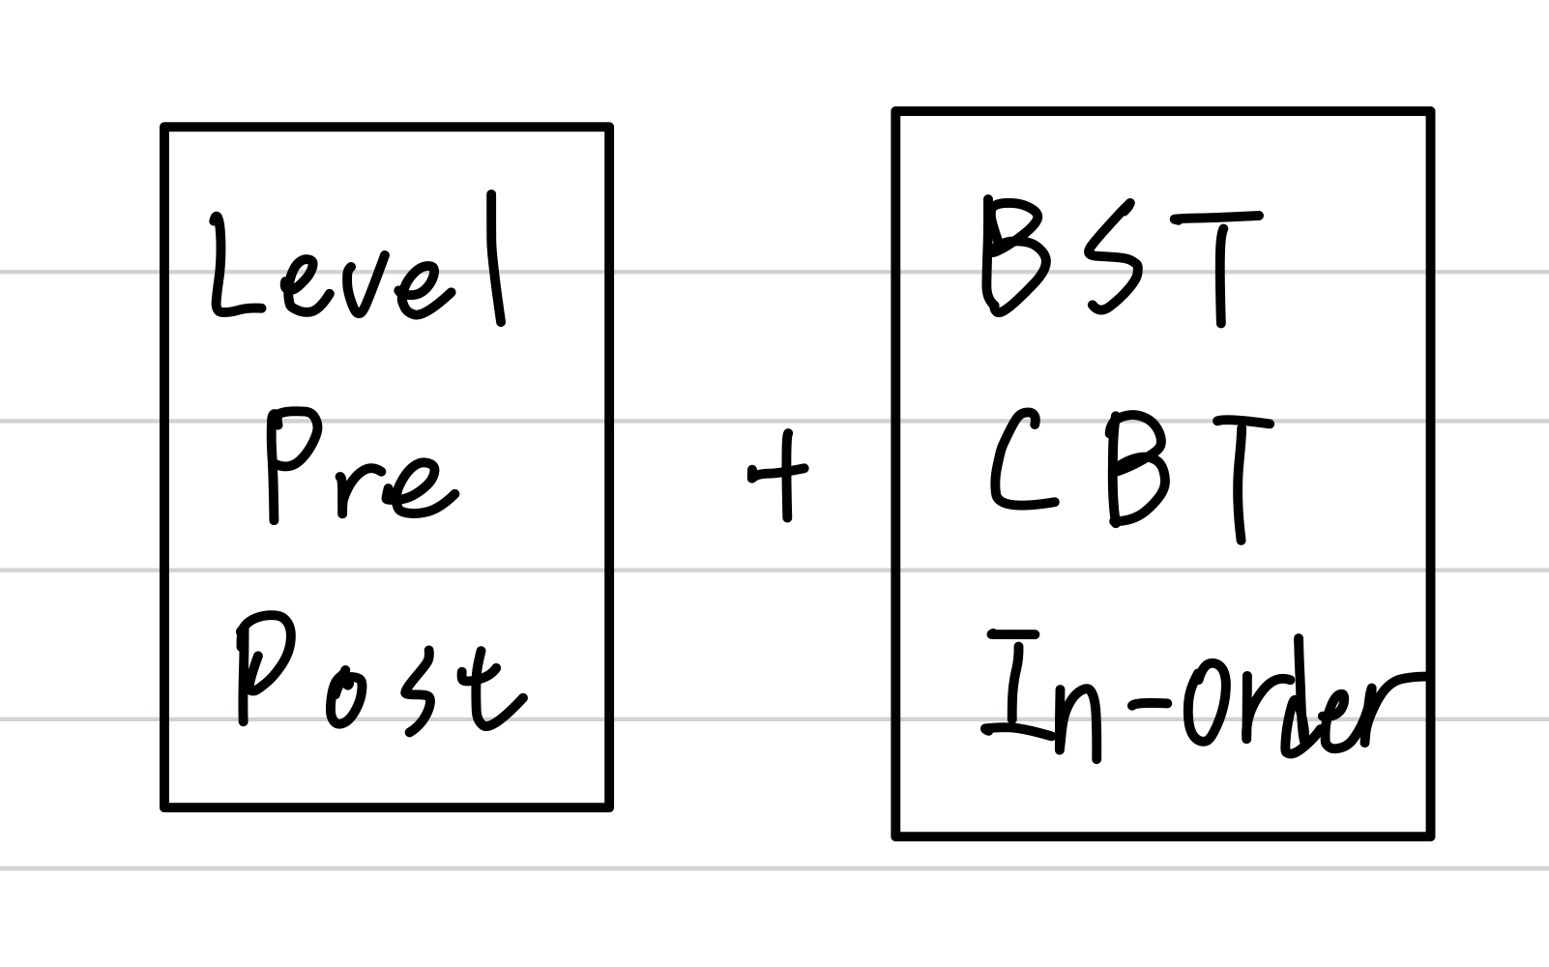
8. (5%) Which of the following statements provides enough information to build a unique binary tree?
a. Pre-order & in-order traversals
b. In-order & level-order traversals
c. The tree is a completed binary tree & post-order traversal
d. The tree is a binary search tree & in-order traversal
In-order and BST only show ascending order of the nodes
e. The tree is a binary search tree & post-order traversal
Answer: abce

Slide 14
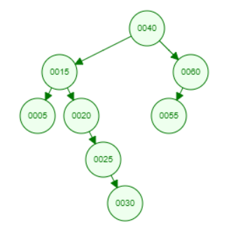
9.1 (25%) Please build different trees by inserting 40,60,55,15,20,5,25, and 30 sequentially.
a. Binary Search Tree

Slide 15
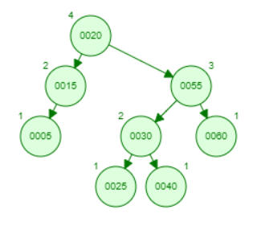
9.1 (25%) Please build different trees by inserting 40,60,55,15,20,5,25, and 30 sequentially.
b. AVL Tree

Slide 16
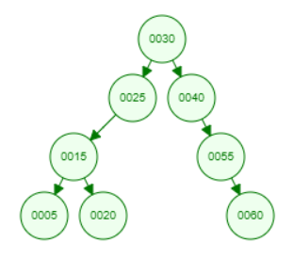
9.1 (25%) Please build different trees by inserting 40,60,55,15,20,5,25, and 30 sequentially.
c. Splay Tree

Slide 17
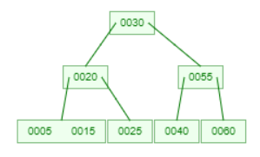
9.1 (25%) Please build different trees by inserting 40,60,55,15,20,5,25, and 30 sequentially.
d. 2-3 Tree

Slide 18
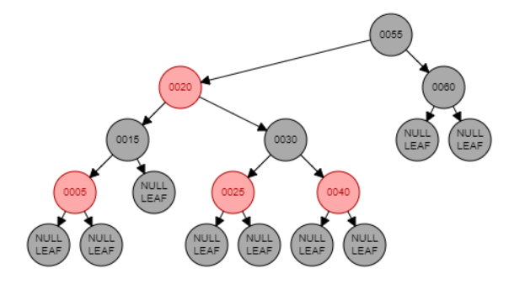
9.1 (25%) Please build different trees by inserting 40,60,55,15,20,5,25, and 30 sequentially.
e. Red Black Tree

Slide 19
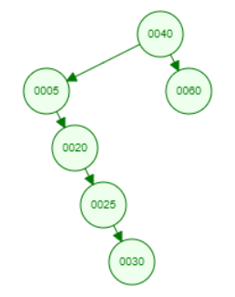
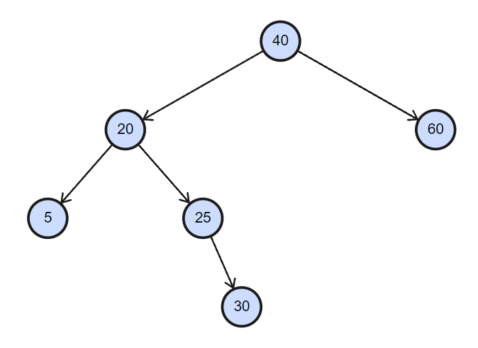
9.2 (20%) Based on the trees built in the previous question, please delete 55 and 15 sequentially.
a. Binary Search Tree

Slide 20
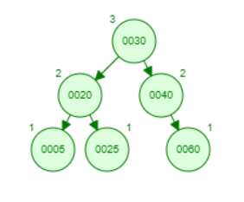
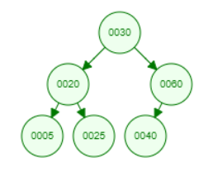
9.2 (20%) Based on the trees built in the previous question, please delete 55 and 15 sequentially.
b. AVL Tree

Slide 21
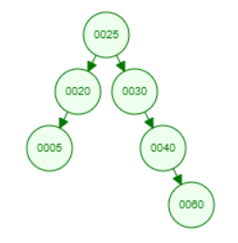
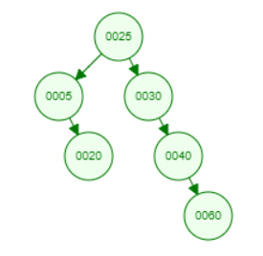
9.2 (20%) Based on the trees built in the previous question, please delete 55 and 15 sequentially.
c. Splay Tree

Slide 22
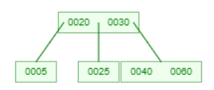
9.2 (20%) Based on the trees built in the previous question, please delete 55 and 15 sequentially.
d. 2-3 Tree

Slide 23
10. (10%; 5% each) Suppose there is a priority queue that supports three priority levels (0: high priority, 1: medium priority, 2: low priority). The priority queue is implemented using a 5x5 2D array, where each priority is represented as the rows of the array, and is implemented like a circular queue with a ‘front’ and ‘rear’ pointer for each priority level.
Note: Pseudocodes or detailed implementation in C or C++ is accepted.
‘push’ function that takes two parameters: 'value' (the value to be inserted) and 'priority' (the priority level). The function inserts element to the back of the appropriate queue according to its priority.
b. ‘pop’ function that will remove and return the top element starting from the highest priority.

Slide 24
Important points:
Implementation of a circular queue (front and rear pointers can go around the queue in a circular manner)
Use mod (%)
Implementation of FIFO
Push to the end of queue (rear)
Pop from the front of queue (front)
Push to the correct location according to the given priority
Pop elements starting with the highest priority
Checking if the queue is full or empty beforehand

Slide 25
a. push function
void push(int value, int priority) {
if (isFull(priority))
return;
arr[priority][rear[priority]] = value;
rear[priority] = (rear[priority] + 1) % 5;
}

Slide 26
b. pop function
int pop() {
int highestPriority = -1;
for (int i = 0; i < 3; i++) {
if (!isEmpty(i)){
highestPriority = i;
break;
}
}
if (highestPriority == -1)
return -1;
int popped = arr[highestPriority][front[highestPriority]];
front[highestPriority] = (front[highestPriority] + 1) % 5;
return popped;
}

Slide 27
Average : 50.44

