Slide 1
Geant4 学习

Slide 2
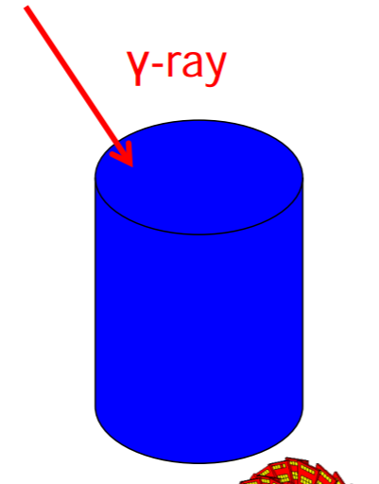
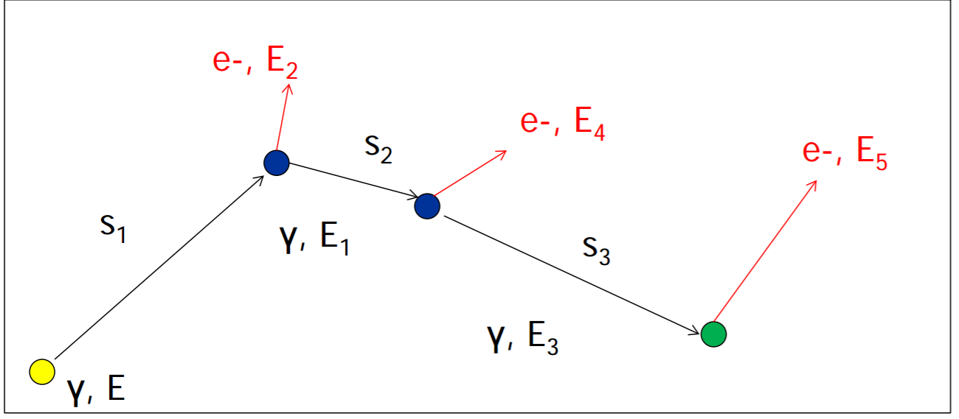
particle tracking
Notes:
Two step 之间是 Straight free-flight tracks between consecutive physics interactions
step length s 用模型
次级粒子 Store 方向改变
电子的能量 The mixed Monte Carlo 用了能量 cuts

Slide 3
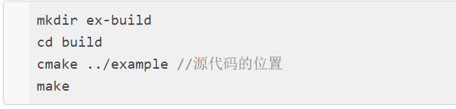
Cmake编译例子
Notes:
Cmake 文件的介绍放附录 不讲
开场简单

Slide 4
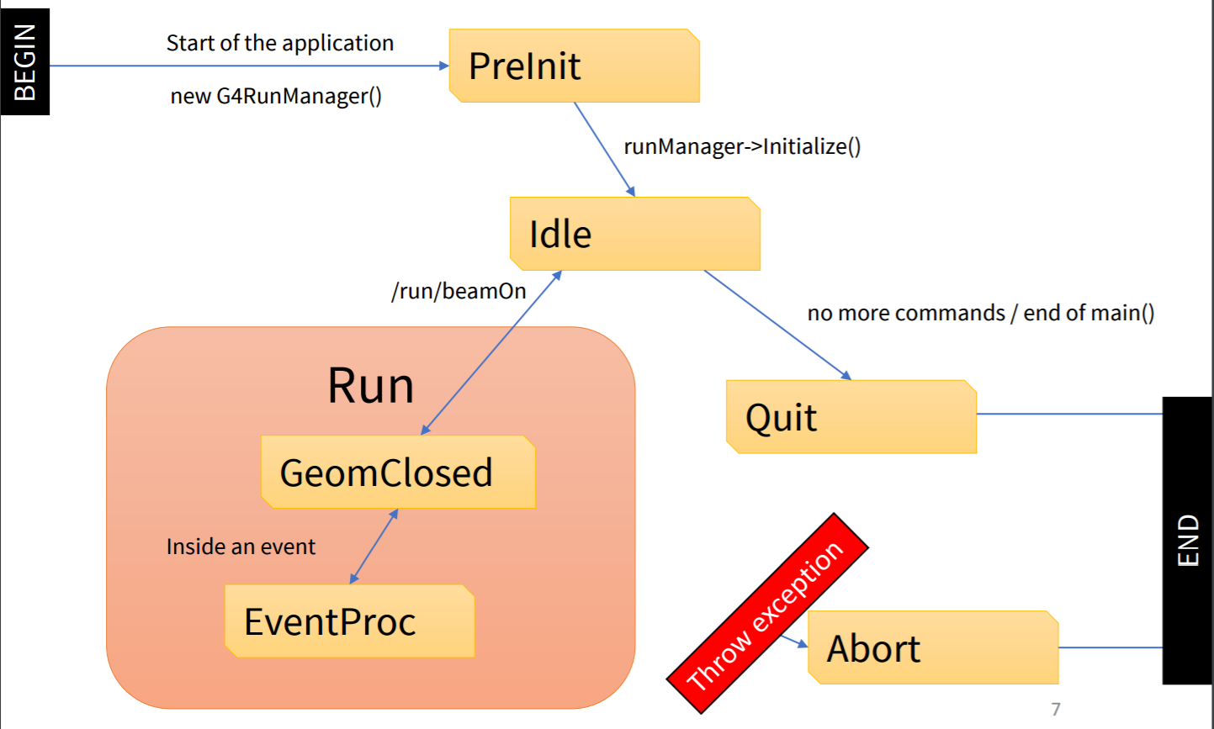
geant4 运行示意图
Notes:
/run/initialize
在preinit dectorconstruction 不可以修改

Slide 5
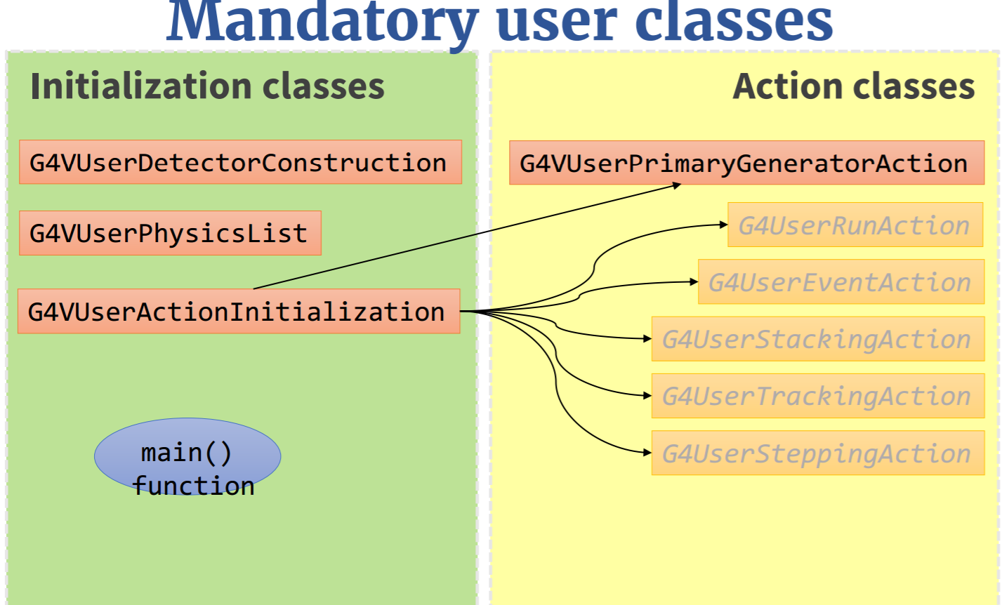

Slide 6
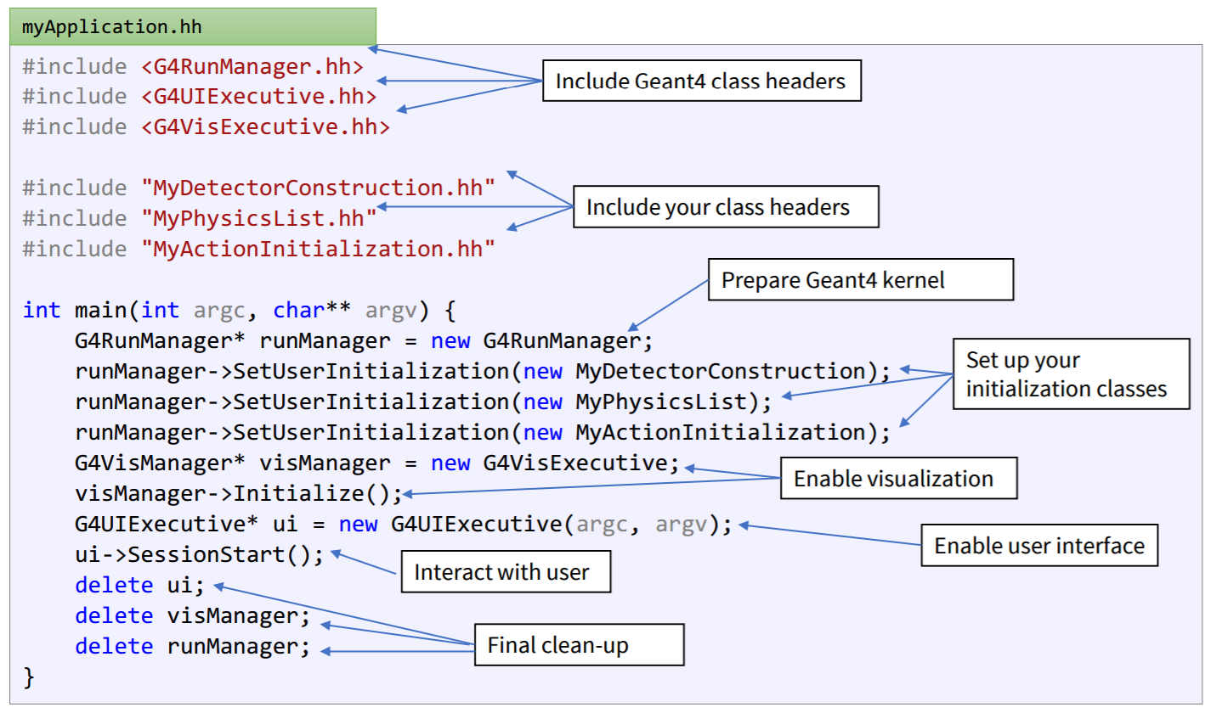
Notes:
没有run initial
讲 geant4 导入基础 导入到 maneger 类里面
然后action获取信息

Slide 7

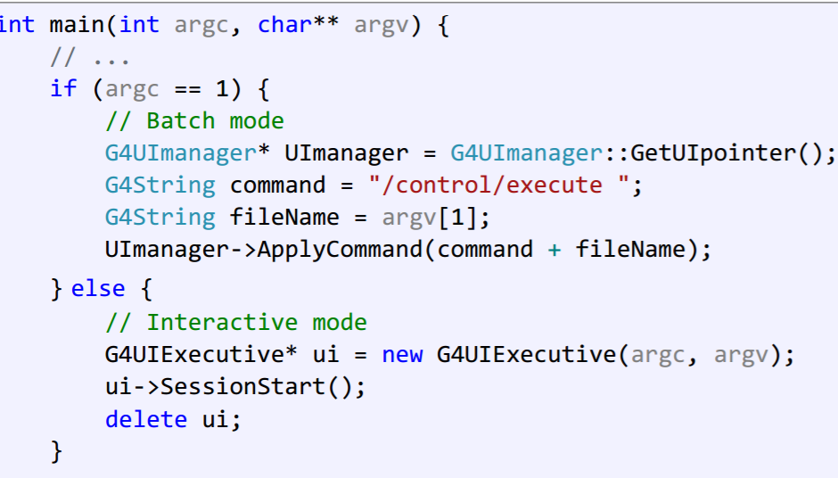
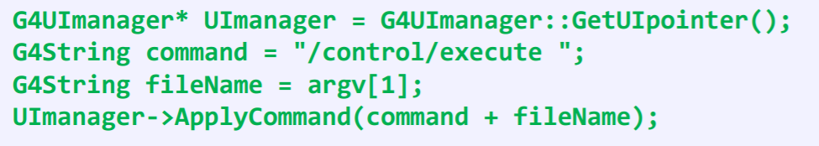
Hard-coded C++
Interactive session
Batch session
Notes:
忽略 简单提一下 下一张

Slide 8
Materials and geometry

Slide 10
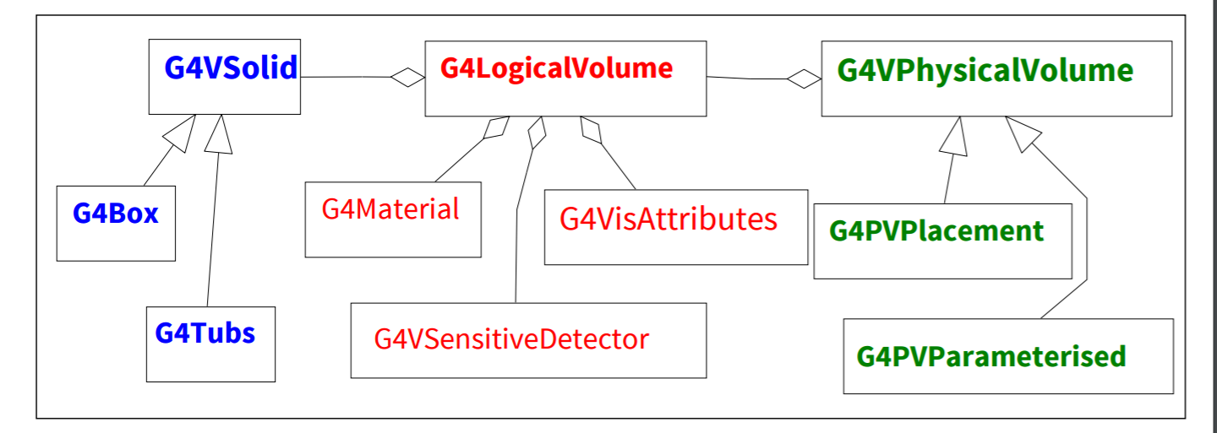
Notes:
parameterised

Slide 11
Sensitive dector

Slide 12
Sensitive dector
Create an instance of a sensitive detector and register it to the SensitiveDetector Manager
Assign the pointer of your SD to the logical volume of your detector geometry
Must be done in ConstructSDandField() of the user geometry class
Notes:
场的构建和敏感探测器构建差不多

Slide 13
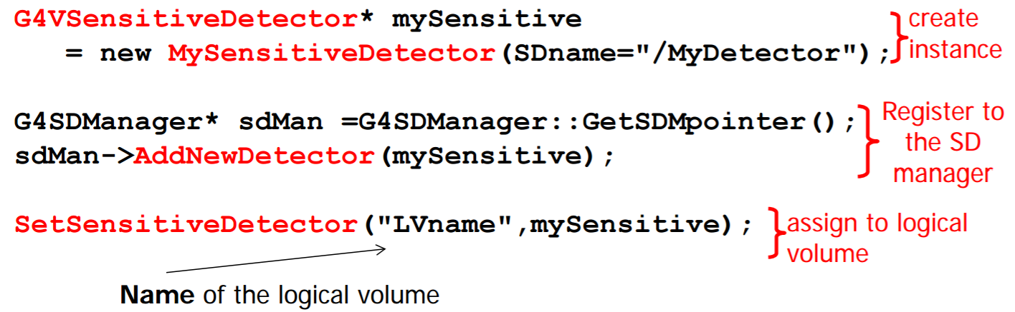
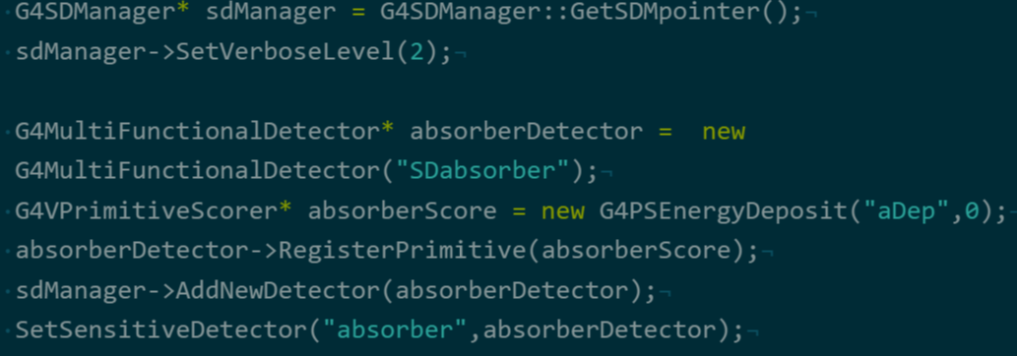

Slide 14
Physical list
Setcut
particial
process
Notes:
Gps gun

Slide 16
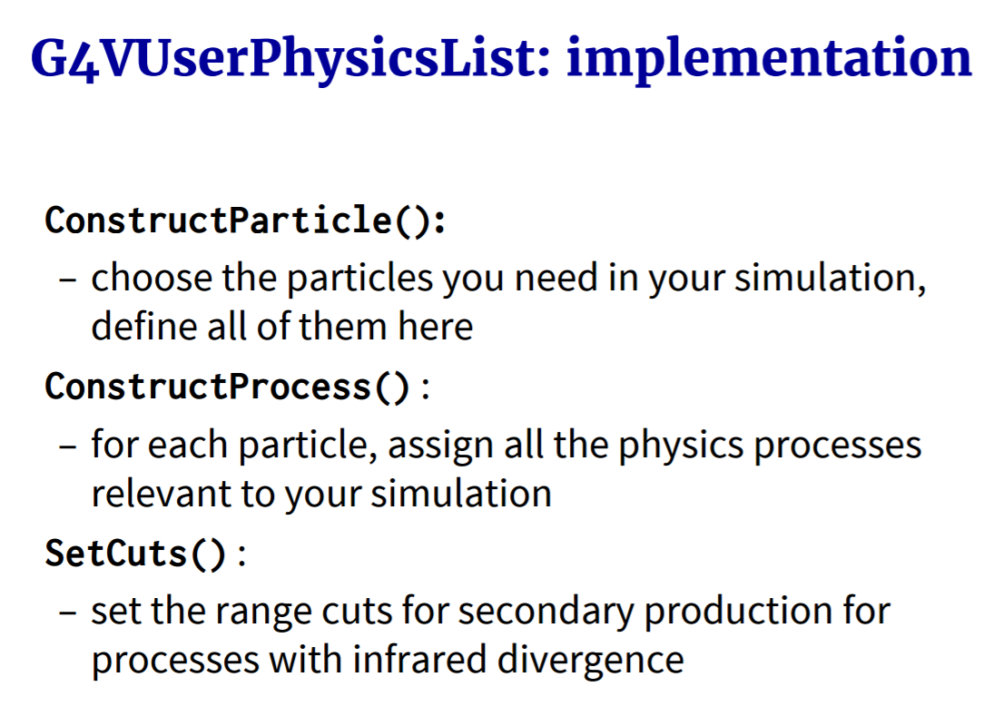

Slide 17
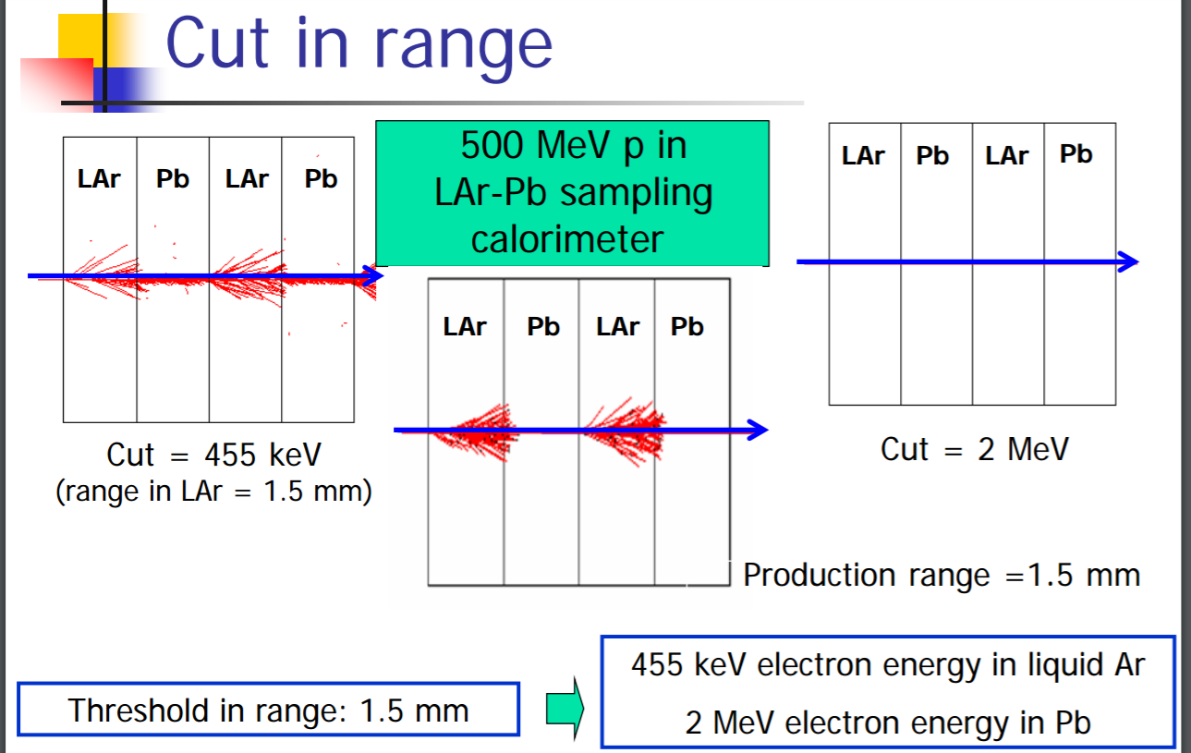
Notes:
讲啦一些geant4里面用到的模型 不懂

Slide 18
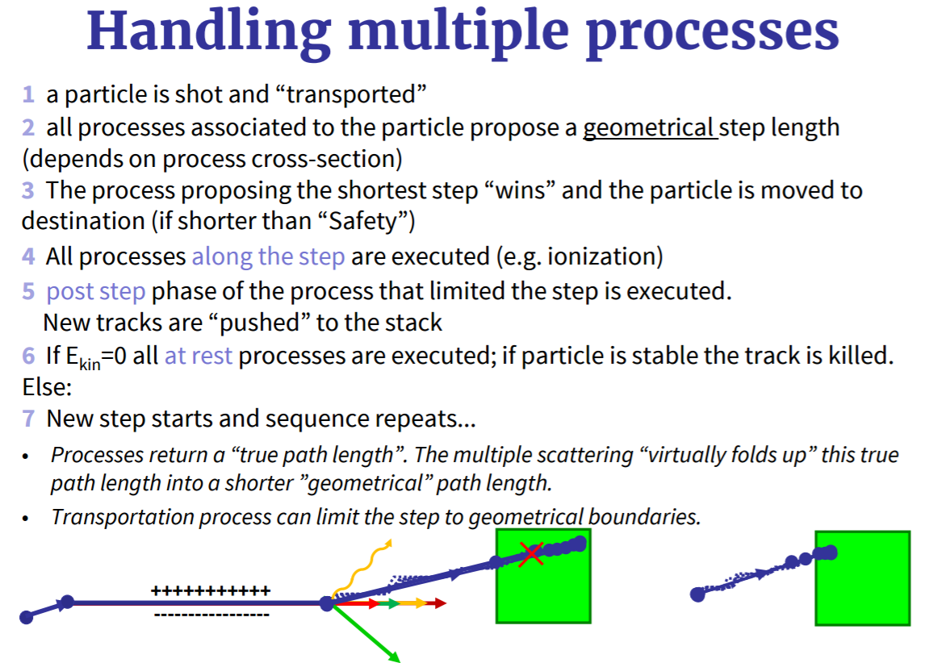
Notes:
代码细节不讲了

Slide 19
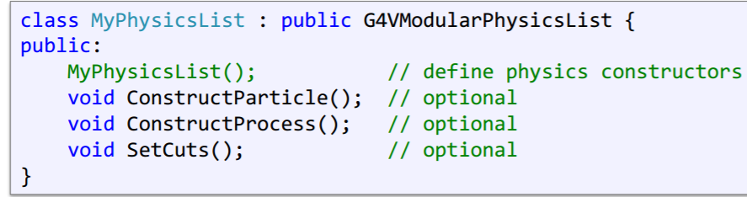
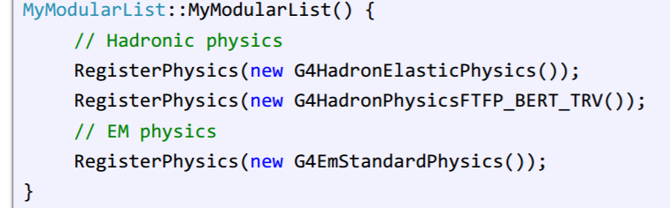
G4VModularPhysicsList G4VUserPhysicslist
自己编写粒子构建和粒子过程构建函数

Slide 20
Primary Generator Action
Notes:
简单地介绍一个action

Slide 22
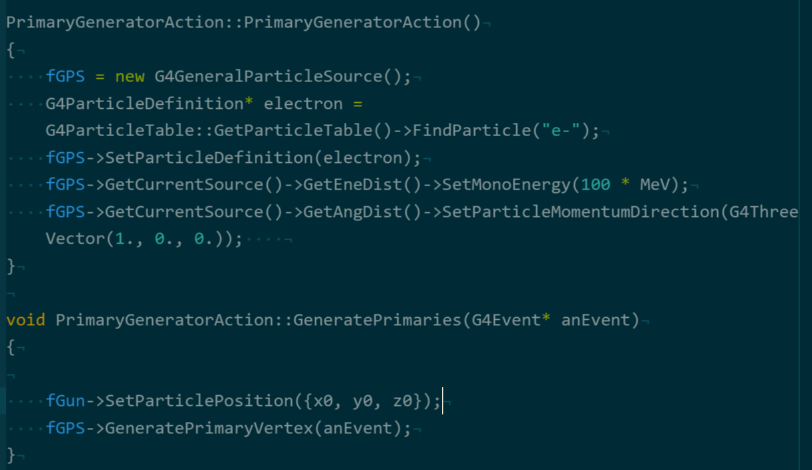
Notes:
Run action event action 有一个小错误

Slide 23
Thanks for listening

Slide 24
场

Slide 25
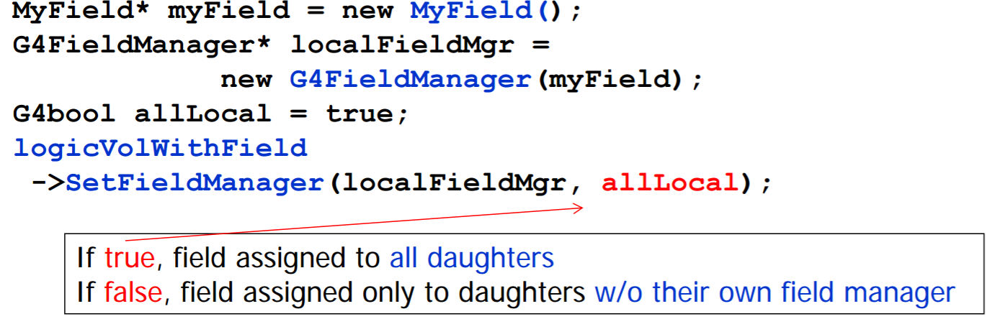
场是利用四阶龙格库塔

Slide 26
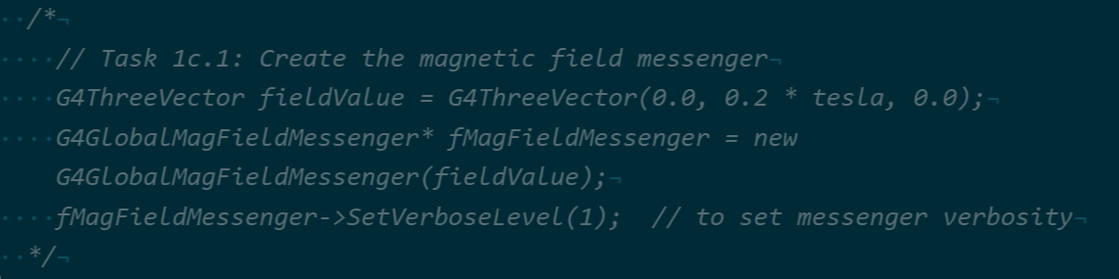
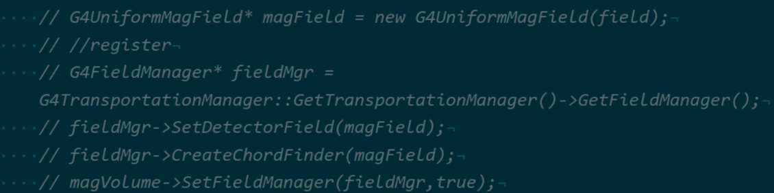

Slide 27
cmake

Slide 28
