Slide 1
Build your Virtual Conference on Microsoft Azure
Javier Lozano
Principal, lozanotek, Inc.

Slide 2
Agenda
How did we get here?
Building yourConf
Demos
In closing

Slide 3

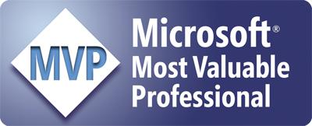
About Me
javier@lozanotek.com
@jglozano
http://jglozano.io
Des Moines, Iowa

Slide 4
Logistics
https://github.com/lozanotek/BuildYourVirtualConfWithAzure
Full Source, Slides, Misc.
https://github.com/lozanotek/yourConf
Deployment Repo – Full Source
https://github.com/lozanotek/yourConfVideoHub
Video SignalR Hub

Slide 5
GOAL #1
Provide a solution-based look on how to use and configure Azure services.

Slide 6
GOAL #2
Implement features in your application by leveraging Azure & 3rd party services.

Slide 7
GOAL #3
Show an ASP.NET perspective on how to build awesome applications on Azure.

Slide 8
How did we get here?
It took a little luck and a lot of hard work…

Slide 9

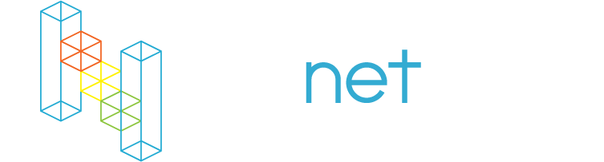

Slide 10
mvcConf 1 & 2
→ Single shared host
→ Unforeseen capacity issues (Good Problem)
→ Better deployment story

Slide 11
1
3
0
APPLICATION
STATISTICS
SESSIONS
MICRO SITE – MAIN & LIVE
ACROSS 2 EVENTS
1
5
3
REGISTERED
ATTENDEES
THOUSAND
THOUSAND
2011
2012
Notes:
Fastest Growing Hypervisor, taking share from VMWare”
2 releases of Hyper-V since ESX 5.1 (WS2012 and WS2012 R2)
Hyper-V share is growing 3x that of VMW over the past 2 years
Hyper-V steadily taking over a point of share per quarter
Microsoft in the Gartner Virtualization Magic Quadrant for the 3rd straight year and is the only vendor moving up and to the right
Over 50 new services released this year
Compute & Storage Capacity doubling every 6 – 9 months

Slide 12
Fast and Nimble
→ Smaller sites, and more of them
→ Quick feature adoption for platform & host
→ Reduce overhead as much as possible

Slide 13
aspConf 1 & 2
→ Go bigger but stay true to core values
→ Outsource problems
→ Don’t break the bank

Slide 14
2
7
0
APPLICATION
STATISTICS
SESSIONS
MICRO SITES – MAIN & LIVE
ACROSS 2 EVENTS
8
5
11
2
REGISTERED
ATTENDEES
THOUSAND
THOUSAND
2012
2013
Notes:
Fastest Growing Hypervisor, taking share from VMWare”
2 releases of Hyper-V since ESX 5.1 (WS2012 and WS2012 R2)
Hyper-V share is growing 3x that of VMW over the past 2 years
Hyper-V steadily taking over a point of share per quarter
Microsoft in the Gartner Virtualization Magic Quadrant for the 3rd straight year and is the only vendor moving up and to the right
Over 50 new services released this year
Compute & Storage Capacity doubling every 6 – 9 months

Slide 15
dotnetConf 1 & 2
→ Do more with less
→ Limit idle time for attendees
→ Have fun

Slide 16
2
3
8
APPLICATION
STATISTICS
SESSIONS
MICRO SITES – MAIN & LIVE
ACROSS 2 EVENTS
4
0
4
5
REGISTERED
ATTENDEES
THOUSAND
THOUSAND
2013
2014
Notes:
Fastest Growing Hypervisor, taking share from VMWare”
2 releases of Hyper-V since ESX 5.1 (WS2012 and WS2012 R2)
Hyper-V share is growing 3x that of VMW over the past 2 years
Hyper-V steadily taking over a point of share per quarter
Microsoft in the Gartner Virtualization Magic Quadrant for the 3rd straight year and is the only vendor moving up and to the right
Over 50 new services released this year
Compute & Storage Capacity doubling every 6 – 9 months

Slide 17
Building yourConf
A working application is worth 1000 nights of good sleep...

Slide 18
yourConf 2014
→ Run micro site on all US regions
→ Direct traffic to closest data center (DC)
→ Tell DC when application has failed

Slide 19
yourConf 2014
→ Application autonomy
→ Lightweight and flexible
→ Rolling updates are a must

Slide 20
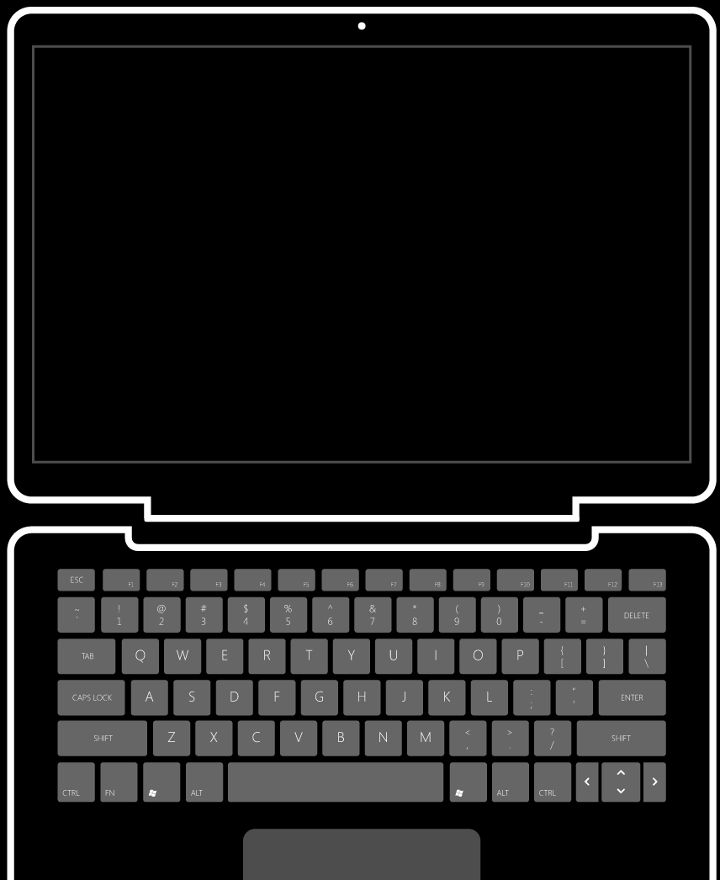
Our Toolset
Microsoft Azure
ASP.NET
Web Matrix
GitHub
Robust DNS

Slide 21
CAVEAT
Showing only some of the things we do for the conferences.

Slide 22
Demos
Bringing all the pieces together…

Slide 23
In closing
Hope this was useful information…

Slide 24
Logistics
https://github.com/lozanotek/BuildYourVirtualConfWithAzure
Full Source, Slides, Misc.
https://github.com/lozanotek/yourConf
Deployment Repo – Full Source
https://github.com/lozanotek/yourConfVideoHub
Video SignalR Hub

