Slide 1
FizzBuzz: Tactics and Lessons for Modern Technical Interviews
Javier G. Lozano
javier@lozanotek.com
@jglozano

Slide 2
Goal
Get us to think about how we ‘judge’ ourselves.
In our industry it’s always a little bit of theory and practice.

Slide 3
WARNING!
This is a discussion heavy session…speak up!
Feel free to speak your mind but be kind to others.
Don’t worry about me, it takes a lot for me to get offended.

Slide 4
Agenda
Ranges, Ranges, Ranges!
Titles and Roles
Technical Puzzle

Slide 5




Info
javier@lozanotek.com
@jglozano
http://jglozano.io
https://github.com/lozanotek/FizzBuzz

Slide 6

Ranges, Ranges, Ranges!
For our exercise…
0-3 → Entry/Junior
4-7 → Intermediate

Slide 7
Ranges, Ranges, Ranges!
For our exercise…
8-10 → Senior
10+ → Lead

Slide 8
Ranges, Ranges, Ranges!
For our exercise…
0-3 → Entry/Junior
4-7 → Intermediate
8-10 → Senior
10+ → Lead

Slide 9
Ranges, Ranges, Ranges!
Range Call!

Slide 10
Ranges, Ranges, Ranges!
Why is it so??
Easy to quantify/group
If the shoe fits...
Transition across industry is easier
Assign a cost/value
People who are X, typically get paid Y.
Helps create a market…

Slide 11
Ranges, Ranges, Ranges!
Why is it so??
External requirement
Government
Regulatory Body
Make things equal
School degree?
Years of experience

Slide 12
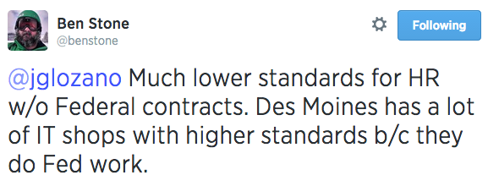
Titles and Roles
https://twitter.com/benstone/status/496286064181407744

Slide 13
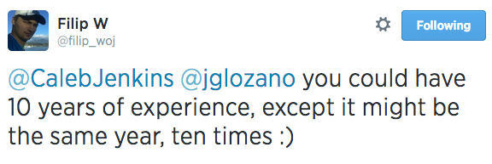
Titles and Roles
https://twitter.com/filip_woj/status/496260025019809792

Slide 14
Titles and Roles
Define Entry/Junior:
Constant Supervision
Can handle small tasks
Getting footing on “the industry”
Knows HOW to do what they’re told

Slide 15
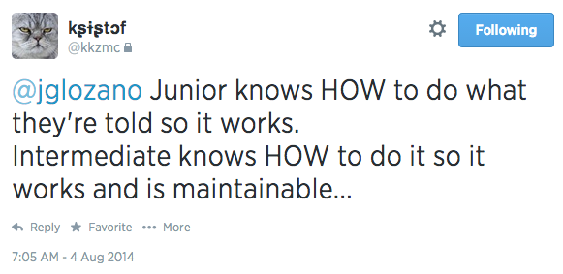
Titles and Roles
https://twitter.com/kkzmc/status/496265718027931648

Slide 16
Titles and Roles
Define Intermediate:
Knows HOW to do it so it works and is maintainable
Needs less supervision
Can handle complex tasks
Lack design understanding & experience to choose right tools

Slide 17
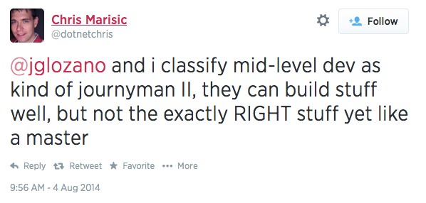
Titles and Roles
https://twitter.com/dotnetchris/status/496308609782124544

Slide 18
Titles and Roles
Define Senior:
Knows WHAT to do
Knows what NOT to do
Needs no supervision
Solves business problems with technology

Slide 19
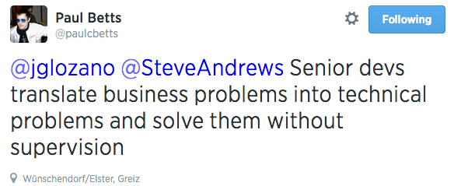
Titles and Roles
https://twitter.com/paulcbetts/status/496264866294808576

Slide 20
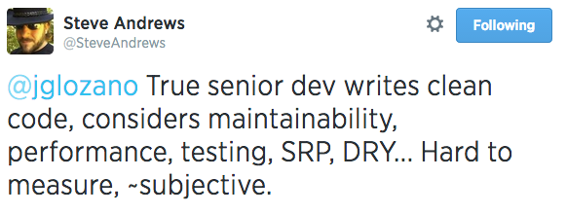
Titles and Roles
https://twitter.com/SteveAndrews/status/496258920755642370

Slide 21
Titles and Roles
Define Lead:
Could manage people**
Can we swapped with Technical Architect
Knows how to get everyone on team to do their best and enjoy it
Other duties may apply

Slide 22
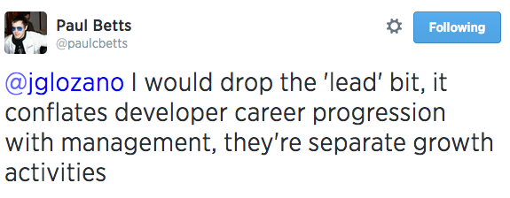
Titles and Roles
https://twitter.com/paulcbetts/status/496265997209174016

Slide 23
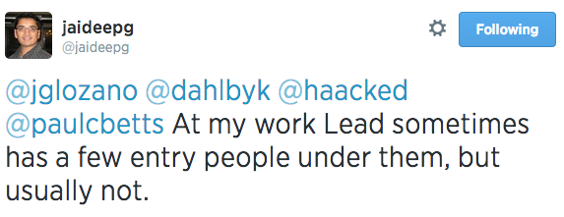
Titles and Roles
https://twitter.com/jaideepg/status/496317451185844224

Slide 24
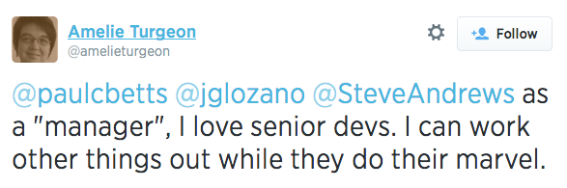
Titles and Roles
https://twitter.com/amelieturgeon/status/496269467320872960

Slide 25
Titles and Roles
Anything else to add?

Slide 26
Technical Puzzle
Remember your range? Let’s put it to good use…

Slide 27
Thanks!
Comments?

