Slide 1
Implementing Web Security in Your ASP.NET Applications
Javier G. Lozano
javier@lozanotek.com
@jglozano

Slide 2
Goal
Get a basic understanding of open source tooling that helps YOUR security solution.
Spark ideas about what you add to your application to make user authentication easier and simple.

Slide 3
Caveat
Your mileage may vary with the topics and approaches discussed.
Implementation of an SSO solution will vary depending on your business needs.

Slide 4




Info
javier@lozanotek.com
@jglozano
http://jglozano.io
https://github.com/lozanotek/aspnet-security

Slide 5
Agenda
Quick Overview
Demos, Demos, Demos!

Slide 6

Authentication Flow
Helps define delegation protocol for conveying authorization decisions for applications and APIs….
http://oauth.net/articles/authentication/

Slide 7
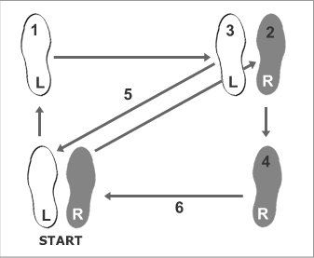
Authentication Flow
Rumba (Men)
http://www.dancing4beginners.com/rumba-dance-steps.htm

Slide 8
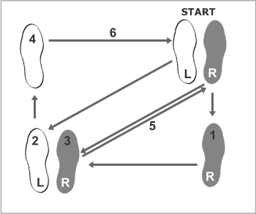
Authentication Flow
Rumba (Women)
http://www.dancing4beginners.com/rumba-dance-steps.htm

Slide 9
Authentication Flow
OAuth 2
Delegation protocol for authorization decisions
Allows issuance of access tokens to third-party clients once approved by an owner (user)
Access tokens grant (limited) access to owner resources (pictures, timeline, tweets, etc.)

Slide 10
Authentication Flow
OpenID Connect
Uses OAuth 2 flow
Adds User Information exchange via claims

Slide 11
Demo
Enough slides, let’s code.

Slide 12
Thanks!
Questions?

