Slide 1
Implementing Web Security in Your ASP.NET Applications
Javier G. Lozano
javier@lozanotek.com
@jglozano

Slide 2
Goal
Get a basic understanding of open source tooling that helps YOUR security solution.
Spark ideas about what you add to your application to make user authentication easier and simple.

Slide 3
Caveat
Your mileage may vary with the topics and approaches discussed.
Implementation of an SSO solution will vary depending on your business needs.

Slide 4




Info
javier@lozanotek.com
@jglozano
http://jglozano.io
https://github.com/lozanotek/aspnet-security

Slide 5
Agenda
Quick Overview
Demos, Demos, Demos!

Slide 6

Authentication Flow
Helps define delegation protocol for conveying authorization decisions for applications and APIs….
http://oauth.net/articles/authentication/

Slide 7
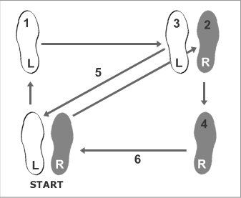
Authentication Flow
Rumba (Men)
http://www.dancing4beginners.com/rumba-dance-steps.htm

Slide 8
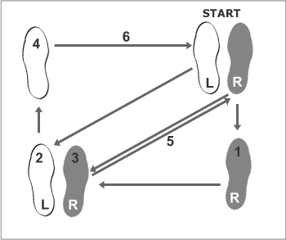
Authentication Flow
Rumba (Women)
http://www.dancing4beginners.com/rumba-dance-steps.htm

Slide 9
Authentication Flow
OAuth 2
Delegation protocol for authorization decisions
Allows issuance of access tokens to third-party clients once approved by an owner (user)
Access tokens grant (limited) access to owner resources (pictures, timeline, tweets, etc.)

Slide 10
Authentication Flow
OpenID Connect
Uses OAuth 2 flow
Adds User Information exchange via claims

Slide 11
OAuth 2 Flow
Application redirects User to Service for authorization
User authenticates into Service and grants Application access to Resources
Service redirects User back to Application (via Redirect URL) with a special Code

Slide 12
OAuth 2 Flow
Application uses Code to get an Access Token
Service returns Access Token for the User
Application can use Access Token for subsequent requests to Service on User’s behalf

Slide 13
OpenID Connect Flow
Relying Party sends request to the OpenID Provider to authenticate the end user
OpenID provider authenticates the user
OpenID provider sends the ID Token and Access Token to the Relying Party

Slide 14
OpenID Connect Flow
Relying Party sends a request to the User Info endpoint with the access token.
User Info endpoint returns the Claims for the User.

Slide 15
Huh?
Huh?

Slide 16
Demo
Enough slides, let’s code.

Slide 17
Thanks!
Questions?

