Slide 1
ASP.NET vNext Unleashed
Javier G. Lozano
javier@lozanotek.com
@jglozano

Slide 2
Goal
Give an overview of where ASP.NET is heading and what it means to developers.
Spark ideas about what you can do to make contributions to the ASP.NET community.

Slide 3
Caveat
This is a slide heavy presentation. My apologies for this but it was the only way to get the information needed to understand the demos/new way of doing things.

Slide 4
Agenda
History
Why vNext?
Feature Overview
Demos
Questions

Slide 5




Info
javier@lozanotek.com
@jglozano
http://jglozano.io
https://github.com/lozanotek/aspnet-vnext-unleashed

Slide 6

History – where are we now?
A look back at Classic ASP/ASP.NET …
1996 – ASP (part of IIS 3.0/Windows NT 4.0 SP2)
2002 – ASP.NET (Web Forms) with .NET 1.0
2008 – ASP.NET MVC

Slide 7
History – where are we now?
A look back at Classic ASP/ASP.NET …
2010 – ASP.NET Web Pages
2012 – ASP.NET Web API, SignalR
2013/2014 – ASP.NET vNext

Slide 8
Why vNext?
Fast(er) Development Cycle
Opt-in Approach
Open Source

Slide 9
Why vNext?
Cross Platform
On-prem to Cloud
Development Experience

Slide 10
Fast(er) Development Cycle
Framework ships with application
Similar to mobile applications
2 Framework Versions
.NET vNext – full
.NET Cloud – lighter
Break dependency on VS/Core schedules

Slide 11
Opt-in Approach
Modularity First
Features are now packages
Choose the components you want
Lighter Core Runtime
HttpContext is ~30K request (legacy)

Slide 12
Open Source
Released under MS Open Tech umbrella
Subsidiary of MS Corp
Hosted on Github
https://github.com/aspnet
Allows YOU to contribute

Slide 13
Cross Platform
Windows (.NET)
OSX (Mono)
Linux (Mono)
?

Slide 14
On-Prem to Cloud
Simpler Deployment
New runtime eliminates compilation step
Platform does the Lifting
Environment configures app by default
Loose Coupling
Caching, Session, etc.

Slide 15
Development Experience
Choose your own Editor
Visual Studio, vim, Notepad++, ??
Opt-in to different runtime components
Raw sockets to Managed Stack
Simpler Structure
Lighter framework, projects, runtime, and dependencies

Slide 16
Feature Overview
Project Structure
Packages
Runtime

Slide 17
Feature Overview
Dependency Injection
Diagnostics/Logging
Hosting

Slide 18
Project Structure
JSON based
Specifies application needs
Runtime Requirements
Package Dependencies
Commands (how to run based on hosts)
Used by runtime to setup environment

Slide 19
Project Structure
//project.json
{
"dependencies": {
"Kestrel": "1.0.0-alpha4",
"Microsoft.AspNet.Diagnostics": "1.0.0-alpha4",
"Microsoft.AspNet.Hosting": "1.0.0-alpha4",
"Microsoft.AspNet.Mvc": "6.0.0-alpha4",
"Microsoft.AspNet.Server.WebListener": "1.0.0-alpha4"
},
"commands": {
"web": "Microsoft.AspNet.Hosting --server Microsoft.AspNet.Server.WebListener --server.urls http://localhost:5001",
"kestrel": "Microsoft.AspNet.Hosting --server Kestrel --server.urls http://localhost:5004"
},
"frameworks": {
"aspnet50": { },
"aspnetcore50": { }
}
}

Slide 20
Packages
Every features is a package
Allows for loose coupling, lighter framework
Out-of-band Releases
Create your own schedule, ship new features as needed
Easier to opt-in to new features
Feature-v1.0 -> Feature-v2.0

Slide 21
Packages
//part of project.json file – you can pick and choose the version (and packages) you want to reference
//NOTE: You might have code (and breaking) changes as you opt-in for new features
"dependencies": {
"Kestrel": "1.0.0-*",
"Microsoft.AspNet.Server.IIS": "1.0.0-*",
"Microsoft.AspNet.Mvc": "6.0.0-*",
"Microsoft.AspNet.Server.WebListener": "1.0.0-*",
"Microsoft.AspNet.Diagnostics": "1.0.0-*",
"Microsoft.AspNet.StaticFiles": "1.0.0-*",
"Microsoft.AspNet.SignalR.Server": "3.0.0-*”
}

Slide 22
Runtime
Quick development feedback
Enable change and run
Remove Design Time
Everything is “as is”, allows for faster load times
No compilation step
Disk I/O dependency is removed through caching

Slide 23
Runtime
Split into layers
Layer 0: Native Process (native)
Layer 1: CLR Host (native)
Layer 2: Entry Point (managed)
Layer 3: Application Host (managed)
Layer 4: Application (managed)

Slide 24
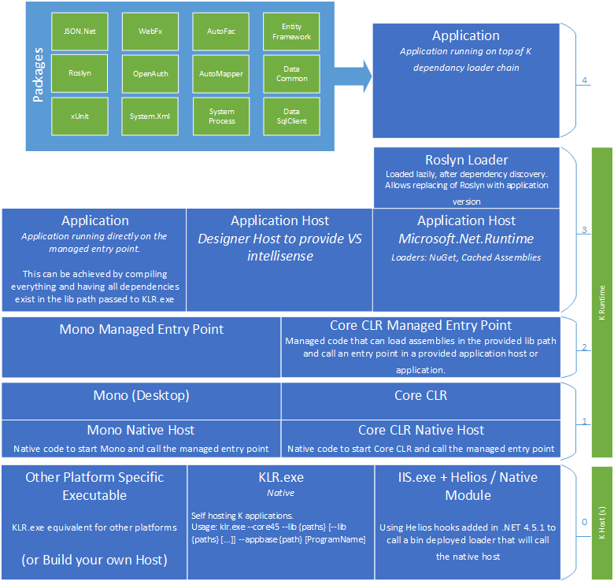
Runtime
https://github.com/aspnet/Home/wiki/KRuntime-structure

Slide 25
Dependency Injection
DI abstractions shared across all the layers
ASP.NET
EF7
Allows developer to pick your favorite DI container
Ninject
Windsor
StructureMap

Slide 26
Dependency Injection
Provides resolve-only approach for services
Registration happens at container

Slide 27
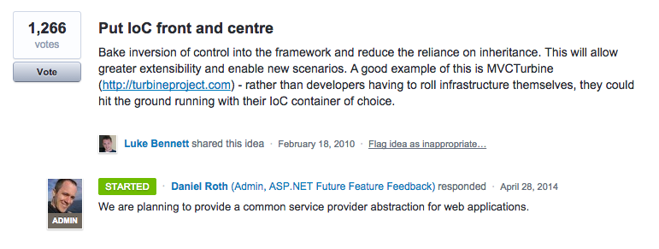
Dependency Injection
http://aspnet.uservoice.com/forums/41199-general-asp-net/suggestions/487734-put-ioc-front-and-centre

Slide 28
Diagnostics/Logging
Basic logging abstractions
Setup across all layers of the runtime/framework
Ships with NLog

Slide 29
Hosting
Server becomes a pluggable component
Allows for self-hosting and standard scenarios

Slide 30
Hosting
Microsoft.AspNet.Loader.IIS (Helios)
Integration with IIS and IIS Components
Bypasses System.Web (good thing)
Microsoft.AspNet.Server.WebListener (WebListener)
Uses Http.sys kernel driver
Non-IIS hosting (Windows only)

Slide 31
Hosting
Microsoft.AspNet.Server.Kestrel (Kestrel)
Non-IIS hosting (cross platform)

Slide 32
Demo
Enough slides, let’s code.

Slide 33
Thanks!
Questions?

