Slide 1
ASP.NET vNext Unleashed
Javier G. Lozano
javier@lozanotek.com
@jglozano

Slide 2
Goal
Give an overview of where ASP.NET is heading and what it means to developers.
Spark ideas about what you can do to make contributions to the ASP.NET community.

Slide 3
Agenda
History
Why?
Feature Overview
Demos
Questions

Slide 4



Info
javier@lozanotek.com
@jglozano
http://jglozano.io
http://lzno.tk/aspnet5-unleashed

Slide 5

History – where are we now?
A look back at Classic ASP/ASP.NET …
1996 – ASP (part of IIS 3.0/Windows NT 4.0 SP2)
2002 – ASP.NET (Web Forms) with .NET 1.0
2008 – ASP.NET MVC

Slide 6
History – where are we now?
A look back at Classic ASP/ASP.NET …
2010 – ASP.NET Web Pages
2012 – ASP.NET Web API, SignalR
2013/2014 – ASP.NET 5

Slide 7
Why?
Fast(er) Development Cycle
Opt-in Approach
Open Source

Slide 8
Why?
Cross Platform
On-prem to Cloud
Development Experience

Slide 9
Fast(er) Development Cycle
Framework ships with application
Similar to mobile applications
2 Framework Versions
.NET vNext – full
.NET Cloud – lighter
Break dependency on VS/Core schedules

Slide 10
Opt-in Approach
Modularity First
Features are now packages
Choose the components you want
Lighter Core Runtime
HttpContext is ~30K request (legacy)
~90% faster than current implementation

Slide 11
Open Source
Released under MS Open Tech umbrella
Subsidiary of MS Corp
Hosted on Github
https://github.com/aspnet
Allows YOU to contribute

Slide 12
Cross Platform
Windows (.NET)
OSX (Mono)
Linux (Mono)
?

Slide 13
On-Prem to Cloud
Simpler Deployment
New runtime eliminates compilation step
Platform does the Lifting
Environment configures app by default
Loose Coupling
Caching, Session, etc.

Slide 14
Development Experience
Choose your own Editor
Visual Studio, vim, Notepad++, ??
Opt-in to different runtime components
Raw sockets to Managed Stack
Simpler Structure
Lighter framework, projects, runtime, and dependencies

Slide 15
Feature Overview
Runtime
Dependency Injection
Diagnostics/Logging

Slide 16
Feature Overview
POCO Controllers
Tag Helpers
Custom Commands

Slide 17
Runtime
Quick development feedback
Enable change and run
Remove Design Time
Everything is “as is”, allows for faster load times
No compilation step
Disk I/O dependency is removed through caching

Slide 18
Runtime
Split into layers
Layer 0: Native Process (native)
Layer 1: CLR Host (native)
Layer 2: Entry Point (managed)
Layer 3: Application Host (managed)
Layer 4: Application (managed)

Slide 19
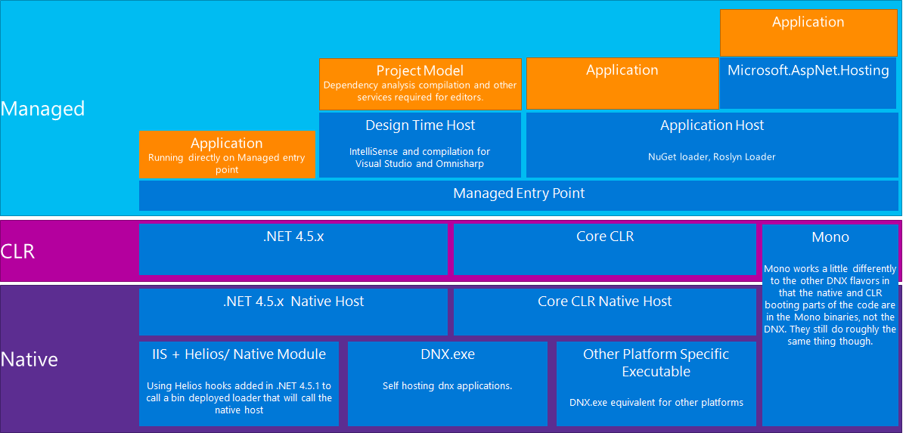
Runtime
https://github.com/aspnet/Home/wiki/DNX-structure

Slide 20
Dependency Injection
DI abstractions shared across all the layers
ASP.NET
EF7
Allows developer to pick your favorite DI container
Ninject
Windsor
StructureMap

Slide 21
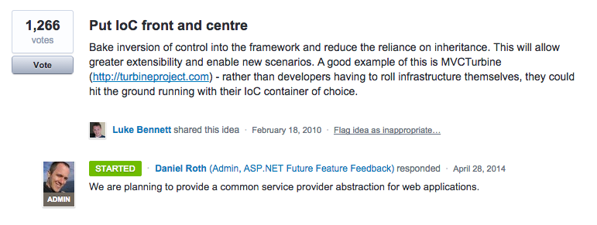
Dependency Injection
http://aspnet.uservoice.com/forums/41199-general-asp-net/suggestions/487734-put-ioc-front-and-centre

Slide 22
Diagnostics/Logging
Basic logging abstractions
Setup across all layers of the runtime/framework
Ships with NLog

Slide 23
Demo
Enough slides, let’s code.

Slide 24
Thanks!
Questions?

