Slide 1
ASP.NET 5 Unleashed
Javier Lozano
Javier@lozanotek.com

Slide 2
Goal
Give an overview of where ASP.NET is heading and what it means to developers.
Spark ideas about what you can do to make contributions to the ASP.NET community.

Slide 3
Overview
History
Why?
Feature Overview
Demos
Review
Questions

Slide 4


About Me
javier@lozanotek.com
@jglozano
http://jglozano.io
http://lzno.tk/aspnet5-unleashed

Slide 5
CAVEAT Just to set thing straight…
All demos work with VS 2015 RTM
All demos target Beta 5
Using my own NuGet gallery feed for demos

Slide 6
Status Quo What’s the chase and how do we cut to it?
Beta 6 – 27 Jul 2015
Beta 7 – 2 Sep 2015
Beta 8 – 15 Oct 2015
RC 1 – Nov 2015
1.0.0 – Q1* 2015
* Calendar-based quarters (Q1, Q2, etc.)
https://github.com/aspnet/Home/wiki/Roadmap

Slide 7
History Where are we now?
A look back at Classic ASP/ASP.NET …
1996 – ASP (part of IIS 3.0/Windows NT 4.0 SP2)
2002 – ASP.NET (Web Forms) with .NET 1.0
2008 – ASP.NET MCVC

Slide 8
History Where are we now?
A look back at Classic ASP/ASP.NET …
2010 – ASP.NET Web Pages
2012 – ASP.NET Web API, SignalR
2013/2014 – ASP.NET 5

Slide 9
Why? All this work for …
Fast(er) Development Cycle
Opt-in Approach
Open Source

Slide 10
Why? All this work for …
Cross Platform
On-prem to Cloud
Development Experience

Slide 11
Fast(er) Development Cycle
Framework ships with application
Similar to mobile applications
2 Framework Versions
.NET vNext – full
.NET Core – lighter
Break dependency on VS/Core schedules

Slide 12
Opt-in Approach
Modularity First
Features are now packages
Choose the components you want
Lighter Core Runtime
HttpContext is ~30K request (legacy)
~90% faster execution than current implementation

Slide 13
Open Source
Released under MS Open Tech umbrella
Subsidiary of MS Corp
Hosted on Github
https://github.com/aspnet
Allows YOU to contribute

Slide 14
Cross Platform
Windows (.NET)
OS X (Mono)
Linux (Mono)
?

Slide 15
On-Prem to Cloud
Simpler Deployment
New runtime eliminates compilation step
Platform does the Lifting
Environment configures app by default
Loose Coupling
Caching, Session, Metrics, etc.

Slide 16
Development Experience
Choose your own Editor
Visual Studio, vim, Notepad++, ??
Opt-in to different runtime components
Raw sockets to Managed Stack
Simpler Structure
Lighter framework, projects, runtime, and dependencies

Slide 17
Feature Overview Just to name a few …
Runtime
Dependency Injection
Diagnostics/Logging

Slide 18
Feature Overview Just to name a few …
POCO Controllers
Tag Helpers
Custom Commands

Slide 19
Runtime The engine quietly humming…
Quick development feedback
Enable change and run
Remove Design Time
Everything is “as is”, allows for faster load times
No compilation step
Disk I/O dependency is removed through caching

Slide 20
Runtime The engine quietly humming…
Split into layers (onion or Ogre)
Layer 0: Native Process (native)
Layer 1: CLR Host (native)
Layer 2: Entry Point (managed)
Layer 3: Application Host (managed)
Layer 4: Application (managed)

Slide 21
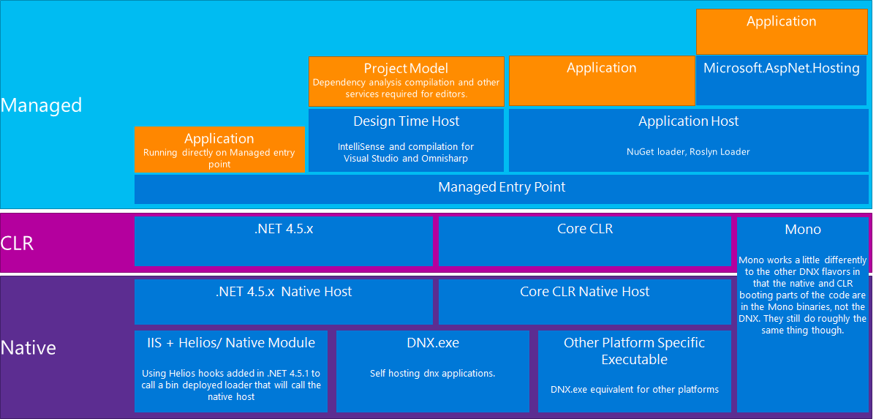
Runtime The engine quietly humming…
https://github.com/aspnet/Home/wiki/DNX-structure

Slide 22
Dependency Injection Building systems through composition…
DI abstractions shared across all the layers
ASP.NET
EF7
Allows developer to pick your favorite DI container
Ninject
Windsor
StructureMap
Autofac

Slide 23
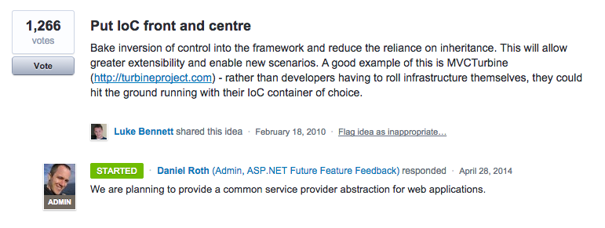
Dependency Injection Building systems through composition…
http://aspnet.uservoice.com/forums/41199-general-asp-net/suggestions/487734-put-ioc-front-and-centre

Slide 24
Diagnostics/Logging Peek through the stack…
Basic logging abstractions
Setup across all layers of the runtime/framework
Can add your own favorite logging framework

Slide 25
Enough slides, let’s code!

Slide 26
Review
History
Bigger revamp than ASP -> ASP.NET
Allow for legacy applications to continue as is
Why?
Need to compete in a cloud first, mobile first world
Software is becoming more commoditized
We can’t predict the future

Slide 27
Review
ASP.NET 5 Links
http://www.asp.net/vnext
http://lzno.tk/aspnet-community-standup
http://docs.asp.net
https://github.com/aspnet

Slide 28
Questions?
Please use Event Board to fill out a session evaluation.
Thank you!

