Slide 1
Automated Delivery for .NET Applications
Javier G. Lozano
javier@lozanotek.com
@jglozano

Slide 2
Goal
Provide ideas on how separating builds and deployments for your application.
Breaking a problem into smaller subsets allows for different solutions along the way…

Slide 3
Caveat
The techniques covered are based on generalizations across different team cultures.
Your mileage will vary as you apply within your team culture.

Slide 4
Agenda
Foundation
Builds
Deploys
Demo, Demos, Demos!

Slide 5




Info
javier@lozanotek.com
@jglozano
http://jglozano.io
https://github.com/lozanotek/automated-delivery/

Slide 6
Demo Links
http://appdemo.test.lozanotek.net
http://appdemo.lozanotek.net
http://build.lozanotek.net
http://deploy.lozanotek.net

Slide 7
Foundation
Effectiveness
Efficiency

Slide 8
Foundation
Doing the right things
Doing things right

Slide 9
Foundation
Doing the right things, right…
…and predictable.

Slide 10
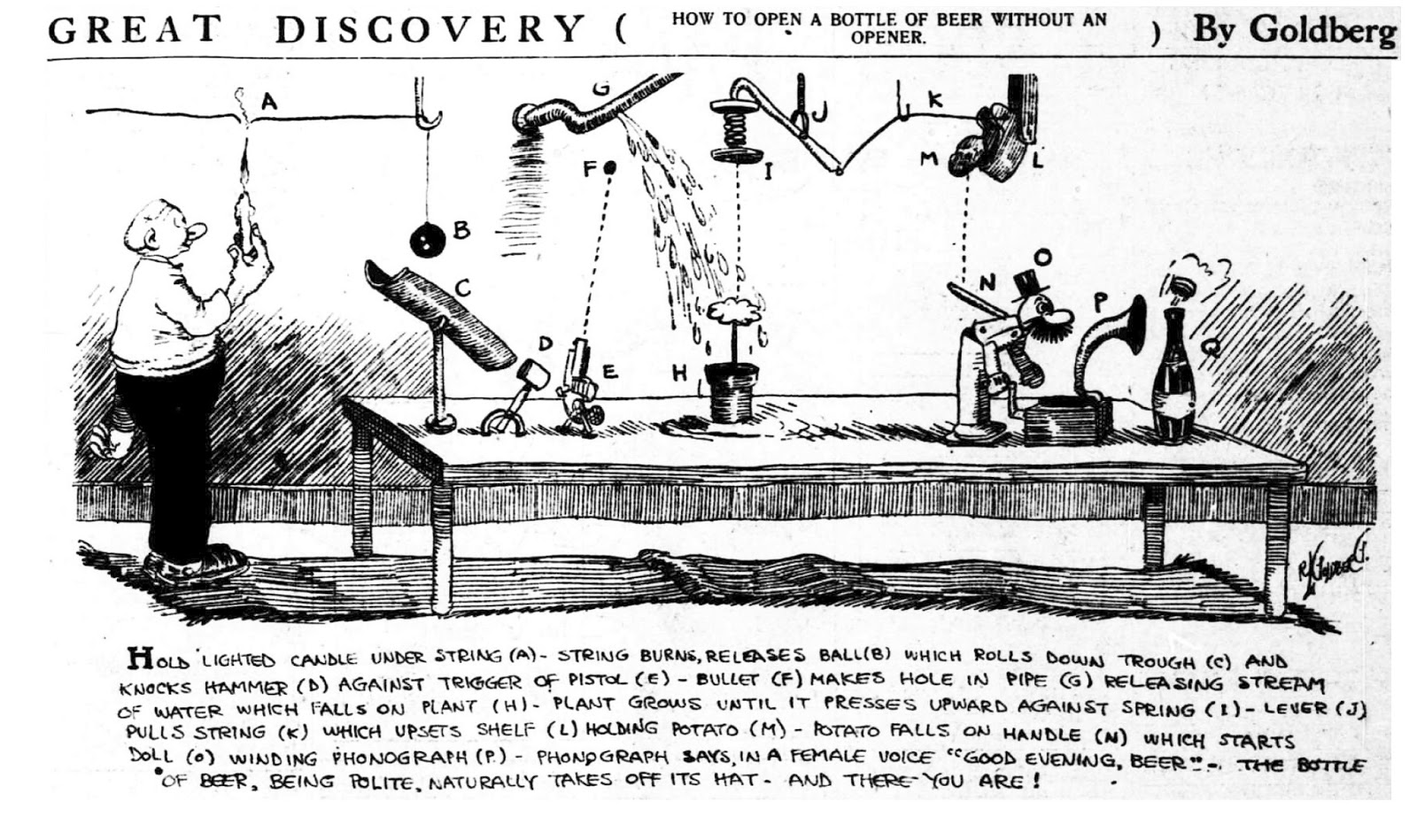

Slide 11


Slide 12
Foundation
Remember, you too are a customer of your processes.

Slide 13
Builds
Fetching Dependencies
Updating Dependencies
Code Compile

Slide 14
Builds
Running of Unit Tests
Gathering Metrics
Producing an Output

Slide 15
Builds - Tools
Jenkins
Team Build (TFS)
Bamboo
Maven
TeamCity

Slide 16
Builds – Tools *
AppVeyor
CodeShip
Travis CI

Slide 17
Deploy
Release Management
Publishing Packaged Application
Variable/Setting Replacement

Slide 18
Deploy
Configuring Application on Target
Verifying Installation
Instrumentation for Release

Slide 19
Deploy - Tools
Jenkins
Maven
Bamboo
Team Build

Slide 20
Deploy - Tools
Team City
Octopus Deploy
AppVeyor
Code Ship
Travis CI

Slide 21
Builds – Team City
Well documented and supported
Simple to setup
Extensible via plugins
Free-mium (20 configs, 3 agents)

Slide 22
Deploy – Octopus Deploy
Always been a fan
Simple to use
Extensible – target on-prem, cloud
Free-ium (5 projects, 10 targets)

Slide 23
Demo
Enough slides, let’s code.

Slide 24
Thanks!
Questions?

Slide 25
Info
javier@lozanotek.com
@jglozano
http://jglozano.io
https://github.com/lozanotek/automated-delivery/

