Slide 1
Microsoft Azure for ASP.NET Developers
Javier Lozano
javier@lozanotek.com

Slide 2
First Things, First…
http://www.orwellasp.net

Slide 3
Goal
For you to start thinking differently about your ASP.NET applications.
You can do more with less if you have the right foundation supporting your applications.

Slide 4
Overview
What is Azure?
Infrastructure as a Service (IaaS)
Platform as a Service (Paas)
Orwell Demos
Review
Questions

Slide 5


About Me
javier@lozanotek.com
@jglozano
http://jglozano.io
http://lzno.tk/azure-aspnet

Slide 6
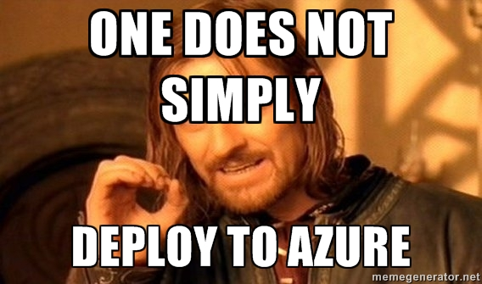
Before Scott Guthrie…

Slide 7



Microsoft Azure
Your Datacenter
Virtual Machines
Cloud Services
Web Sites
Applications
Applications
Applications
Applications
Data
Data
Data
Data
Firewall
Firewall Rules
Firewall Rules
Network
Virtual Network
Virtual Network
O/S
O/S
Virtualization
Hardware
Focus on the Application
Notes:
Slide Objectives:
Explain the differences between traditional self-hosting and the three options of Windows Azure hosting.
Notes:
In a traditional environment you must manage the full stack. With Windows Azure you can choose a variety of options depending on your needs.

Slide 8
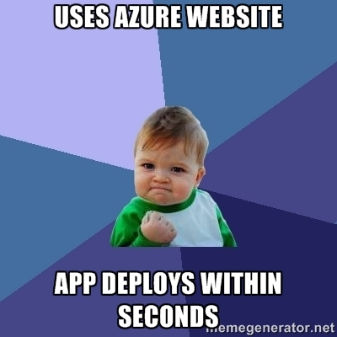
Azure Websites

Slide 9
Orwell ASP.NET Controlling your Experience
Demo application built to leverage different components of Azure
Table Storage
SQL Database
Traffic Manager
Service Bus
Websites

Slide 10
Orwell ASP.NET Controlling your Experience
Each piece is built with a different piece of ASP.NET
MVC
Web AP!
Web Forms
Web Pages

Slide 11
Enough slides, let’s code!

Slide 12
Review
No right answer
Adapt to change quickly
Be flexible with your application
Evolve as needed

Slide 13
Questions?
Please use Event Board to fill out a session evaluation.
Thank you!

