Slide 1
Windows Azure for ASP.NET Developers
Javier G. Lozano
javier@lozanotek.com
@jglozano

Slide 2
Goal
For you to start thinking differently about your ASP.NET applications.
You can do more with less if you have the right foundation supporting your apps…

Slide 3
Agenda
What is Windows Azure?
Web Role
Infrastructure as a Service (IaaS)
Platform as a Service (PaaS)
Orwell Demo

Slide 4




Info
javier@lozanotek.com
@jglozano
http://lozanotek.com/blog
https://github.com/lozanotek/AzureASPNET

Slide 5
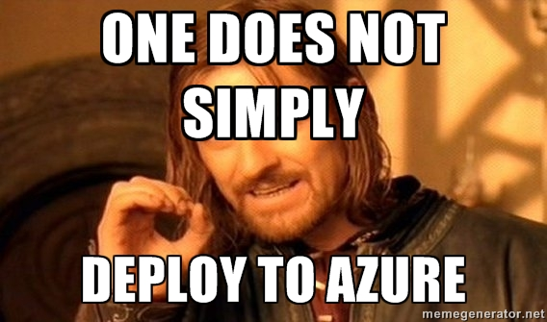
Before ScottGu

Slide 6



Microsoft Azure
Your Datacenter
Virtual Machines
Cloud Services
Web Sites
Applications
Applications
Applications
Applications
Data
Data
Data
Data
Firewall
Firewall Rules
Firewall Rules
Network
Virtual Network
Virtual Network
O/S
O/S
Virtualization
Hardware
Focus on the Application
Notes:
Slide Objectives:
Explain the differences between traditional self-hosting and the three options of Windows Azure hosting.
Notes:
In a traditional environment you must manage the full stack. With Windows Azure you can choose a variety of options depending on your needs.

Slide 7
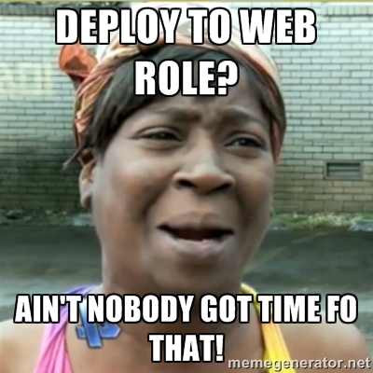
Web Role

Slide 8
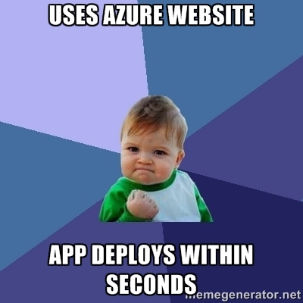
Azure Website

Slide 9
Demo
Enough slides, let’s code.

Slide 10
Links
Web Role
http://memegenerator.net/instance/42620090
Azure Website
http://memegenerator.net/instance/42621251

Slide 11
Thanks!
Questions?

