Slide 1
Scaling Your Application on the Cloud
Javier G. Lozano
javier@lozanotek.com
@jglozano

Slide 2
Agenda
Why?
How?

Slide 3
Info
javier@lozanotek.com
@jglozano
http://lozanotek.com/blog
https://github.com/lozanotek/cloudscale

Slide 4

Why?

Slide 5
Why?
Old Assumptions Were Wrong
We designed for ‘typical flow’
Serving too much content from one source
Not levering the ‘Internet’

Slide 6

Why?

Slide 7
Why?
Shared Hosting Doesn’t (Easily) Scale
503s during the keynote
Management of resources was limited
Couldn’t divert people to other ‘nodes’

Slide 8
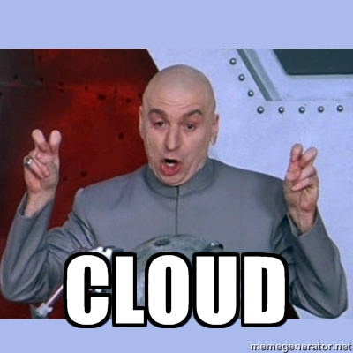
How?

Slide 9
How?
Robust DNS
Leveraging how the web works
Content Delivery Network (CDN)
Bring Mount Fuji ‘closer’…

Slide 10
How?
Ad-hoc Provisioning
Instance bursting/sizing
Re-thinking paradigm
Re-work
Crappy code in the cloud costs money – Scott Hanselman

Slide 11
How?
DEMO

Slide 12
Thanks!
Questions?

