Slide 1
Scaling Your Application on the Cloud
Javier G. Lozano
javier@lozanotek.com
@jglozano

Slide 2
Goal
Get a basic understanding of how using the “Cloud” can shape your applications and operations.
Spark ideas about you can do a lot more with less by stepping away from your app/service.

Slide 3




Info
javier@lozanotek.com
@jglozano
http://jglozano.io
https://github.com/lozanotek/CloudScale
https://github.com/lozanotek/CloudScale-Demo

Slide 4
Agenda
Why?
How?

Slide 5

Why?

Slide 6
Why?
Old Assumptions Were Wrong
We designed for ‘typical flow’
Serving too much content from one source
Not levering the ‘Internet’

Slide 7

Why?

Slide 8
Why?
Shared Hosting Doesn’t (Easily) Scale
503s during the keynote
Management of resources was limited
Couldn’t divert people to other ‘nodes’

Slide 9
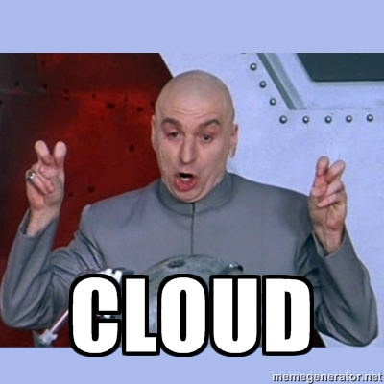
How?

Slide 10
How?
Robust DNS
Leveraging how the web works
Content Delivery Network (CDN)
Bring Mount Fuji ‘closer’…

Slide 11
How?
Ad-hoc Provisioning
Instance bursting/sizing
Re-thinking paradigm
Re-work
Crappy code in the cloud costs money – Scott Hanselman

Slide 12
How?
DEMO

Slide 13
Thanks!
Questions?

