Slide 1
.NET
Free. Cross-platform. Open source.
A developer platform for building all your apps.
www.dot.net

Slide 2
What is .NET?
Notes:
So what is .NET?

Slide 3










Your platform for building anything
DESKTOP
WEB
CLOUD
MOBILE
GAMING
IoT
AI
.NET
Notes:
You can build anything with .NET. From desktop apps to cloud-native services, iPhone and Android mobile apps to artificial intelligence, you can build almost anything with the .NET platform.

Slide 4

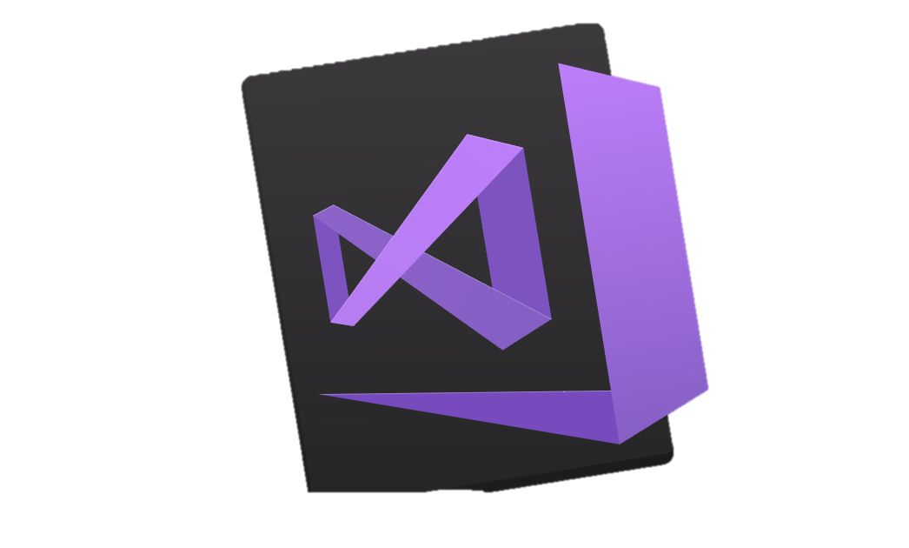


.NET is a software development platform
TOOLS
DESKTOP
WEB
CLOUD
MOBILE
GAMING
IoT
AI
VISUAL STUDIO
.NET STANDARD
VISUAL STUDIO FOR MAC
LIBRARIES
VISUAL STUDIO CODE
INFRASTRUCTURE
RUNTIME COMPONENTS
COMPILERS
LANGUAGES
COMMAND LINE INTERFACE
Notes:
.NET is an entire software development platform that takes care of a lot of the heavy lifting for you when you want to build an application. Applications frameworks help you build the specific types of apps or workloads and enable you to literally build any app for any platform with any operating system. Each .NET workload shares a common infrastructure and .NET Standard library. This means not only are your .NET skills portable, but your actual code is portable no matter what you’re building. This makes it easy to share reusable components (called libraries) across the breadth of applications people build.
Additionally, there are a broad set of development tools that makes it really productive to write, debug, build and manage code bases.
See: www.dot.net

Slide 5
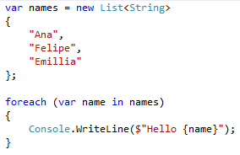

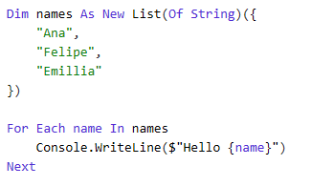
You can write code with many .NET languages
C# (c-sharp)
C# is a simple, modern, object-oriented, and type-safe programming language
Its roots in the C family of languages makes C# immediately familiar to C, C++, Java, and JavaScript programmers
F# (f-sharp)
F# is a cross-platform, open-source, functional programming language for .NET
It also includes object-oriented and imperative programming
Visual Basic
Visual Basic is an approachable language with a simple syntax for building type-safe, object-oriented apps
Notes:
(Speak to slide bullet points.)

Slide 6
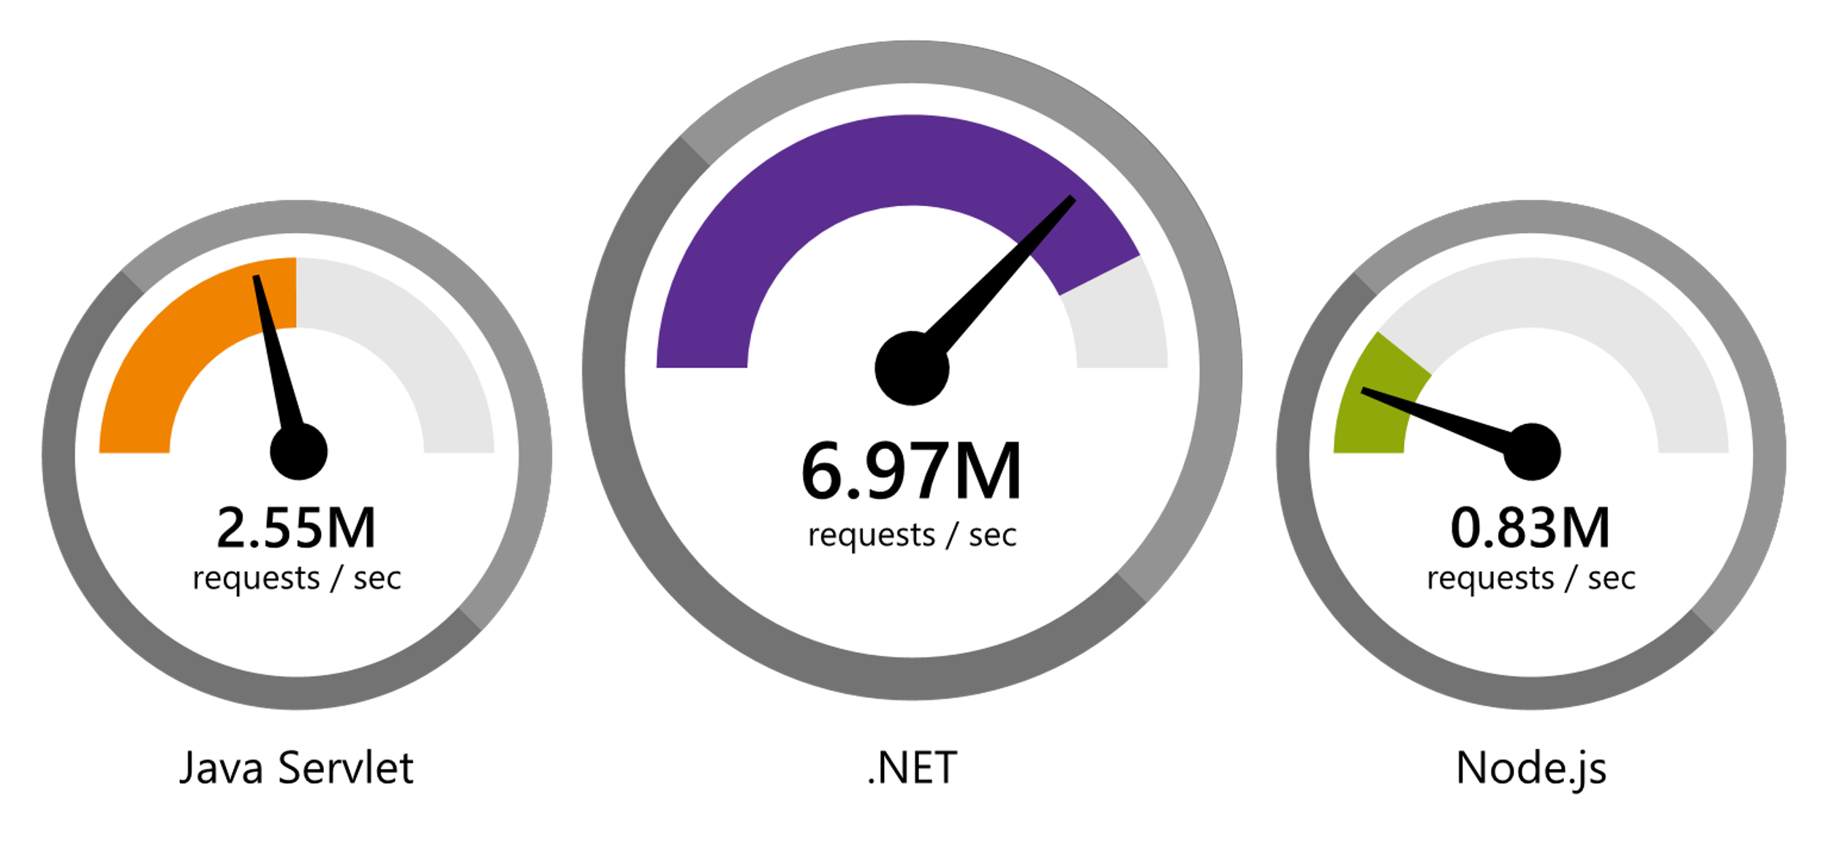
.NET Faster than any other popular framework
Data sourced from official tests available at TechEmpower Round 16.
“Using the same-size server, we were able to go from 1,000 requests per second per node with Node.js to 20,000 requests per second with .NET Core.“ — Raygun
www.dot.net/customers
Notes:
We’ve made significant investments in the platform especially in terms of performance.
The popular TechEmpower benchmark compares web application frameworks with tasks like JSON serialization, database access, and server side template rendering - .NET performs faster than any other popular framework.
https://www.techempower.com/benchmarks/#section=data-r16&hw=ph&test=plaintext
In the latest benchmarks on raw platform performance, .NET is more than 8 times faster than Node.js

Slide 7
.NET Core 2.1 on TechEmpower
REQUESTS / SECOND
+15%
+18%
+147%
Data sourced from official tests on TechEmpower round 16.
Notes:
These numbers show the micro framework tests (as opposed to the raw platform tests) which makes them more realistic.
Call out the incredible performance increase in the REAL WORLD data access scenario.

Slide 8


.NET is Open Source
Community Accepted PRs
“Samsung is embracing .NET because it is a completely open source project.” — Samsung
".NET is open source; that allows us to contribute back to it if we have any performance issues which Microsoft review and together we make a better product.“ — Illyriad Games
16,000+ Community Contributions from 3000+ Companies outside Microsoft
Notes:
We’ve seen companies taking a bet on .NET because it’s a completely open source project. More than 16,000 contributors* from 3300 companies have contributed to .NET Core and related open source repositories, with over half of the contributions coming from outside Microsoft.
Samsung is a big partner and are releasing their new Smart TVs that support .NET. They plan to expand to all their IoT devices too. Illyriad Games, specifically Ben Adams, contributed many performance enhancements to the platform. They build a MMO with hundreds of thousands of concurrent users so performance is super important to them. These enhancements not only benefit them but everyone that uses .NET.
*contributor = Submitted a Pull Request or Created an Issue

Slide 9
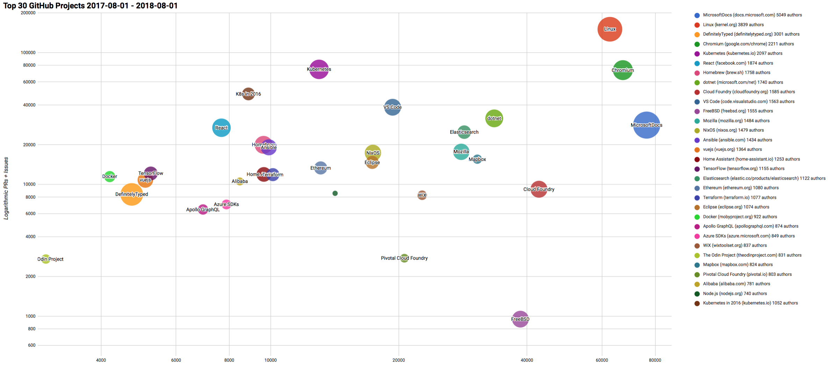

Top 30 Highest Velocity OSS Projects on GitHub
https://www.cncf.io/blog/2017/06/05/30-highest-velocity-open-source-projects/
https://raw.githubusercontent.com/cncf/velocity/master/charts/top30_20170801_20180801.png
Notes:
Jim Zemlin, Executive director of Linux foundation said “There are 10’s of millions of open source projects, invest in the ones with sustainable ecosystems”. .NET is one of those projects. CNCF tracks the top 30 highest velocity open source projects. This is a logarithmic scale to measure OSS project velocity with commits on the X axis and PRs and issues on the Y axis, with # of authors indicated by the size of the circle. The farther upper right the more activity a project has. Linux Kernel is #1, followed by Chromium, Kubernetes and Microsoft Docs. Notice .NET is the #1 application framework.

Slide 10
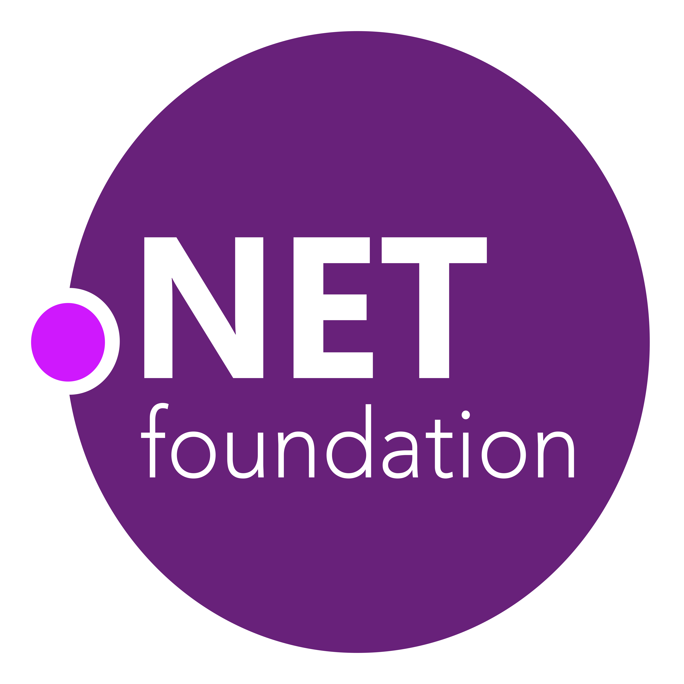

.NET Open Source Journey
.NET
Aug. 2017
.NET Core 2.0 released
2001
ECMA 335
2008
ASP.NET MVC (web platform) open source
April 2014
.NET Compiler Platform (“Roslyn”) open source
.NET Foundation founded
Fall 2019
.NET Core 3.0
2016
Mono project joins .NET Foundation
2002
NET 1.0 for Windows released. Mono project begins
Dec. 2018
.NET Core 2.2 released
.NET Core 3.0 preview WinForms and WPF go open source
Nov. 2014
.NET Core (cross-platform) project begins
Notes:
<talk to the journey, key milestones below>
Dec 2001-Feb 2002.
A new platform is born. Along with HP, Intel and others, the ECMA-335 standard was created that defined a common language infrastructure to support multiple programming languages. C# and Visual Basic.NET were released and F# came later in 2007, but there are over 20 other .NET languages today. Visual Studio .NET was released and included C#, VB, C++ development all in one box. This was the first IDE that was truly integrated across multiple languages.
Mono project begins. The CLI spec gave others the ability to create their own .NET implementations. Even though Microsoft built the first .NET Framework for Windows-only, the spec was intentionally portable across OSes and chipsets. The Mono project began, spearheaded by Miguel de Icaza, with the goal to implement Microsoft's new .NET development platform on Linux and Unix-like platforms. Later, Miguel started Xamarin which focused on cross-platform, native, mobile development with C#, built upon Mono. This allows developers to use C# and .NET to build apps for iOS and Android. Unity games development also emerged from Mono.
2008.
ASP.NET MVC web development stack is released to CodePlex as open source. This was the first application development framework from Microsoft to be released as open source. The underlying runtime and compilers were still closed however.
2014.
Hell freezes over & pigs fly. Early 2014 at Microsoft’s BUILD conference, Anders Hejlsberg, the father of C#, releases the .NET Compiler Platform “Roslyn” as open source on stage. Later in November, .NET Core project begins in the open. The technology world is shocked, and the .NET community is excited. .NET Core is a new cloud-native implementation of .NET that is geared for cross-platform, hyper-scale services as well as small IoT devices. It’s meant to bring .NET into the next 15 years of computing. And the community has been extremely supportive….
2016.
Mono comes home. In early 2016, Microsoft finally acquires Xamarin and brings Miguel de Icaza into Developer Division. Mono joins the .NET foundation and is officially supported and contributed to by Microsoft. The Microsoft community officially meets the Mono community.
2017.
.NET Core 2.0 Released. Our cross platform and open source implementation of .NET finally releases to the world with unified tooling support across multiple operating systems and editors.
2018.
Winforms and WPF go open source. At Microsoft Connect 2018 we announced the open sourcing of Windows Forms and WPF desktop frameworks. We’ve seen incredible contributions and activity since. The community now has the power to guide the direction of these frameworks.
2019
.NET Core 3.0 released. .NET Core 3.0 brings Windows desktop workloads to the .NET Core runtime which will allow self contained EXEs, side-by-side installs, and faster performance.

Slide 11
.NET Core
3
2
.NET Core 3 expands supported workloads to include Windows Desktop, IoT & AI
.NET Core is perfectly suited for the requirements of cloud-native, cross-platform workloads
WEB
CLOUD
DESKTOP
IoT
AI
.NET CORE
.NET CORE 3
LIBRARIES
INFRASTRUCTURE
RUNTIME COMPONENTS
COMPILERS
LANGUAGES
Notes:
ANIMATED SLIDE – shows progression of entire .NET platform into .NET Core specific workloads.
.NET Core is our cross-platform, open source implementation of .NET and is perfectly suited for requirements of cloud-native, cross-platform services. We’ve made significant investments in the core performance as well as the web stack so that you can easily take advantage of cloud patterns and scale.
.NET Core 3 will expand on the supported workloads to include IoT, AI and Windows Desktop.

Slide 12
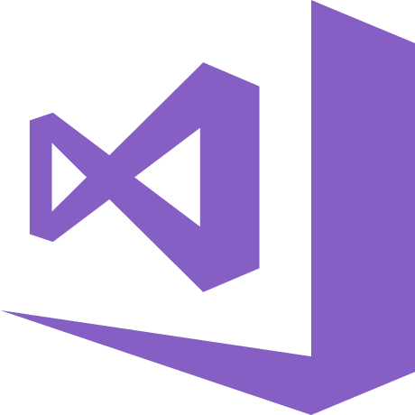
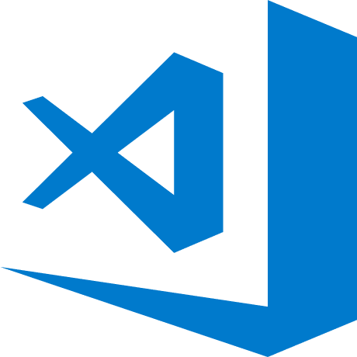
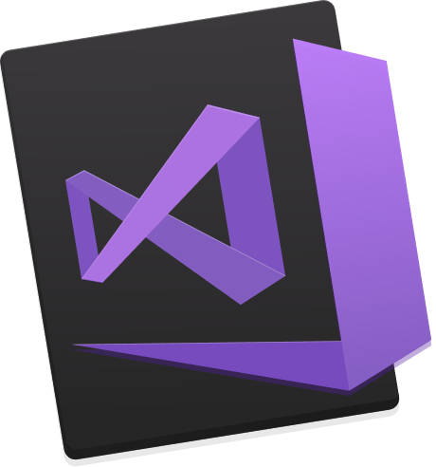
Make it easier with some free tools www.VisualStudio.com
Visual Studio
A fully-featured, integrated development environment (IDE) for developing .NET apps on a Windows PC development machine.
Visual Studio Code
Open source, cross-platform editor with .NET support.
Visual Studio for Mac
A fully-featured IDE for developing .NET apps on a Mac OS development machine.
Download from www.VisualStudio.com
Notes:
We also have free tools that can help you build your apps.

