Slide 1
The Zen of ASP.NET and MVC
Javier Lozano
lozanotek, principal
Pre-requisites for this presentation:
ASP.NET Pipeline
Basic HTTP
Design Patterns

Slide 2









platinum
GOLD
PRIZE SPONSORS
silver
Thanks to our sponsors!

Slide 3
Agenda
What is the Zen of ASP.NET?
What is this “MVC” thing?
MVC on ASP.NET
DEMOS
Recap
Questions

Slide 4
Goals
ASP.NET != WebForms
Alternatives are good!
You HAVE choices
MVC = {Pattern, Approach}
MVC != Technology

Slide 5



Who am I?
ASP.NET MVP
ASP Insider
MCSD.NET
User Group Leader

Slide 6
Contact Info
Email: javier@lozanotek.com
Blog: http://blog.lozanotek.com
Twitter: http://twitter.com/jglozano
Code: http://github.com/jglozano/zenofmvc

Slide 7
JOKE TIME
Why did the multithreaded chicken cross the road?
-Mike Woodring, Pluralsight Training

Slide 8
JOKE TIME
Why did the multithreaded chicken cross the road?
to To other side. get the
-Mike Woodring, Pluralsight Training

Slide 9
define Zen
“…emphasis on mindful acceptance of the
present moment, spontaneous action,
and letting go of self-conscious,
judgmental thinking.”
http://en.wikipedia.org/wiki/zen

Slide 10
What is the Zen of ASP.NET?
ASP.NET is a platform, not a framework
Provider Model
Caching
Master Pages
Session State
Page/Control Lifecycle
AJAX
etc.

Slide 11
What is the Zen of ASP.NET?
At the end of the day, it’s all about:
IHttpHandler
IHttpHandlerFactory
IHttpModule
HttpApplication
HttpRuntime
HttpContext

Slide 12
Demo
Understanding the Zen

Slide 13
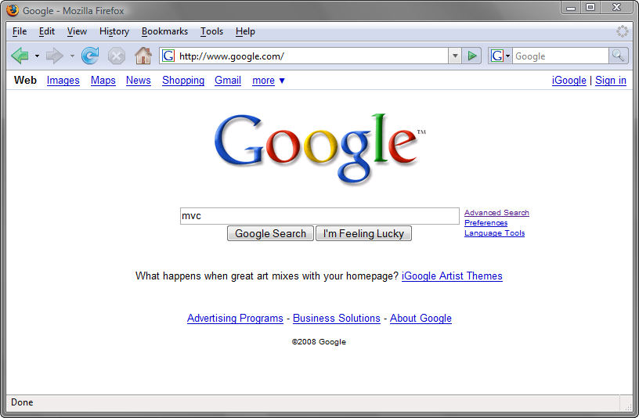
What is this “MVC” thing?

Slide 14
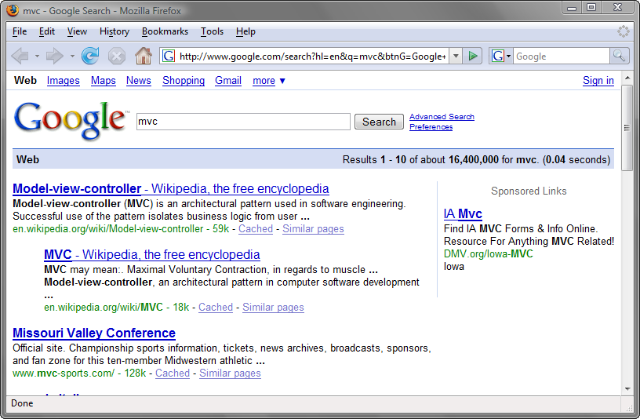
What is this “MVC” thing?

Slide 15
What is this “MVC” thing?
Model-View-Controller (MVC) Pattern
First described in 1979 by Trygve Reenskaug
Described in depth in the influential paper Applications Programming in Smalltalk-80: How to use Model-View-Controller
http://en.wikipedia.org/wiki/mode-view-controller

Slide 16
What is this “MVC” thing?
Controller
Brains behind the operation
Picks which view to use
Picks which data to pass to the view
Maps straight URL
Example
GET my.com/person/15
POST my.com/person/15
PUT my.com/person/15

Slide 17
What is this “MVC” thing?
View
Represents how the “data” is “interpreted”
Typically associated with HTML.
Can be many other types of markup (XAML,XML,RSS,ATOM, etc.)
Can be javascript/ecmascript (JSON)
Can be binary data

Slide 18
What is this “MVC” thing?
Model
Core of your application (or part of it)
Can encapsulate “data”, “logic” for the application
Is unaware of application context
Example
Person p = new Person();

Slide 19
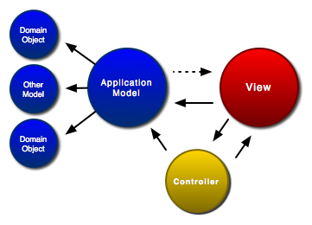
What is this “MVC” thing?
http://www.clientjava.com/blog/images/mvc.png

Slide 20
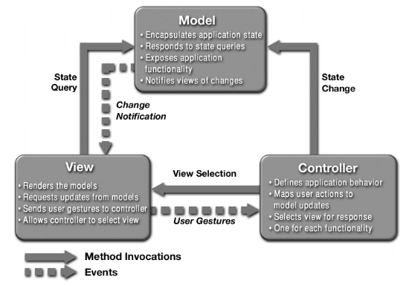
What is this “MVC” thing?
http://java.sun.com/blueprints/patterns/images/mvc-structure-generic.gif

Slide 21
What is this “MVC” thing?
Separation of Concerns
Loose coupling and little overlap
A concern is any piece of interest or focus in a program
Single Responsibility
One piece of the pattern focuses on delivering just ONE thing

Slide 22
What is this “MVC” thing?
Transparency
It’s easy to see the “what’s” and the “how’s” of your application
Light Objects
Less likely for your application to suffer from “code bloat”

Slide 23
What is this “MVC” thing?
Transparency
It’s easy to see the “what’s” and the “how’s” of your application
Light Objects
Less likely for your application to suffer from “code bloat”
All of these pieces yield a system that is
Componentized
Testable
Maintainable

Slide 24

MVC On ASP.NET
MonoRail
Open Source project
Built on .NET 2.0
Parallels Rails or SpringMVC
Uses other open source projects

Slide 25

MVC On ASP.NET
ASP.NET MVC (MSMVC)
Developed by Microsoft
Built on .NET 3.5
Currently in v2

Slide 26
MVC On ASP.NET
FubuMVC
Open Source project
Built on .NET 3.6
ALT.NET based

Slide 27
Demo

Slide 28
Recap
MVC is a pattern, not a technology
It’s YOUR choice to use
Gives you more control and less coupling

Slide 29
Recap
Closer to the HTTP “metal”
Out of the box:
Separation of Concerns
Single Responsibility
Transparency
Light Objects

Slide 30
Questions?
Clear as mud?

Slide 31
THANKS!
Email
javier@lozanotek.com
Blog
http://blog.lozanotek.com
Twitter
http://twitter.com/jglozano
Code
http://github.com/jglozano/zenofmvc

