Slide 1
The Zen of ASP.NET and MVC
Javier Lozano
Senior Developer
imagetek
Pre-requisites for this presentation:
ASP.NET Pipeline
Basic HTTP
Design Patterns
Level: Intermediate

Slide 2
Agenda
What is the Zen of ASP.NET?
What is this “MVC” thing?
MVC on ASP.NET
ASP.NET MVC Overview
MonoRail Overview
Recap
Questions

Slide 3
Goals
ASP.NET != WebForms
Alternatives are good!
You HAVE choices
MVC = {Pattern, Approach}
MVC != Technology

Slide 4




Who am I?
ASP.NET MVP
ASP Insider
MCSD.NET
Senior Developer
User Group Leader

Slide 5
Contact Info
Email
javier@lozanotek.com
Blog
http://blog.lozanotek.com
Twitter
http://twitter.com/lozanotek
Code
http://code.google.com/p/jglozano

Slide 6
define Zen
“…emphasis on mindful acceptance of the
present moment, spontaneous action,
and letting go of self-conscious,
judgmental thinking.”
http://en.wikipedia.org/wiki/zen

Slide 7
What is the Zen of ASP.NET?
ASP.NET is a platform, not a framework
Provider Model
Caching
Master Pages
Session State
Page/Control Lifecycle
AJAX
etc.

Slide 8
What is the Zen of ASP.NET?
At the end of the day, it’s all about:
IHttpHandler
IHttpHandlerFactory
IHttpModule
HttpApplication
HttpRuntime
HttpContext

Slide 9

Demo
Experiencing the Zen of ASP.NET

Slide 10
What is the Zen of ASP.NET?
Take away points
It’s just an IHttpHandler at the core
My code had to “intimately” know pieces of the “view”
Not all the pieces can setup for automated testing

Slide 11
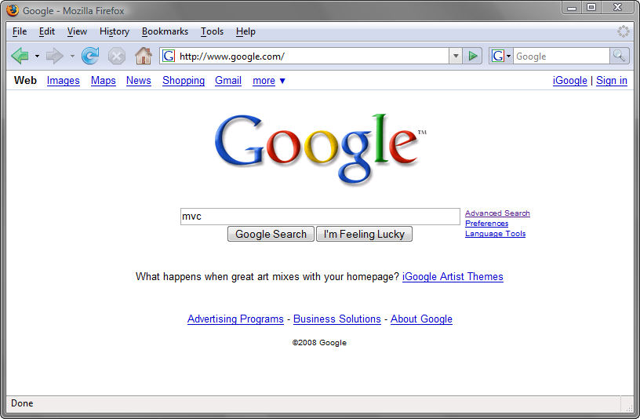
What is this “MVC” thing?

Slide 12
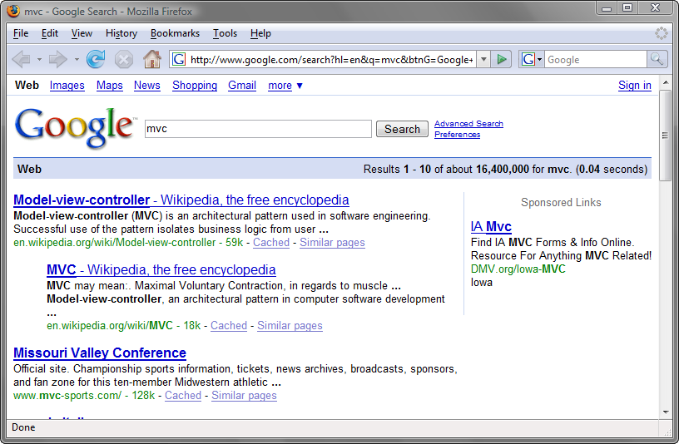
What is this “MVC” thing?

Slide 13
What is this “MVC” thing?
Model-View-Controller (MVC) Pattern
First described in 1979 by Trygve Reenskaug
Described in depth in the influential paper Applications Programming in Smalltalk-80: How to use Model-View-Controller
http://en.wikipedia.org/wiki/mode-view-controller

Slide 14
What is this “MVC” thing?
Controller
Brains behind the operation
Picks which view to use
Picks which data to pass to the view
Maps straight URL
Example
GET my.com/person/15
POST my.com/person/update

Slide 15
What is this “MVC” thing?
View
Represents how the “data” is “interpreted”
Typically associated with HTML.
Can be many other types of markup (XAML,XML,RSS,ATOM, etc.)
Can be javascript/ecmascript (JSON)
Can be binary data

Slide 16
What is this “MVC” thing?
Model
Core of your application (or part of it)
Can encapsulate “data”, “logic” for the application
Is unaware of application context
Example
Person p = new Person();

Slide 17
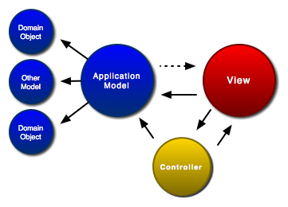
What is this “MVC” thing?
http://www.clientjava.com/blog/images/mvc.png

Slide 18
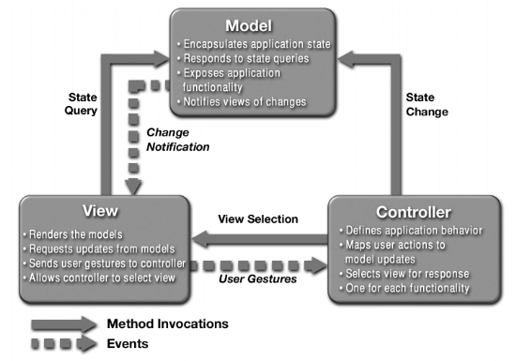
What is this “MVC” thing?
http://java.sun.com/blueprints/patterns/images/mvc-structure-generic.gif

Slide 19
What is this “MVC” thing?
Separation of Concerns
Loose coupling and little overlap
A concern is any piece of interest or focus in a program
Single Responsibility
One piece of the pattern focuses on delivering just ONE thing

Slide 20
What is this “MVC” thing?
Transparency
It’s easy to see the “what’s” and the “how’s” of your application
Light Objects
Less likely for your application to suffer from “code bloat”

Slide 21
What is this “MVC” thing?
Transparency
It’s easy to see the “what’s” and the “how’s” of your application
Light Objects
Less likely for your application to suffer from “code bloat”
All of these pieces yield a system that is
Componentized
Testable
Maintainable

Slide 22


MVC On ASP.NET
MonoRail
Open Source project
Built on .NET 2.0
Parallels Rails or SpringMVC
Uses other open source projects
ASP.NET MVC
Developed by Microsoft
Built on .NET 3.5
Currently under development

Slide 23
ASP.NET MVC Overview
Alternate request model from WebForms
http://www.asp.net/mvc
Car vs. Motorcycle
Uses these components by default
Routing
Master Pages
ASP.NET WebForm View Engine

Slide 24
Demo
Experiencing ASP.NET MVC

Slide 25
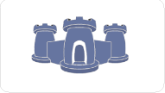
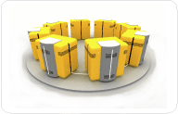
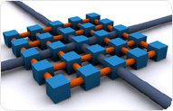
MonoRail Overview
Part of the Castle Project
http://www.castleproject.org/MonoRail/
Uses these components by default
Action Pack – Data Access
Castle Windsor – Component instantiation
NVelocity – View generation

Slide 26
Demo
Experiencing MonoRail

Slide 27
Recap
MVC is a pattern, not a technology
It’s YOUR choice to use
Gives you more control and less coupling

Slide 28
Recap
Closer to the HTTP “metal”
Out of the box:
Separation of Concerns
Single Responsibility
Transparency
Light Objects

Slide 29
Questions?
Clear as mud?

Slide 30
Thank You!
Email
javier@lozanotek.com
Blog
http://blog.lozanotek.com
Twitter
http://twitter.com/lozanotek
Code
http://code.google.com/p/jglozano

