Slide 1

The Zen of ASP.NET and MVC
Javier Lozano
Senior Developer
imagetek
Pre-requisites for this presentation:
ASP.NET Pipeline
Basic HTTP
Design Patterns
Level: Intermediate
Notes:
MGB 2003
© 2003 Microsoft Corporation. All rights reserved.
This presentation is for informational purposes only. Microsoft makes no warranties, express or implied, in this summary.

Slide 2
Agenda
What is the Zen of ASP.NET?
What is this “MVC” thing?
MVC on ASP.NET
MonoRail Overview
ASP.NET MVC Overview
Recap
Questions
Notes:
MGB 2003
© 2003 Microsoft Corporation. All rights reserved.
This presentation is for informational purposes only. Microsoft makes no warranties, express or implied, in this summary.

Slide 3
Goals
ASP.NET != WebForms
Alternatives are good!
You HAVE choices
MVC = {Pattern, Approach}
MVC != Technology
Notes:
MGB 2003
© 2003 Microsoft Corporation. All rights reserved.
This presentation is for informational purposes only. Microsoft makes no warranties, express or implied, in this summary.

Slide 4




Who am I?
ASP.NET MVP
ASP Insider
MCSD.NET
Senior Developer
User Group Leader
Notes:
MGB 2003
© 2003 Microsoft Corporation. All rights reserved.
This presentation is for informational purposes only. Microsoft makes no warranties, express or implied, in this summary.

Slide 5
define Zen
“…emphasis on mindful acceptance of the
present moment, spontaneous action,
and letting go of self-conscious,
judgmental thinking.”
http://en.wikipedia.org/wiki/zen
Notes:
MGB 2003
© 2003 Microsoft Corporation. All rights reserved.
This presentation is for informational purposes only. Microsoft makes no warranties, express or implied, in this summary.

Slide 6
What is the Zen of ASP.NET?
ASP.NET is a platform, not a framework
  Provider Model
  Caching
  Master Pages
  Session State
  Page/Control Lifecycle
  AJAX
  etc.
Notes:
MGB 2003
© 2003 Microsoft Corporation. All rights reserved.
This presentation is for informational purposes only. Microsoft makes no warranties, express or implied, in this summary.

Slide 7
What is the Zen of ASP.NET?
At the end of the day, it’s all about:
  IHttpHandler
  IHttpHandlerFactory
  IHttpModule
  HttpApplication
  HttpRuntime
  HttpContext
Notes:
MGB 2003
© 2003 Microsoft Corporation. All rights reserved.
This presentation is for informational purposes only. Microsoft makes no warranties, express or implied, in this summary.

Slide 8

Demo
Experiencing the Zen of ASP.NET
Notes:
MGB 2003
© 2003 Microsoft Corporation. All rights reserved.
This presentation is for informational purposes only. Microsoft makes no warranties, express or implied, in this summary.

Slide 9
What is the Zen of ASP.NET?
Take away points
  It’s just an IHttpHandler at the core
  My code had to “intimately” know pieces of the “view”
  Not all the pieces can setup for automated testing
Notes:
MGB 2003
© 2003 Microsoft Corporation. All rights reserved.
This presentation is for informational purposes only. Microsoft makes no warranties, express or implied, in this summary.

Slide 10
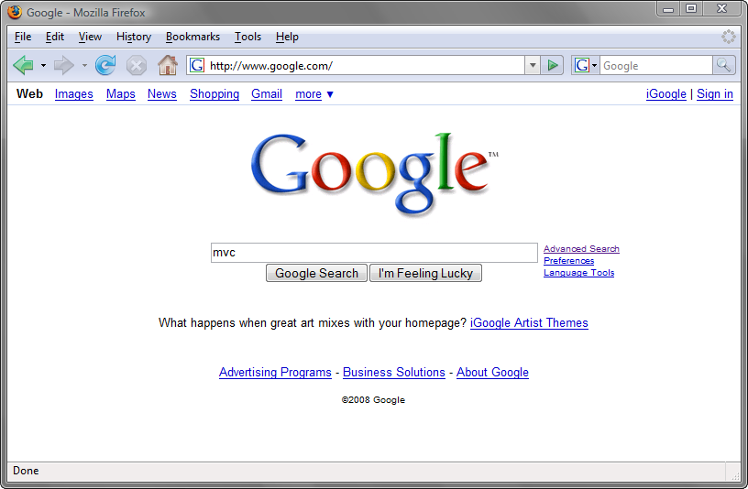
What is this “MVC” thing?
Notes:
MGB 2003
© 2003 Microsoft Corporation. All rights reserved.
This presentation is for informational purposes only. Microsoft makes no warranties, express or implied, in this summary.

Slide 11
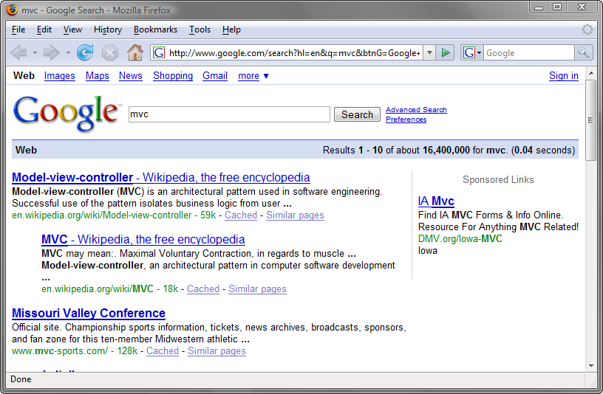
What is this “MVC” thing?
Notes:
MGB 2003
© 2003 Microsoft Corporation. All rights reserved.
This presentation is for informational purposes only. Microsoft makes no warranties, express or implied, in this summary.

Slide 12
What is this “MVC” thing?
Model-View-Controller (MVC) Pattern
First described in 1979 by Trygve Reenskaug
Described in depth in the influential paper Applications Programming in Smalltalk-80: How to use Model-View-Controller
http://en.wikipedia.org/wiki/mode-view-controller
Notes:
MGB 2003
© 2003 Microsoft Corporation. All rights reserved.
This presentation is for informational purposes only. Microsoft makes no warranties, express or implied, in this summary.

Slide 13
What is this “MVC” thing?
Controller
  Brains behind the operation
  Picks which view to use
  Picks which data to pass to the view
  Maps straight URL
Example
  GET my.com/person/15
  POST my.com/person/update
Notes:
MGB 2003
© 2003 Microsoft Corporation. All rights reserved.
This presentation is for informational purposes only. Microsoft makes no warranties, express or implied, in this summary.

Slide 14
What is this “MVC” thing?
View
  Represents how the “data” is “interpreted”
  Typically associated with HTML.
  Can be many other types of markup (XAML,XML,RSS,ATOM, etc.)
  Can be javascript/ecmascript (JSON)
  Can be binary data
Notes:
MGB 2003
© 2003 Microsoft Corporation. All rights reserved.
This presentation is for informational purposes only. Microsoft makes no warranties, express or implied, in this summary.

Slide 15
What is this “MVC” thing?
Model
  Core of your application (or part of it)
  Can encapsulate “data”, “logic” for the application
  Is unaware of application context
Example
  Person p = new Person();
Notes:
MGB 2003
© 2003 Microsoft Corporation. All rights reserved.
This presentation is for informational purposes only. Microsoft makes no warranties, express or implied, in this summary.

Slide 16
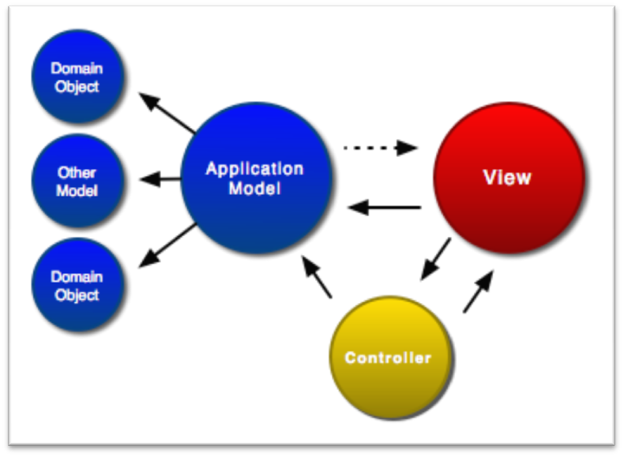
What is this “MVC” thing?
http://www.clientjava.com/blog/images/mvc.png
Notes:
MGB 2003
© 2003 Microsoft Corporation. All rights reserved.
This presentation is for informational purposes only. Microsoft makes no warranties, express or implied, in this summary.

Slide 17
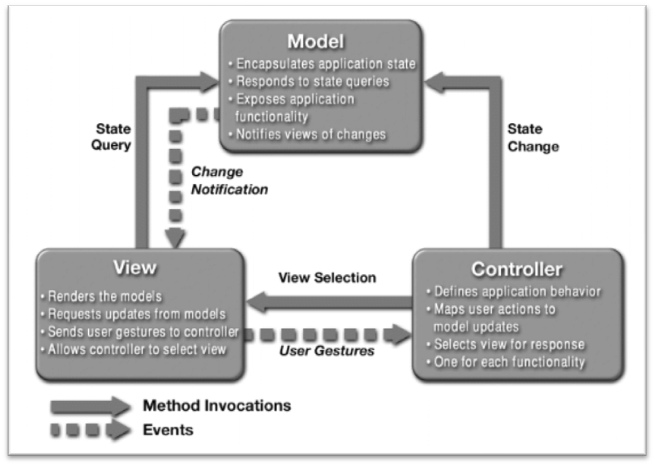
What is this “MVC” thing?
http://java.sun.com/blueprints/patterns/images/mvc-structure-generic.gif
Notes:
MGB 2003
© 2003 Microsoft Corporation. All rights reserved.
This presentation is for informational purposes only. Microsoft makes no warranties, express or implied, in this summary.

Slide 18
What is this “MVC” thing?
Separation of Concerns
  Loose coupling and little overlap
  A concern is any piece of interest or focus in a program
Single Responsibility
  One piece of the pattern focuses on delivering just ONE thing
Notes:
MGB 2003
© 2003 Microsoft Corporation. All rights reserved.
This presentation is for informational purposes only. Microsoft makes no warranties, express or implied, in this summary.

Slide 19
What is this “MVC” thing?
Transparency
  It’s easy to see the “what’s” and the “how’s” of your application
Light Objects
  Less likely for your application to suffer from “code bloat”
Notes:
MGB 2003
© 2003 Microsoft Corporation. All rights reserved.
This presentation is for informational purposes only. Microsoft makes no warranties, express or implied, in this summary.

Slide 20
What is this “MVC” thing?
Transparency
  It’s easy to see the “what’s” and the “how’s” of your application
Light Objects
  Less likely for your application to suffer from “code bloat”
All of these pieces yield a system that is
  Componentized
  Testable
  Maintainable
Notes:
MGB 2003
© 2003 Microsoft Corporation. All rights reserved.
This presentation is for informational purposes only. Microsoft makes no warranties, express or implied, in this summary.

Slide 21


MVC On ASP.NET
MonoRail
  Open Source project
  Built on .NET 2.0
  Parallels Rails or SpringMVC
  Uses other open source projects
ASP.NET MVC
  Developed by Microsoft
  Built on .NET 3.5
  Currently under development
Notes:
MGB 2003
© 2003 Microsoft Corporation. All rights reserved.
This presentation is for informational purposes only. Microsoft makes no warranties, express or implied, in this summary.

Slide 22



MonoRail Overview
Part of the Castle Project
  http://www.castleproject.org/MonoRail/
Uses these components by default
  Action Pack – Data Access
  Castle Windsor – Component instantiation
  NVelocity – View generation
Notes:
MGB 2003
© 2003 Microsoft Corporation. All rights reserved.
This presentation is for informational purposes only. Microsoft makes no warranties, express or implied, in this summary.

Slide 23
Demo
Experiencing MonoRail
Notes:
MGB 2003
© 2003 Microsoft Corporation. All rights reserved.
This presentation is for informational purposes only. Microsoft makes no warranties, express or implied, in this summary.

Slide 24
ASP.NET MVC Overview
Alternate request model from WebForms
  http://www.asp.net/mvc
Car vs. Motorcycle
Uses these components by default
  Routing
  Master Pages
  ASP.NET WebForm View Engine
Notes:
MGB 2003
© 2003 Microsoft Corporation. All rights reserved.
This presentation is for informational purposes only. Microsoft makes no warranties, express or implied, in this summary.

Slide 25
Demo
Experiencing ASP.NET MVC
Notes:
MGB 2003
© 2003 Microsoft Corporation. All rights reserved.
This presentation is for informational purposes only. Microsoft makes no warranties, express or implied, in this summary.

Slide 26
Recap
MVC is a pattern, not a technology
It’s YOUR choice to use
Gives you more control and less coupling
Notes:
MGB 2003
© 2003 Microsoft Corporation. All rights reserved.
This presentation is for informational purposes only. Microsoft makes no warranties, express or implied, in this summary.

Slide 27
Recap
Closer to the HTTP “metal”
Out of the box:
  Separation of Concerns
  Single Responsibility
  Transparency
  Light Objects
Notes:
MGB 2003
© 2003 Microsoft Corporation. All rights reserved.
This presentation is for informational purposes only. Microsoft makes no warranties, express or implied, in this summary.

Slide 28
Questions?
Clear as mud?
Notes:
MGB 2003
© 2003 Microsoft Corporation. All rights reserved.
This presentation is for informational purposes only. Microsoft makes no warranties, express or implied, in this summary.

Slide 29
Thank You!
Email
  javier@lozanotek.com
Blog
  http://blog.lozanotek.com
Twitter
  http://twitter.com/lozanotek
Code
  http://code.google.com/p/jglozano
Notes:
MGB 2003
© 2003 Microsoft Corporation. All rights reserved.
This presentation is for informational purposes only. Microsoft makes no warranties, express or implied, in this summary.

