Slide 1
Zen of ASP.NET and MVC

Slide 2
Questions?

Slide 3
Javier Lozano

Slide 4


Slide 5


Slide 6


Slide 7
javier@lozanotek.com
(email/msn)

Slide 8
@jglozano
(twitter)

Slide 9
http://tinyurl.com/
jglozano-sample-code
(code)

Slide 10

(Zen)

Slide 11

(Zen of ASP.NET)

Slide 12
MVC

Slide 13
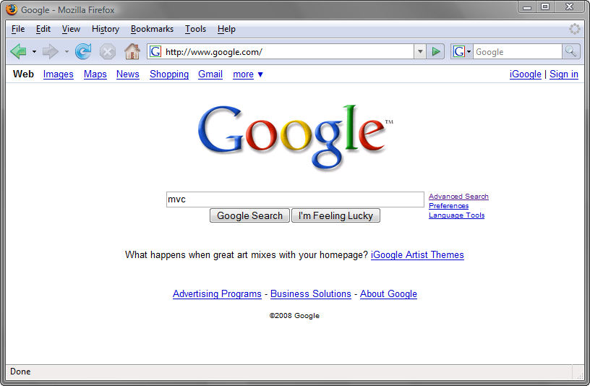

Slide 14
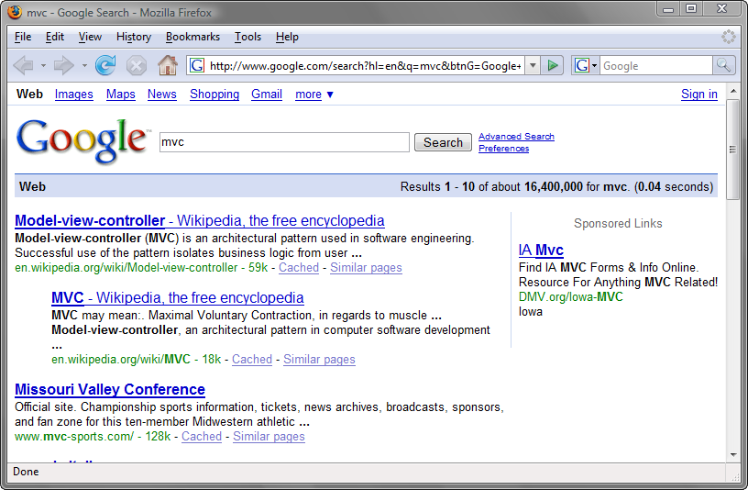

Slide 15
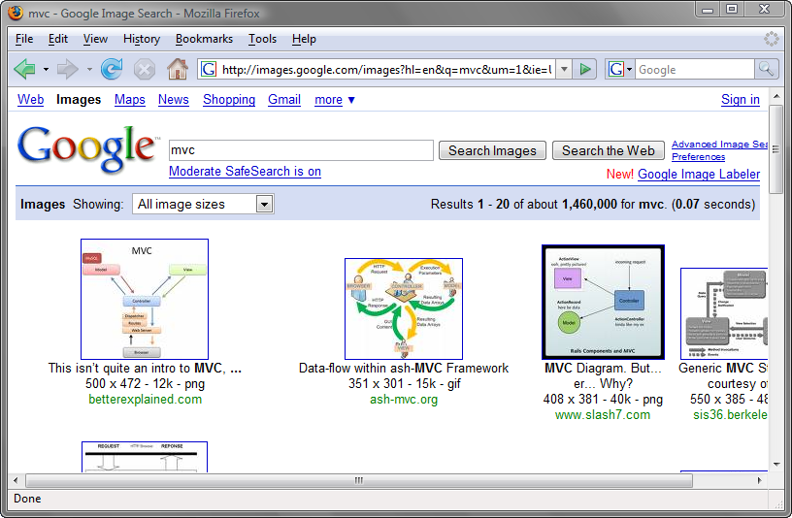

Slide 16
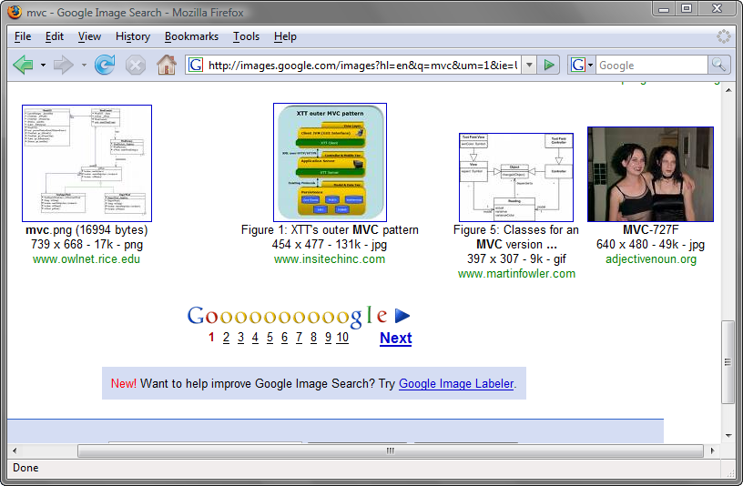

Slide 17
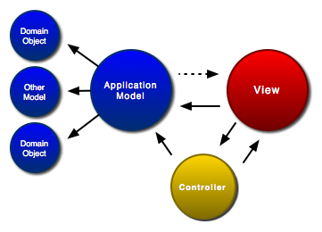
http://www.clientjava.com/blog/images/mvc.png

Slide 18
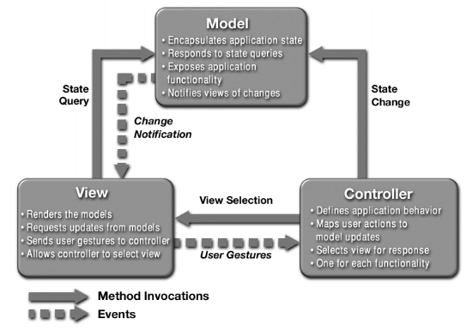
http://java.sun.com/blueprints/patterns/images/mvc-structure-generic.gif

Slide 19
CMV

Slide 20
Controller
(GET my.com/user/14)

Slide 21
Model
(User u = new User();)

Slide 22
View & ViewModel
(rss, xml, js, html)

Slide 23
Why?

Slide 24
Simple URLs
(pretty address bar)

Slide 25
Separation of Concerns
(pieces with little overlap)

Slide 26
Single Responsibility Principle
(just focus on one thing)

Slide 27
Transparency
( “what’s” and “how’s”)

Slide 28
Light Objects
( less code FTW!)

Slide 29
Testable
(easy to mock)

Slide 30
Componentized
(model, view …)

Slide 31
Maintainable
(it’s a good thing)

Slide 32

(MonoRail)

Slide 33

(Action Pack)

Slide 34

(Windsor Container)

Slide 35

(Castle Project)

Slide 36
(demo)

Slide 37

(you know, ‘web forms’)

Slide 38
An Option
(you don’t have to use it)

Slide 39
Not Web Forms 4.0
(you don’t have to use it)

Slide 40
Car vs. Motorcycle
(…get the theme?)

Slide 41

(SubSonic, MVC Contrib)

Slide 42
(demo)

Slide 43
(Zen)

Slide 44
(Zen of ASP.NET)

Slide 45
Questions?

Slide 46
Thanks!

