Slide 1
Visual Analytics: Task Abstraction
Ian Nabney
ian.nabney@bristol.ac.uk

Slide 2
Overview
Reading: Chapter 3 of Munzner (e-book that can be downloaded from UoB library website)
Understand why task analysis is important to create good visualisations
Analyse a task in terms of actions and targets
Apply this framework to a case study

Slide 3
Why analyse tasks abstractly?
Transforming task descriptions from domain-specific language into abstract form allows you to reason about similarities and differences between them
In particular, it helps you to design a visualisation by focusing on what works in a generic way for certain types of task
an epidemiologist studying the spread of a new strain of influenza might initially describe her task as “contrast the prognosis of patients who were intubated in the ICU more than one month after exposure to patients hospitalized within the first week”
a biologist studying immune system response might use language such as “see if the results for the tissue samples treated with LL-37 match up with the ones without the peptide”
“compare values between two groups”
Why are people using vis:
Verbs describing actions
Nouns describing targets/goals

Slide 4
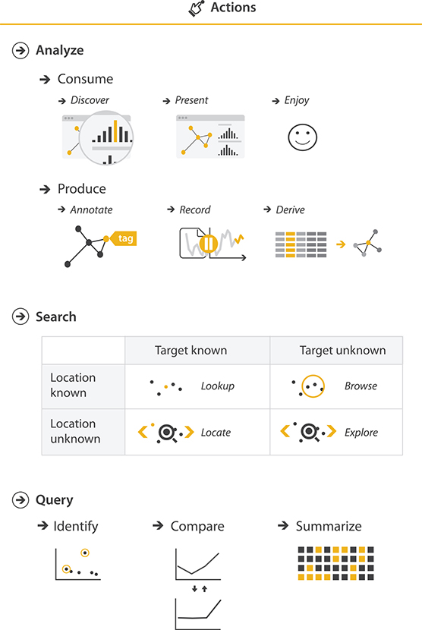
Actions
Analyse to consume existing data or produce new data
Search (target known or unknown)
Query

Slide 5
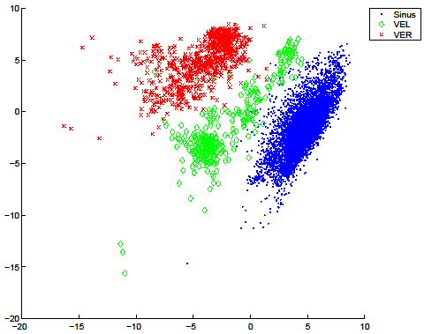
Analyse: discover
Find new knowledge through visualisation. May be
serendipitous observation
motivated by theories or models
This can be
generation of a new hypothesis (explore)
verify a theory (explain)
Example – identify outliers

Slide 6
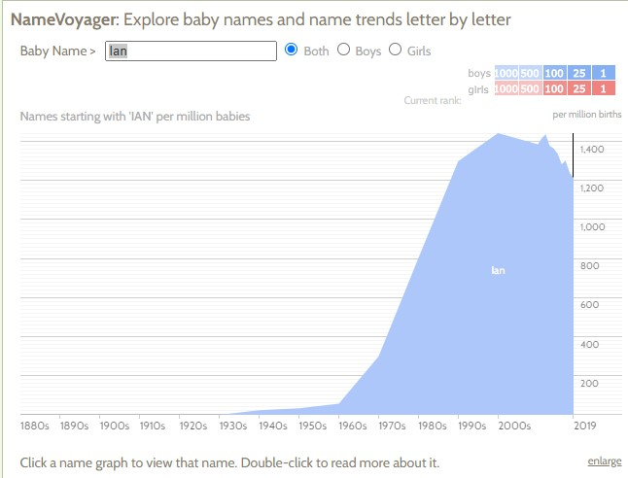
Analyse: present and enjoy
Present:
use of vis for the succinct communication of information, for telling a story with data, or guiding an audience through a series of cognitive operations
knowledge presented is known in advance
Enjoy:
user driven by curiosity
this may not have been the original intention of the designer!
I was born in 1963
‘Ian’ was much less popular then

Slide 7
Produce: annotate and record
The annotate goal refers to the addition of graphical or textual annotations associated with one or more pre-existing visualization elements, typically as a manual action by the user.
When an annotation is associated with data items, it is effectively a new attribute for them.
The record goal saves or captures visualization elements as persistent artifacts.
A graphical history includes a static snapshot of the view showing its current state, and these snapshots accumulate in a branching meta-visualization for the user’s entire session.

Slide 8
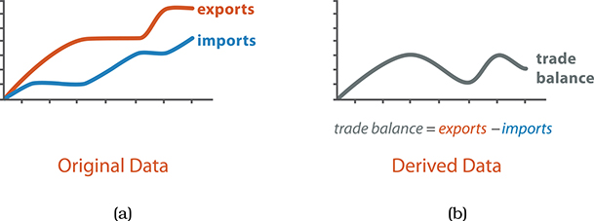
Produce: derive
Produce new data elements based on existing data elements
Transform the data with new attributes based on existing ones
Sometimes this is a simple change of type (e.g. discretising a variable)
Sometimes it means a mathematical calculation (e.g. linear combination of existing variables – see dimensionality reduction later in the course)

Slide 9
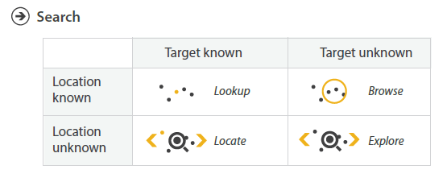
Search
The analyse use cases nearly all involve the user in searching for elements of interest
Four alternatives categorised in table

Slide 10
Query
Identify – characteristics of a single target
Compare – multiple targets which require more sophisticated vis idioms to support the user
Summarise – an overview of all possible targets
Broadly speaking: produce, search, query correspond to the three parts of Shneiderman’s mantra: overview first, (zoom and) filter, details on demand

Slide 11
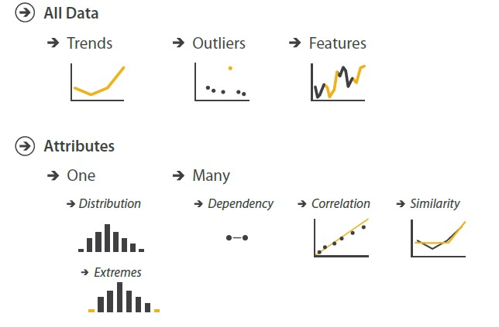
Targets
The goal of the user encompasses an action based on a target
Trends are high-level patterns in the data
Outliers are data points that don’t follow trends
Features are ‘everything else’, perhaps more local trends, clustering

Slide 12
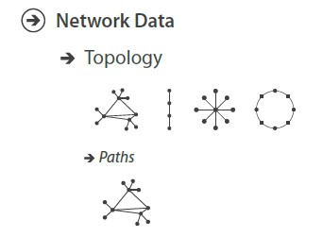
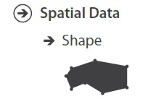
Targets: networks and spatial data

Slide 13
Case study: comparison of tree visualisers
Comparing two vis tools that differ in how the idiom works when used for exactly the same context of what and why at abstraction level
SpaceTree
TreeJuxtaposer

Slide 14
Analysis
Same input data (what): a large tree composed of nodes and links.
Why these tools are being used is for the same goal: to present a path traced between two nodes of interest
Some aspects of idioms (how) are the same: both systems allow the user to navigate and to select a path, so it’s encoded differently from the non-selected paths through highlighting.
The systems differ in how elements of the visualization are manipulated and arranged.
SpaceTree ties the act of selection to a change of what is shown by automatically aggregating and filtering the unselected items.
TreeJuxtaposer allows the user to arrange areas of the tree to ensure visibility for areas of interest

Slide 15
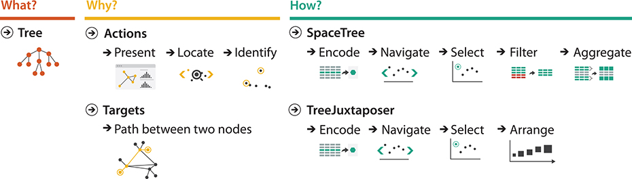
Comparative analysis

Slide 16
Summary
Understand why task analysis is important to create good visualisations
Analyse a task in terms of actions and targets
Apply this framework to a case study

