Slide 1
Introduction to Data Analytics: Visual Search
Ian Nabney
ian.nabney@bristol.ac.uk

Slide 2
Overview
Reading: Chapter 2 of Ware
Understand the theory of how we see small things
Able to use this understanding to make good design choices especially in assisting visual search

Slide 3
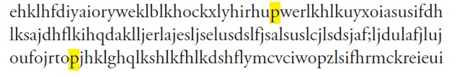
Visual search
The challenge for the designer is to ensure that visual queries can be effectively and rapidly served
In practice, this means that each of the semantically meaningful graphical objects (‘glyphs’) that make up a graphic design have the right degree of salience (importance)
The most important and frequent visual queries should be supported by the most visually distinct objects
This distinctiveness is based on low-level early-stage processing in the visual system – so an understanding of how this works is valuable
Find the two occurrences of the letter p in this text. Now find the two letters q. How long did each search take?

Slide 4
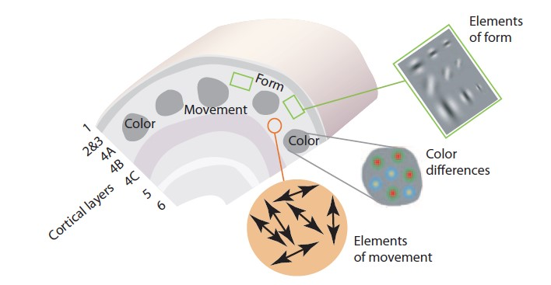
Low-level feature analysis
The neural architecture of the primary visual cortex has been mapped in detail through experiments in which neurophysiologists inserted very small electrical probes into single neurons in the brains of various animals
Cells ‘fire’ (emitting a series of spikes of electrical current) when certain patterns are put in front an animal’s eyes
V1 is a kind of tapestry of interlocking regions where different kinds of information are processed. The elements of colour, shape, texture, motion, and stereoscopic depth are processed by different interwoven areas.
What do you think these patches represent?

Slide 5
Next-level processing
V2 receives input from V1: the neurons respond to slightly more complex patterns, based on the processing already done in V1
There are a million nerve fibres providing input from each eye to the V1 area where several billion neurons process information. Information is then passed on to area V2 where several billion more neurons process it at a more complex level
These cortical areas are parallel computers because they process every part of the visual image simultaneously, computing local orientation information, local colour difference information, local size information, and local motion information.
Neurons are comparatively slow processors, but there are a lot of them working in parallel

Slide 6
Eye movement planning
Visual search is not random
If we are looking for something small, we can only see it when we are looking at it. But how do the eyes get directed to the right locations if the information has not been processed?
Biased competition. If we are looking for tomatoes, then red-sensitive cells in V1 are dialled up, while blue- and green-sensitive cells are dialled down.
Responses from the cells that are sensitized are passed both up the what pathway, biasing the things that are seen, and up the where pathway, to regions that send signals to make eye movements occur.

Slide 7

Popout experiment
Anne Triesman studied the properties of simple patterns that made them easy to find
Visual search tasks: subject told what the target shape was going to be and given an instant to look at it
Then they were briefly exposed to that same shape embedded in a set of distractors
For certain combinations of targets and distracters the time to respond did not depend on the number of distractors
This suggests a parallel automatic process that she described as pre-attentive

Slide 8
Pop-out mechanism
Pop-out effects depend on the relationship of a visual search target to the other objects that surround it. If that target is distinct in some feature channel of the primary visual cortex we can program an eye movement so that it becomes the centre of fixation.
‘Pre-attentive’ is a misnomer – in fact subjects have to focus their attention on the presence or absence of a particular target.
A better term is tunable, to indicate those visual properties that can be used in the planning of the next eye movement. Triesman’s experiments tell us about those properties to which our eye-movement programming system is sensitive.
Something that pops out can be seen in a single eye fixation
Experiments show that the processing to separate a pop-out object from its surroundings actually takes less than a tenth of a second.
Things that do not pop out require several eye movements to find, with eye movements taking place at a rate of roughly three per second. Between one and a few seconds may be needed for a search
This is the difference between visually efficient at-a-glance processing and cognitively effortful search

Slide 9
Environment
The strongest pop-out effects occur when a single target object differs in some feature from all other objects and where all the other objects are very similar to one another
Visual distinctness has as much to do with the visual characteristics of the environment of an object as the characteristics of the object itself – contrast matters
Contrast is defined in terms of the basic features that are processed in the primary visual cortex. The simple features that lead to pop-out are colour, orientation, size, motion, and stereoscopic depth.
There are some exceptions, such as convexity and concavity of contours, that are somewhat mysterious, because primary visual cortex neurons have not yet been found that respond to these properties.

Slide 10
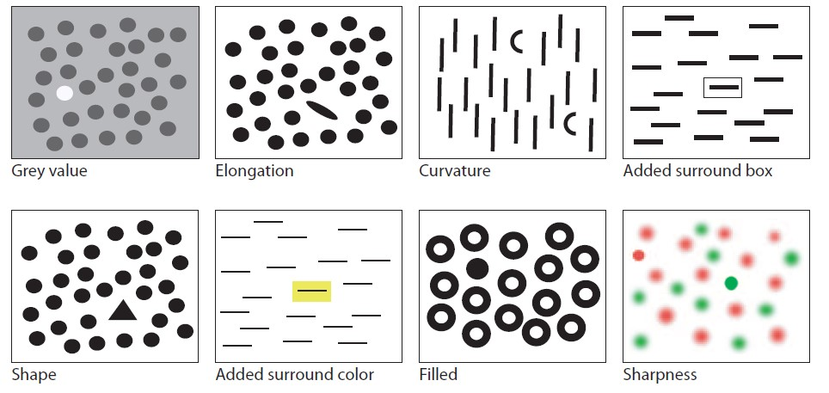
Showcase of pop-outs 1

Slide 11
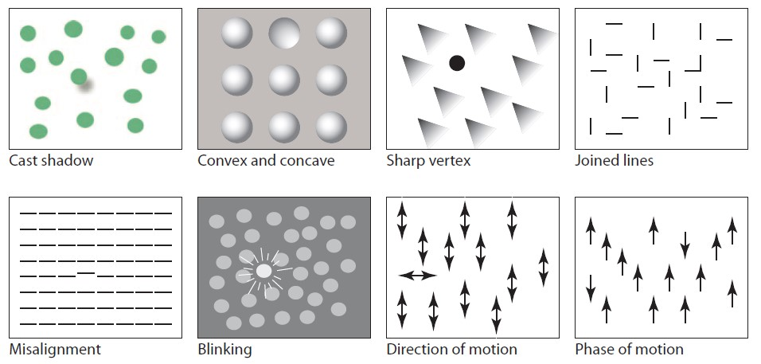
Showcase of pop-outs 2

Slide 12
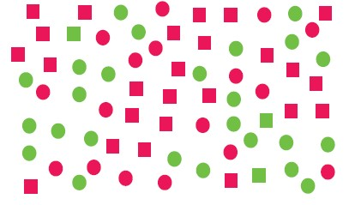
Non-pop-out
Here is a box containing a number of red and green squares and circles. Look for the green squares. How long does it take?
The green squares do not show a pop-out effect, even though you know what to look for. The problem is that your primary visual cortex can either be tuned for the square shapes, or the green objects, but not both.

Slide 13
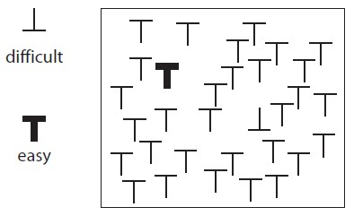
Visual conjunctive search
Visual conjunctive search: a target based on two features
Most visual conjunctions are hard to see.
Neurons sensitive to more complex conjunction patterns are only found farther up the what processing pathway, and these cannot be used to plan eye movements.

Slide 14
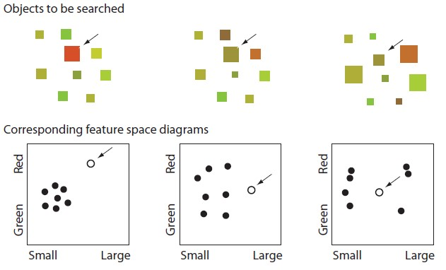
Feature channels
If a target symbol
differs on two feature channels it will be more distinct than if
it differs only on one. On the left panel the target differs in both colour and size from non-targets.
In the middle panel the target differs only in size from non-targets. A target will be least distinct if it is completely surrounded in feature space as is shown in the right panel.

Slide 15
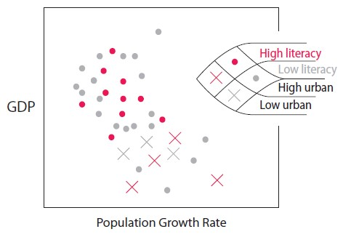
Lessons for design
To make something easy to find, use pop-out on a primary channel
To make several things easily searchable at the same time, use multiple channels
Layers in the primary visual cortex are divided up into small areas that separately process the elements of form (most importantly, orientation and size), colour, and motion.
These are semi-independent processing channels for visual information.
Literacy uses colour
Urban density uses orientation
Note the limited number of levels for non-spatial channels

Slide 16
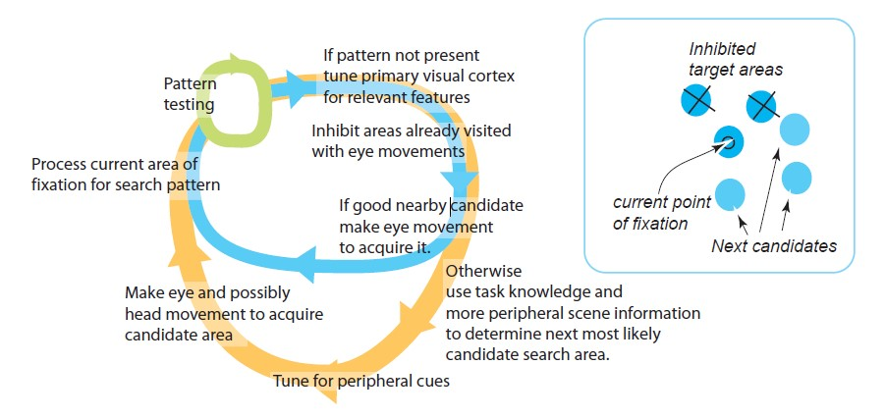
Visual search process

Slide 17
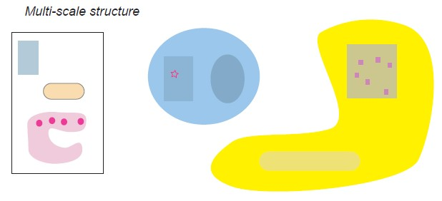
Multiscale structure
To support efficient visual search, a design should be given large-scale as well as small-scale structure.
Adding multiscale visual structure will make search much more efficient, as long as the smaller objects of search can predictably be associated with larger visual objects.
Structure at multiple scales is most important for designs that will be used often.
It permits visual search skills to develop in the form of eye movement sequences that occur in response to the general properties of a particular scene.

Slide 18
Summary
Understand the theory of how we see small things
Able to use this understanding to make good design choices especially in assisting visual search
Pop-out is the difference between visually efficient at-a-glance processing and cognitively effortful search
Two seconds is a long time in a visual thinking.
There is a world of difference between something that can be located with a single eye movement and one that takes five or ten. In the former case, visual thinking will be fluid, in the latter, it will be inefficient and frustrating.

Slide 19
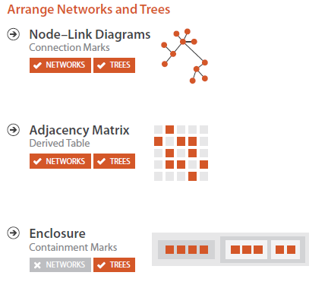
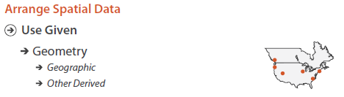
Non-table data

Slide 20
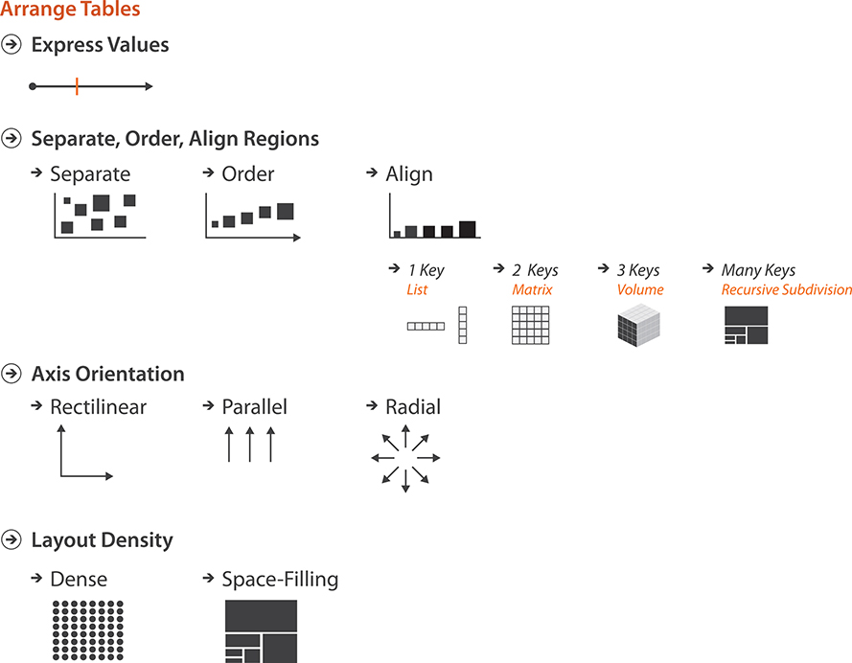
Arranging tables

