Slide 1

Neural Motifs: Scene Graph Parsing with Global Context
Baoyi Wang
School of Data and Computer Science
Dec 19, 2018

Slide 2
Outline
Motivation
Model
Experiment
Analysis
2/21
Notes:
我将从以下四个方面进行介绍

Slide 3
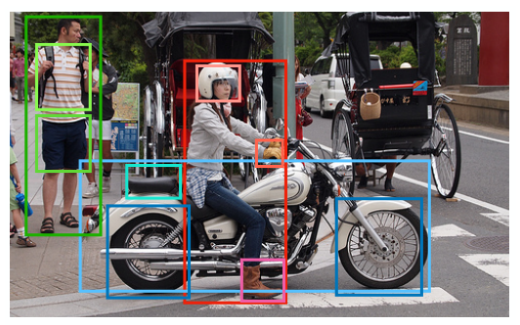
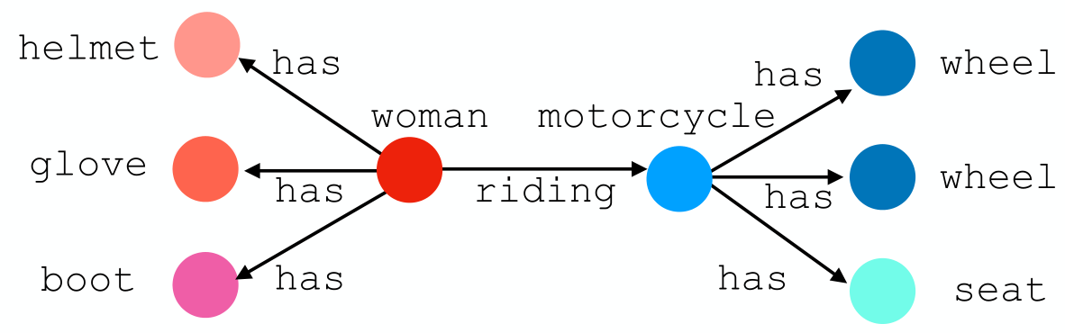
Motivation
Scene Graph Parsing
The task of producing graph representations of real-world images that provide semantic summaries of objects and their relationships.
Input：An image
Output：All triplets (head, edge, tail)
man
shirt
has
has
shorts
3/21

Slide 4
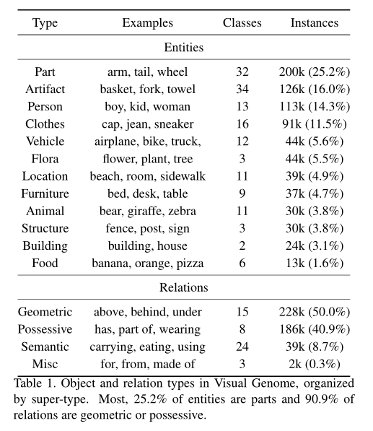
Motivation
Dataset analysis
VG（150 entities & 50 relations）
12 entity categories
4 relation categories
4/21

Slide 5
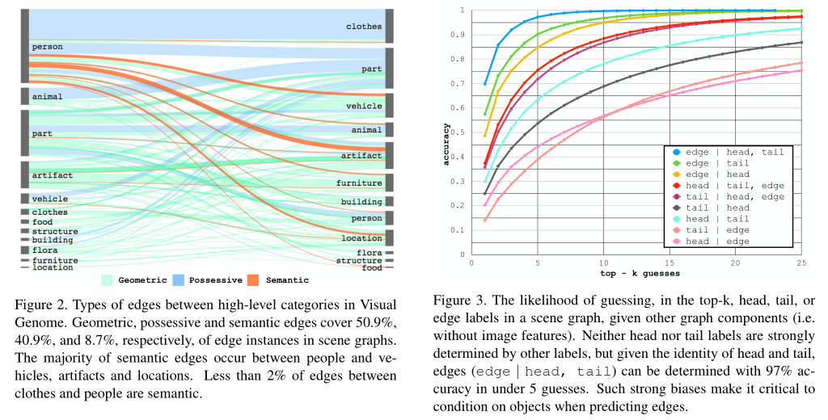
Motivation
Dataset analysis
“clothes” and “part” entities are mainly linked through possessive relations
“furniture” and “building” entities are mainly linked through geometric relations
Most semantic relationship are headed by “person”
5/21

Slide 6
Motivation
Dataset analysis
neither head nor tail labels are strongly determined by other labels
edge labels are strongly determined by head and tail labels
6/21

Slide 7
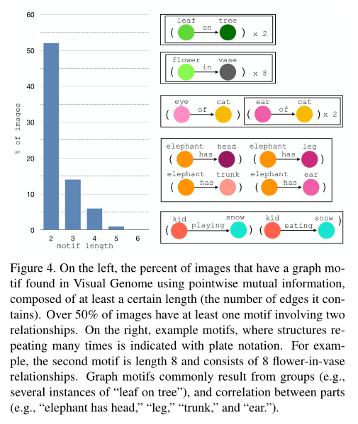
Motivation
Motif
Substructures that regularly appear in scene graph
Combinations of graph elements were selected as motifs if met conditions.
7/21

Slide 8
Motivation
Dataset analysis
relation label has a strong correlation with the labels of the object pair
there are many identical substructures in the images
A new baseline
given object detections, predict the most frequent relation between object pairs with the given labels
MotifNet
8/21

Slide 9
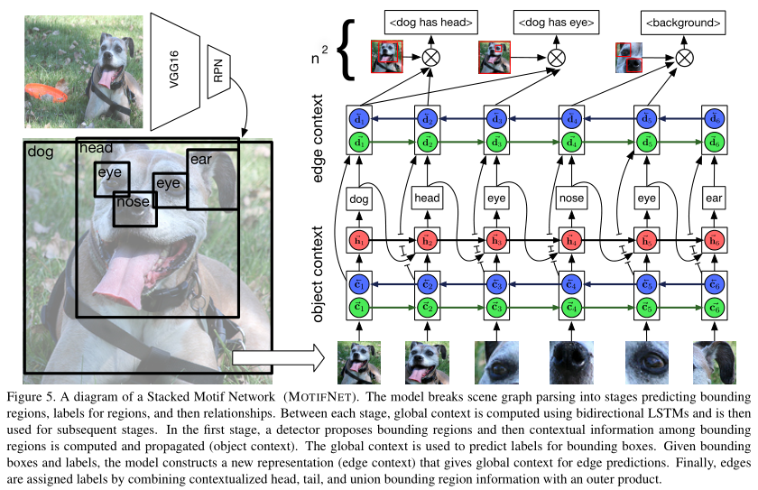
Model
9/21

Slide 10

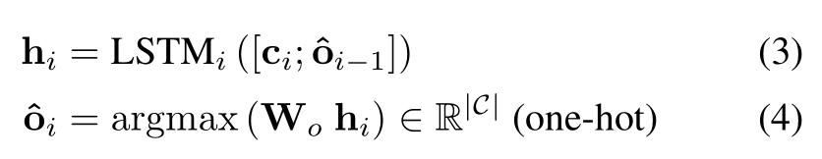

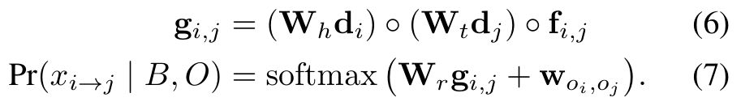
Model
Object Context：
Object Decoding：
Relations Context：
Relations Decoding：
10/21

Slide 11
Experiment
Constrains
With graph constrains： a head-tail pair only has a specific relation
Without graph constrains：allowing a head-tail pair to have multiple edge labels in system output
Evaluation mode | Input | Output
Predicate classification (PREDCLS) | Image with boxes and labels | edge labels
Scene graph classification (SGCLS) | Image with boxes | box labels, edge labels
Scene graph detection (SGDET) | Image | boxes, box labels, edge labels
11/21

Slide 12
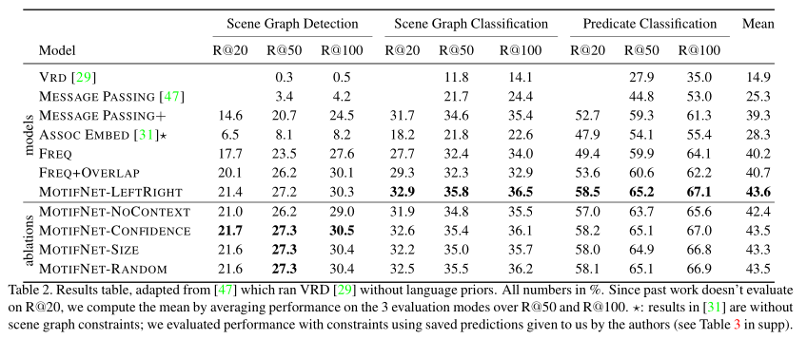
Experiment
New baselines
FREQ/FREQ+OVERLAPE
12/21

Slide 13
Analysis
Scene graph parsing
The task of producing graph representations of real-world images that provide semantic summaries of objects and their relationships
Scene graph generation
The task of generating a visually-grounded scene graph that most accurately correlates with an image
Visual relation/relationship detection
The task of capturing a wide variety of interactions between pairs of objects in an image
13/21

Slide 14
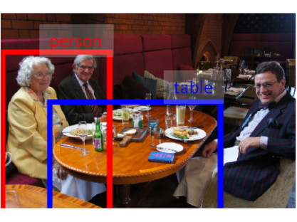

Analysis
Predicate detection(PREDDET)
Input：Image with head-tail boxes and labels
Output： edge labels
Condition： correct predicate
person-?-table
person-next to-table
14/21

Slide 15
Analysis
Predicate classification(PREDCLS)
Input：Image with boxes(not distinguish head or tail) and labels
Output： edge labels
Condition： correct predicate
person-next to-table
15/21

Slide 16
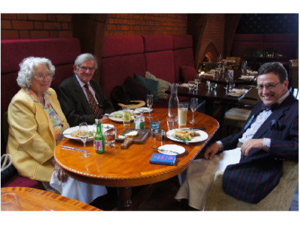
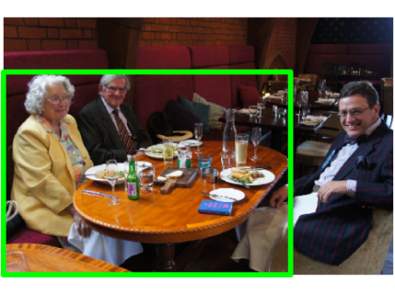
Analysis
Phrase detection(PHRDET)
Input：Image
Output： union box, entity labels, edge labels
Condition： correct predicate, subject, and object & IoU of ROI >0.5
person-next to-table
16/21

Slide 17
Analysis
Scene graph detection(SGDET) / Relationship detection
Input：Image
Output： boxes, box labels, edge labels
Condition： correct predicate, subject, and object & IoUs>0.5 & IoUo>0.5
person-next to-table
17/21

Slide 18
Analysis
Scene graph classification(SGCLS)
Input：Image with boxes(not distinguish head or tail)
Output： box labels, edge labels
Condition： correct predicate, subject, and object
person-next to-table
18/21

Slide 19
Analysis
Scene graph parsing / generation：PREDCLS, SGDET, SGCLS
Visual relation detection：PREDDET, PHRDET, SGDET
Evaluation mode | Input | Output
Predicate detection (PREDDET) | Image with head-tail boxes and labels | edge labels
Predicate classification (PREDCLS) | Image with boxes and labels | edge labels
Phrase detection (PHRDET) | Image | union box, box labels, edge labels
Scene graph detection (SGDET) | Image | boxes, box labels, edge labels
Scene graph classification (SGCLS) | Image with boxes | box labels, edge labels
19/21

Slide 20
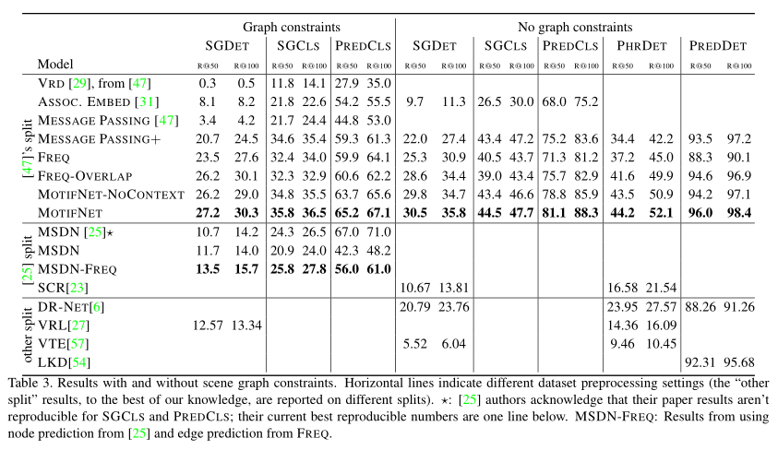
Analysis
20/21

Slide 21
Thanks!

