Slide 1
Goal-Conflict Likelihood Assessment based on Model Counting
基于模型计数的冲突可能性评估

Slide 2
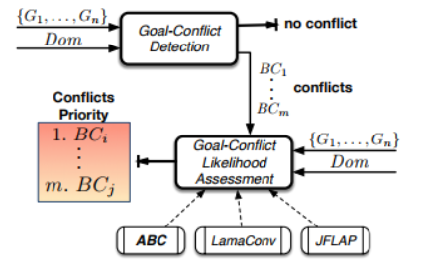
1.Goal-Conflict Detection. 2.Goal-Conflict Likelihood Assessment. 3.Goal-Conflict Severity Assessment

Slide 3
1.Goal-Conflict Detection. (not particularly mentioned in this paper)
Discuss in paper “Goal-conflict detection based on temporal satisfiability checking”

Slide 4
2.Goal-Conflict Likelihood Assessment. (mainly discussed method in this paper)
Using string model counting：
compute the number of strings of a given length k, that satisfy a set of string constraints.
In this work we use string model counter ABC.
Input:
Domain: Dom
BCs : {BC1,BC2,...,BCm}
Output:
likelihood of each BC

Slide 5
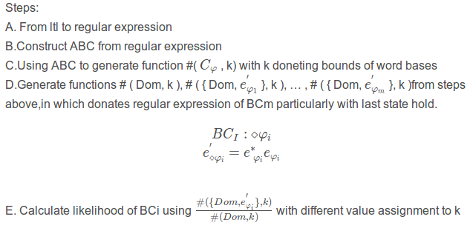
Goal-Conflict Likelihood Assessment.

Slide 6
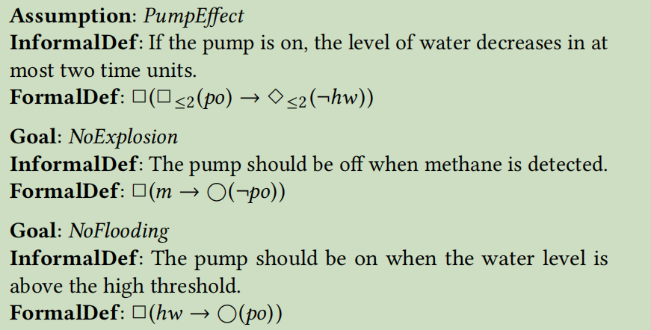
Examples:MPC
BC1：
BC2：

Slide 7
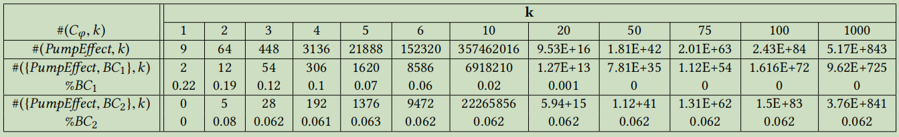
Counting word bases of length k for the BC of the MPC:

Slide 8
3.Goal-Conflict Severity Assessment
Input :
Domain： Dom
Goals : { G1, ..., Gj },
BCs : { BC1, BC2, ..., BCm} Output:
Degree of impact of a BC on specific goal Method : same as phase 2 Calculate impact of BCi on goal j using :

Slide 9
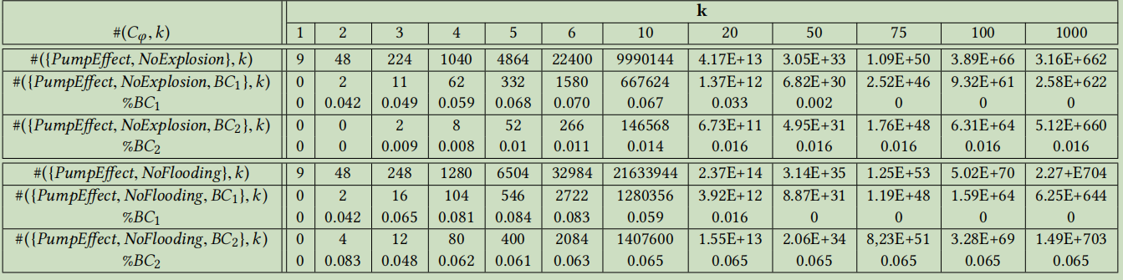
Example: MPC Loss of Goal Satisfaction for the MPC, in k-bounded word bases:

