Slide 1
Divergence Detection
1. Regressing Negated Assertions
2.Using Divergence Patterns

Slide 2
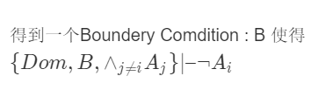
Regressing Negated Assertions(1)
目标：

Slide 3
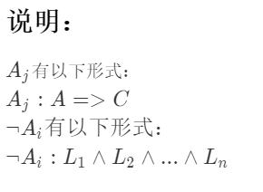
Regressing Negated Assertions(2)

Slide 4
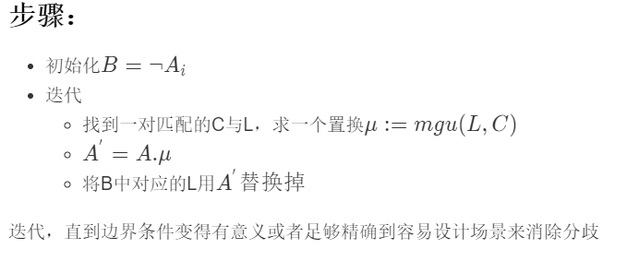
Regressing Negated Assertions(3)

Slide 5
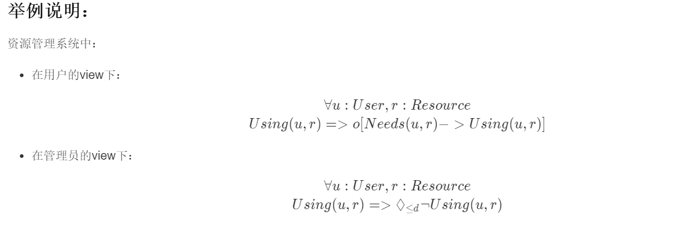
Regressing Negated Assertions(4)

Slide 6
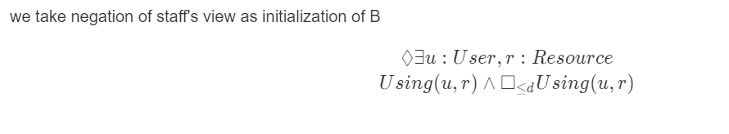
Regressing Negated Assertions(5)
初始化：

Slide 7
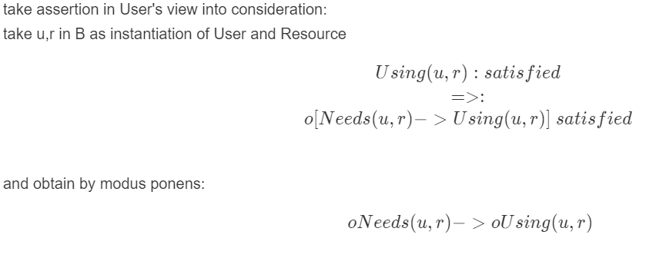
Regressing Negated Assertions(6)

Slide 8
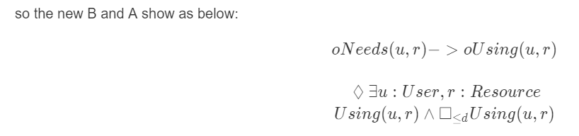
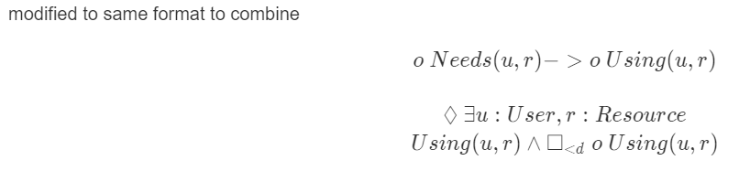
Regressing Negated Assertions(7)

Slide 9
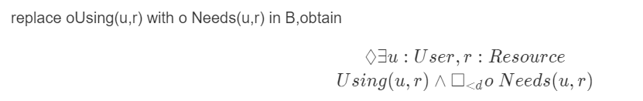
Regressing Negated Assertions(8)
there is no 'o' in paper,why?

Slide 10
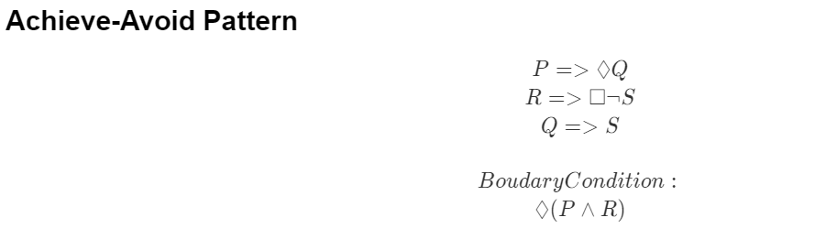
Divergence Patterns

Slide 11
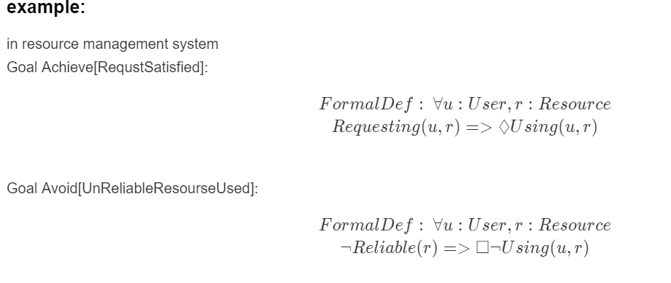
Divergence Patterns(1)

Slide 12
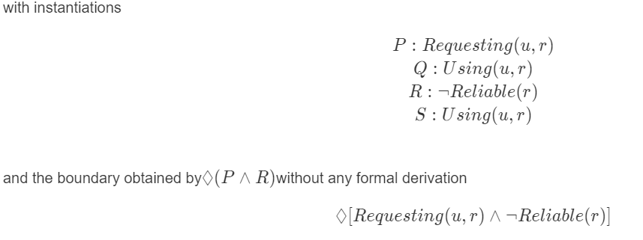
Divergence Patterns(2)

Slide 13
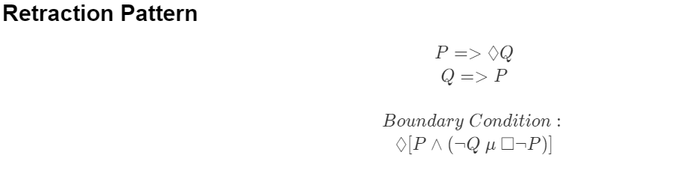
Divergence Patterns(3)

Slide 14
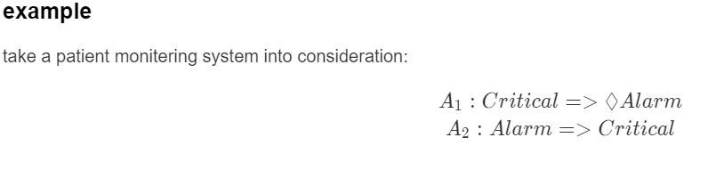
Divergence Patterns(4)

Slide 15
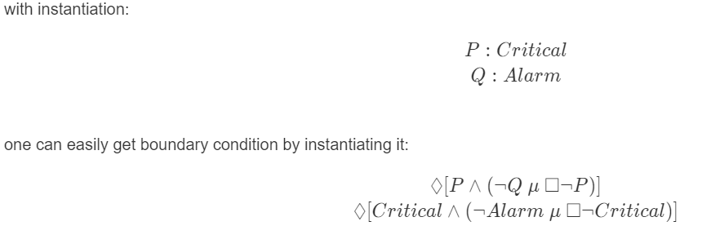
Divergence Patterns(5)
Boundary Condition:Cirtical situation occurs and then disappers before the alarm arise

Slide 16
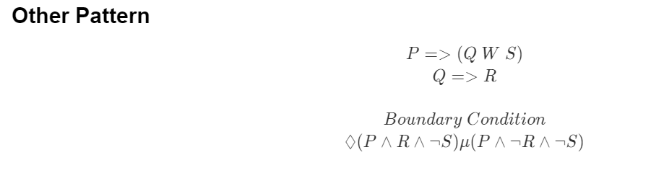
Divergence Patterns(6)

Slide 17
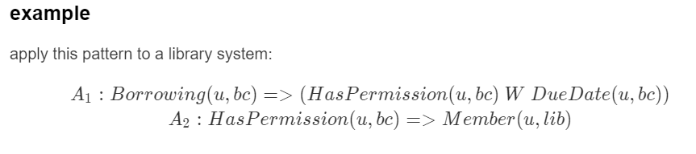
Divergence Patterns(7)

Slide 18
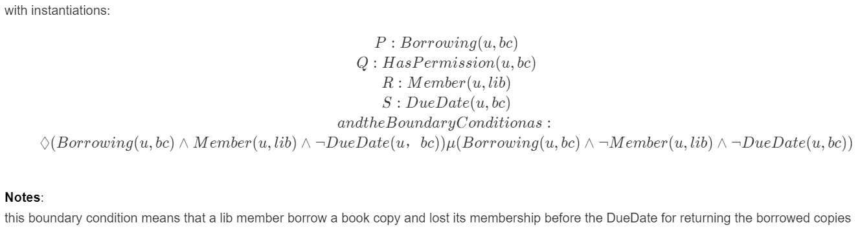
Divergence Patterns(8)

