Slide 1
Lecture 3 MIMO&OFDM
Refer to <<Fundamentals of Wireless Communication>> Chapter 7.1 & 8 & 3.4.4
Notes:
4G，速度，换卡，实名制，新闻

Slide 2
Part 1: MIMO
Refer to <<Fundamentals of Wireless Communication>> Chapter 7.1 & 8
Notes:
4G，速度，换卡，实名制，新闻

Slide 3



Capacity of SISO AWGN Channel
Capacity of AWGN channel
If average transmit power constraint is watts and noise psd is watts/Hz,
Notes:
4G 带宽：移动 135M，电信100，联通90

Slide 4
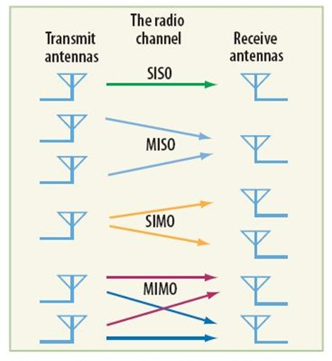
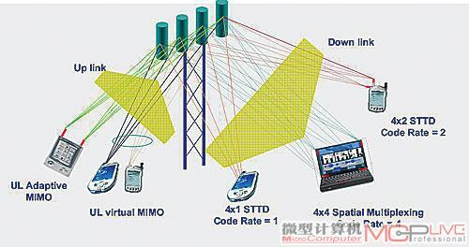
Multiple-Antenna System

Slide 5
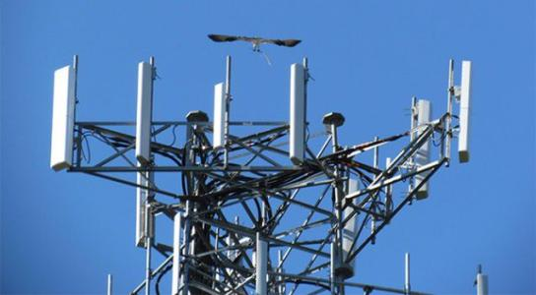

MIMO Channel
Right

Slide 6
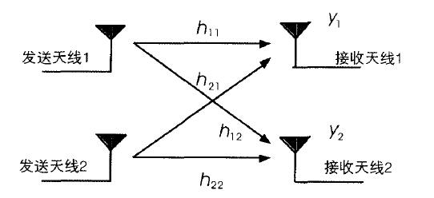
MIMO Channel
2x2 Example

Slide 7







MIMO Capacity via SVD
Narrowband MIMO channel:
is by , fixed channel matrix.
Singular value decomposition (SVD):
are complex orthogonal matrices and real diagonal (singular values).

Slide 8
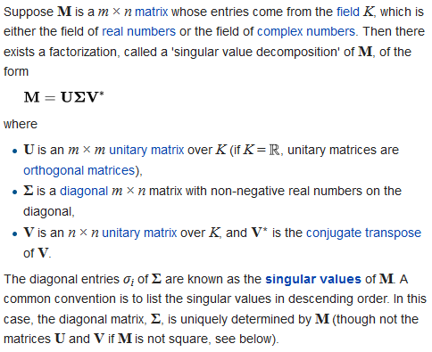
Singular Value Decomposition: SVD

Slide 9
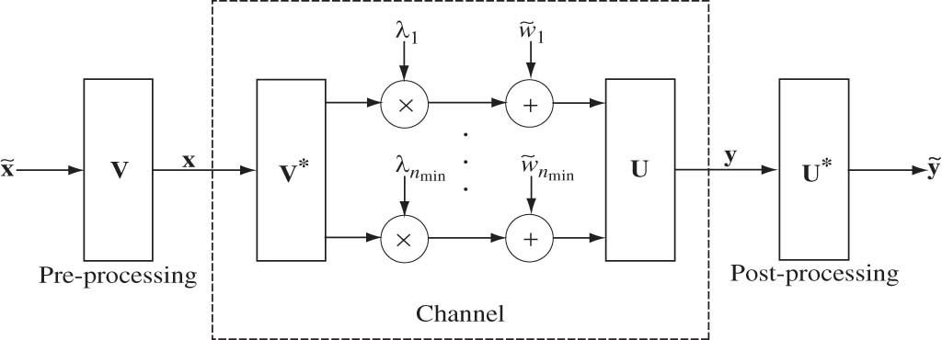


Spatial Parallel Channel
Capacity is achieved by waterfilling over the eigenmodes of H. (Analogy to frequency-selective channels.)

Slide 10
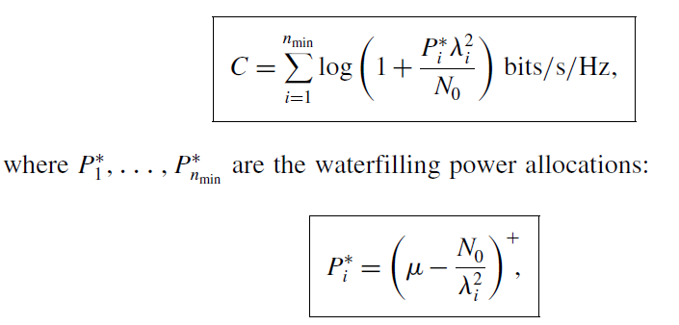
MIMO Capacity by waterfilling

Slide 11
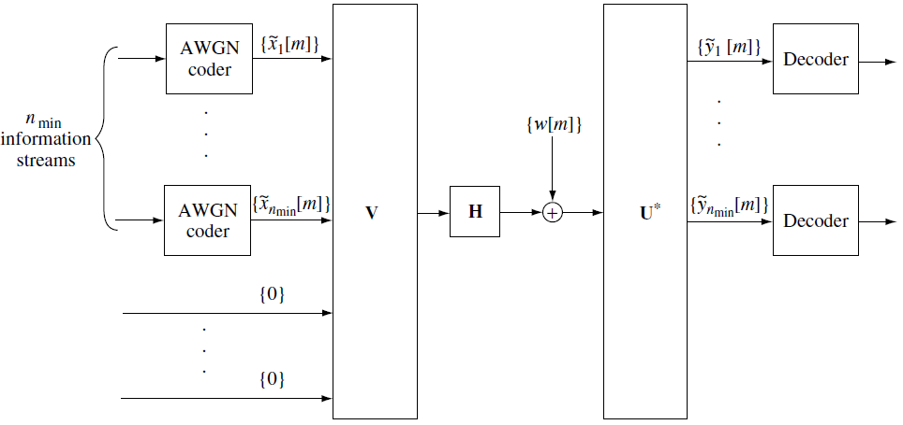
The SVD architecture for MIMO communication

Slide 12
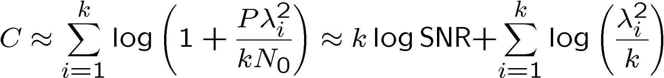
Rank and Condition Number (1)
At high SNR, equal power allocation is near optimal:
where k is the number of nonzero λ_{i}² 's, i.e. the rank of H.
The parameter k is the number of spatial degrees of freedom per second per hertz.

Slide 13
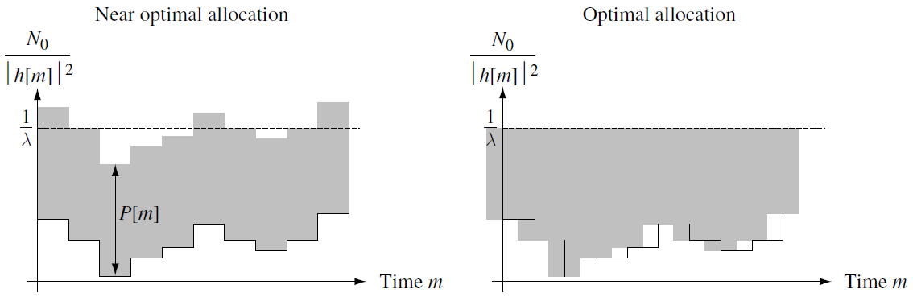
High SNR

Slide 14


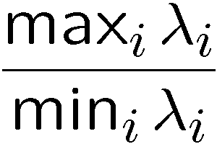
Rank and Condition Number (2)
By Jensen’s inequality,
Note
The closer the condition number:
to 1, the higher the capacity.

Slide 15

Rank and Condition Number (3)
At low SNR, the near optimal policy is to allocate power only to the strongest Eigenmode.There sulting capacity is,
In this regime, the rank or condition number of the channel matrix is less relevant.
What matters is how much energy gets transferred from the transmitter to the receiver.

Slide 16
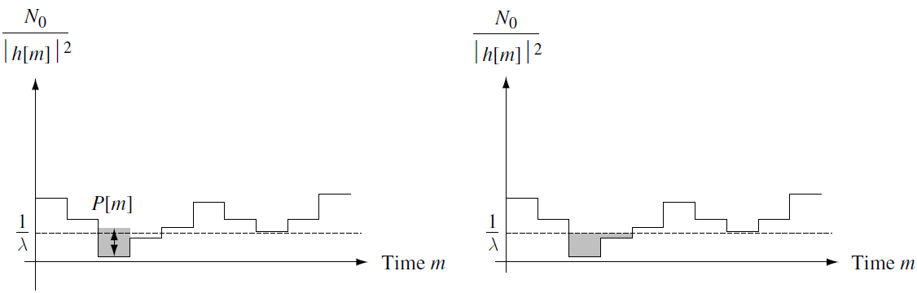
Low SNR

Slide 17
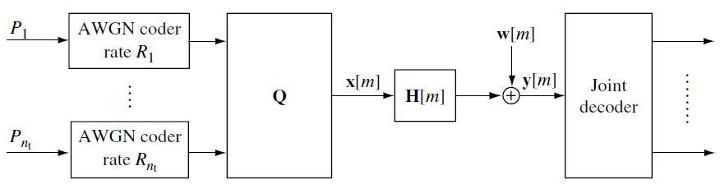
The V-BLAST architecture
If Q = V and the powers are given by the waterfilling allocations.
If Q = Inr , then independent data streams are sent on the different transmit antennas

Slide 18


Capacity with precoding
The rate achieved in a given channel state H is
Kx = E{x*x’} is the covariance matrix of the transmitted signal x:
We call the precoder as

Slide 19
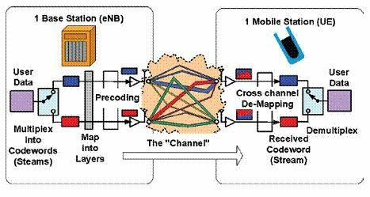
Precoding

Slide 20
Capacity with non-AWGN
If w is non-AWGN, and its covariance matrix is R=E{w*w’}
The rate achieved in a given channel state H is
Proof:

Slide 21


Fast fading MIMO channel with Receiver CSI Only
where {H[m]} is a random fading process.
A long-term rate of reliable communication equal to
We can now choose the covariance Kx as a function of the
channel statistics to achieve a reliable communication rate of

Slide 22

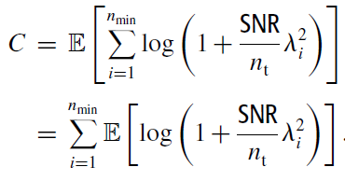
i.i.d. Rayleigh fading model
For i.i.d. Rayleigh fading model, equal powers are the optimal:
where SNR = P/N0 is the common SNR at each receive antenna.

Slide 23

High SNR regime
For i.i.d. Rayleigh fading model, at high SNR, the capacity is
The asymptotic slope of capacity versus SNR in dB scale is proportional to n, which means that the capacity scales with SNR like n log SNR.

Slide 24
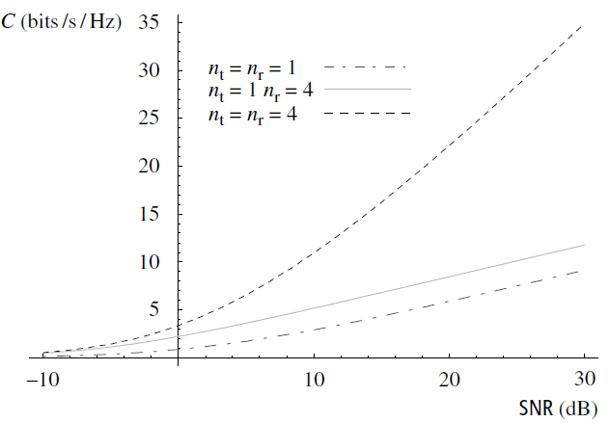
Fast Fading Capacity for I.I.D. Rayleigh Fading

Slide 25
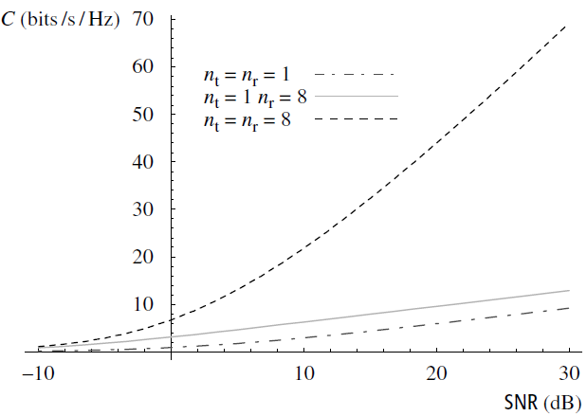
Fast Fading Capacity for I.I.D. Rayleigh Fading

Slide 26
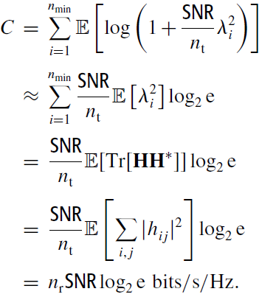
Low SNR regime
For i.i.d. Rayleigh fading model, at Low SNR, the capacity is
Thus, at low SNR, an nt by nr system yields a power gain of nr over a single antenna system.

Slide 27
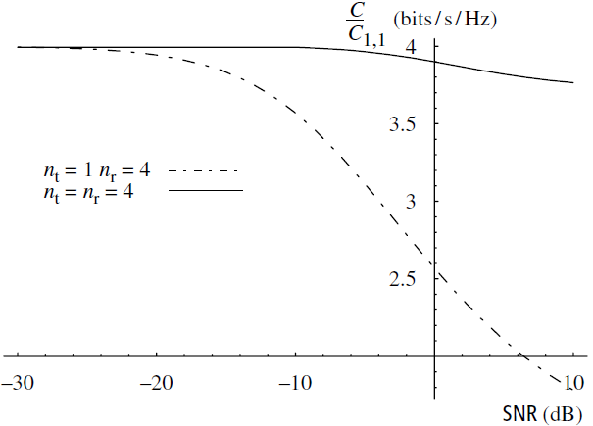
Fast Fading Capacity: Low SNR
n_{r} – fold power gain at low SNR

Slide 28



Fast fading MIMO channel with full CSI
Decompose the channel matrix as
A parallel channel
waterfilling policy
capacity

Slide 29
Linear Receiver
Linear MMSE (minimum mean squared error) receiver D
Mean squared error (MSE)
Optimal D to minimize MSE is

Slide 30
Part 2: OFDM
Refer to <<Fundamentals of Wireless Communication>> Chapter 3.4.4
Notes:
4G，速度，换卡，实名制，新闻

Slide 31



Frequency-Selective Channel
Frequency-Selective Channel:
Assuming a finite number of non-zero taps L:
We transmit over only a finite duration, say Nc symbols:

Slide 32

Cyclic Prefix (CP)
A prefix of length L−1 consisting of data symbols:
An Nc+L−1 input block:
The output to the channel:

Slide 33
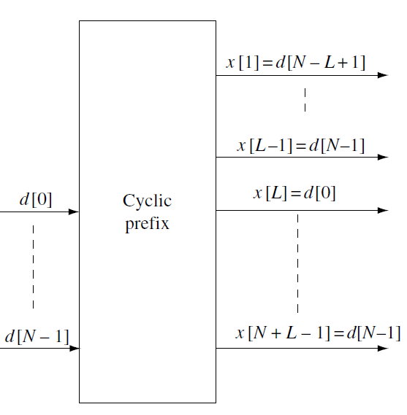
Cyclic Prefix (CP)

Slide 34

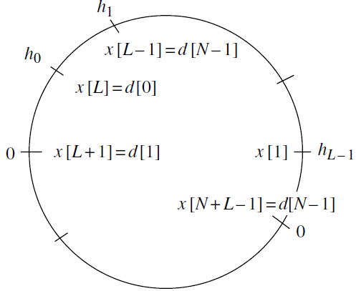
Removing Cyclic Prefix
The ISI extends over the first L−1 symbols and the receiver ignores it by considering only the output over the time interval m ∈ [L, Nc+L−1]:

Slide 35



Cyclic Convolution
Denoting the output of length Nc by
The channel by a vector of length Nc
The output by cyclic convolution:

Slide 36


Discrete Fourier transform (DFT)
DFT of d:
DFT of both sides of
Nc parallel subchannel:

Slide 37

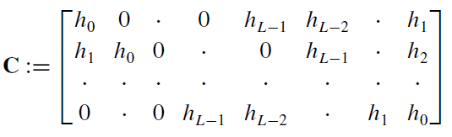
Connection between the frequency-selective channel and the MIMO channel (1)
The circular convolution peration u = h⊗d can be viewed as a linear transformation:
where
C is a circulant matrix.

Slide 38




Connection between the frequency-selective channel and the MIMO channel (2)
The DFT of d can be represented as an Nc-length vector Ud, where U is the unitary matrix with its (k,n)th entry equal to
Then is equivalent to
where

Slide 39



Connection between the frequency-selective channel and the MIMO channel (3)
We come to the conclusion that
Then is equivalent to

Slide 40
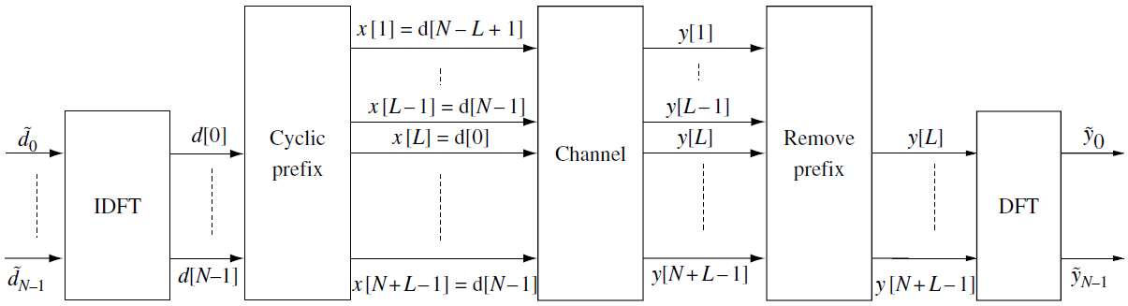
The OFDM transmission and reception schemes

Slide 41
Homework
1. If , , the noise power N0=0dB, compute the capacity of the AWGN MIMO channel.
2. For the MIMO channel ,
how to parallelize it?
Tips: For Q1, see P18; For Q2, see P 7-9
Requirements: Submitted next week.

