Slide 1
Lecture 2 Fundamentals
Refer to <<Fundamentals of Wireless Communication>> Chapter 2&5&3
Notes:
4G，速度，换卡，实名制，新闻

Slide 2
Outline
The Wireless Channel (ch.2)
Capacity of Wireless Channels (ch.5)
Diversity & Error Probability (ch.3)

Slide 3
Part 1：The Wireless Channel

Slide 4
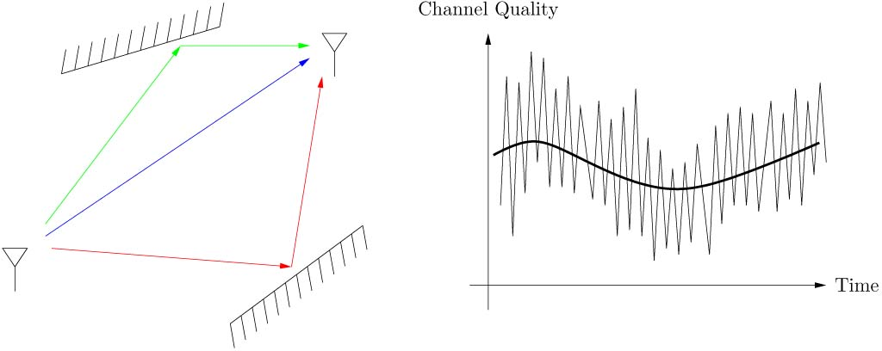
The Wireless Channel
Wireless Mulipath Channel
Channel varies at two spatial scales:
large scale fading
small scale fading

Slide 5
Wireless Mulipath Channel
Large-scale fading
In free space, received power attenuates like 1/r².
With reflections (反射) and obstructions (障碍), can attenuate even more rapidly with distance. Detailed modelling complicated.
Time constants associated with variations are very long as the mobile moves, many seconds or minutes.
More important for cell site planning, less for communication system design.

Slide 6
Path Loss
The ratio between the transmit power, Pt, and the receive power, Pr,
The path loss is usually represented in the decibel scale, i.e.,

Slide 7
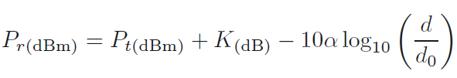
A General Path-Loss Model
To facilitate analytical studies on wireless communication systems, it is often convenient to use simpler path loss models,
d0 is the reference distance, K is a constant related to the antenna gain and the average channel attenuation, and α is the path-loss exponent.

Slide 8
Path-loss exponent
Free space: α = 2
Urban macrocells: 3.7 ≤ α ≤ 6.5
Urban microcells: 2.7 ≤ α ≤ 3.5
Office building (same floor): 1.6 ≤ α ≤ 3.5
Office building (multiple floors): 2 ≤ α ≤ 6
Store: 1.8 ≤ α ≤ 2.2
Factory: 1.6 ≤ α ≤ 3.3
Home: α ≈ 3

Slide 9
Shadowing Effect
The radio waves may also be distorted by the obstacles that appear along the transmission paths.
These obstacles may absorb part of the signal energy, resulting in signal strength degradation or cause random scattering.
The effects may vary slowly over time. This slow-varying power variation is called the shadowing effect and is considered as a type of large-scale fading.

Slide 10
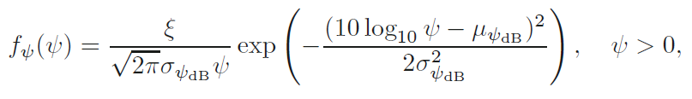

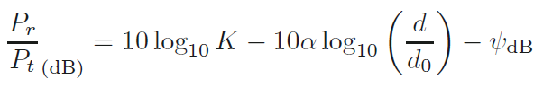
Shadowing Effect Model
A log-normal random variable with probability density function (PDF)
The log-normal distributed shadowing effect with the average path loss

Slide 11
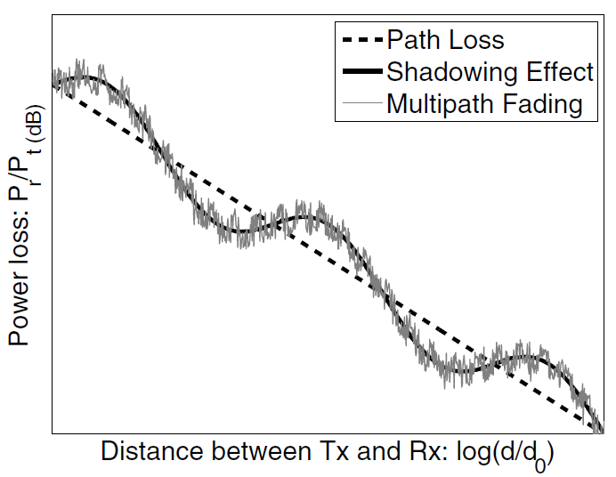
Illustration of path loss, shadowing effect and multipath fading

Slide 12
Small-scale multipath fading
Wireless communication typically happens at very high carrier frequency. (eg. fc = 900 MHz or 1.9 GHz for cellular)
Multipath fading due to constructive and destructive interference of the transmitted waves.
Channel varies when mobile moves a distance of the order of the carrier wavelength. This is about 0.3 m for 900 MHz cellular.
Primary driver behind wireless communication system design.

Slide 13
Small-scale multipath fading
How to describe?

Slide 14


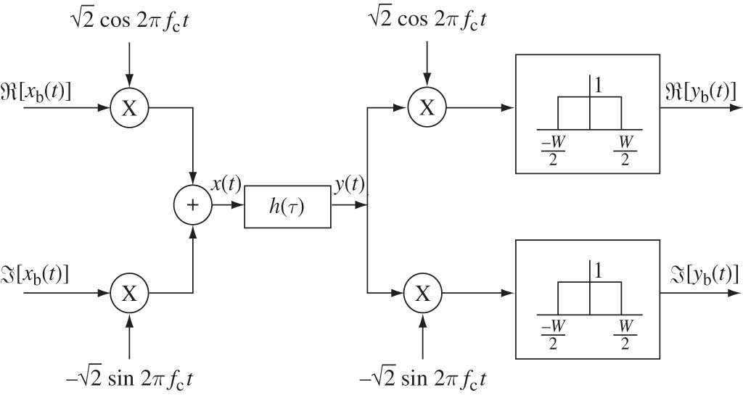
Passband to Baseband Conversion
Communication takes place at
Processing takes place at baseband

Slide 15
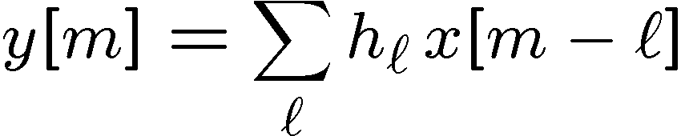
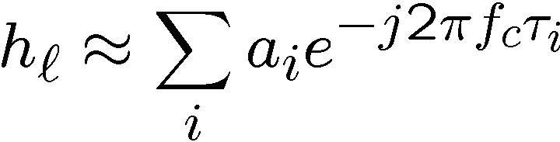
Complex Baseband Equivalent Channel
Sampled baseband-equivalent channel model:
where hl is the l-th complex channel tap (抽头).
Each path is associated with a delay and a complex gain.
Note: l denotes time slot, and i denotes path.

Slide 16

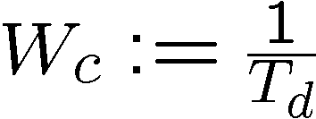
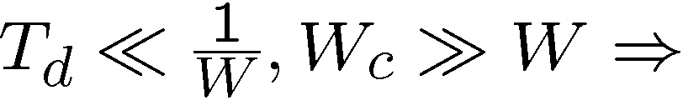
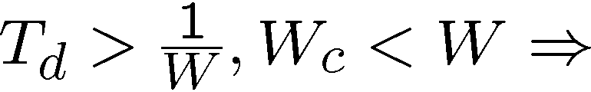
Flat and Frequency-Selective Fading
Fading occurs when there is destructive interference of the multipaths that contribute to a tap.
Delay spread
Coherence bandwidth
single tap, flat fading
multiple taps, frequency selective

Slide 17
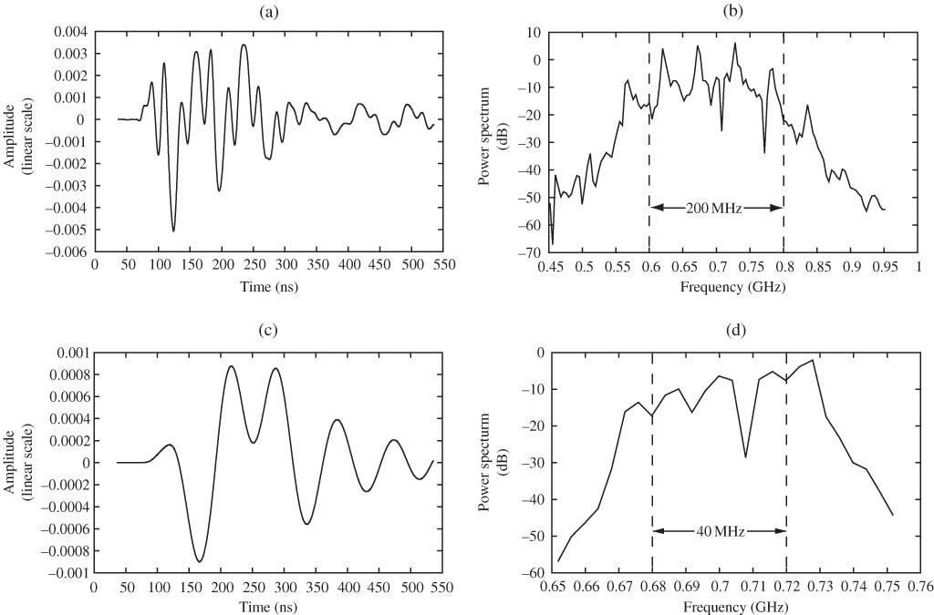
Flat and Frequency-Selective Fading

Slide 18
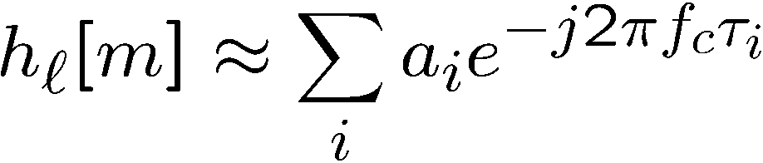
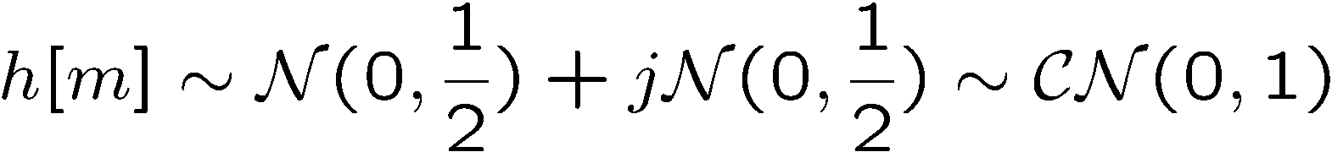
Statistical Models
Design and performance analysis based on statistical ensemble of channels rather than specific physical channel.
Rayleigh flat fading (瑞利平衰落) model: many small scattered paths
Complex circular symmetric Gaussian .
Notes:
It follows that the real part of h[m] is the sum of many small independent real random variables, and so by the Central Limit Theorem, it can reasonably be modeled as a zero-mean Gaussian random variable.

Slide 19




Rayleigh flat fading model
The magnitude is a Rayleigh random variable with density
The squared magnitude is exponentially distributed with density

Slide 20

Rician model
Rician model: 1 line-of-sight plus scattered paths
The parameter K (so-called K-factor) is the ratio of the energy in the specular path to the energy in the scattered paths; the larger K is, the more deterministic is the channel.

Slide 21
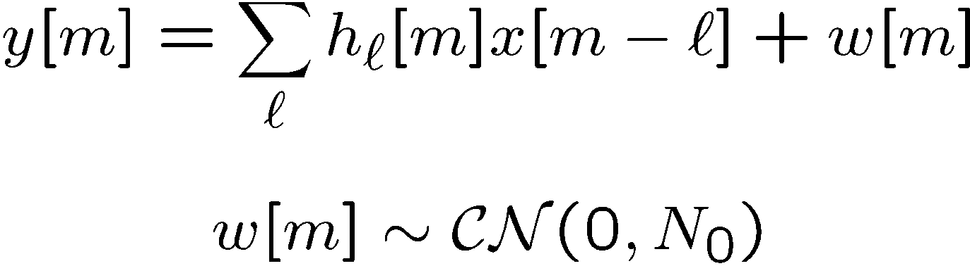
Additive Gaussian Noise
Complete baseband-equivalent channel model:
Special case: flat fading:
Will use this throughout the course.

Slide 22
Additive Gaussian White Noise Chanel （AWGN Chanel）
AWGN Chanel
h[m] is a constant, w[m] is additive Gaussian noise.

Slide 23
Common Complete Channel Models
Combining large scale fading and small scale fading

Slide 24
Part 2：Capacity of Wireless Channels

Slide 25
Capacity of Wireless Channels
Information Theory
Information theory provides a fundamental limit to (coded) performance.
It succinctly identifies the impact of channel resources on performance as well as suggests new and cool ways to communicate over the wireless channel.
It provides the basis for the modern development of wireless communication.

Slide 26


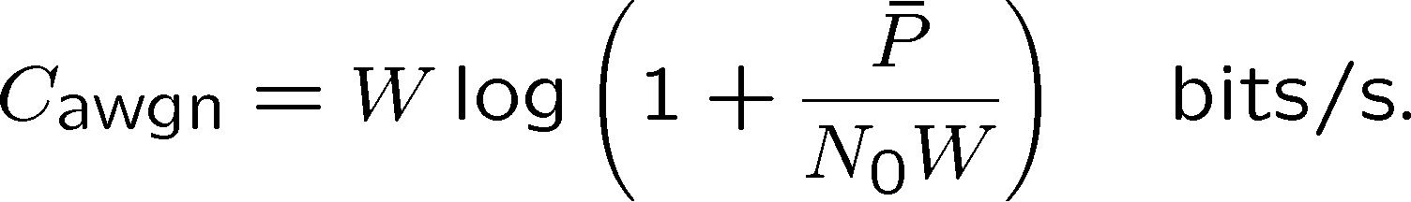
Capacity of AWGN Channel
Capacity of AWGN channel
If average transmit power constraint is watts and noise psd is watts/Hz,

Slide 27
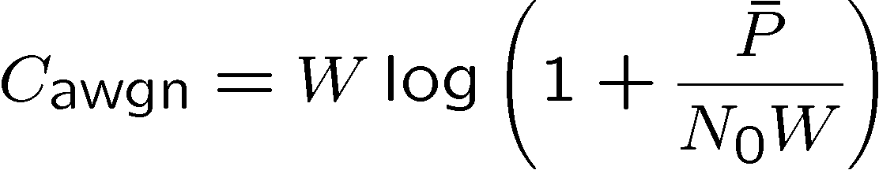
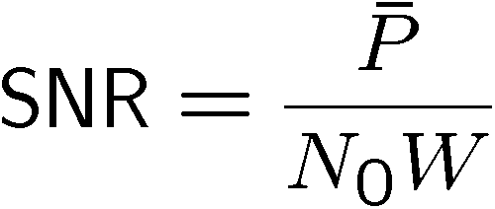


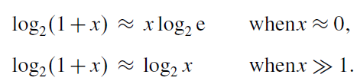
Power and Bandwidth Limited Regimes
Bandwidth limited regime capacity logarithmic in power, approximately linear in bandwidth.
Power limited regime capacity linear in power, insensitive to bandwidth.

Slide 28

Bandwidth Limited Regimes
Let us first see how the capacity depends on the received power. To this end, a key observation is that the function
is concave, i.e., f’’(x)≤0 for all x≥0.
This means that increasing the power ¯P suffers from a law of diminishing marginal returns (边际收益递减规律): the higher the SNR, the smaller the effect on capacity.

Slide 29
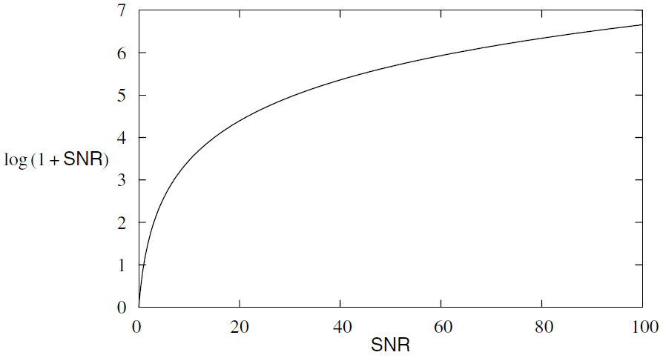
Bandwidth Limited Regimes
When the SNR is low, the capacity increases linearly with the received power ¯P: every 3 dB increase in (or, doubling) the power doubles the capacity.
When the SNR is high, the capacity increases logarithmically with ¯P : every 3 dB increase in the power yields only one additional bit per dimension.

Slide 30


Power-Limited Regime
When the bandwidth is large such that the SNR per degree of freedom is small,
In this regime, the capacity is proportional to the total received power across the entire band.
It is insensitive to the bandwidth, and increasing the bandwidth has a small impact on capacity.

Slide 31
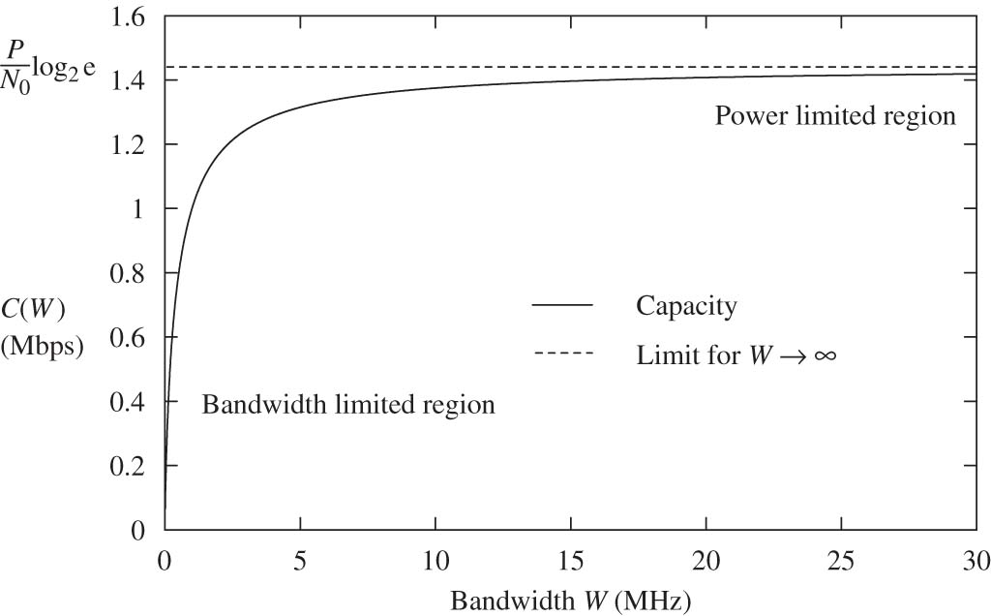

Power and Bandwidth Limited Regimes

Slide 32
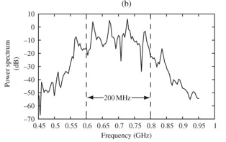
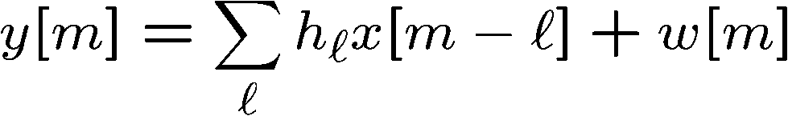
Frequency-selective Channel
Consider a time-invariant L-tap frequency-selective AWGN channel,
OFDM converts it into a parallel channel:

Slide 33
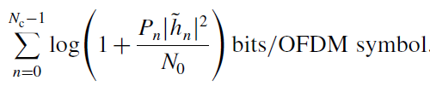
Frequency-selective Channel
Consider a time-invariant L-tap frequency-selective AWGN channel,
OFDM converts it into a parallel channel:
The maximum rate of reliable communication：

Slide 34
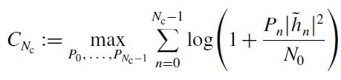

Optimal Power Allocation
The power allocation can be chosen appropriately, so as to maximize the rate
subject to

Slide 35

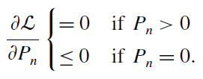
Waterfilling Power Allocation
Consider the Lagrangian
where is the Lagrange multiplier. The Kuhn–Tucker condition for the optimality of a power allocation is

Slide 36
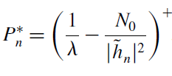

Waterfilling Power Allocation
Define x+ = max{x,0}. The power allocation
where is the Lagrange multiplier and satisfies the power constraint

Slide 37


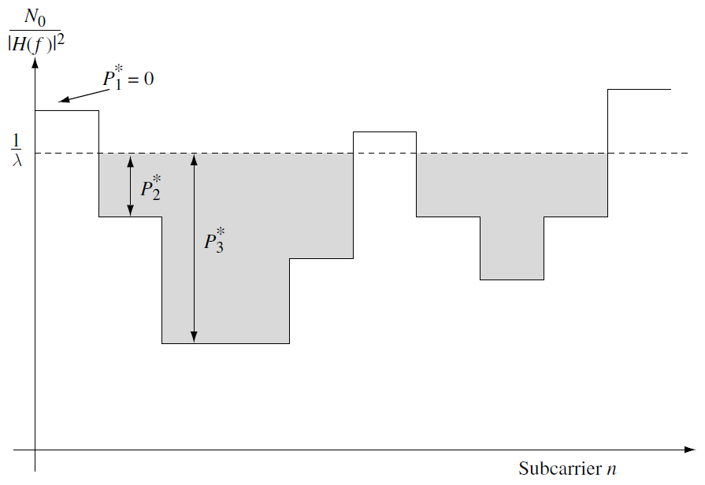
Waterfilling Power Allocation
versus index

Slide 38

Waterfilling Power Allocation
If P units of water per sub-carrier are filled into the vessel, the depth of the water at sub-carrier n is the power allocated to that sub-carrier, and is the height of the water surface.
There are some sub-carriers where the bottom of the vessel is above the water and no power is allocated to them. In these sub-carriers, the channel is too poor for it to be worthwhile to transmit information.
In general, the transmitter allocates more power to the stronger sub-carriers, taking advantage of the better channel conditions, and less or even no power to the weaker ones.

Slide 39



Slow Fading Channel
The channel gain is random but remains constant for all time, i.e.,
which models the slow fading situation. This is also called the quasi-static scenario.
The system is said to be in outage, if
The outage probability is

Slide 40
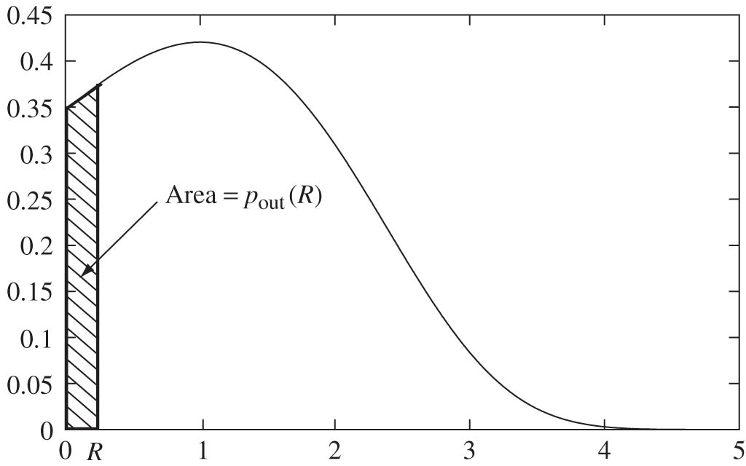
Outage for Rayleigh Channel
Pdf of log(1+|h|²SNR), Rayleigh fading and SNR = 0 dB.
For any target rate R, there is a non-zero outage probability.

Slide 41


Outage for Rayleigh Channel
For Rayleigh fading (i.e., h is CN(0,1)), the outage probability is
At high SNR,

Slide 42
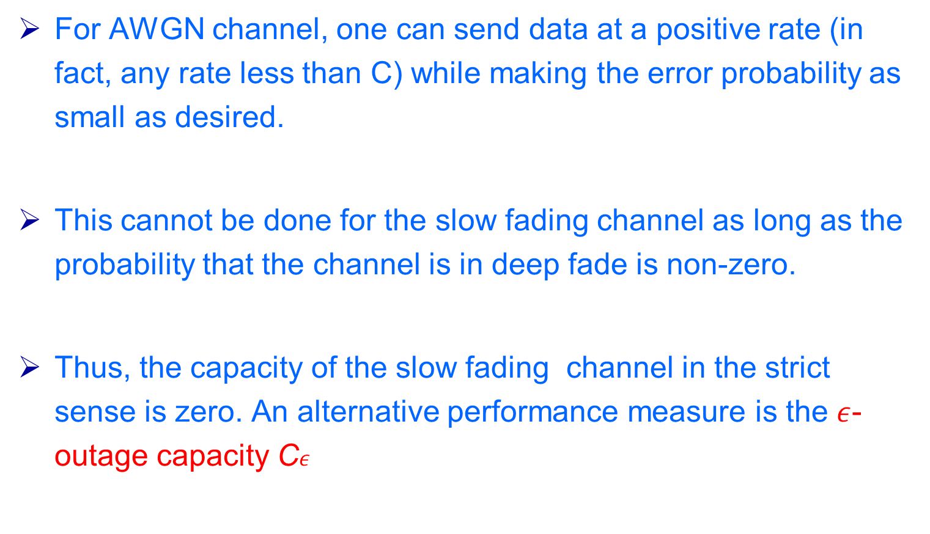
AWGN channel vs fading channel
For AWGN channel, one can send data at a positive rate (in fact, any rate less than C) while making the error probability as small as desired.
This cannot be done for the slow fading channel as long as the probability that the channel is in deep fade is non-zero.
Thus, the capacity of the slow fading channel in the strict sense is zero. An alternative performance measure is the $ε$-outage capacity C$ε$

Slide 43




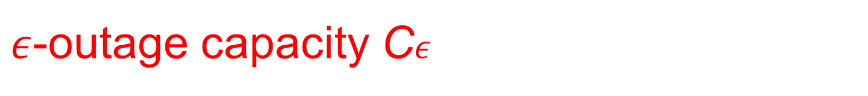
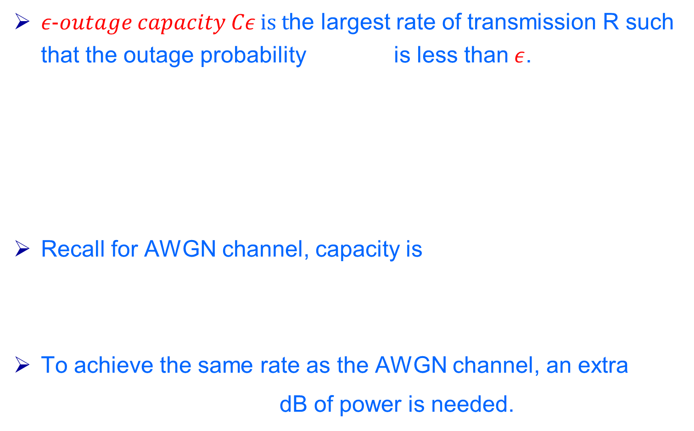
$ε$-outage capacity C$ε$
$ε−outage capacity Cε is t$he largest rate of transmission R such that the outage probability is less than$ε$.
Recall for AWGN channel, capacity is
To achieve the same rate as the AWGN channel, an extra
dB of power is needed.

Slide 44

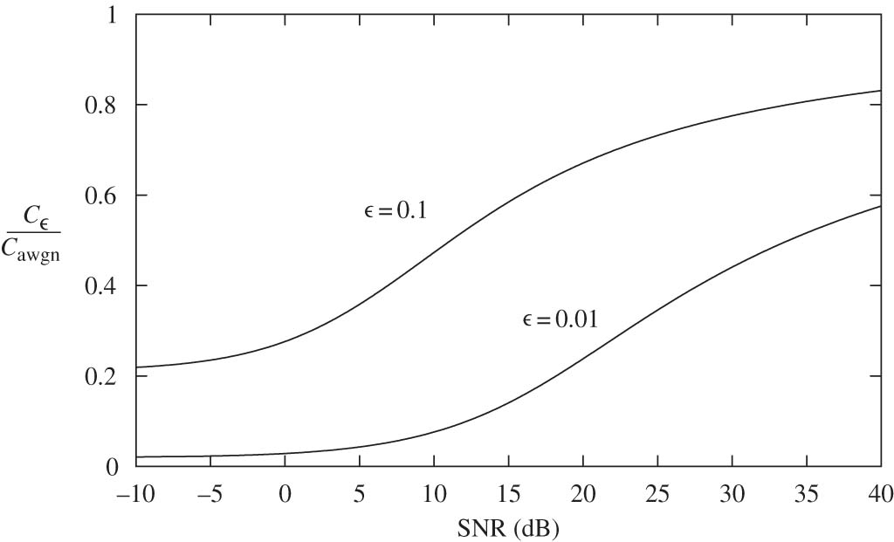
AWGN channel vs fading channel (2)

Slide 45
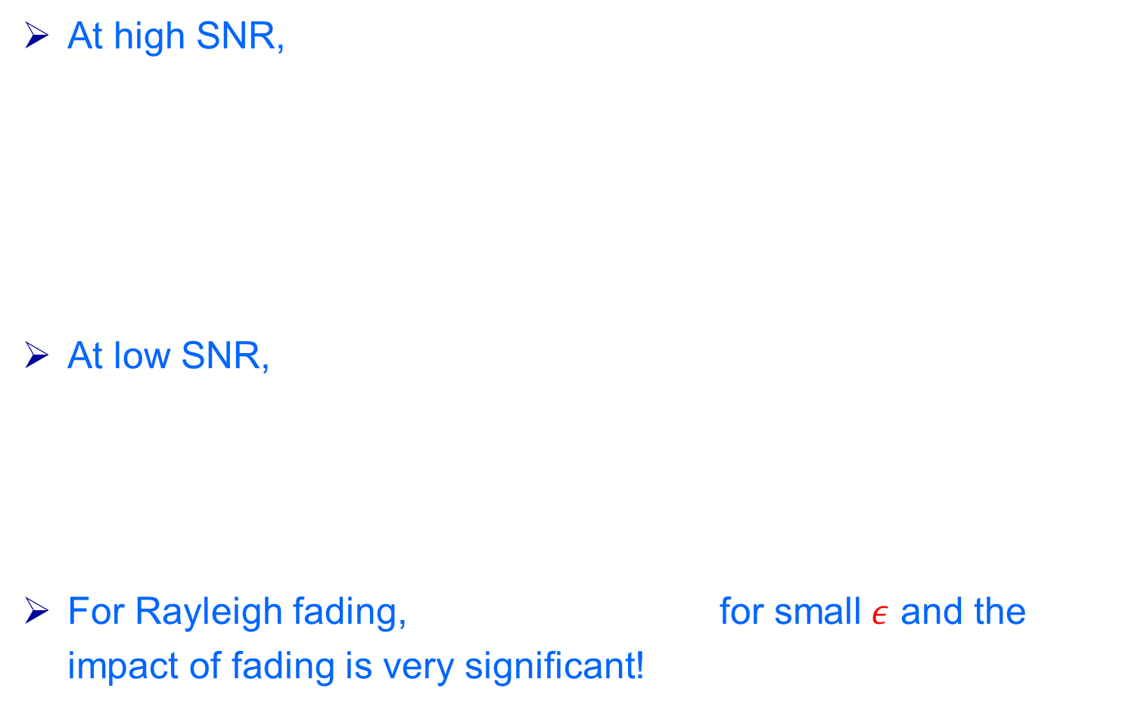
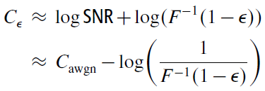
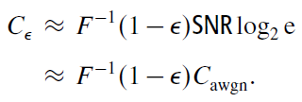
AWGN channel vs fading channel (3)
At high SNR,
At low SNR,
For Rayleigh fading, for small$ε$ and the impact of fading is very significant!

Slide 46


Fast Fading Channel
Ergodic Capacity:
At low SNR,
At high SNR,
This difference is −0.83 bits/s/Hz for the Rayleigh fading channel. Equivalently, 2.5 dB more power is needed.

Slide 47



Fast fading: waterfilling
Ergodic Capacity:
How to optimize power with transmitter channel knowledge?
Satifying
Optimal power allocation is waterfilling

Slide 48

Fast fading with Full CSI
The capacity of the fast fading channel with transmitter channel knowledge (Full CSI) is
Recall that with only receiver tracking the channel only (CSIR),

Slide 49
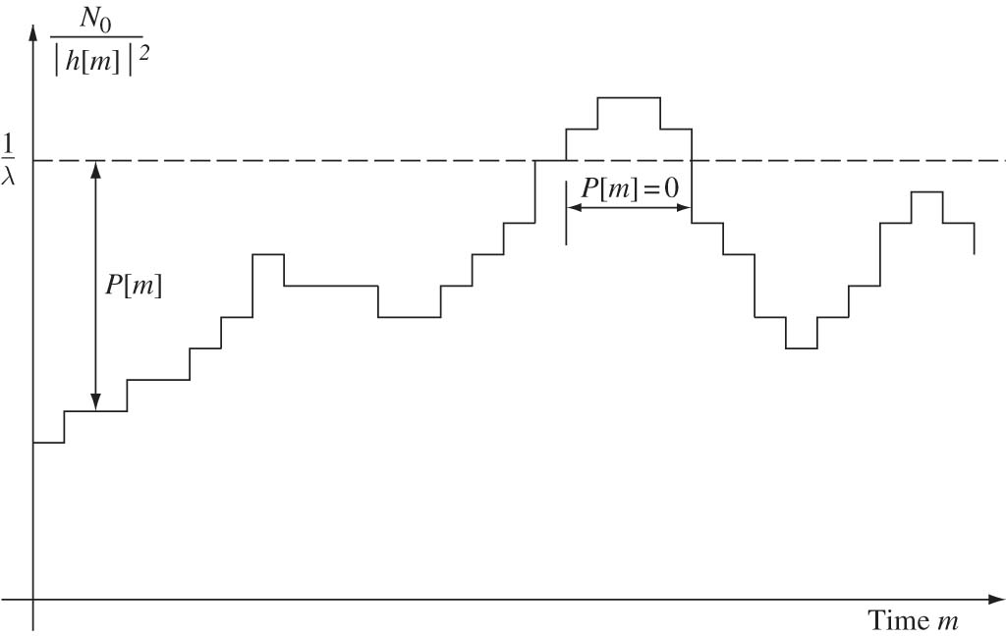
Fast fading with Full CSI
Transmit More when Channel is Good

Slide 50
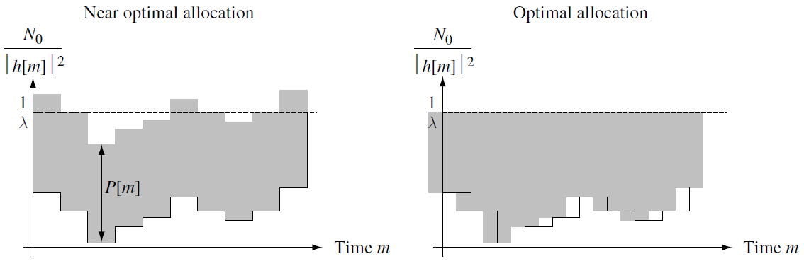
Fast fading with Full CSI, High SNR

Slide 51
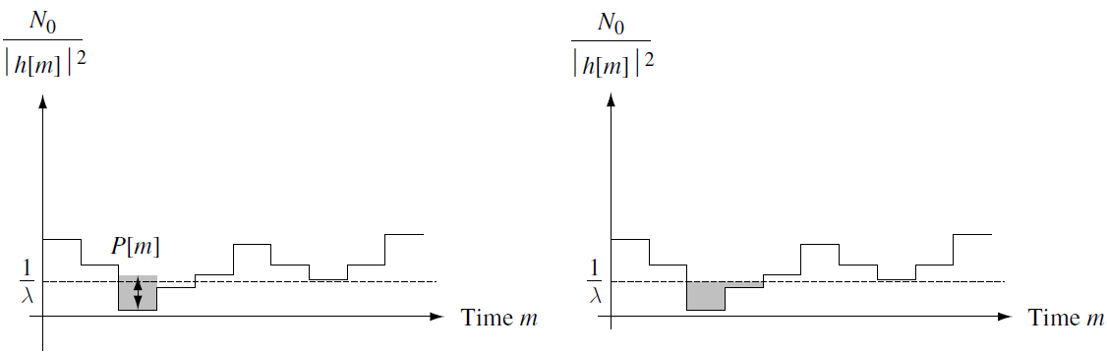
Fast fading with Full CSI, Low SNR

Slide 52
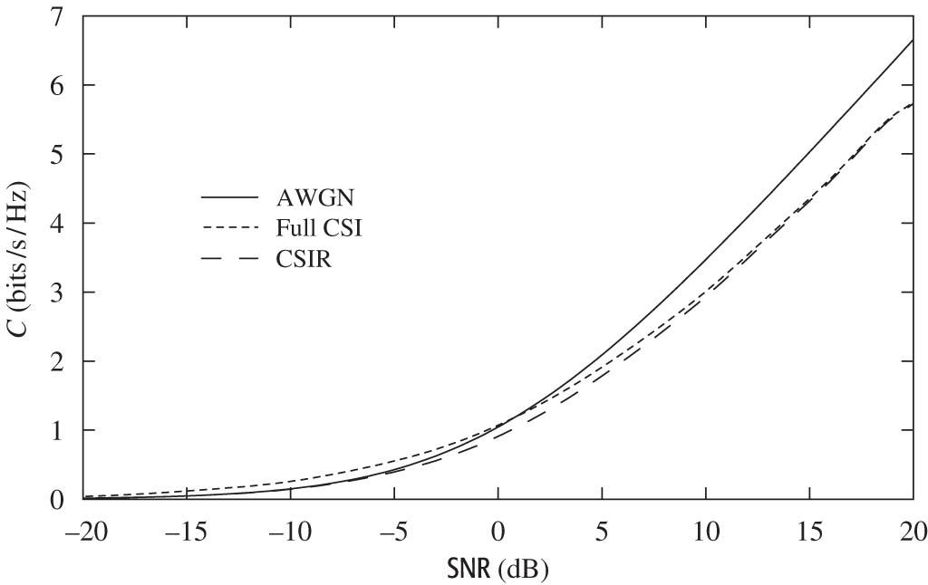
Fast fading with Full CSI vs CSIR
Performance
At high SNR, waterfilling does not provide any gain.
But transmitter knowledge allows rate adaptation and simplifies coding.

Slide 53
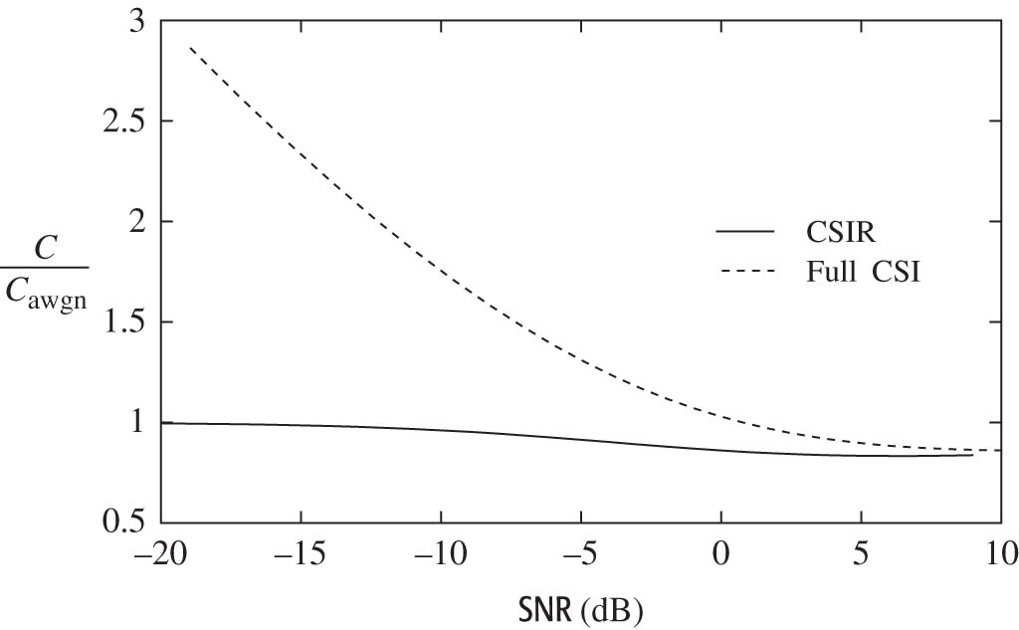
Fast fading with Full CSI vs CSIR
Performance: Low SNR
Waterfilling povides a significant power gain at low SNR.

Slide 54
Part 3：Error Probability & Diversity

Slide 55


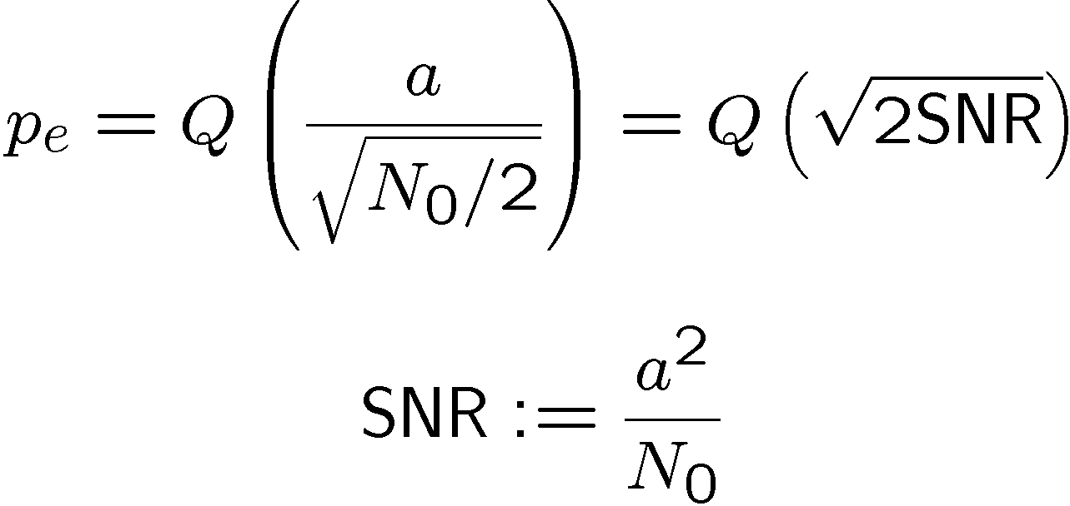
Error probability
Baseline: AWGN Channel
BPSK modulation
Error probability decays exponentially with SNR.

Slide 56
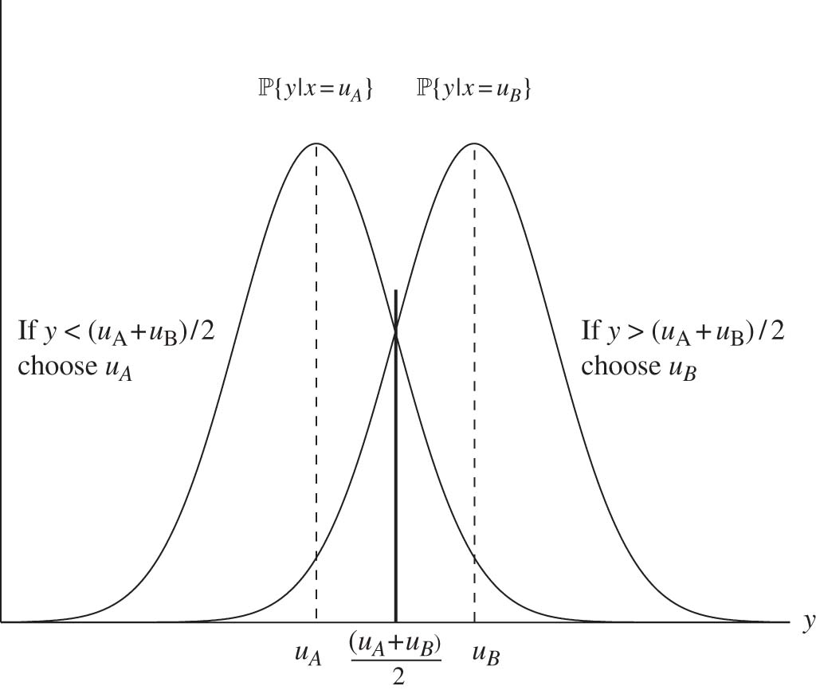
Error probability
Gaussian Detection

Slide 57




Q-function
Q-function is the complementary cumulative distribution function (CCDF) of an N(0,1) random variable,
This function decays exponentially with x2

Slide 58
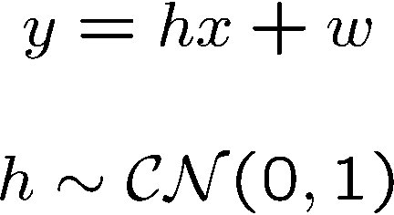

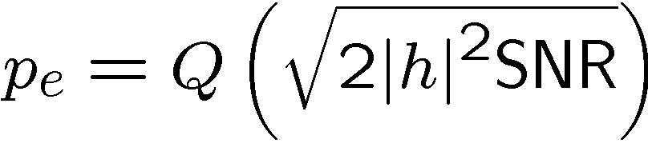
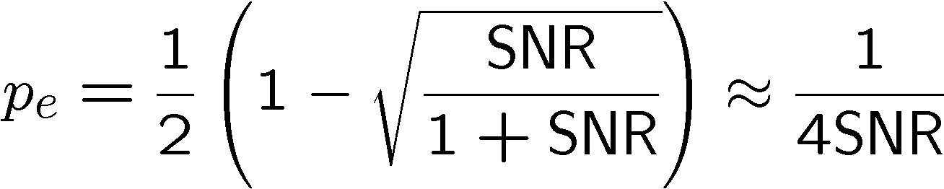
Error probability
Rayleigh Flat Fading Channel
BPSK: Coherent detection.
Conditional on h,
Averaged over h,
at high SNR.

Slide 59



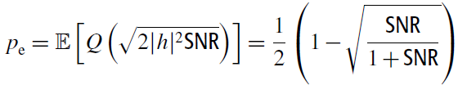
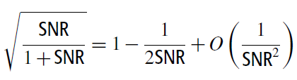
Coherent detection
The decision is now based on the sign of the real sufficient statistic,
For a given value of h, the error probability of detecting x is
Average over the random gain h,

Slide 60
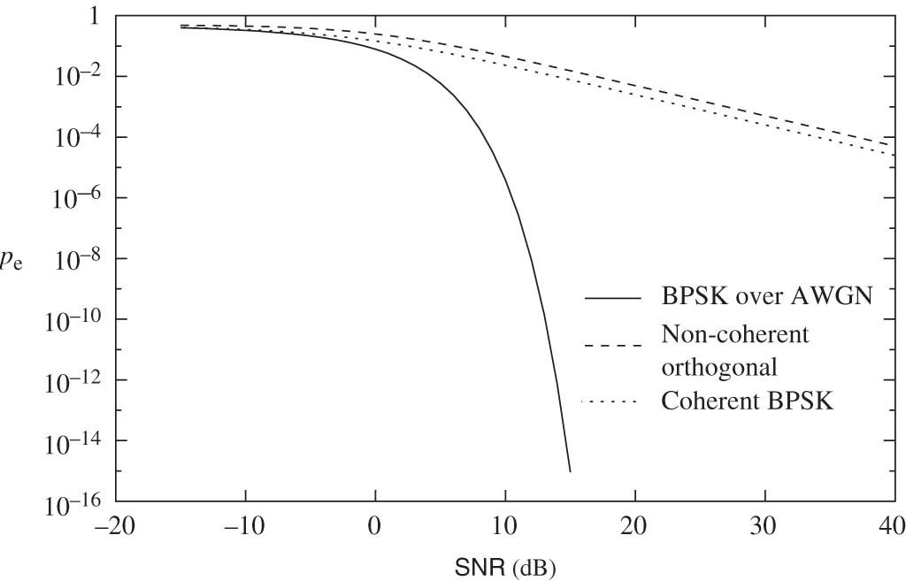
Error probability
Rayleigh vs AWGN

Slide 61
Coherent detection: Rayleigh vs AWGN
There is only a 3 dB difference in the required SNR between the coherent and non-coherent schemes.
At an error probability of 10^−3, there is a 17 dB difference between the performance on the AWGN channel and coherent detection on the Rayleigh fading channel.

Slide 62
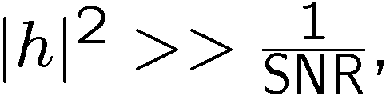


Typical Error Event
Conditional on h,
When pe is very small (e.g., Q(10)=7.62e-24)
When pe is large: (e.g., Q(1)=0.159)
Typical error event is due to channel being in deep fade
rather than noise being large.

Slide 63

Diversity
Time Diversity
Time diversity can be obtained by interleaving and coding over symbols across different coherent time periods.
Repetition coding
Coding alone is not sufficient!

Slide 64




Simplest Code: Repetition
After interleaving over L coherence time periods,
Repetition coding: for all
where
and
This is classic vector detection in white Gaussian noise.

Slide 65
Simplest Code: Repetition
After interleaving over L coherence time periods,
Repetition coding: for all
where
and
This is classic vector detection in white Gaussian noise.

Slide 66




Simplest Code: Repetition
Geometry
For BPSK
Is a sufficient statistic (match filtering/maximal ratio combiner).
Reduces to scalar detection problem:

Slide 67



Simplest Code: Repetition
Deep Fades Become Rarer
chi-square distribution:卡方分布/西格玛分布

Slide 68


Simplest Code: Repetition
Performance

Slide 69

Diversity
Antenna Diversity
Receive
Transmit
Both
Receive
Transmit
Both

Slide 70




Diversity
Receive Diversity
Same as repetition coding in time diversity, except that there is a further power gain.
Optimal reception is via match filtering (receive beamforming).

Slide 71



Receive Diversity
Receive Diversity
Total received SNR:
: power gain (also called array gain)
: diversity gain, converges to 1 with increasing L
A 3-dB gain is obtained for every doubling of the number of antennas.

Slide 72




Transmit Diversity
If transmitter knows the channel, send:
maximizes the received SNR by in-phase addition of signals at the receiver (transmit beamforming).
Reduce to scalar channel:
same as receive beamforming.
What happens if transmitter does not know the channel?

Slide 73
Space-time Codes
Transmitting the same symbol simultaneously at the antennas doesn’t work.
Using the antennas one at a time and sending the same symbol over the different antennas is like repetition coding.
More generally, can use any time-diversity code by turning on one antenna at a time.
Space-time codes are designed specifically for the transmit diversity scenario.

Slide 74



Alamouti Scheme
Over two symbol times:
Projecting onto the two columns of the H matrix yields:
double the symbol rate of repetition coding.
3dB loss of received SNR compared to transmit beamforming.

Slide 75
Homework
1. If K=0dB, transmit power is 1 w(watt), reference distance is 1 m, path-loss exponent is 3, and the distance between the transmitter and receiver is 10 m, what is the received power？
2. In the right Figure, h1=3, h2=4, what is the
diversity gain ?
3. Compute the Capacity of an AWGN channel when SNR=20dB.
Tips: For Q1, see P6; For Q2, see P67-69; for Q3, see P24.
Requirements: Submitted next week.

