Slide 1
Lecture 4: Massive MIMO

Slide 2
Contents
Introduction to Massive MIMO
Fundamental overview: Massive MIMO
Single-cell Massive MIMO
Massive MIMO DL
Linear precoding schemes (ZF-BF/MRT)
Perfect CSIT / imperfect CSIT
Massive MIMO UL
Linear receiver techniques (ZF-R/MRC/MMSE)
Perfect CSIR / imperfect CSIR
Multi-cell Massive MIMO
Inter-cell interference problem
Pilot contamination problem

Slide 3
Introduction to Massive MIMO

Slide 4

Introduction to Massive MIMO : Beyond 4G Network
MTC : Machine Type Communications
VoIP : Voice over Internet Protocol
M2M : Machine-to-machine
Future mobile data traffic
Global exponential mobile data traffic increase
By a factor of ~ 20 from 2011 until 2016, and more expected in 2020.
More devices, higher bit rates, always active
Larger variety of traffic types e.g. Video, MTC
× 20
Further capacity enhancement is needed

Slide 5
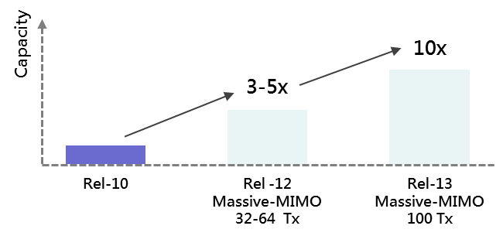
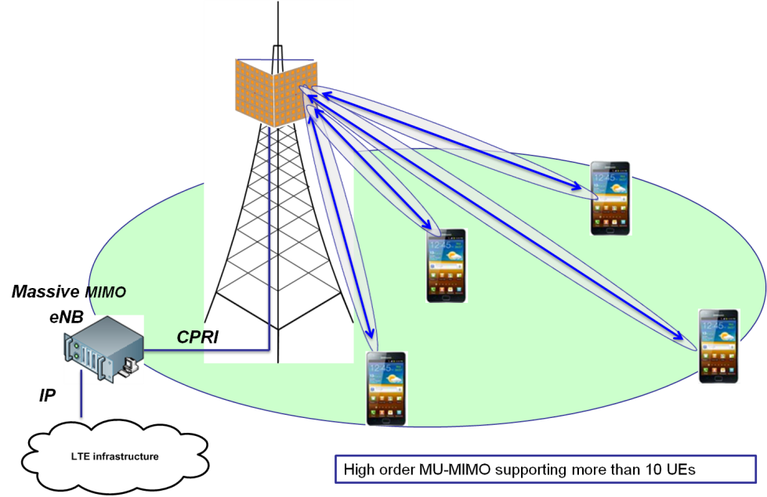
Introduction to Massive MIMO : Candidate of Beyond 4G Network
[1] RWS-120002, “Technologies for Rel-12 and Onwards,” Samsung, 3GPP RAN WS on Rel-12 and onwards, Ljubljana, Slovenia, June 11–12, 2012.
[2] T. L. Marzetta et, “Beyond LTE: Hundreds of Base Station Antennas! “, 2010 IEEE Communication Theory Workshop
CSI : Channel State Information
Solution for Capacity Demand^{[1],[2]}
Benefit of Massive Antenna
Capacity enhancement^{[1]}
Mathematically Exact^{[2]}
Required Tx energy/bit is arbitrarily small
Eliminate the effects of uncorrelated noise & fast fading
Compensate the poor-quality CSI
Massive MIMO
Using hundreds of antennas at BS
Support the dozens of UEs
(Multi-user MIMO)

Slide 6
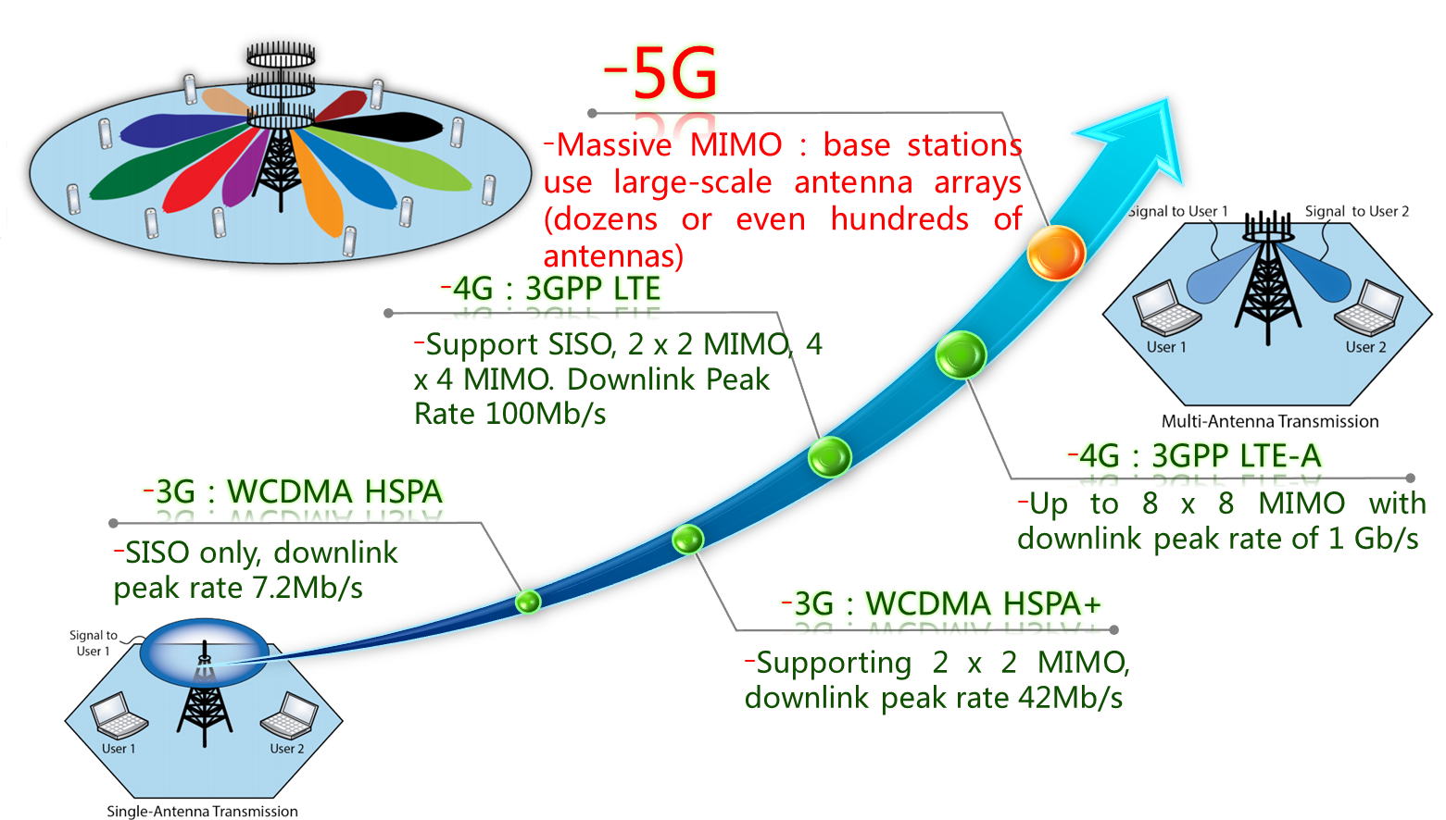
Introduction to Massive MIMO : Evolution of MIMO Technology

Slide 7
Introduction to Massive MIMO
[5] T. L. Marzetta, “Noncooperative cellular wireless with unlimited numbers of base station antennas,” IEEE Trans. Wireless Commun., vol. 9, no. 11, pp. 3590–3600, Nov. 2010.
MAC : Multiple Access Channel
Motivation of Massive MIMO^{[5]}
Consider a MIMO MAC ( M : # of BSs antennas, K : # of user)
If the BS process its receive signal by matched filtering,
By the strong law of large numbers (大数定律),
With an unlimited number of antennas
Uncorrelated interference and noise vanish
The matched filter is optimal
The transmit power can be made arbitrarily small
: i.i.d. with zero mean and unit variance
By strong law of large numbers

Slide 8
Introduction to Massive MIMO
Simulation result
M = 1 ~ 500, h_{i} = M X 1 Real Gaussian Vector
Converges to 1 as M increases
Converges to 0 as M increases

Slide 9
Introduction to Massive MIMO
[6] H. Q. Ngo, E. G. Larsson and T. L. Marzetta, “Uplink power efﬁciency of multiuser MIMO with very large antenna arrays,” in Proc. of Allerton Conference on Communication, Control, and Computing, Sept. 2011.
On channel estimation and pilot contamination^{[5]}
The receiver estimates the channels based on pilot sequences.
The # of orthogonal sequences is limited by the coherence time
Thus, the pilot sequences must be reused
Assume that transmitter m & j use the same pilot sequence
Thus, the BS process its receive signal by matched filtering
With an unlimited number of antennas
Uncorrelated interference, noise and estimation errors vanish
The matched filter is optimal
The transmit power can be made arbitrarily small^{[6]}
The performance is limited by pilot contamination
m
m
j
j
m
m
j
pilot contamination
pilot contamination
estimation noise
m
m
j
By strong law of large numbers

Slide 10
Introduction to Massive MIMO
CSIT : Channel State Information at the Transmitter
CSIR : Channel State Information at the Receiver
Analysis of Massive MIMO with sufficient large # of BS antennas
Single-cell massive MIMO scenario
Massive MIMO Downlink scenario
Analysis the performance of various linear precoding/beamforming technique for Massive MIMO based on channel information
Perfect CSIT/ imperfect CSIT cases
Massive MIMO Uplink scenario
Linear receiver technique for Massive MIMO Uplink
Perfect CSIR/ imperfect CSIR cases
Multi-cell massive MIMO scenario
Inter-cell interference problem
Pilot contamination problem

Slide 11
Fundamental Overview: Massive MIMO

Slide 12
Fundamental Overview: Massive MIMO : Point-to-Point MIMO (1/4)
SNR : Signal to Noise Ratio
Channel Model
# of BS antennas M, # of UE antennas N
IID complex-Gaussian channel H, x, n with zero mean and variance 1
is downlink transmission power
Receiver has perfect knowledge of H
Received SNR/ Capacity at Receiver
M>N
M<N

Slide 13
Fundamental Overview: Massive MIMO : Point-to-Point MIMO (2/4)
Capacity at Receiver (M>N)
For large M with IID complex-Gaussian channel H,
Conclusion

Slide 14
Fundamental Overview: Massive MIMO : Point-to-Point MIMO (3/4)
Capacity at Receiver (N>M)
For large N with IID complex-Gaussian channel H,
Conclusion

Slide 15
Fundamental Overview: Massive MIMO : Point-to-Point MIMO (4/4)
Point-to-point MIMO
Large number of transmit antennas
Large number of receive antennas
Independent with M
Linearly increase as N
Increase as N with log shape

Slide 16
Fundamental Overview: Massive MIMO : Multi-User MIMO (1/4)
Multi-user MIMO Uplink
M antennas simultaneously serves K users
Each user has single antenna, N = 1
Channel modeling (large scale + small scale)
Propagation matrix G
Massive MU-MIMO Uplink
Only large scale fading coefficients remain
H: small scale fading
D: large scale fading (path loss, shadow fading)

Slide 17
Fundamental Overview: Massive MIMO : Multi-User MIMO (2/4)
MRC: Maximal Ratio Combining
Massive MU-MIMO Uplink
UL Received vector for K users
Total capacity of UL MU-MIMO
Detection using MRC
SNR vector for K users
Assume Perfect CSIT
Symbol power: normalized to 1
Achievable by detection
using MRC

Slide 18
Fundamental Overview: Massive MIMO : Multi-User MIMO (3/4)
Multi-user MIMO Downlink
M antennas simultaneously serves K users
Each user has single antenna, N = 1
Channel modeling (large scale + small scale)
Propagation matrix G
Massive MU-MIMO Downlink
Only large scale fading coefficients remain
H: small scale fading
D: large scale fading (path loss, shadow fading)

Slide 19
Fundamental Overview: Massive MIMO : Multi-User MIMO (4/4)
Massive MU-MIMO Downlink
DL Received vector for BS (equal power allocation assumption)
Total capacity of DL MU-MIMO
Maximal Ratio Transmission (MRT) precoding based received signal
SNR vector for K users:
Achievable by MRT
→ I_{K}

Slide 20
Massive MIMO Downlink Channel
Deterministic Equivalent for the Achievable Sum Rate

Slide 21
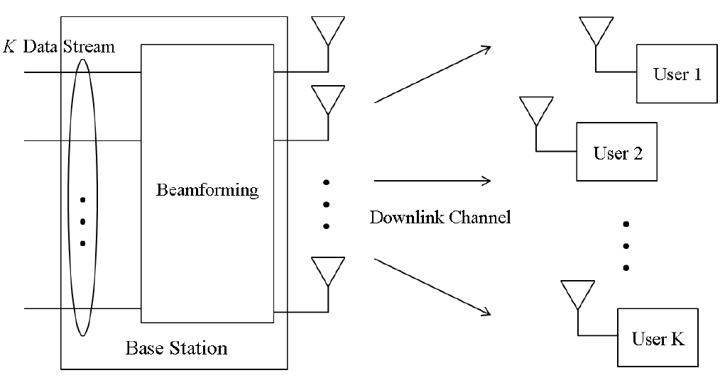
Massive MIMO Downlink Channel : System Model
Parameters
: small scale fading
: beamforming vector
M : # of BS antenna
K: # of users
Single antenna at user
Received vector

Slide 22
Massive MIMO Downlink Channel : Linear Precoding
MRT: Maximal Ratio Transmission
ZFBF: Zero-Forcing Beamforming
Conventional linear precoding
Received signal after using linear precoding
SINR of the kth user
MRT | ZFBF
Rate of user k
Ergodic sum rate

Slide 23
Massive MIMO Downlink Channel : Linear Precoding – Perfect CSI
SINR: Signal-to-Interference-plus-Noise Ratio
CSI: Channel State Infromation
Deterministic form of the SINR_{k}/R_{sum} as M, K →∞, M/K=α
MRT
ZFBF

Slide 24
Massive MIMO Downlink Channel : Linear Precoding – Imperfect CSI
Estimated CSI ( ) using MMSE channel estimation
Deterministic form of R_{sum} with imperfect CSI
MRT
ZFBF

Slide 25
Massive MIMO Downlink Channel : Linear Precoding – Simulation Results (2/2)
Ergodic sum-rate vs. M
Simulation parameters
Deterministic form of R_{sum}
Perfect CSI, Imperfect CSI
The approximations is very close to the numerical result
It is also accurate even for small M, K.
Performance comparison
As α>>1, ZFBF > MRT
As α=1, MRT > ZFBF
M ↑ → R_{sum} ↑
Channel
Imperfectness
Cross point

Slide 26
Massive MIMO Downlink Channel : Linear Precoding – Simulation Results (2/2)
Ergodic sum-rate vs. K
Simulation parameters
Performance comparison
As α>>1, ZFBF > MRT
As α=1, MRT > ZFBF
Optimal K* for ZFBF
ex)
Optimal K*
Cross point
MRT: K ↑ → R_{sum} ↑
ZFBF: Concave function of K

Slide 27
Massive MIMO Uplink Channel
Energy and Spectral Efficiency with Linear Receivers

Slide 28
Massive MIMO Uplink Channel : Contents
Massive MIMO Uplink Channel
System model
Uplink power efficiency – Perfect CSI case
Uplink power efficiency – Imperfect CSI case
Energy efficiency and spectral efficiency tradeoff

Slide 29
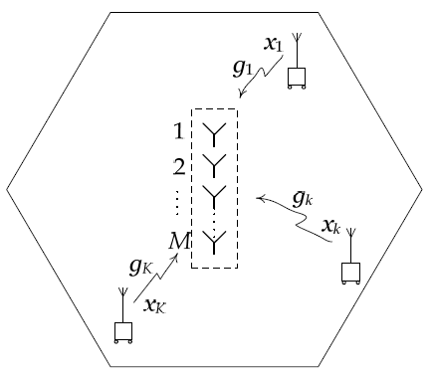
Massive MIMO Uplink Channel : System Model
Parameters
: small scale fading
: path loss + shadowing
SNR for the kth UE:
Received signal

Slide 30
Massive MIMO Uplink Channel : Linear Detector
MRC: Maximal Ratio Combining
ZF: Zero-Forcing
MMSE: Minimum Mean Square Error
Conventional linear detector
Received signal after using the linear detector
SINR of the kth user
MRC | ZF | MMSE

Slide 31
Massive MIMO Uplink Channel : Uplink Power Efficiency – Perfect CSI (1/2)
Ergodic achievable uplink rate of the kth user
Proposition 1: Assume that the BS has perfect CSI and the transmit power of each user is scaled with M_{t} according to , where E_{u} is fixed. Then,
Massive MIMO effect
Small-scale fading/ Inter-user interference goes away in the limit

Slide 32
Massive MIMO Uplink Channel : Uplink Power Efficiency – Perfect CSI (2/2)
Uplink performance with MRC – Perfect CSI
Capacity lower bound
Limit case
Small-scale fading/ Inter-user interference goes away in the limit !
Tx power can be scaled as
p_{u}=E_{u}/M

Slide 33
Massive MIMO Uplink Channel : Uplink Power Efficiency – Imperfect CSI (1/3)
Estimated CSI ( ) using MMSE channel estimation
Received signal vector after using the linear detector

Slide 34
Massive MIMO Uplink Channel : Uplink Power Efficiency – Imperfect CSI (2/3)
Ergodic achievable uplink rate of the kth user
If we cut the Tx power
→ Both data and pilot signal suffer from the reduction in power.
→ We cannot reduce power proportionally to 1/M.
Proposition 2: Assume that the BS has imperfect CSI, obtained by MMSE estimation from uplink pilots, and that the transmit power of each user is
, where E_{u} is fixed. Then,
Pilot power (p_{p})

Slide 35
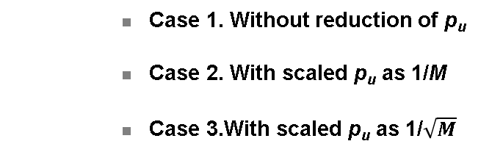
Massive MIMO Uplink Channel : Uplink Power Efficiency – Imperfect CSI (3/3)
Uplink performance with MRC – Imperfect CSI
Capacity lower bound
Squaring effect
Limit case ( )
Tx power can be scaled as

Slide 36
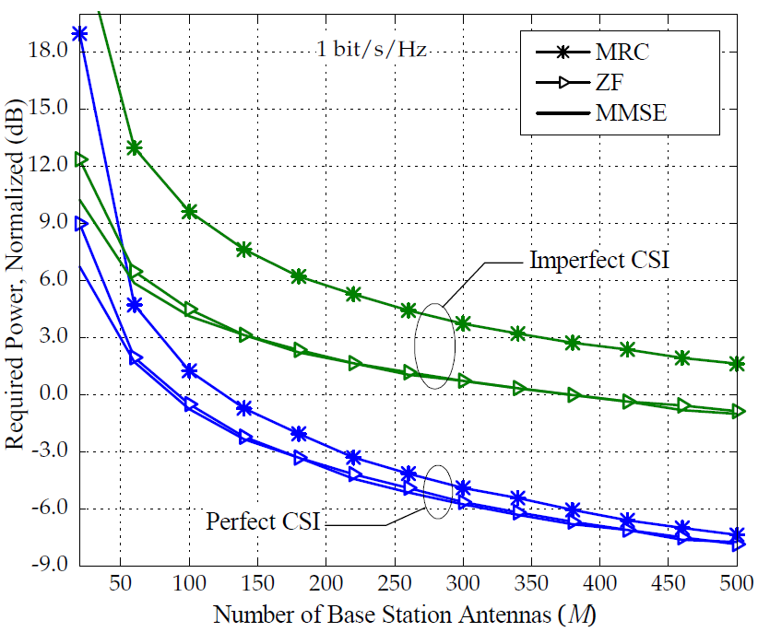

Massive MIMO Uplink Channel : Uplink Power Efficiency – Simulation Results
Required Power vs. M
Simulation parameters
K=10
Target rate: 1bit/s/Hz
Power scaling low
Perfect CSI
Imperfect CSI
As M increases, the difference in performance between MRC and ZF (or MMSE) decreases.
Perfect CSI: less than 1dB
Imperfect CSI: less than 3dB
Performance gap between
MRC and ZF (or MMSE)
M↑ → p_{u}↓ as 1/M

Slide 37
Multi-Cell Massive MIMO
Pilot Contamination & Inter-Cell Interference Problem

Slide 38
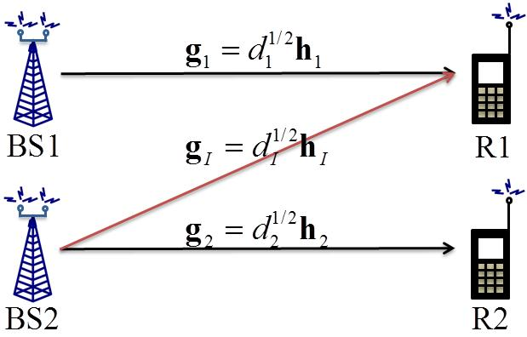
Multi-Cell Massive MIMO : Inter-Cell Interference Problem (1/3)
Non-cooperative multi-cell environment
Assumption: MRT precoder / 2 cell assumption
MRT based transmit signal
Transmit signal at BS 1:
Transmit signal at BS 2:
Received signal for R1

Slide 39
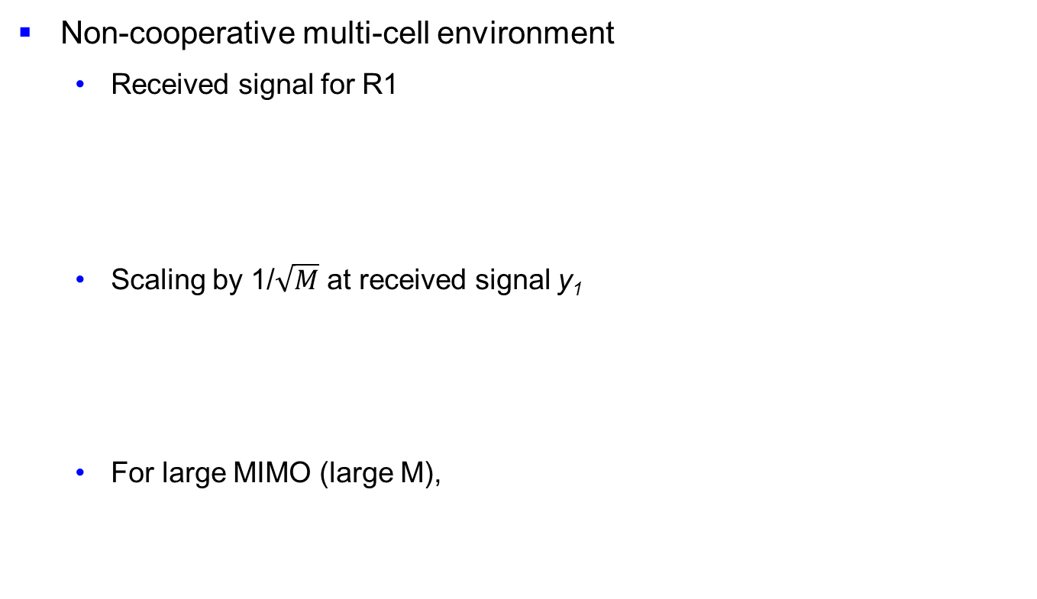
Multi-Cell Massive MIMO : Inter-Cell Interference Problem (2/3)
→ 0

Slide 40
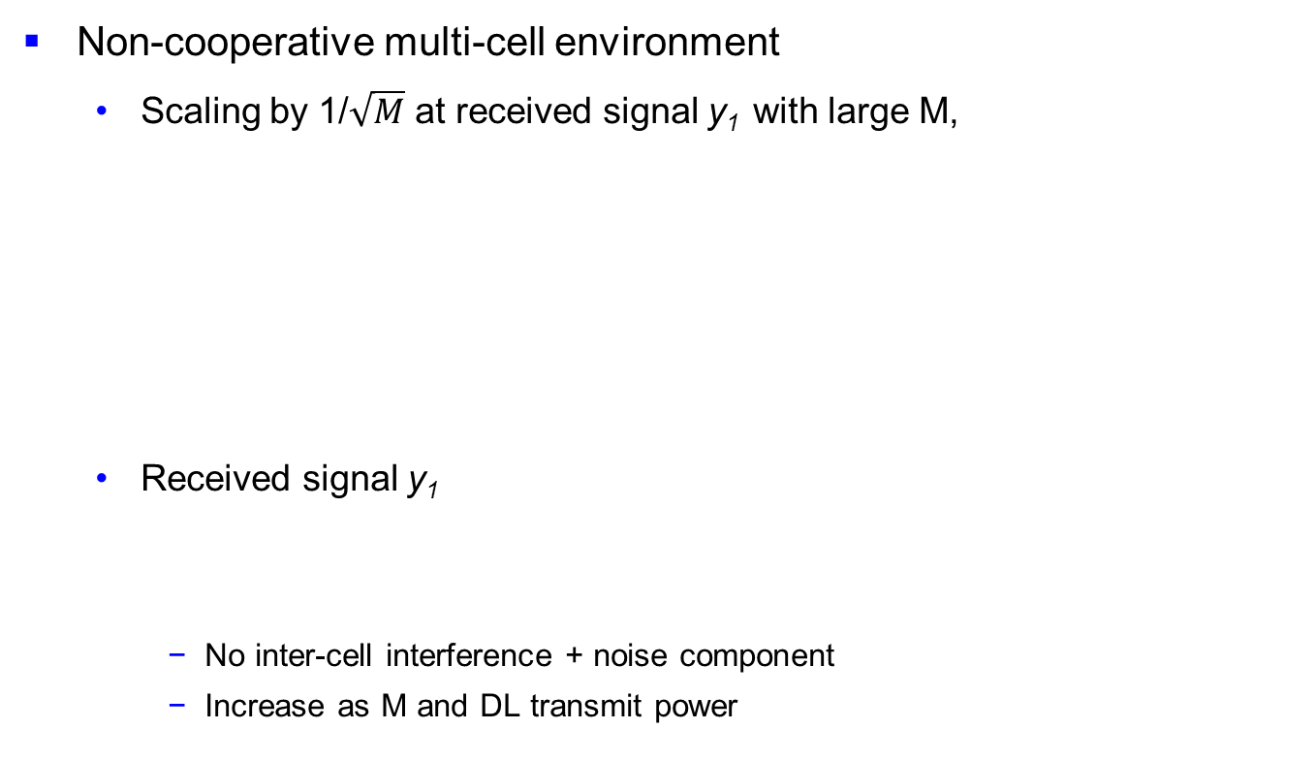
Multi-Cell Massive MIMO : Inter-Cell Interference Problem (3/3)
1
0
0

Slide 41
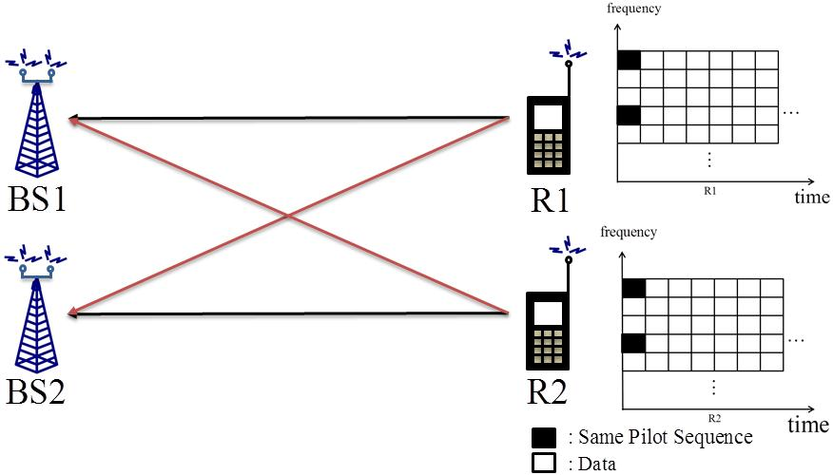
Multi-Cell Massive MIMO : Pilot Contamination Problem (1/5)
[7] F. Rusek et al., “Scailing up MIMO: Opportunities and challenges with very large arrays,”
Practical problems for non-cooperative multi-cell
Assumption [7]
Non-cooperative multi-cell with TDD mode
MIMO-OFDM system with MU-MIMO
To perfectly mitigate interference at large M, exact MRT scheme is needed
Perfect CSIT is necessary to design exact MRT precoder
UL pilots are allocated in same time-frequency elements to obtain perfect CSIT
UL pilots can be separated by orthogonal sequences → Can obtain perfect CSIT
Problem: Exact same time-frequency elements with same pilot sequence
Perfect CSIT is impossible → pilot contamination problem

Slide 42
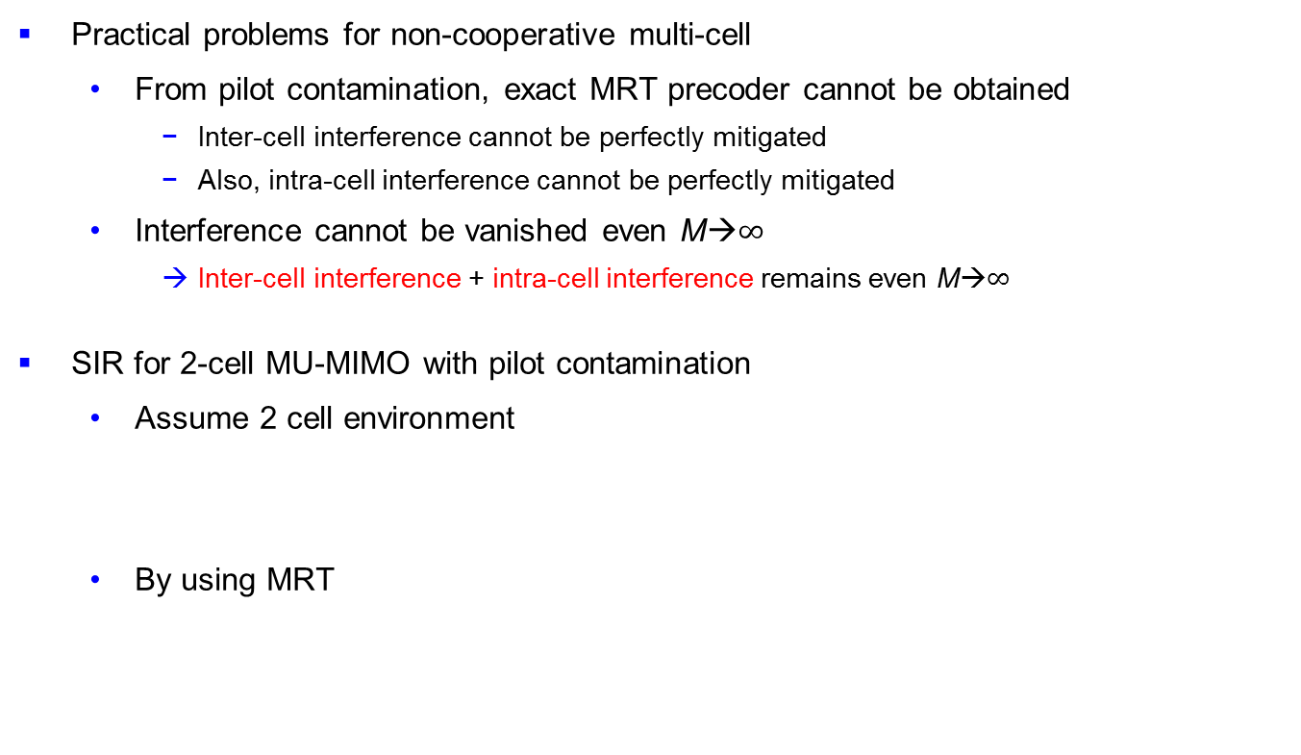
Multi-Cell Massive MIMO : Pilot Contamination Problem (2/5)

Slide 43
Multi-Cell Massive MIMO : Pilot Contamination Problem (3/5)
SIR for 2-cell MU-MIMO with pilot contamination
Received signal at R1
Desired signal
Interference signal
Received SIR
No small scale fading effects
Pilot contamination is independent from pilot power

Slide 44
Multi-Cell Massive MIMO : Pilot Contamination Problem (4/5)
[7] F. Rusek et al., “Scailing up MIMO: Opportunities and challenges with very large arrays,”
SIR for multi-cell MU-MIMO with pilot contamination [7]
MRT based SINR for l-th UE
ZF-BF based SINR for l-th UE [7]
If p_{p} → 0, MRT = ZF-BF
No small scale fading effects
Pilot contamination is independent from pilot power
No small scale fading effects
Pilot contamination is dependent from pilot power

Slide 45
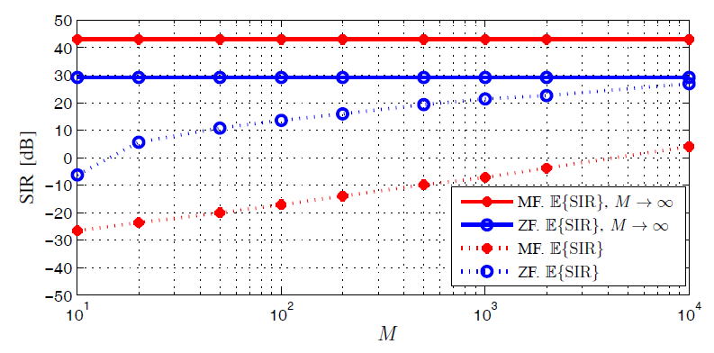
Multi-Cell Massive MIMO : Pilot Contamination Problem (5/5)
[7] F. Rusek et al., “Scailing up MIMO: Opportunities and challenges with very large arrays,”
Simulation Results [7]
Simulation Parameters
MRT / ZF-BF is considered
Number of users (K): 10
Cell diameter: 1600m
Large scale + small scale considered
Performance is limited by pilot contamination
Conclusion from simulation results
Finite M → MRT < ZF-BF
Infinite M → MRT > ZF-BF
SIR for MRT and ZF as function of M and K=10
Finite M: ZF > MRT
Infinite M: ZF < MRT

Slide 46
Homework
1. What are the advantages of Massive MIMO technology？
2. For a 100 x 4 Massive MIMO channel, when the transmit power Pd=10 dB, what is the capacity?
Tips: For Q1, see P5; For Q2, see P15

