Slide 1

SCHC Architecture Discussion
July 23rd, 2026
Side meeting
Draft : draft-ietf-schc-architecture-06
Authors : A. Pelov , P. Thubert , A. Minaburo , Q. Lampin , M. Dumay
IETF 126, Vienna

Slide 2

Note Well
By participating in the IETF you agree to follow IETF processes and policies. This Note Well is a reminder of some of those policies. For a linked version of this text, please visit www.ietf.org/note-well or use the QR code below.
IETF participants are expected to behave in a professional manner and extend respect and courtesy to their colleagues at all times (see RFC 7154: IETF Guidelines for Conduct and IETF Anti-Harassment Policy). If you have any concerns about behavior, please contact the Ombudsteam who have a duty of confidentiality and extensive powers to act, as set out in RFC 7776: IETF Anti-Harassment Procedures.
If you are aware that any IETF contribution (as defined in RFC 5378: Rights Contributors Provide to the IETF Trust) is covered by patents or patent applications that are owned or controlled by you, your employer or your sponsor, you must disclose that fact, or not participate in the discussion (see RFC 8179: Intellectual Property Rights in IETF Technology).
For detailed process information consult RFC 2026: Internet Standards Process and RFC 2418: IETF Working Group Guidelines and Procedures and updates to those.
The IETF routinely makes public written, audio, video, and photographic records of IETF activities, including your personal information as set out in the IETF Privacy Statement.
For advice, please talk to Working Group chairs or Area Directors.
Notes:
The IETF Note Well should be shown at the start of every IETF working session. The guidance below is adapted from IETF legal counsel presentation during IETF 120
DO
Do make sure people have enough time to read through the slide before you move on,
Do give a high-level summary of what’s covered in the Note Well: “IETF policies on conduct, privacy and IPR.”,
Do encourage people to read through all the linked policies & documents in detail before participating or contributing,
Do explain where people can direct questions or concerns (IETF Executive Director or Ombudsteam).
DON'T
Don’t dismiss the importance or relevance of any of the information on the Note Well.
Don’t interpret the meaning or get into the substance of any of the topics or content of the policies.
Don’t communicate that the Note Well conveys all the information participants need to know.
Don’t address questions or concerns in the meeting itself.

Slide 3
Agenda
Introduction and outline – 30 min
A little bit of context
Objectives and scope of the Architecture document
Impacts of -06 on existing documents
Current definitions of core components
Endpoints, Instances, Stratum, …
A few scenarios to illustrate those definitions
Discussion – 1h

Slide 4
History and Objectives
Objectives
Document SCHC
For generic use (including LPWANs)
Provide unified terminology
Clarify and fill gaps
Informational document
Cover simple, as well as more advanced use-cases
Document the work of the WG
Work should happen on standard-track documents
Evolution 2021 -> 2026
Work 2021-2025 (lpwan-> schc)
Side meeting during IETF123
Design team creation after IETF124
Open to anyone to join, consensus-driven
Work presented during interim meeting on May 12th, 2026

Slide 5
How do the drafts work with the architecture?
SCHC Framework Core + Extensions
SCHC Interoperability
RFC 8724 SCHC Framework
RFC 9363 YANG Data Model
RFC 9441 Compound Ack
draft-ietf-schc-schclet-00
draft-ietf-schc-universal-option-01
draft-ietf-schc-protocol-numbers-06
draft-corneo-schc-compress-payload-02
draft-lampin-voici-02
draft-corneo-schc-ctx-mgmt-00
draft-pelov-schc-header-format-00
draft-westerlund-schc-compute-address-00
SCHC Adapted to
SCHC Applied to
RFC 9011 LoRaWAN
RFC 8824 CoAP
RFC 9391 NB-IOT
draft-ietf-ipsecme-diet-esp-10
RFC 9442 Sigfox
draft-ietf-schc-icmpv6-compression-02
draft-ietf-schc-over-networks-prone-to-disruptions-03
draft-ietf-schc-8824-update-09
draft-ietf-schc-over-ppp-00
draft-sirohi-schc-quic-frame-compression-00
Document SCHC (Generic: LPWAN and other uses)
Clear terminology
Cover simple, as well as more advanced use-cases
Entry-point for non-SCHC people (KISS)
draft-ietf-schc-architecture-06
Informational

Slide 6
Take-away from today
How -06 impacts existing documents
Automatically processed 7 RFCs and 17 drafts against -06 version (Claude, Gemini, meta-analysis with Codex)
✅ For all 7 RFCs - all concepts, roles, communication patterns, rule structures, and fragmentation mechanisms map directly or compositely to SCHC architecture -06
✅ All 17 drafts map onto the architecture with High or Very High conceptual equivalence
✅ 14 Easy, 3 Medium, 0 Hard - the bulk is terminology alignment, not technical rework
With diff suggestions
https://github.com/lp-wan/archi/tree/main/archi-06-document-analysis
The work continues

Slide 7
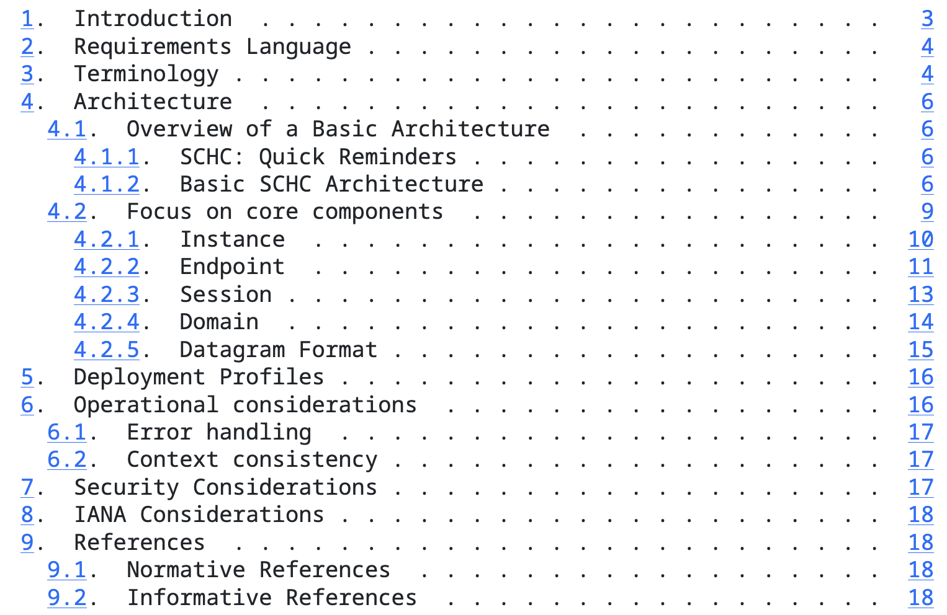
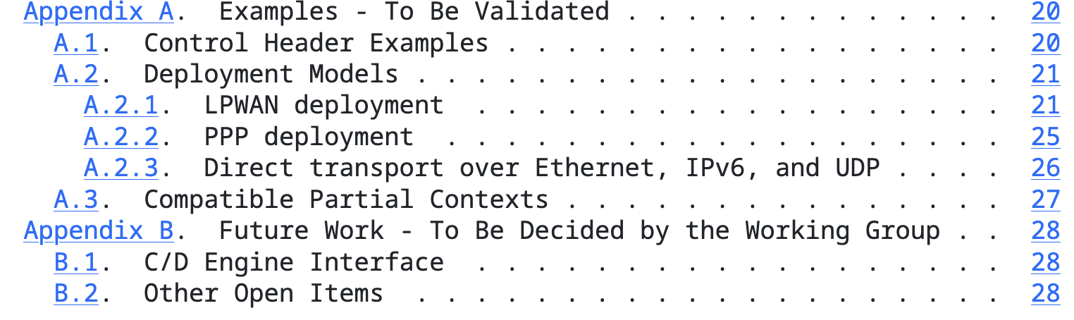
The Contents
A new structure designed to introduce the main entities and their relationships right from the first few pages

Slide 8
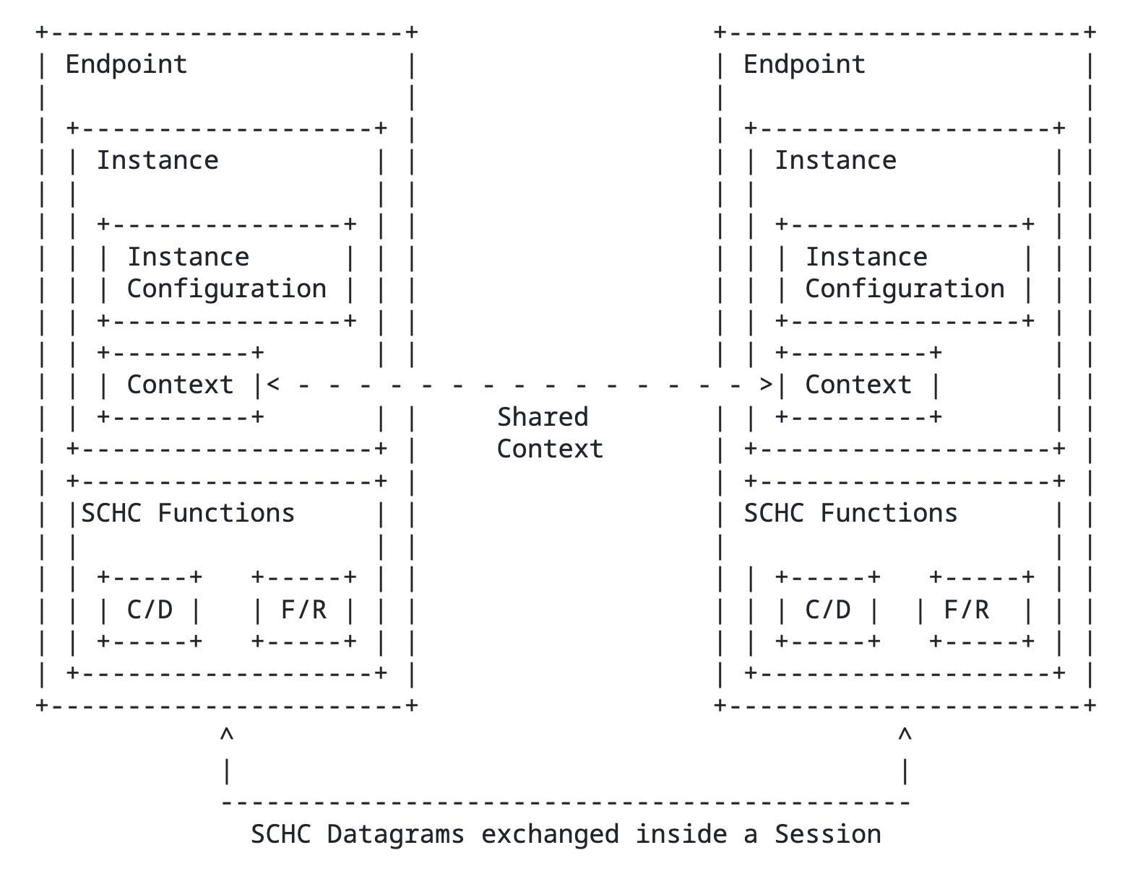
Basic SCHC Architecture
A logical entity that provides SCHC functionality by hosting the SCHC processing code.
One or more can be present on a physical device.
A logical component of an Endpoint that executes the actual SCHC operations (C/D, F&R)
One or more can be present on an endpoint.
Local parameters
|Stratum|
SoR + Metadata
The unit exchanged between SCHC Instances.
Dynamic or implicit communication sessions
Background concept, portion of the network protocol stack targeted by SCHC

Slide 9
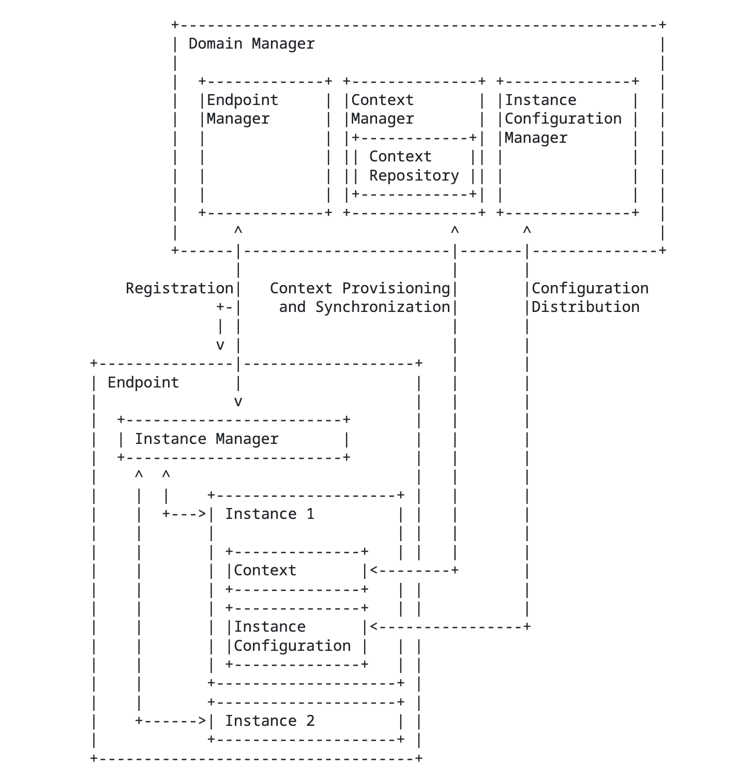
Domain
Domain: A logical grouping of Instances that share a common Context. Domain Manager: manages the Domain, including Context synchronization and configuration distribution.
It uses:
Endpoint Manager to manage the Endpoints (TBD)
Context Manager to manage the Contexts
Instance Conf Manager to manage Instance Configuration
Domain vs. Session
The Domain defines which Instances share Contexts, while the Session identifies which Instances are actually communicating.
A logical component that manages the lifecycle and configuration of Instances within an Endpoint.
E.g. creating, updating, and deleting Instances as needed.
Note: These are logical components.
They may be implemented in a single software for example.
The domain may be peer-to-peer.
Notes:
The Domain defines which Instances share Contexts, while the Session identifies which Instances are actually communicating.

Slide 10
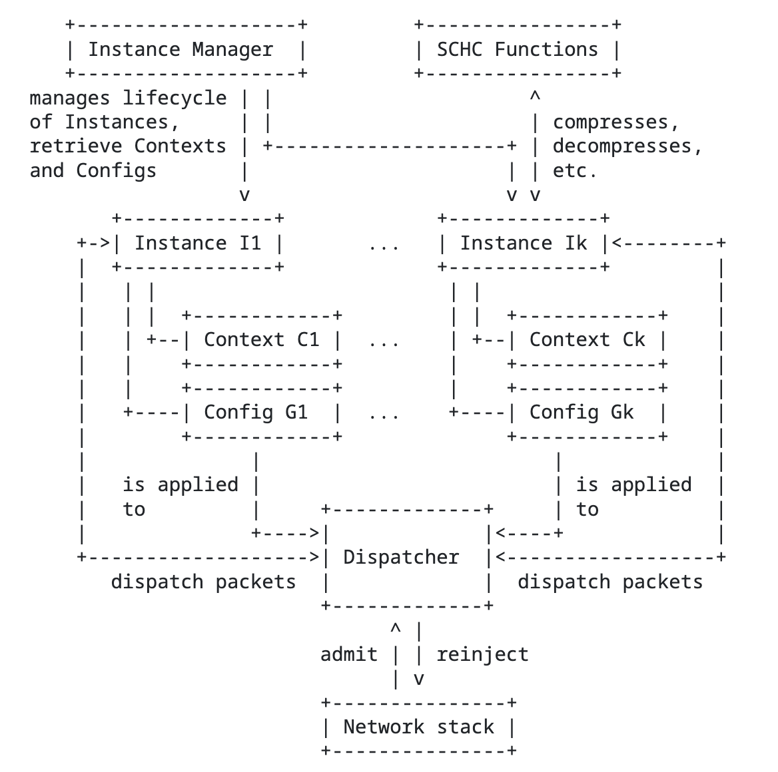
Multiple Instances on an Endpoint
Dispatcher: A logical component of the Endpoint that routes Datagrams to the appropriate Instances based on defined admission rules.
It can be integrated into the network stack or implemented as a separate component.
Discriminator: An optional information element used by the Dispatcher to route SCHC Datagrams to the appropriate Instance. The discriminator can be a combination of several criteria.

Slide 11
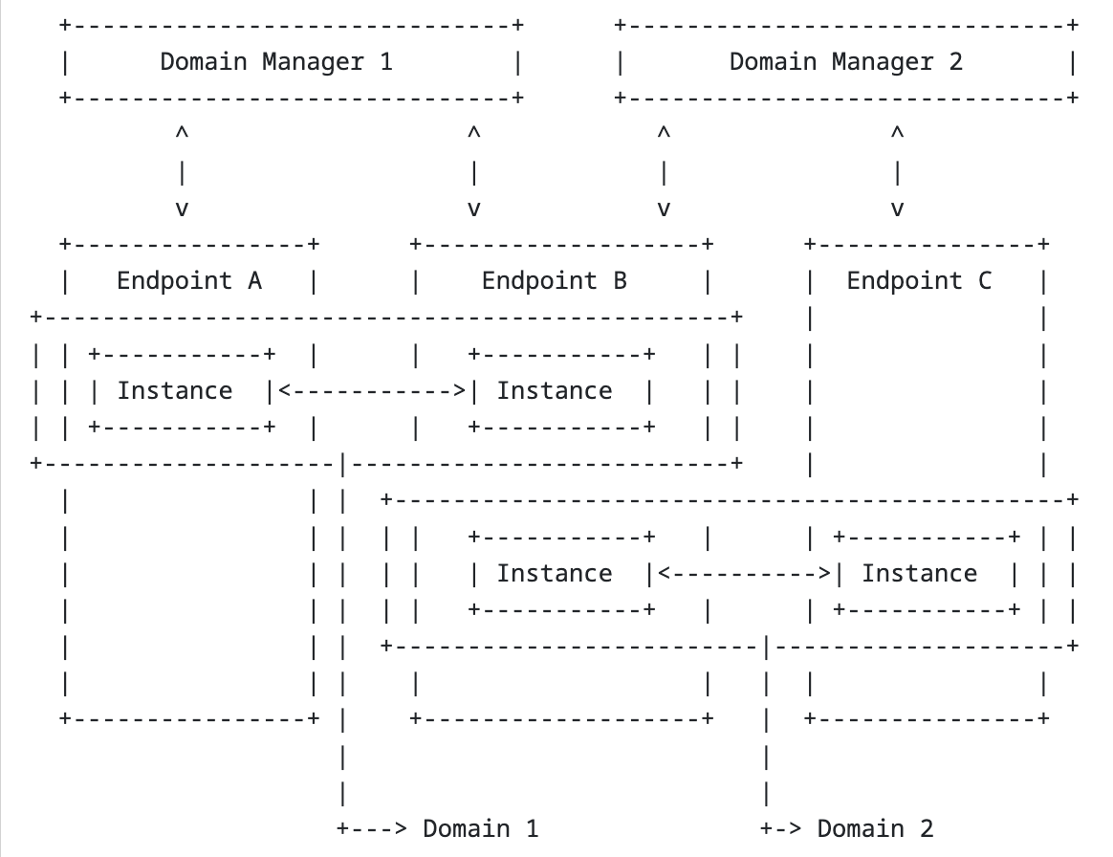
Multi-Tenants LPWAN Scenario 1 Gateway, 2 IoT devices with different Contexts
1 Gateway, 2 IoT devices with different Contexts
A single SCHC Instance runs on each IoT Endpoint (A, C).
Two Instances run on the Gateway (B)
Single Domain per IoT Endpoint
Two Domains on Gateway
Discriminator is provided by L2, e.g., DevEUI.

Slide 12
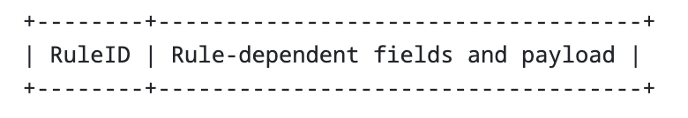
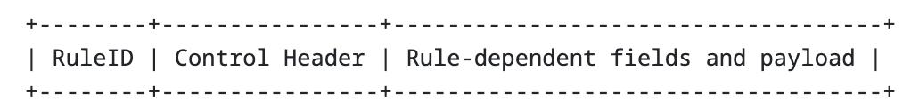
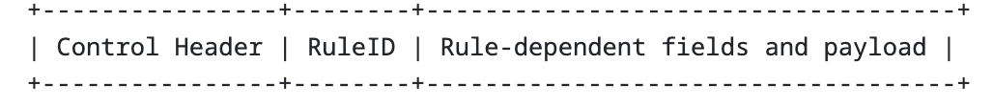
SCHC Datagram Format
Datagram Format
A Datagram starts with a RuleID. The Rule identified by that RuleID determines the format and interpretation of the remaining bits. A Datagram may be an unfragmented SCHC Packet or a SCHC F/R message, such as a SCHC Fragment, SCHC ACK, SCHC ACK Request, SCHC Sender-Abort, or SCHC Receiver-Abort.
Control Header for Advanced Use Cases
or
The presence, placement, and format of the Control Header must be clearly identified, e.g., by a SCHC profile document or other specification that defines the framing used by the deployment.
Example of a control header for generic multiplexing use-cases is given in: draft-lampin-voici-02
It is expected there to be several such standard-track documents that specify different control headers.
Notes:
A Datagram consists of a Rule Identifier (RuleID) and the result of the SCHC operation (if non-empty), such as a compression residue or a packet fragment. It may be followed by a Payload.
In some deployments, it may be necessary to add information to the Datagram, for example so that it can be properly routed to the correct Instance. This information may be carried in a Control Header.

Slide 13
SCHC Header and SCHC Header Format
SCHC Header: The portion of a SCHC Datagram that carries SCHC processing information, including the RuleID and, when present, Control Header or F/R control fields. The SCHC Header enables the receiver to identify the Rule and interpret the remaining SCHC Payload, fragment, residue, or control information. Its exact encoding is defined by the applicable Rule, profile, or encapsulation.
SCHC Header Format: A profile-, encapsulation-, or deployment-specific description of the SCHC Header encoding, including the presence, order, and encoding of the RuleID and any Control Header or F/R control fields.
Example of how this can be implemented: draft-pelov-schc-header-format-00

Slide 14
Thank you!
Discussion
Questions
Next steps

